Slide 1
IBM Cloud platform: Bluemix

Slide 2
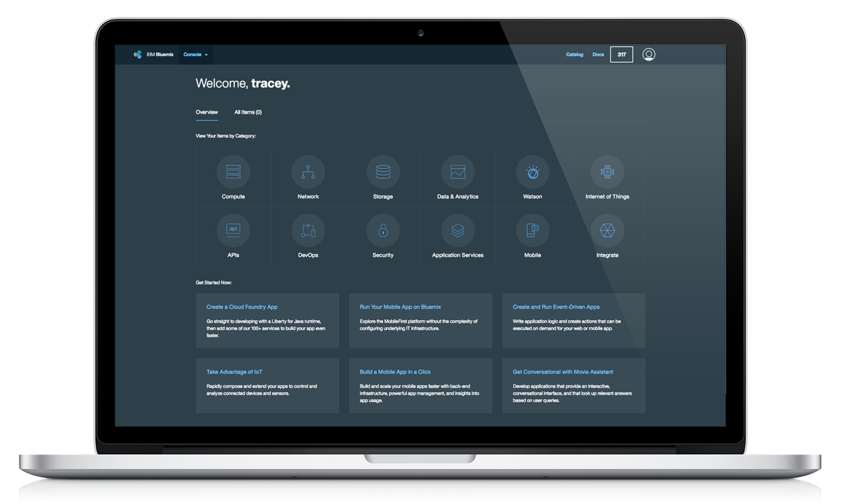



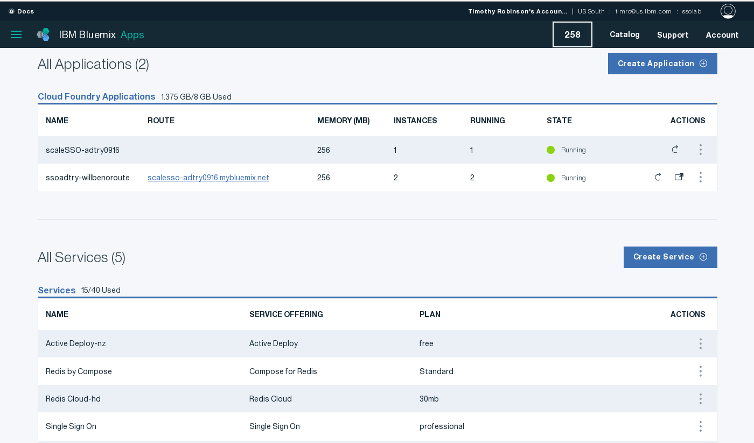



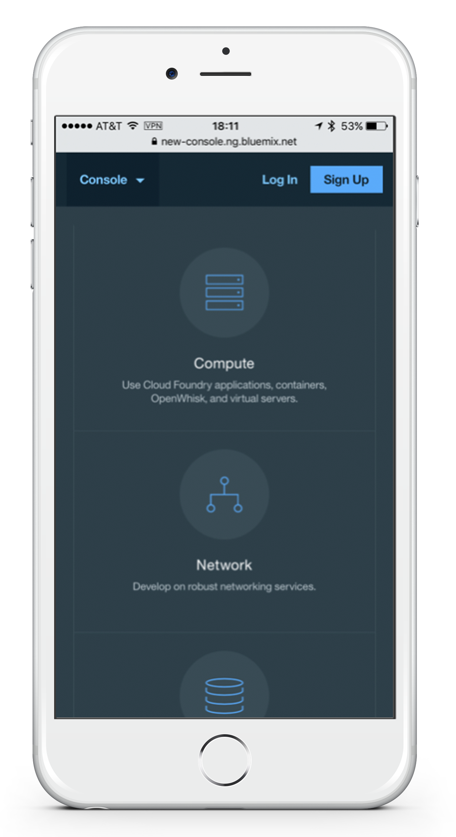
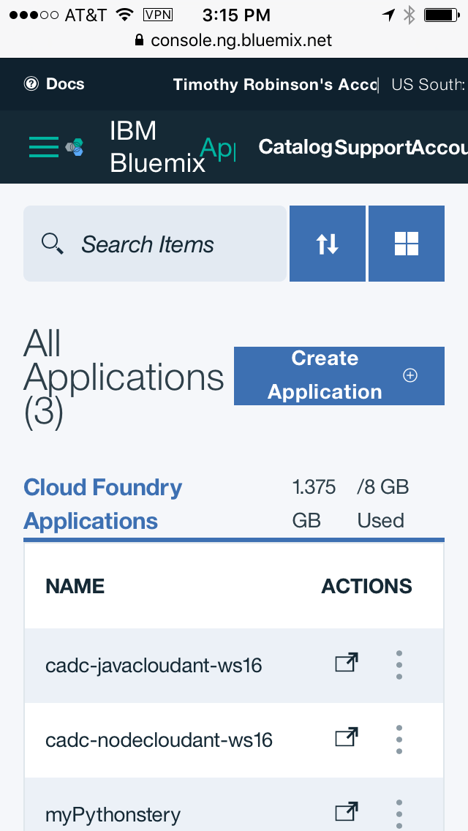

IBM Bluemix
The most advanced cloud platform that weaves together services, infrastructure, and data to rapidly bring your ideas to production.
Third-party
IBM
Open source
Your own

Slide 3
What Bluemix offers
Compute
Hybrid
Global
Services
Open
Offerings spanning from bare metal to serverless programming
Delivered across public, dedicated, and on-premises deployment models
Available in over 26 IBM Cloud data centers around the globe
Offers over 130 composable services across Watson, data, mobile, IoT, and DevOps
Built on open standards and architecture
Notes:
At a high level, here is what Bluemix has to offer.
Bluemix combines enterprise grade Platform as a Service and Infrastructure as a Service in a simple developer experience. This makes it the ideal platform of the next generation of always available and highly scalable applications.
It does this with multiple compute platform options that developers can choose based on their application needs. It supports today’s hybrid deployment approach to address multi-speed IT with systems of engagement in public Clouds that can integrate securely with systems of record in private cloud or traditional enterprise environments. Bluemix is available globally in IBM Cloud data centers so you can be sure of where your data resides.
Open standards like OpenWhisk, Cloud Foundry and Docker

Slide 4





Flexible compute options
Flexible compute options
Bare Metal
Maximum performance and control
Virtual Server or VMware
Leverage existing languages and tools
Containers
Maximum portability
Cloud Foundry
Open PaaS environment
OpenWhisk
Maximum speed with server-less apps
PERFORMANCE & CONTROL
PORTABILITY
DEVELOPMENT SPEED
Notes:
Bluemix gives the developer a wide range of IaaS and PaaS compute options.
Bare Metal servers give leading Cloud performance and full control of all aspects of the compute to the developer
Virtual Servers and VMWare increase efficiency and allow the developer manage just the OS, middleware, data and applications and VM operations like start and stop.
Containers give maximum portability across environments, developers create application or microservice and package in a Container and then deploys to a server that could be on-premise or in the Cloud
Cloud Foundry Applications run apps using a supported runtime, with explicit binding of managed services to applications. Developers push code artifacts to Cloud Foundry that are then packaged and executed with built-in support for horizontal app scalability.
OpenWhisk provides a server-less platform to support Functions as a Service where code snippets are run as a result of events. This gives a stateless model where you pay for only the compute you consume. No application start/stop required.

Slide 5












Benefits of Bluemix Cloud Foundry applications
Eliminates and simplifies various tasks compared to on-premises or IaaS
Health management
Load balancing
Scaling
Deployment
OS patching
OS security hardening
Traditional On-Premises
Infrastructure as a Service
Platform as a Service
Software as a Service
Applications
Applications
Applications
Applications
Data
Data
Data
Data
Runtime
Runtime
Runtime
Runtime
Middleware
Middleware
Middleware
Middleware
O/S
O/S
O/S
O/S
Virtualization
Virtualization
Virtualization
Virtualization
Servers
Servers
Servers
Servers
Storage
Storage
Storage
Storage
Networking
Networking
Networking
Networking
Developer Manages
Vendor Manages in cloud
Standardization; OPEX savings; faster time to value
Notes:
Why Cloud Foundry Applications? Here’s a comparison of the different levels of concern in modern IT environments ranging from traditional on-premise apps to software as a service. Since we’re talking about building new applications (although you may compose one or more SaaS capabilities into your app), let’s focus on the three to the left. As we move from traditional, to IaaS to PaaS the parts of the total solution managed by the cloud provider goes up.
With Cloud Foundry PaaS, you only need to focus on your code and data, less time managing infrastructure means more time for features and innovation.

Slide 6
Bluemix account and organization model
IBM ID Account – Anchor point for billing
Organizations
Enables team collaboration
User
Organizations
Enables team collaboration
User
Organizations – enables team collaboration
User
SL Account
Spaces
Logical grouping of apps and service instances
per-user permissions
IBM Cloud Infrastructure
Spaces
Logical grouping of apps and service instances
per-user permissions
CF Spaces
Logical grouping of apps and service instances
Per-user permissions
Space
Space
Space
Virtual & bare metal servers
Apps
Containers
Service instances
Notes:
Your Bluemix environment is organized as follows. At the top level is the account, which is used for all billing. Depending on the account type, there can be one or more organizations. Users belong to a default account, and may also be associated with organizations in other accounts in Bluemix.
Each organization has one or more cloud foundry spaces, that are used to provide partitioning within an organization. For example, you may choose to create a space for a team project, or to separate out development, test and production versions of an application. Applications and Containers within a space may only be bound to Cloud Foundry managed applications located within the same space.
Beginning in October 2016, IBM is supporting unifying Bluemix and SoftLayer accounts and experience. SoftLayer (IBM Cloud Infrastructure in Bluemix) accounts can be merged with some Bluemix account types starting with the Pay-As-You-Go accounts in October 2016. This allows you to link Bluemix users in your organization to a SoftLayer account by adding them as SL users by their IBMid used to log into Bluemix.

Slide 7


Bluemix public regions
Stand-alone cloud with catalog, apps, and services
Maximum isolation from entities in other regions
us-south
https://console.ng.bluemix.net
https://api.ng.bluemix.net
eu-gb
https://console.eu-gb.bluemix.net
https://api.eu-gb.bluemix.net
sydney
https://console.au-syd.bluemix.net
https://api.au-syd.bluemix.net
... more coming
Notes:
Note – examples of Public Cloud regions. Add Sydney (and more coming…)

Slide 8
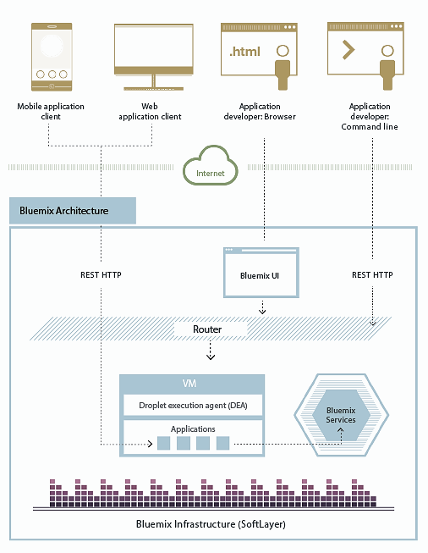
Bluemix developer user experience
Users access your application from web or mobile
Manage your app with web browser or CLI
Build local with text editor or Eclipse, then deploy
Or… build with web UI on Bluemix DevOps Services

Slide 9
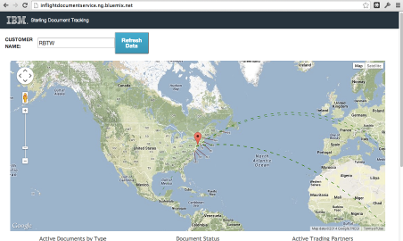
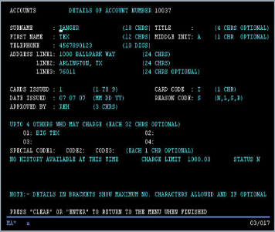
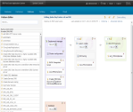
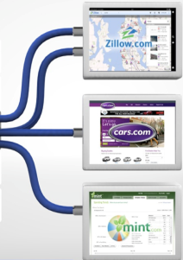




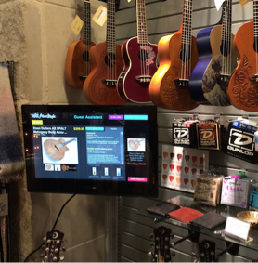
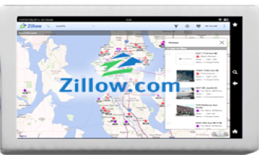

How will you use it?
Extend existing applications
Add user experience such as mobile, social
Add new capabilities integrating other services and APIs
Do rapid experimentation for new capabilities
API-enable applications
Scalable API layer on top of existing services
Simplify how composite service capabilities are exposed through APIs
New applications
Systems of Engagement
Internet of Things
API creation and management
Backend systems and
integration
New channels and
opportunities

