Slide 1
IBM Bluemix boilerplates: deploying your first application
Notes:
The dW team will add the course graphic. Use this deck for introducing labs (videos). These intros should be short.

Slide 2
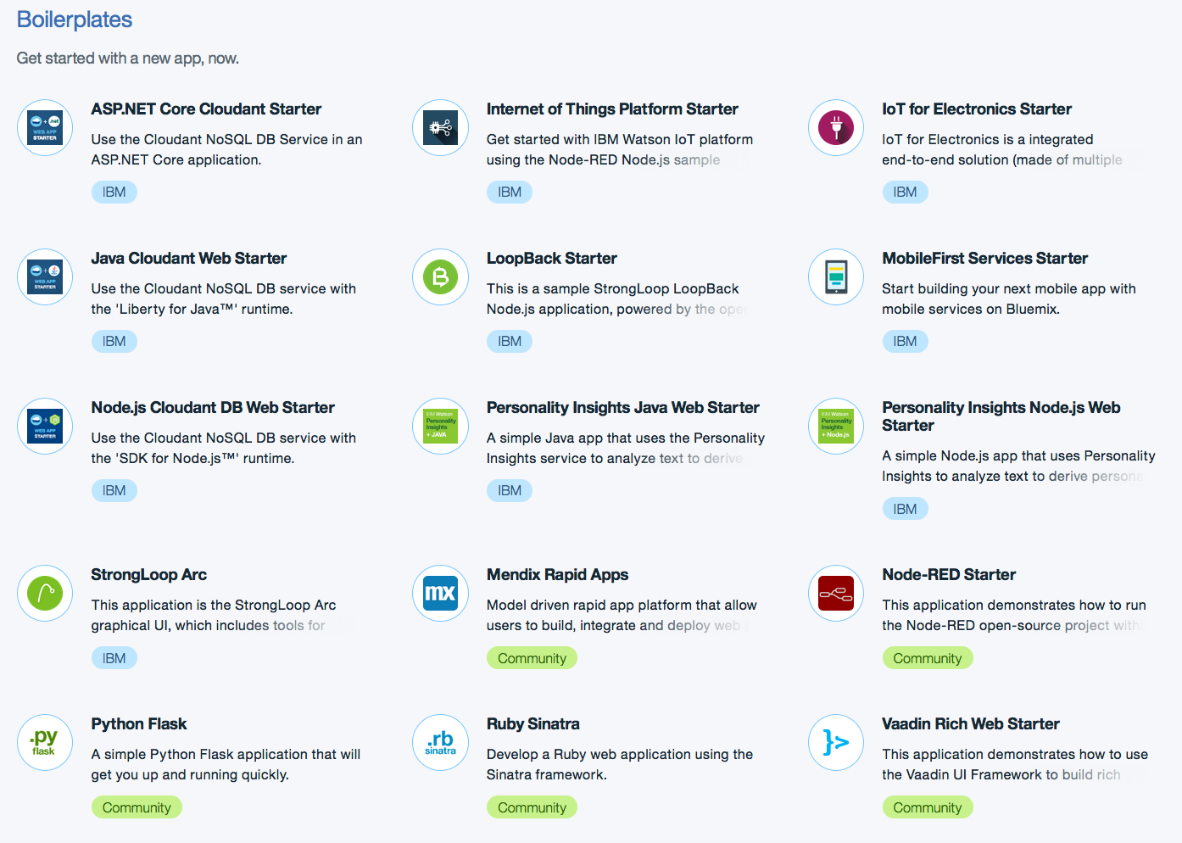
Boilerplates
Provide a fast way to get an application started
Package of sample application code and services

