Slide 1
Using Eclipse: deploying your application from the eclipse IDE
Notes:
The dW team will add the course graphic. Use this deck for introducing labs (videos). These intros should be short.

Slide 2
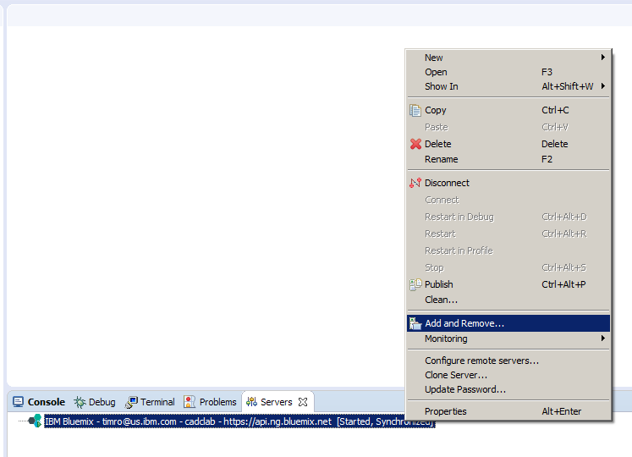
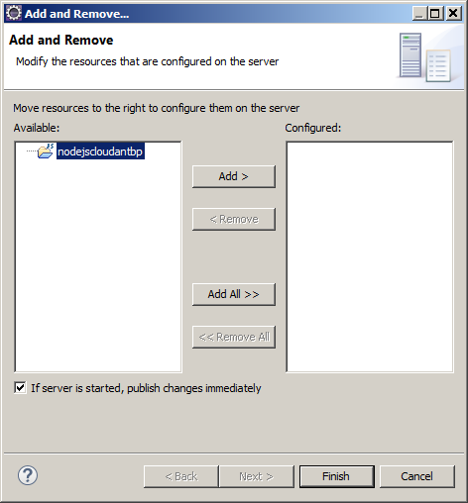
IBM Eclipse Tools for Bluemix
Available in the Eclipse marketplace as a plug-in
Enables developers to develop in Eclipse and then deploy to Bluemix Cloud Foundry applications
Java Liberty and Node.js apps are supported
Click Add to deploy to Bluemix
Select available app
Select Add and Remove
Servers view
Right-click Bluemix

Slide 3
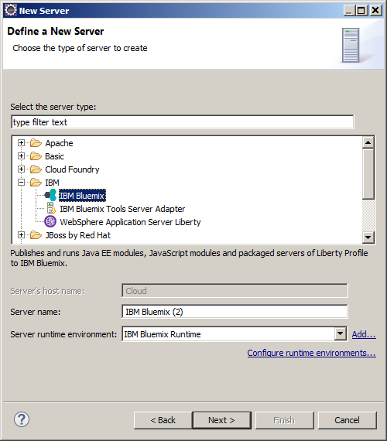
Creating an IBM Bluemix server connection in Eclipse
In Eclipse preferences, click File > New > Other. Then, click Server and Next.
Click IBM Bluemix and proceed through the setup wizard.
Select IBM Bluemix
Click Next to continue

Slide 4
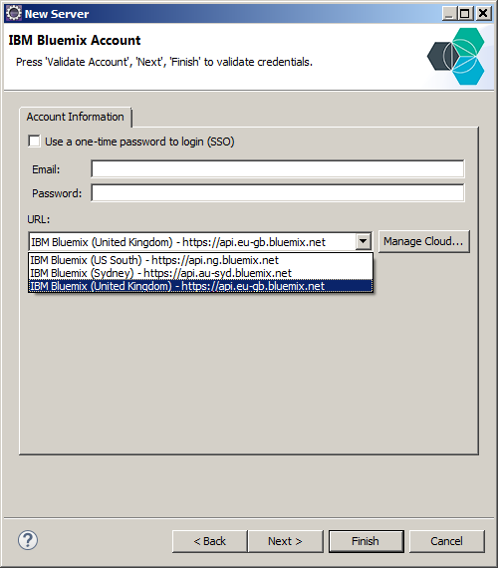
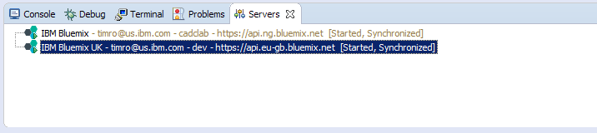
Working with multiple Bluemix regions in Eclipse
Select the URL pulldown in the IBM Bluemix Account dialog.
Select the desired region.
Click here
Add a server for each region and space for deploying apps
Select Region

