Slide 1
LamPI Achitecture
Slides

Slide 2
GUI Clients
sniffer
GUI Clients
GUI Clients
LamPI-daemon
GUI Clients
websockets
webserver
ajax
ajax
Backend_set
Backend_sql
Backend_ics
Backend_rasp
Cmdline Exe
Json
UDP
ICS-1000
433MHz devices
Config
file
MySQL
Notes:
This was the first version of the lamPI architecture but this is not used anymore

Slide 3
GUI Clients
GUI Clients
LamPI-node.js
GUI Clients
GUI Clients
websockets
UDP IP bus communication
Config
file
Wired 1W
Sensors
Cmdline Exe
Wired
I2C Sensors
Wired
Sensor
Wired
Sensor
433MHz Devices
433MHz transceiver
MySQL
Notes:
Version 2 of the Architecture

Slide 4
GUI Clients
GUI Clients
GUI Clients
GUI Clients
LamPI Gui
websockets
LamPI-node.js
(master)
Config
file
MySQL
LamPI node
IP communication
Wired
Wired
Sensors
Sensors
LamPI
Slave Node
GPIO
433MHz transceiver
Receivers /
Transmitters
Raspberry
(slave)
Sensors
Arduino Gateway
Arduino G’way
USB
433MHz transceiver
Notes:
Details on the achitectural setup. Master, Slave and connected devices (wired, wireless and through Arduino Gateway)

Slide 5
GUI Clients
GUI Clients
GUI Clients
GUI Clients
LamPI Gui
websockets
LamPI-node.js
(master)
Config
file
MySQL
LamPI node
IP communication
Wired
Wired
Sensors
Sensors
GPIO
Receivers /
Transmitters
ESP Gateway
ESP Gateway
433MHz transceiver
Notes:
Version 3: Use an ESP8266 node instead of the Raspberry as a slave node. The ESP is much cheaper and as it does not run the Linux operating system its bahaviour in controlling GPIO interrupts is much better.

Slide 6
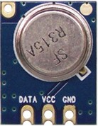
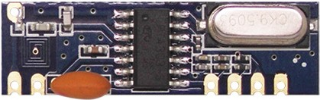
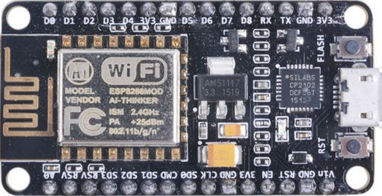
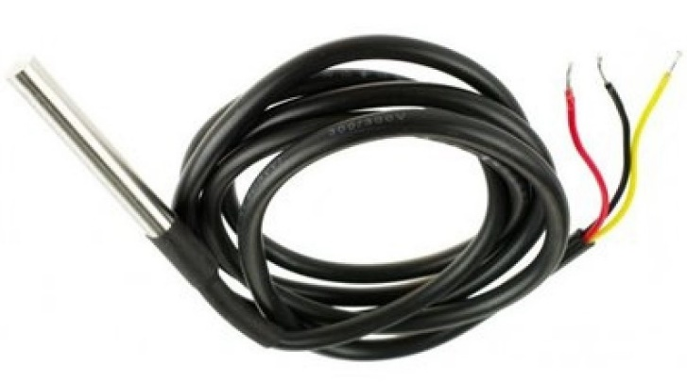
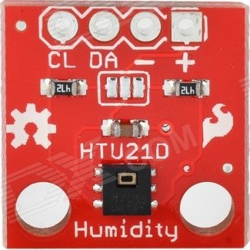
Notes:
Version 3: Use an ESP8266 node instead of the Raspberry as a slave node. The ESP is much cheaper and as it does not run the Linux operating system its bahaviour in controlling GPIO interrupts is much better.

Slide 7
GUI Clients
GUI Clients
GUI Clients
GUI Clients
LamPI Gui
websockets
LamPI-node.js
(master)
Config
file
MySQL
LamPI node
IP communication
Wired
Wired
Sensors
Sensors
GPIO
Receivers /
Transmitters
ESP Gateway
LoRa Gateway
868MHz transceiver
Notes:
Version 3: Use an ESP8266 node instead of the Raspberry as a slave node. The ESP is much cheaper and as it does not run the Linux operating system its bahaviour in controlling GPIO interrupts is much better.

