Slide 1
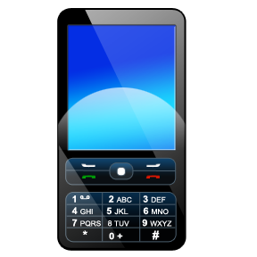

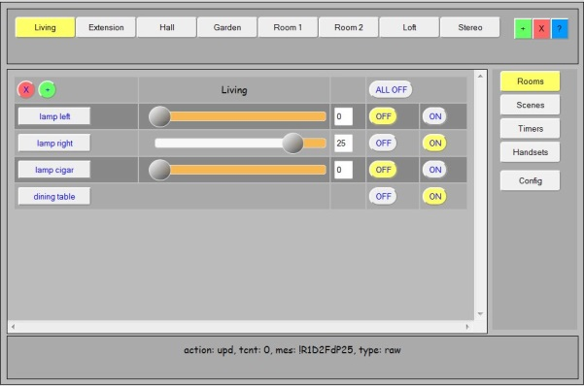
Z-Wave
868MHz
Razberry
OpenRemote
Raspberry
LamPI-daemon
URL Web
Interface

