Slide 1
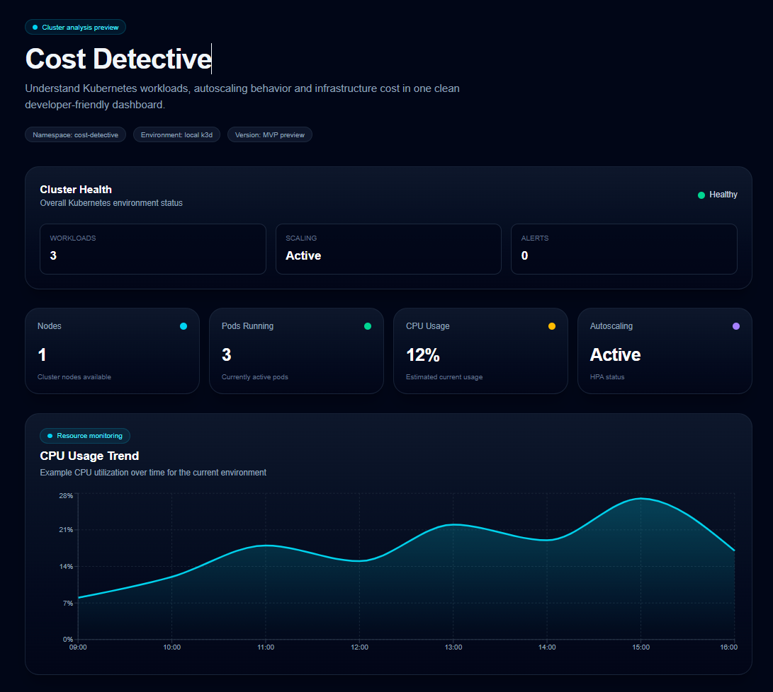
KUBERNETES EFFICIENCY ANALYSIS
Cost Detective
Turn reserved capacity into
an actionable engineering signal.
A developer-friendly dashboard for workload behavior, autoscaling, resource efficiency, and emerging infrastructure cost insight.
32%
3
5
DEMO EFFICIENCY SCORE
WORKLOADS
ANALYSIS FINDINGS
Requested CPU utilization across the example workloads
Local k3d demonstration environment
Mock API evidence used during development
Cost Detective | Engineering platform narrative | June 2026

Slide 2
THE HIDDEN GAP
02
Reserved capacity and actual demand rarely tell the same story.
Cost Detective makes that gap visible at workload level.
Raw metrics
500m
CPU, memory, restarts, replicas and HPA state arrive as separate signals.
CPU requested
Configuration risk
120m used
380m reserved but idle
Missing requests and unhealthy HPA conditions need rule-based interpretation.
Cost ambiguity
Reserved capacity becomes expensive before teams can connect it to a workload.
Illustrative calculation from repository README: 500m requested, 120m used

Slide 3
PRODUCT VIEW
03
One dashboard joins cluster health, scaling behavior, and efficiency.
The product view moves from status to investigation without changing tools.
1
CLUSTER VIEW
Health, workloads, CPU and autoscaling in one scan
Live
SIGNAL PATH
Next.js routes read the FastAPI analysis surface
Designed for platform engineers who need a fast answer before opening kubectl.
Source: Cost Detective repository and dashboard screenshots

Slide 4
EFFICIENCY PROOF
04
The demo cluster uses only 32% of its reserved CPU.
Workload-level evidence makes the optimization target concrete.
cd-api
32%
requested 500m
used 120m
waste 380m
CLUSTER EFFICIENCY SCORE
cd-web
requested 300m
used 80m
waste 220m
Needs improvement
The score summarizes how efficiently reserved CPU is used across the current workloads.
cd-burner
requested 500m
used 220m
waste 280m
Source: dashboard screenshot example; values are demonstration data, not production benchmarks

Slide 5
DETECTION WORKFLOW
05
Cost Detective turns cluster state into evidence and a fix.
Rules preserve the technical detail needed to act.
Observe
Detect
Explain
Recommend
Deployments, HPA conditions and Prometheus summary metrics
→
Missing CPU/memory requests and false HPA conditions
→
Severity, title and structured evidence for each finding
→
A concrete configuration or investigation step
Kubernetes API
rules.py
finding.evidence
finding.fix
Example finding
CPU request appears highly overprovisioned
Reduce CPU request from 100m to 10m.
Source: apps/api/app/rules.py and apps/api/app/main.py

Slide 6
SYSTEM ARCHITECTURE
06
A small stack closes the loop from Kubernetes signal to durable insight.
Each layer has a narrow operational responsibility.
USER EXPERIENCE
ANALYSIS
SIGNALS + HISTORY
Kubernetes
cd-web
cd-api
→ cluster state
Deployments, HPA, metrics-server
Local k3d demo cluster
Next.js + TypeScript dashboard
Server-side API routes
API call →
FastAPI analysis surface
Kubernetes Python client
→ metrics
Prometheus
CPU, memory, restarts and pod summary queries
Delivered through Docker Compose locally and Helm on Kubernetes.
→ snapshots
PostgreSQL
Persisted analysis snapshots and finding counts
CI builds and publishes API + dashboard images to GHCR.
Source: README, Docker/Compose configuration, Helm chart and API implementation

Slide 7
OPERATING LOOP
07
The platform is built to move from a snapshot to continuous optimization.
History and alerts turn a useful demo into an operating habit.
01
02
03
04
Measure
→
Rank
→
Change
→
Verify
Read live resource and scaling signals
Surface the most inefficient workloads
Right-size requests or repair autoscaling
Store snapshots and compare outcomes
Operational proof points
Analysis snapshots
Alert indicators
Cost per service
Multi-cluster view
Current capability plus roadmap direction from repository README

Slide 8
ROADMAP
08
The next milestone is trustworthy cost attribution, not more dashboard surface.
Build depth in the signal-to-action loop before expanding breadth.
NOW
NEXT
LATER
Working foundation
Decision-quality insight
Platform scale
Cluster health + workload analysis
Live Kubernetes metric coverage
Potential savings tracking
HPA visibility
Resource waste alerts
Multi-cluster support
Resource efficiency score
Historical trend charts
Policy-driven recommendations
Docker, Compose, Helm and CI
Cost per service and namespace
Production reliability hardening
Roadmap synthesized from repository README and current implementation

