Slide 1

The ONIOM Method in Gaussian 03
Dr. Ivan Rostov
Australian National University,
Canberra
E-mail: Ivan.Rostov@anu.edu.au

Slide 2
Outline
Basics of ONIOM method
Overview of ONIOM features implemented in Gaussian 03
Examples of Gaussian keywords, input and output
Applications
Recommendations

Slide 3
Hierarchy of Theoretical Methods for Molecular Structure and Energy Calculations
Quality Size
Quantum Mechanics dependence
Ab initio MO Methods
CCSD(T) quantitative (1~2 kcal/mol) but expensive ~N⁶
MP2 semi-quantitative and doable ~N⁴
DFT semi-quantitative and cheap ~N²⁻³
HF qualitative ~N²⁻³
Semi-empirical MO Methods
AM1, PM3, MNDO semi-qualitative ~N²⁻³
Classical Mechanics (Molecular Mechanics Force Field)
MM3, Amber, Charmm semi-qualitative (no bond-breaking) ~N¹⁻²
Notes:
Ab initio methods use Hartree-Fock or DFT theory approach to calculate energy and other properties of the system. Semiempirical methods neglect the differential overlap and use the parameterization of one- and two-electron integrals in solution of the Hartree-Fock equation.
Molecular Mechanics (MM) is a purely classical approach for treatment of molecular systems. Instead of solving the quantum Shrödinger equation to obtain the potential energy surface for the movement of nuclei, the MM approach gets the energy in a much simpler and faster way by use of a classical empirical force field acting on atoms of the molecular system. This drastically reduces the cost of MM methods in comparison with QM methods and extends the limit sizes of systems of study.

Slide 4
The Road to Hybrid Methods
The real system at the high level (target) is too large
Use a low (cheaper) method
Make the system smaller
Results may be poor!
(the level is not good enough)
Results may be poor!
(missing electronic and steric effects)
Use the high level method where the action is.
Use the low level method for the rest/environment
Hybrid methods (QM/MM, ONIOM)

Slide 5
Hybrid Methods Classification Basing on Partition of the System
X
Y
Connection scheme
E(X-Y) = E_{high}(X) + E_{low}(Y) + E_{interlayer}(X,Y)
Requires to define additional potential for interactions between X and Y
Embedding (extrapolation) scheme: ONIOM
E(X-Y) = E_{low}(X-Y) - E_{low}(X) + E_{high}(X)
X-Y interactions are described at the low level

Slide 6
The ONIOM History
1995 | IMOMM (Integrated Molecular Orbital and Molecular Mechanics) scheme | K. Morokuma, F. Maseras
1996 | IMOMO (Integrated Molecular Orbital and Molecular Orbital) method | K. Morokuma et.al.
1996 | ONIOM (Own N-layered Integrated Orbital and Molecular mechanics) method | K. Morokuma et.al.
1998 | ONIOM implementation in Gaussian98 | K. Morokuma, M. Frisch, et.al.
1998 | ONIOM-PCM | K. Morokuma, M.Frisch, J. Tomasi, et al.
2003 | Improved ONIOM implementation in Gaussian 03: Electronic Embedding QM/MM; QuadMacro algorithm | T. Vreven, K. Morokuma, M. Frisch et. al.
Notes:
The ONIOM method was developed in the group of Prof. Keiji Marokuma (Emory University in Atlanta, Georgia, USA), now at
Fukui Institute for Fundamental Chemistry, Kyoto University

Slide 7
The ONIOM Method (Own N-layered Integrated Molecular Orbital and Molecular Mechanics)
Developed initially in the group of Prof. Keiji Morokuma, Emory University, GA, USA.
Notes:
Reduction of the theory level for regions lying far from the reactive site of a system of study gives an effective decrease in computational expense, while the use of a high level of theory to describe the most important active region of the system allows one to produce results of almost the same accuracy as if the high level of theory were applied to the whole system.

Slide 8
The ONIOM extrapolation scheme for a system partitioned into two and three layers
Level of theory
2
4
4
7
9
High
2
5
8
Medium
1
3
1
3
6
Low
Layer
Model
Real
Model Intermediate Real
E_{ONIOM2} = E₃ – E₁ – E₂ E_{ONIOM3} = E₆ – E₃ – E₅ + E₂ – E₄
Notes:
The method allows one to divide the system of study into two or three layers, with a different level of theory applied within each layer.
Illustrate layers.

Slide 9
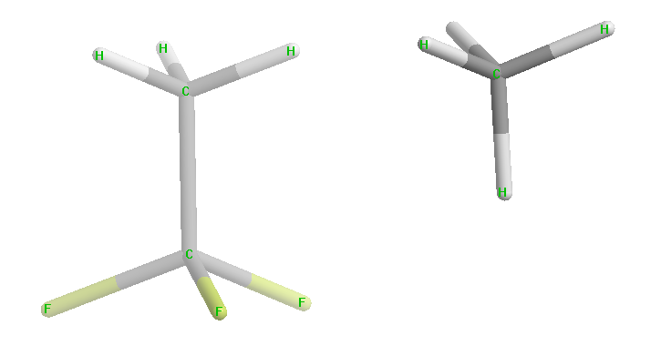
Link Atoms
Layer 1
R_{L}
Layer 2
R_{LAH}
Link atom host → Link atom
Equivalent atoms have the same coordinates
The link atom substitutes the link atom host
The bond length for the link atom is scaled, R_{L} = g x R_{LAH}
Rule: Double bonds should not be broken!
Notes:
The broken bond is capped by the link atom. Normally it is Hydrogen, but it can be specified as any atom. Fro example, in cases when the link atom host is part of the electronegative group the chlorine might be a better choice.

Slide 10
Potential Energy Surface
Jacobian J projects the forces on the link atoms onto the link atoms hosts. J is the function of the atomic coordinates of the model system and link atoms hosts
Notes:
Once we defined the expressio of the ONIOM energy, the definition of ONIOM gradient and Hessian is straightforward.
The use of link atoms reguries to to use the Jacobian matrix to project the forces on the link atoms on the link atoms hosts. Similar gradient and 2d derivatives epxression can be easily derived for 3 ONIOM partitioning.

Slide 11
MM in Gaussian 03
Quantum chemistry style implementation
No short range or soft cutoffs
Analytical 1st and 2d derivatives
O(N) Coloumb energy and gradient via FMM
Currently not periodic
Internal force fields: Amber, UFF, Dreiding
MM force field parameters can be specified via input
Library of potential functions
Limits
~40,000 atoms in ONIOM QM/MM SP
~10,000 atoms in ONIOM QM/MM Opt
Notes:
Talking about Molecular Mechanics methods in Gaussian, we have to say that this part of the code was written quite recently by quantum chemists, and it is not yet in the age of maturity. In its present state, it misses many features common for users of classical force fields programs, such as AMBER, CHARMM et cetera. It has no option for cutoffs of short range forces. The periodic box can not be setup as well. The force fields hardwired in the code are Amber, UFF and Dreiding. The improvement of G03 over G98 is that MM force field parameters can be edited via input. The current limit on the number of MM atoms in ONIOM QM/MM calculations, as I can say from my experience, is ~ 40,000 in single-point calculations and ~ 10,000 in geometry optimization.

Slide 12
ONIOM QM/MM Geometry Optimization with Microiterations
MM optimization step
MM geo converged ?
–
Double Iteration Scheme
Yes
QM optimization step
QM geo converged?
–
+
Done
Notes:
The first algorithm to do ONIOM QM/MM optimization implement in Gaussian was so called microiterations algorithm
Geometry insteat of geo, Yes na d No

Slide 13
ONIOM QM/MM Geometry Optimization with QuadMacro
Geometry step in full QM/MM space
Using analytical 2d
derivatives for MM
MM region optimization step
MM converged?
–
+
Overall converged?
–
+
Done

Slide 14
Electronic Embedding Scheme of ONIOM QM/MM
Keywords:
ONIOM(QM:MM)= Embed,
or
ONIOM(QM:MM)=Scale=ijklm,
where i-m are integers from 0 to 5 specifying the scaling of charge, in multiples of 0.2, on MM atoms 1-5 bonds away from link host atoms

Slide 15
QM/MM Geometry Optimization, Electronic Embedding
MM optimization step
MM geo converged?
–
+
Evaluate wavefunction
QM density converged?
Triple Iteration Scheme
–
+
QM optimization step
QM geo converged?
–
+
Done

Slide 16
Examples of ONIOM keywords
ONIOM(HF/6-31G(d):UFF) IOP(1/33=4)
ONIOM(hf/lanl2dz:am1:amber)=svalue
ONIOM(HF/3-21G:Amber) Opt(QuadMacro)
ONIOM(HF/6-31G(d):Amber)=Embed
ONIOM(B3LYP/6-31G(d):Amber=SoftFirst)=ScaleCharge=54321

Slide 17
2-Layer ONIOM Input
Method
%chk=ethanol
#p oniom(hf/6-31g:amber) geom=connectivity IOP(1/33=3,4/33=3)
Ethanol
0 1 0 1 0 1
C-CT--0.314066 0 -1.225266 1.331811 0.000000 Low H-H1--0.1 5
H-HC-0.068612 0 -0.868594 1.836209 0.873652 Low
H-HC-0.068612 0 -0.868594 1.836209 -0.873652 Low
H-HC-0.068612 0 -2.295266 1.331824 0.000000 Low
C-CT-0.510234 0 -0.711951 -0.120121 0.000000 High
H-H1--0.048317 0 -1.068622 -0.624518 0.873653 High
H-H1--0.048317 0 -1.068625 -0.624520 -0.873650 High
O-OH--0.735013 0 0.718049 -0.120138 -0.000003 High
H-HO-0.428200 0 1.038491 -1.025078 0.000175 High
1 2 1.0 3 1.0 4 1.0 5 1.0
2
3
4
5 6 1.0 7 1.0 8 1.0
6
7
8 9 1.0
9
Partitioning onto layers
Charge/spin for entire molecule (real system), model system-high level & model-low
Atom specification-MM type-MM charge
Link atom Specification
Optimization flag, 0 to optimize, -1 to keep frozen
Connectivity scheme

Slide 18
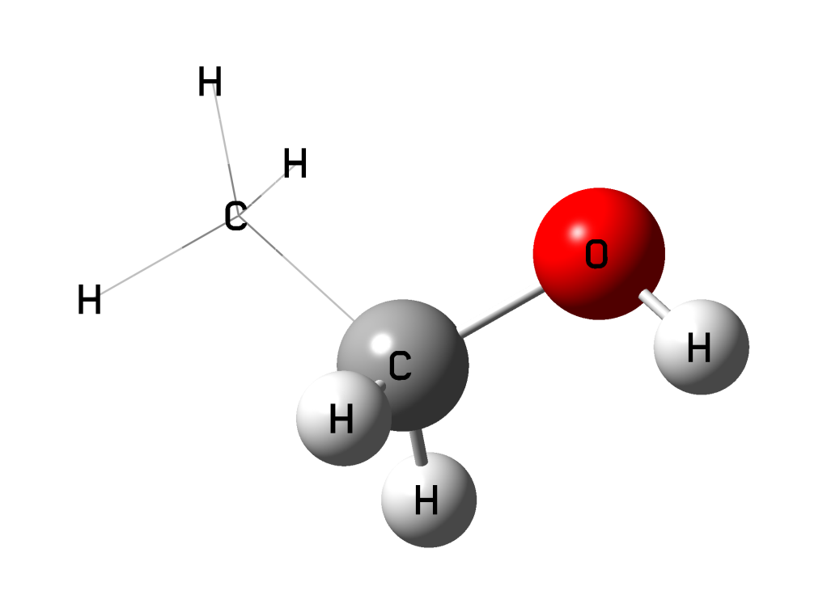
2-Layer Output
ONIOM: saving gridpoint 1
ONIOM: restoring gridpoint 3
ONIOM: calculating energy.
ONIOM: gridpoint 1 method: low system: model energy: -0.027431024742
ONIOM: gridpoint 2 method: high system: model energy: -115.676328005359
ONIOM: gridpoint 3 method: low system: real energy: -0.038427674426
ONIOM: extrapolated energy = -115.687324655044

Slide 19
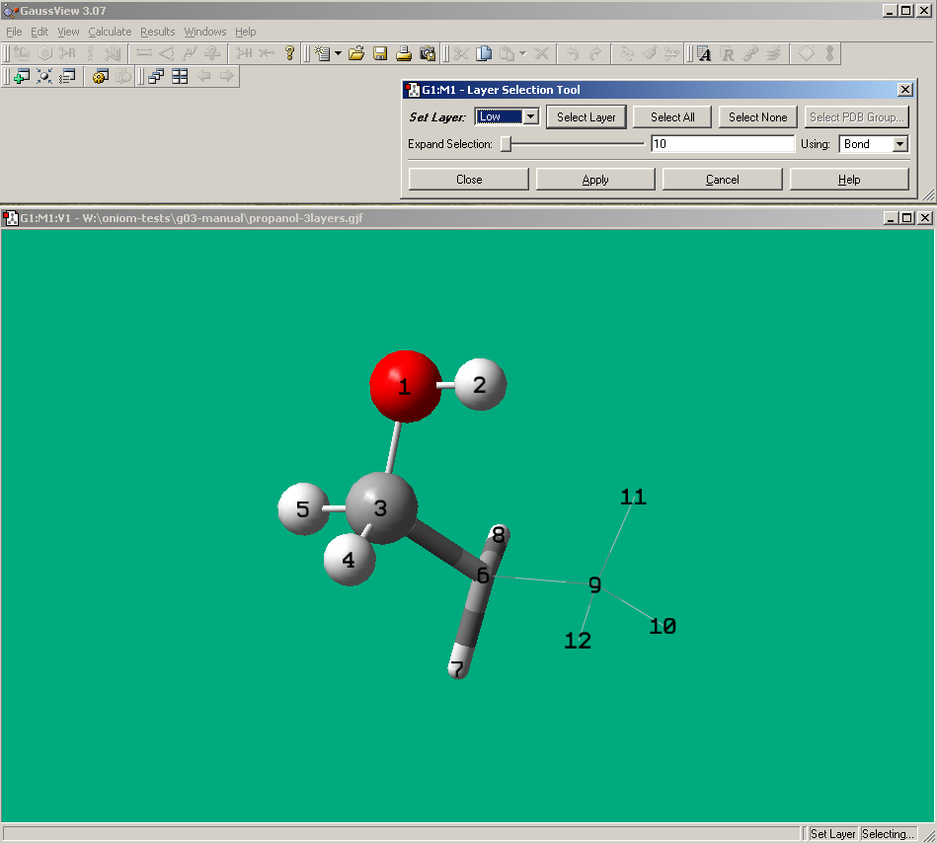
GaussView 3.x-4.X and ONIOM

Slide 20
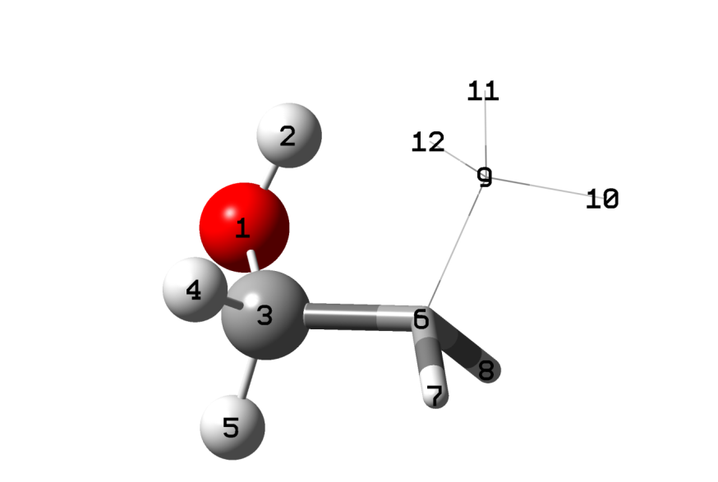
3-Layer Input
%chk=propanol
# ONIOM(MP2/6-31G(d):HF/6-31G(d):Amber) geom=connectivity
Propanol
0 1 0 1 0 1 0 1 0 1 0 1
O-OH--0.691832 0 -0.234000 1.298000 1.240000 H
H-HO-0.423185 0 0.678000 1.233000 1.546000 H
C-CT-0.365885 0 -0.366000 0.328000 0.218000 H
H-H1--0.033330 0 -0.441000 -0.738000 0.563000 H
H-H1--0.033330 0 -1.362000 0.533000 -0.261000 H
C-CT--0.012243 0 0.719000 0.408000 -0.842000 M H-H1--0.03 3
H-HC-0.031363 0 0.526000 -0.330000 -1.664000 M
H-HC-0.031363 0 0.606000 1.406000 -1.342000 M
C-CT--0.327657 0 2.127000 0.134000 -0.382000 L H-HC--0.08 6
H-HC-0.082198 0 2.783000 0.369000 -1.255000 L
H-HC-0.082198 0 2.474000 0.834000 0.418000 L
H-HC-0.082198 0 2.222000 -0.933000 -0.065000 L
1 2 1.0 3 1.0
2
3 4 1.0 5 1.0 6 1.0
4
5
6 7 1.0 8 1.0 9 1.0
7
8
9 10 1.0 11 1.0 12 1.0
10
11
12

Slide 21
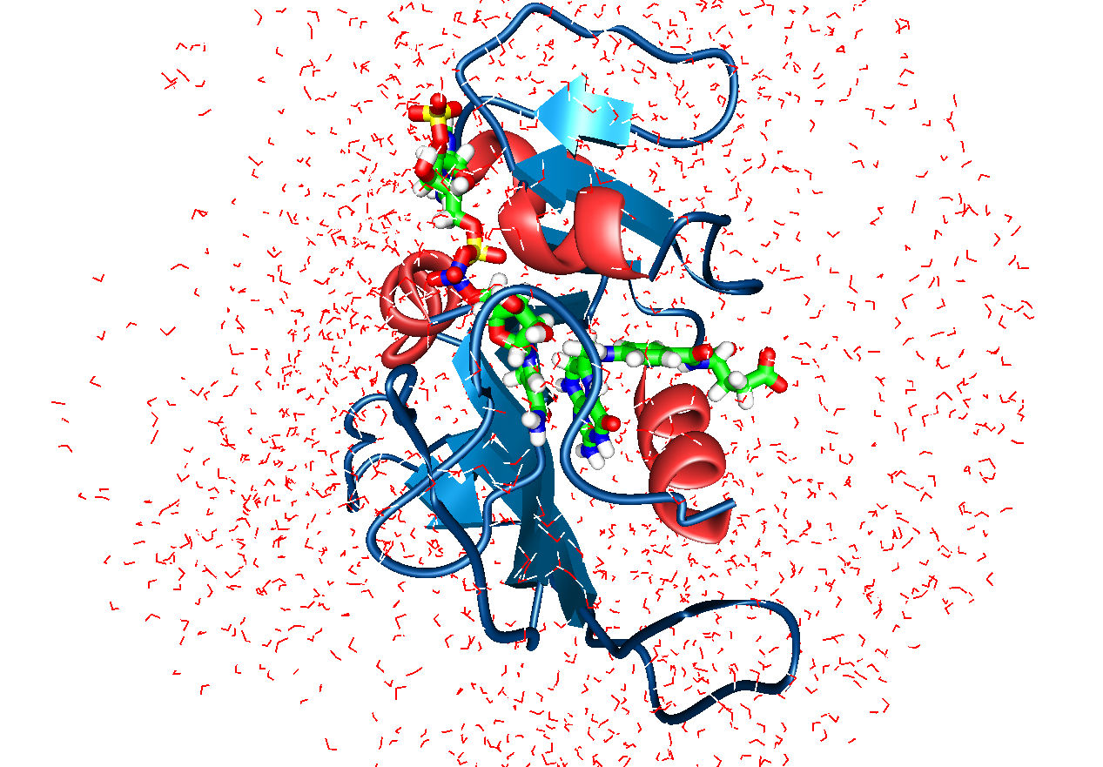
Test case: DHFR enzyme
NADPH
DHF
Dihydrofolate reductase (DHFR) in the Escherichia coli
DHFR•DHF•NADPH complex
Notes:
Dihydrofolate reductase (DHFR) is the enzyme catalyzing the reduction of 7,8-dihydrofolate to 5,6,7,8-tetrahydrofolate, with NADPH being a coenzyme in this process. Tetrahydrofolate is the source of the methyl groups in the synthesis of purines and pyrimidines, as well as methionine and histidine. The importance of DHFR in the folate cycle in living cell processes suggested this enzyme as a possible target for drug development against different tumors and infections of different origin.
The amino acid sequences of DHFR are quite diverse across species, being as little as 30% identical between bacterial species. Eukaryotes and prokaryotes only share about 30% identity at best. These distinctions have made DHFR an excellent candidate for species-specific drugs such as the antibiotic trimethoprim and the antimalarial pyrimethamine. DHFR is also the target of the chemotherapeutic methotrexate as well as the first anticancer drug aminopterin.

Slide 22
Motivation
Geometry optimization of the enzyme active-site fragment is inadequate due to the floppy nature of the enzyme complex. Fixing edge atoms, or applying other restraints to mimic the natural constraints, of the enzyme environment introduces artefacts, particularly for TS which show small but important contraction compared with reactant and product complex.
Solution is to do the optimization in the fully relaxed enzyme environment:
Active site → QM region
Enzyme → MM region
We present our assessment of the ONIOM QM/MM method used for study of the hydride transfer step of DHFR from E. coli.

Slide 23
The Active Site Map
7,8-dihydrofolate
NADPH
The grey area is the QM region in the QM/MM geometry optimization.
Notes:
The active site includes 7,8 dehydrofolate, co-factor , two water molecules an side chains of enzyme binded to the substrate by H-bonds.

Slide 24
Computational Details
Input coordinates
20 snapshots from semiempirical PM3/Amber MD trajectories modelling the reactant state of whole enzyme with a 40 Å radius shell of water molecules
Water molecules beyond 30 Å from the complex centre were cut off
Boundary water molecules, beyond 25 Å from the centre, set to be fixed
5 hydrogen-type link atoms were specified for the QM part of ONIOM calculations to cap bonds broken on the QM/MM boundary
Amber types and charges were obtained using antechamber utility program from AMBER

Slide 25
Computational details
Number of atoms in ONIOM calculations
~8,500 atoms in total
~5,500 atoms were marked for optimization
QM region:
81 atoms + 5 link atoms (optimization)
up to 153 in single-point calculations on the final geometry

Slide 26
Protocol of calculations
ONIOM(HF/3-21G:Amber) using constraints on CD-H and H-CA distances to bring complex closer to the geometry expected for TS
ONIOM(HF/3-21G:Amber) Opt(TS,QuadMacro) geometry optimization with constraints removed
ONIOM(HF/3-21G:Amber) Opt(QuadMacro) geometry optimizations to reactant and product starting from the TS geometries
Single-point ONIOM calculations on final geometry for: - higher electronic basis sets - Electronic Embedding (EE) scheme (to count polarization effects) - different composition of the QM region

Slide 27
Results
ΔE≠ and ΔE of hydride transfer reaction
QM atoms | Method of final energy evaluation, SP after Opt ONIOM-ME(HF/3-21G:Amber) | ΔE≠ |  | ΔE
 |  | ONIOM | QM part | ONIOM | QM part
81 | ONIOM-ME (HF/3-21G:Amber) | 40.0±6.4 | 37.3±4.4 | 22.8±6.2 | 19.5±4.1
 | ONIOM-EE (HF/3-21G:Amber) | 33.7±4.8 | 28.4±4.3 | 14.6±5.3 | 9.5±4.1
 | ONIOM-EE (HF/6-31G(d):Amber) | 39.4±4.2 | 34.4±3.1 | 12.6±5.6 | 7.4±3.8
 | ONIOM-EE (B3LYP/6-31G(d):Amber) | 14.1±4.6 | 8.8±3.6 | 7.7±5.3 | 2.5±3.4
153 | ONIOM-EE (HF/3-21G:Amber) | 36.1±5.4 | 30.4±5.8 | 18.6±6.1 | 14.4±7.8
 | ONIOM-EE (HF/6-31G(d):Amber) | 41.2±3.9 | 35.5±5.1 | 15.5±5.5 | 11.3±7.4
 | ONIOM-EE (B3LYP/6-31G(d):Amber) | 15.4±4.3 | 9.7±4.9 | 9.7±5.2 | 5.5±7.0

Slide 28
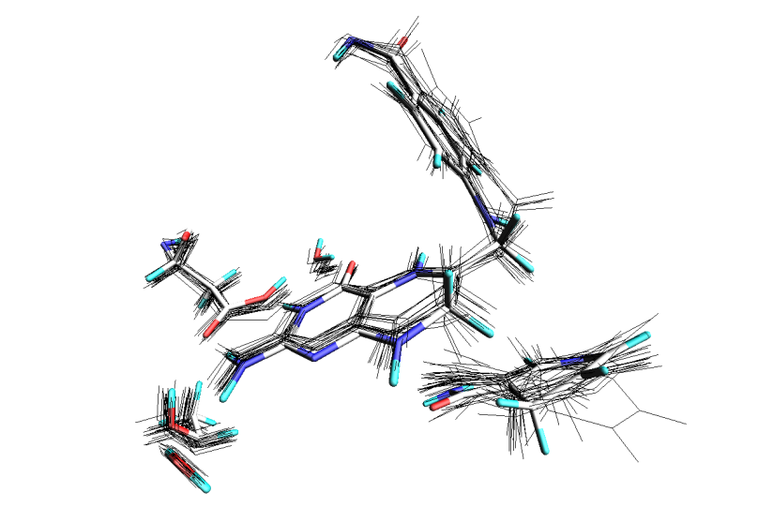
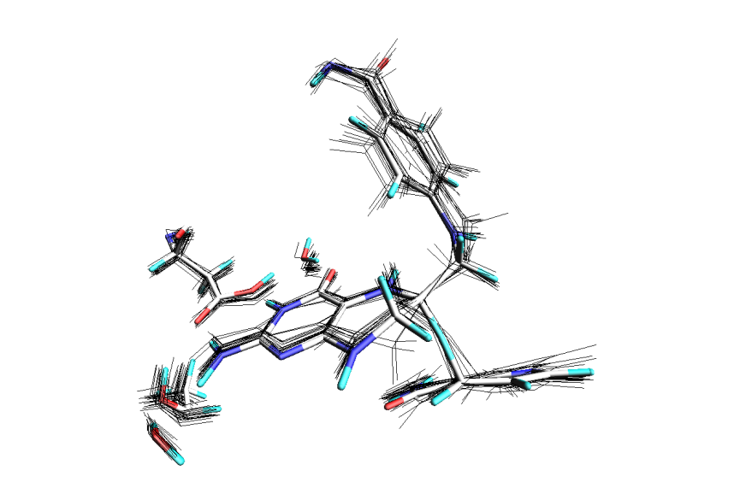
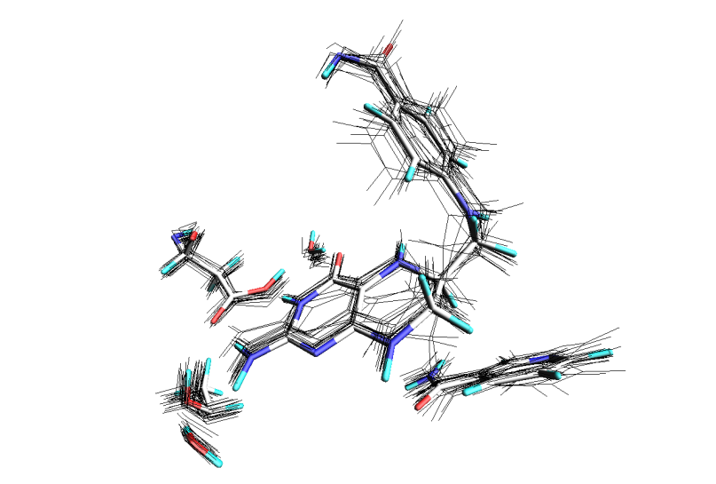
Reactant
ONIOM(HF/3-21G:Amber) HF/3-21G, cluster
R(C_{D}-H), Å 1.08 ± 0.003 1.09
R(C_{A}-H), Å 3.07 ± 0.31 3.56
R(C_{D}-C_{A}), Å 3.79 ± 0.20 4.23
α(C_{D}-H-C_{A}), ° 126 ± 15 121
Transition State
R(C_{D}-H), Å 1.42 ± 0.03 1.49
R(C_{A}-H), Å 1.25 ± 0.02 1.49
R(C_{D}-C_{A}), Å 2.65 ± 0.03 2.88
α(C_{D}-H-C_{A}), ° 169 ± 5 151
<
Product
R(C_{D}-H), Å 2.47 ± 0.14 3.57
R(C_{A}-H), Å 1.09 ± 0.005 1.09
R(C_{D}-C_{A}), Å 3.35 ± 0.12 4.47
α(C_{D}-H-C_{A}), ° 137 ± 6 142

Slide 29
Recommendations
Preparation of the structure
Keep number of bonds crossing layer boundaries at minimum
Double bonds should not be broken
When modelling chemical reactions, keep the active atoms of reactions few bonds away from the layers crossing
Preliminary pure MM optimization of structure may be of help to check if the MM force field setup is correct, and to get a good starting geometry
Opt(Loose) followed by Opt in most cases gives a lower minimum and reduces the overall calculation time
A gradual increase in the level of QM method
Opt(TS,QuadMacro) is a must for TS search in case of large QM/MM structures
Notes:
I add a slide about GaussView

Slide 30
References
Dapprich S., Komáromi I., Byun K.S., Morokuma K., Frisch M.J., J. Mol. Struct. (Theochem) 461-462, 1 (1999).
Vreven T., Morokuma K., Theor. Chem. Acc. 109, 125 (2003).
Vreven T., Morokuma K., Farkas Ö., Schlegel H.B., Firsch M.J., J. Comp. Chem. 24, 760 (2003).
Vreven T., Firsch M.J., Kudin K.N., Schlegel H.B., Morokuma K., Mol. Phys. 104, 701 (2006).

