Slide 1
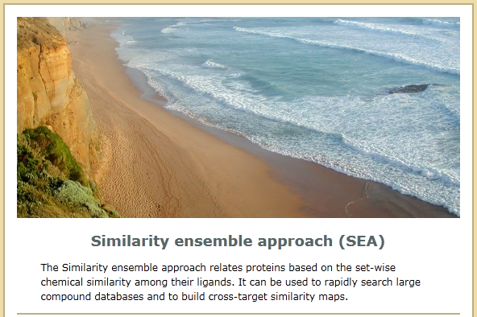
Large-scale prediction and testing of drug activity on side-effect targets
Journal Club
Reporter: Zhixiong Zhao
2012.10.8
Nature 2012,361-368
Brian K. Shoichet ‘s lab, Novartis Institute

Slide 2
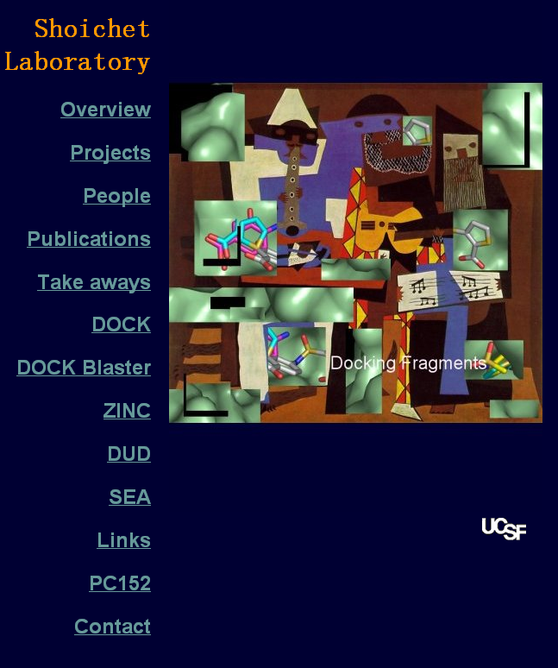
Author Introduction
The corresponding author Brian K. Shoichet is a professor in UCSF. He received his Ph.D for work with Tack Kuntz in UCSF. His team is one of the team to maintain and develop the famous DOCK program. And the ZINC database is also developed in Shoichet’s lab.
Shoichet’s lab focus on the research of docking, protein-ligand interaction. “Two crazy goals for the next five years are predicting one ligand for every accessible protein target, and for every drug predicting one new target to which it binds. “
Here, I will introduce their work on SEA.

Slide 3
Three main articles on this topic:
First is focus on the basic method called SEA, which use the chemical similarity for grouping the proteins from their ligands. (Nature Biotechnology 2007,197)
Second is applying SEA for off-target prediction. (Nature 2009,175)
This paper focus on the application of SEA for large-scale testing the activities of off-targets and relating the adverse drug reaction(ADR) to the off-target. (Nature 2012,361)
Notes:
Their group published three main articles on this topic.

Slide 4
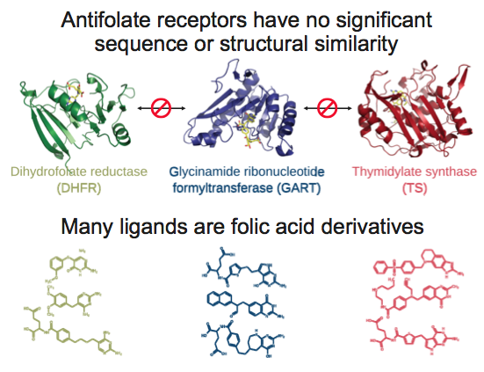
One Drug, Multi Targets
Adverse drug reactions(ADR), often caused by off-target interaction, limits the use of effective drug and may cause disastrous events. Prediction of unknown off-target drug interaction might prevent the disastrous and allow safer molecules to be prioritized for pre-clinical development. However, sometimes the off-target protein have no significant sequence or structural similarity to the expected target. Chemoinformatics methods on the ligands may offer more opportunity.
Notes:
The emerging drug polypharmacology focus on the recognition of off-targets and their affinity to the drug.

Slide 5
SEA (Similarity Ensemble Approach)
Ligands Set A
Target A
Compare to
Binding to
Ligands Set B
Query Ligand
(or ligand set)
Target B
The key idea of SEA is using the known binding ligands as a set for representing the target protein, then the query ligand or ligand set could be compared to the target ligand set by chemical similarity to identify the potential target. Its unique feature is utilizing a statistical method similar to the BLAST.

Slide 6
Preparation of ligand set
Descriptor Generation
Classifying
Annotated Database
(eg: MDDR)
Ligand Sets
65,241 ligands in MDL Drug Data Report (MDDR) were used. Their annotation on the modulated targets were extracted and used for the classification. Only sets containing five or more ligands were used. Finally, they were classified to 246-receptor subsets.
*The classification depends on the kind of database and the chose annotation.

Slide 7
Set Comparison
Tanimoto coeffcients
Ligand Set A
Query Set
Ligand Set B
Then each ligand in the query set was compared to the each ligand in all target ligand sets, and the Tanimoto coeffcients (Tc) for chemical similarity were calculated via 2-dimensional fingerprints by Daylight or ECFP_4. (Tc=0~1)

Slide 8
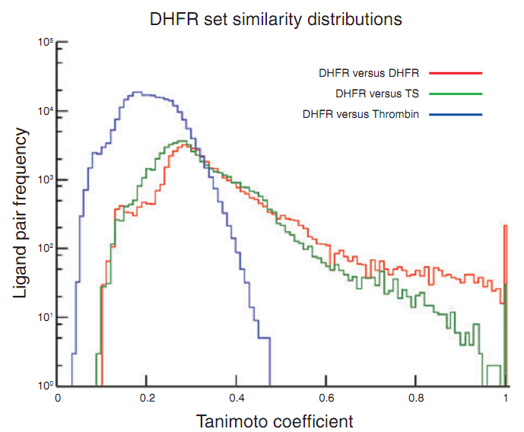
Similarity distribution
DHFR: antifolate enzyme,
216 ligands
TS: thymidylate synthase, related protein, 253 ligands
Thrombin: unrelated protein,
1226 ligands
When comparing the 216 ligands of the antifolate enzyme DHFR to themselves, 80.4% of the pairs had a Tc in the 0.1 to 0.4 range, with only 5.2% having more substantial scores in the 0.6–1.0 range
When the Tc is low, the ligands compared were considered insubstantial similarity. Thus, the ligand pair with Tc>=0.57 were used and raw similarity score between sets could be sum up the Tc of the similar ligand pairs. Most pairs of ligand sets have no raw similarity score(raw score=0, 70.8%).

Slide 9
Necessity for “random” similarity
Though the raw similarity score could help to identify the relationship between query set and target, the size and chemical composition bias could not be ignored. Thus, it’s improper to use the raw score directly to evaluate the similarity between different sets.
To compare the significance of the set similarity raw scores across sets of different sizes, they developed a statistical model of the similarity they would expect at random for sets drawn from the same large but finite database of ligands.

Slide 10
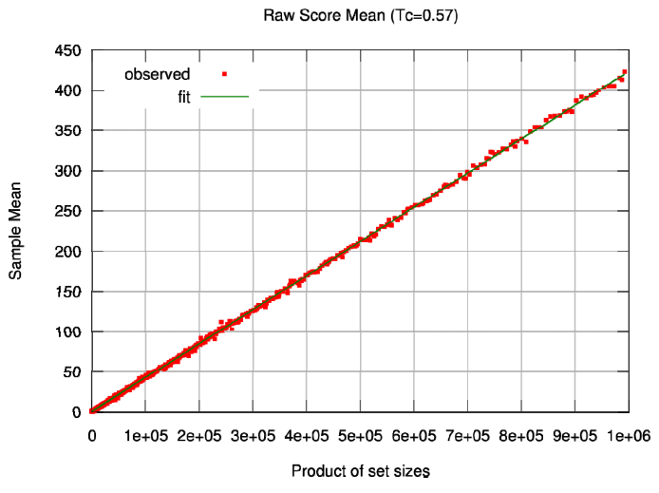


Fit for expect raw score
Raw score mean vs Product of set size
From random set from the same DB
(Background sets)
Set sizes=set A * set B
μ(x):expected raw score mean
Different size ligand sets was extracted from the same database randomly. The similarities via Tc were calculated and different threshold Tc (0~1,0.01 step)was used to calculate the raw score. Nonlinear fitter was used for the expected raw score mean and standard deviation via least-square.
It’s easy to understand the linear relation between the raw score and the product of set size.

Slide 11
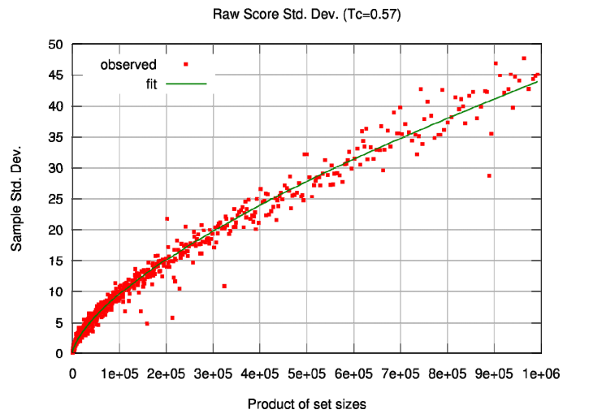


Fit for standard deviation
S.D. vs Product of set size
Bin the data by the x-axis values(>=5 points) and then calculate the standard deviation of each bin with Laplacian correction. Finially, fit the S.D. vs product of set size.

Slide 12
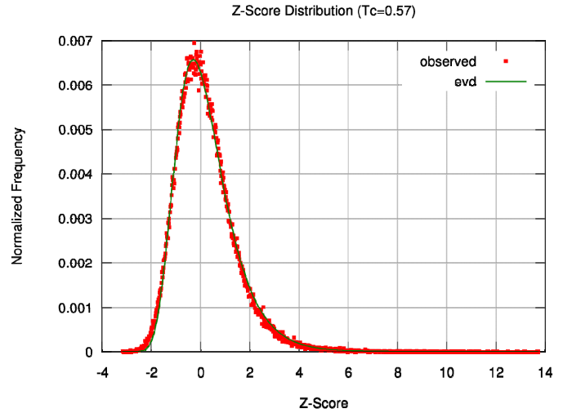


Z-score and E-value
rs(S₁,S₂) =raw score of set S1 vs S2
Then the set comparison Z-scores were calculated as a function of the set raw scores, expected raw scores and s.d. The histogram of Z-scores (right) of the random sets conformed to an extreme value distribution, which underlied BLAST comparisons of protein and DNA sequences. Finally, the probability of the score being achieved by random chance alone, given the Z-score, was converted to an expectation value (E-value).
The threshold Tc was obtained from the best chi-square to fit the extreme value distribution, here threshold Tc=0.57

Slide 13
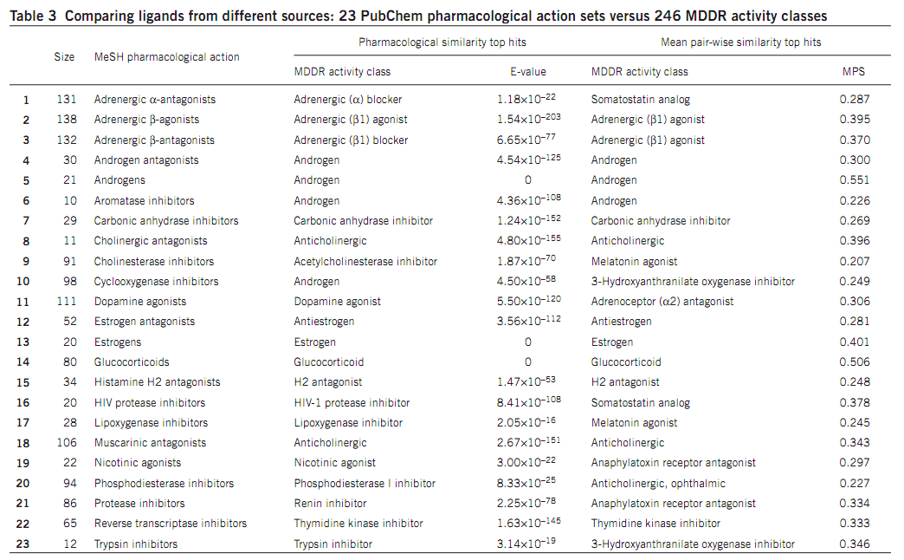
Method testing
23 ligand sets from PubChem (1421 compounds, not in MDDR) were tested by SEA, and 17 found a matching activity class as the top-ranked hit (average rank 1.4). But in mean pair-wise similarity (MPS) method, only 9 found a matching top-ranked hit (average rank 8.2).
This result show that SEA was effective for ligand classification.

Slide 14
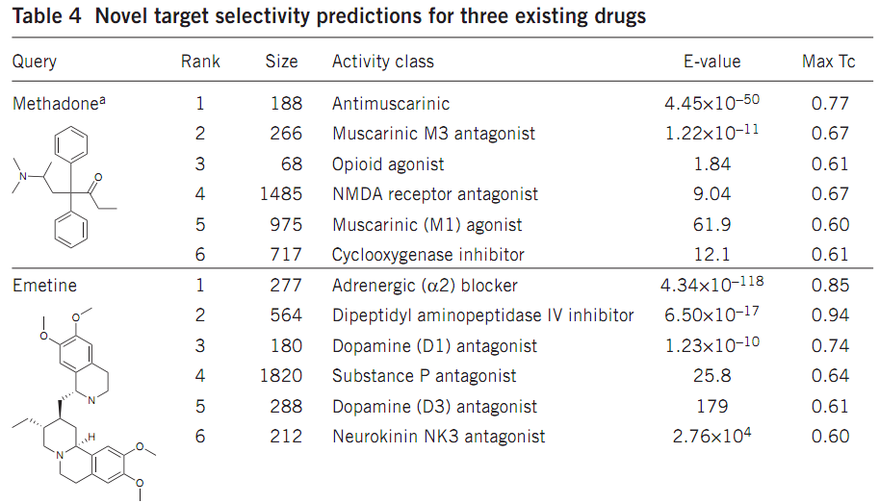
Off-target prediction
Methadone with its analogs as a set, targeting NMDA and μ-opioid, has been predicted to muscarinic M3 antagonist by SEA. Further test show Ki=1.0 uM. Similar result is for emetine.
PS: More information could refer to another paper focusing on off-target prediction.(Nature 2009,175)

Slide 15
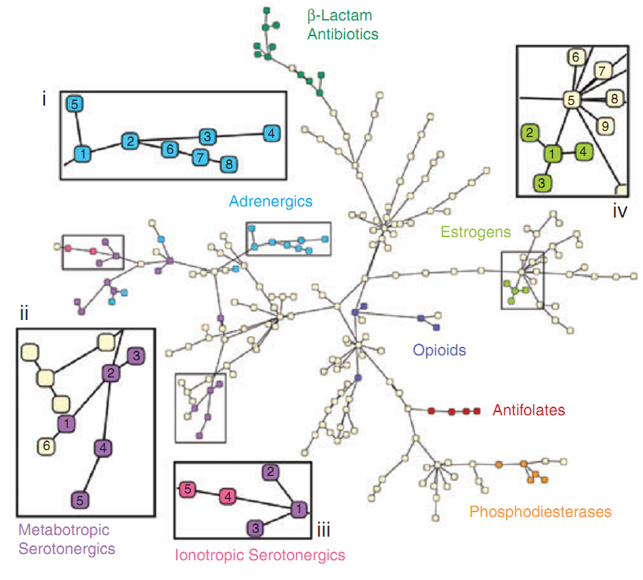
Finding relationship between proteins
After comparison of 246 ligand sets with each other, the E-value between them could be obtained and could be used to plot the relationship tree between the 246 targets via minimal spanning tree.
Clusters of biologically related targets may be observed as an emergent property, as no explicit biological
information, only ligand information, is used to calculate the cross-target similarity.
Similarity maps for 246 enzymes and receptors
based on the E-values

Slide 16
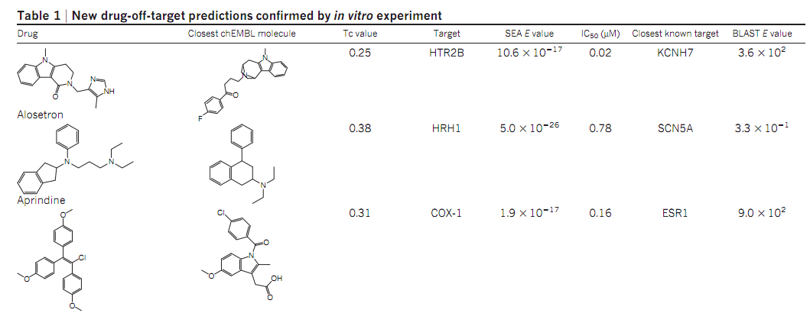
New large-scale prediction
656 marketed drugs were screened by SEA for their likelihood to bind to 73 targets potentially related to ADR. The ligand sets for these targets were from ChEMBL. Totally, 151 new drug-target association were confirmed by in vitro test(IC50<=30uM).
Nature 2012,361-368

Slide 17
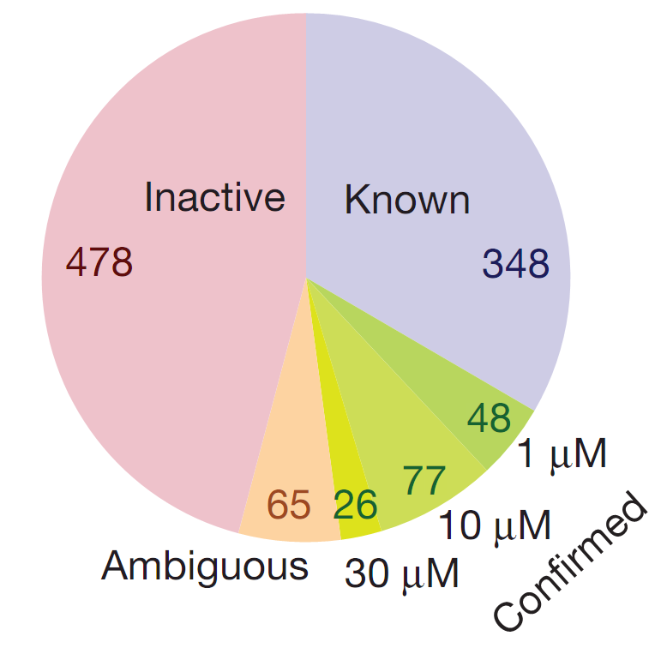
Validation for prediction result
Only 1,644 of the more than 47,000 possible drug–target pairs had significant E values. Of these, 403 were already known
in ChEMBL and so were trivially confirmed. In the remaining 1,241 predictions, 348 (28%) were unknown to ChEMBL, but could be found in proprietary ligand–target databases that were unavailable to SEA. The others were tested for their bioacitivities. 151 have IC50 <=30uM.
In summary, of the 1,042 predictions that were tested (694 by assay, 348 by databases), 48% were confirmed either in proprietary databases or in Novartis assays in full concentration responses, and just under 46% were disproved.

Slide 18
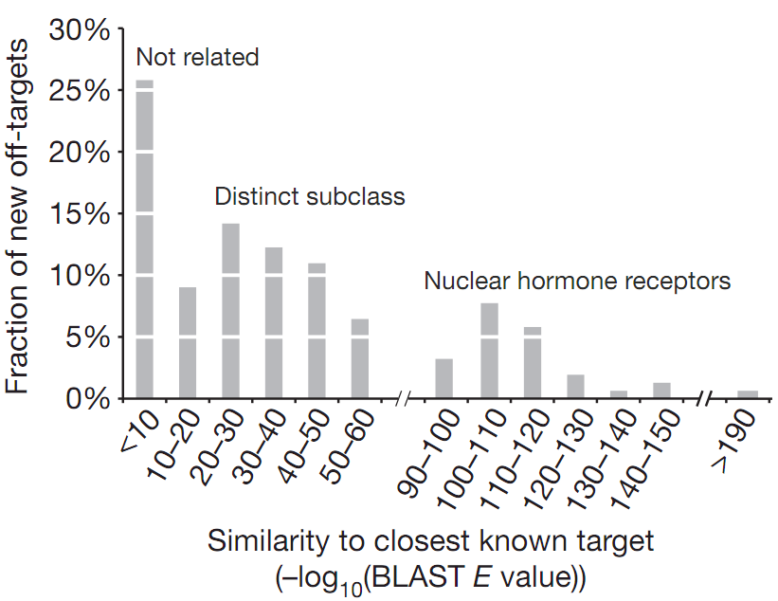
Compare to sequence similarity
The BLAST sequence similarity of predicted targets to any known target of a drug was calculated to identify the similar known targets.
It could be found that 39 in 151(26%) have BLAST E-value>10e-5, suggesting the previously known targets shared no sequence similarity with the new off-targets.
This result indicated that many off-targets are hard to be predicted by the methods based on sequence similarity.

Slide 19

Association of target with ADR
ADRs
(terms from MedDRA)
Targets
p Drugs
All ADR-drug related (total T)
All target-drug related (total A)
punish
To evaluate the relation between targets and ADRs, the author found all the Targets-drugs and Drugs-ADRs relations and enumerated(枚举) all the possible Targets-ADRs relations. Then, an enrichment score (EF) based on guilt-by-association metric(“连坐”) was calculated as follow:
p is the co-occurrence of target X and ADR Y on a drug, A is the number of times ADR Y was linked to any drug–target pair, T is the number of times target X was linked with any drug–ADR pair, and P is the total number of target–ADR pairs (681797 total).
The normal p-value and P-value for chi-squared test were calculated to control the result.
Finally 3257 associations with p-value<0.05 were retained.

Slide 20
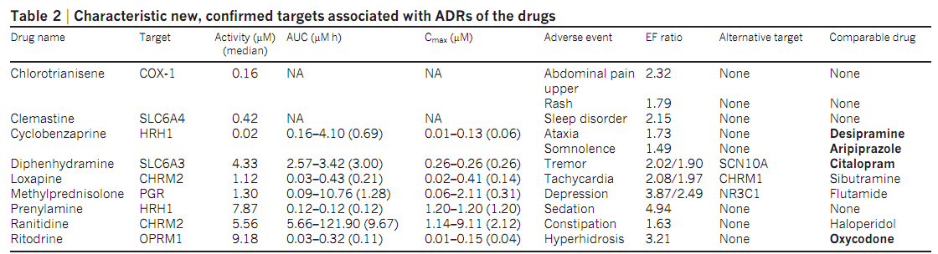
Drug-Target-ADR
Of all 151 new confirmed drug-target association(IC50<=30uM), 82 were significantly associated with one or more ADR, resulting in a total of 247
drug–target–ADR links. In 116 cases, the EF of the new drug–target–ADR link was stronger than that for any previously known target (Alternative target in the table).
The author found that many comparable drugs(in table) with similar activity, pharmacodynamics and pharmacokinetics share the same ADR and could be further used to confirm the drug-target-ADR relationship.

Slide 21
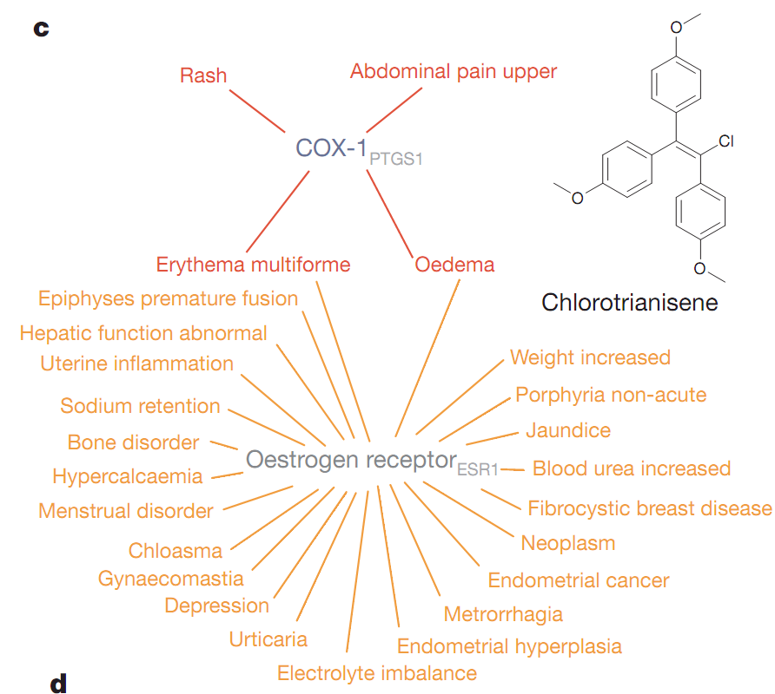
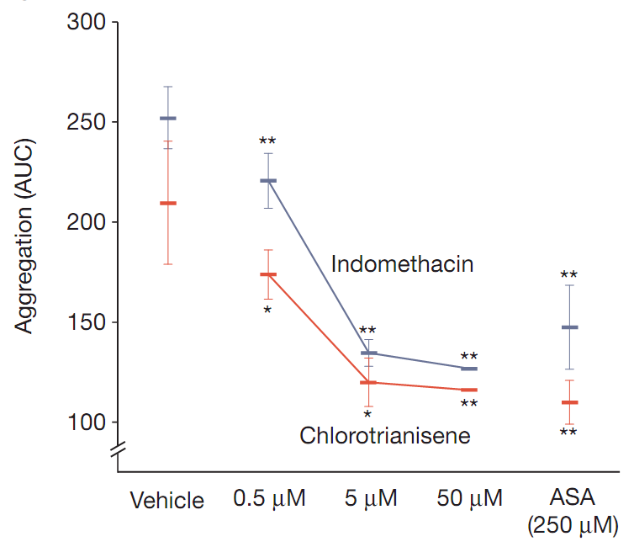
Drug-Target-ADR Net
Positive control
ex vivo test for platelet aggregation
Off-target network
The visual network could help to find the shared ADR between different targets and even new ADR of the drug. Example as chlorotrianisene(氯烯雌醚,非甾体激素), which could target COX-1 causing abdominal pain upper(epigastralgia,胃脘痛), similar to NSAIDs(非甾体抗炎药). Generally, synthetic oestrogen(雌激素) may promote platelet aggregation(血小板聚集); however, NSAIDs inhibit platelet aggregation via inhibition of COX-1. The ex vivo test confirmed the speculation: chlorotrianisene could promote platelet aggregation as NSAIDs, not as synthetic oestrogen.

Slide 22
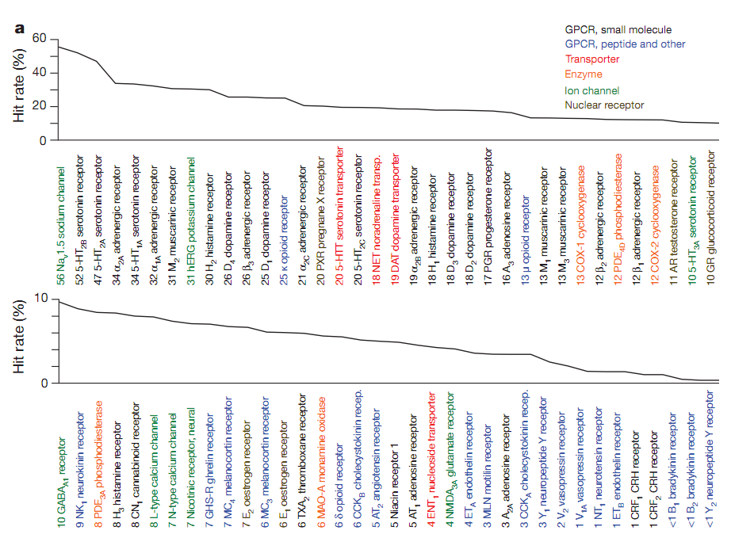
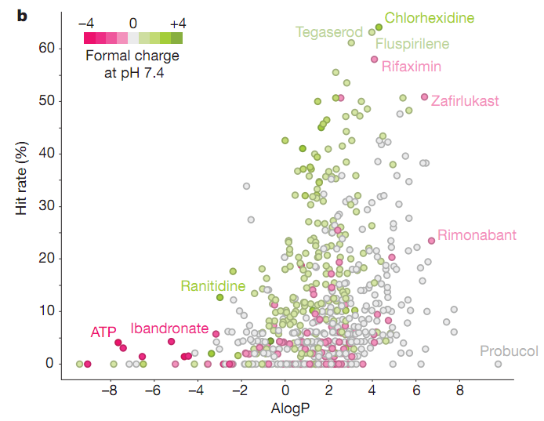
Target and drug promiscuity
Hit rate=tested hit drugs(targets)/total tested drugs(targets)
The hit rate for the targets and drugs may reflect their promiscuity(杂泛性). The larger hit rate for target means that the target may be affected by more drugs.
The right picture show the target promiscuity, showing that GPCR for small molecules were most promiscuity and reversely for peptides.
The left picture show the drug promiscuity, showing that the positive hydrophobic drugs may be more promiscuity, thus they may have more ADRs.

Slide 23
Summary
SEA is a method for predicting the relation between query ligands with target based on chemical similarity (query ligands vs target ligands) and statistical method.
Using SEA to study the off-target and ADR could help to improve the understanding of the nature of the drug and to optimize the drug design procedure. Many off-target activities might be found before pre-clinical.

Slide 24
Thank you!

Slide 25
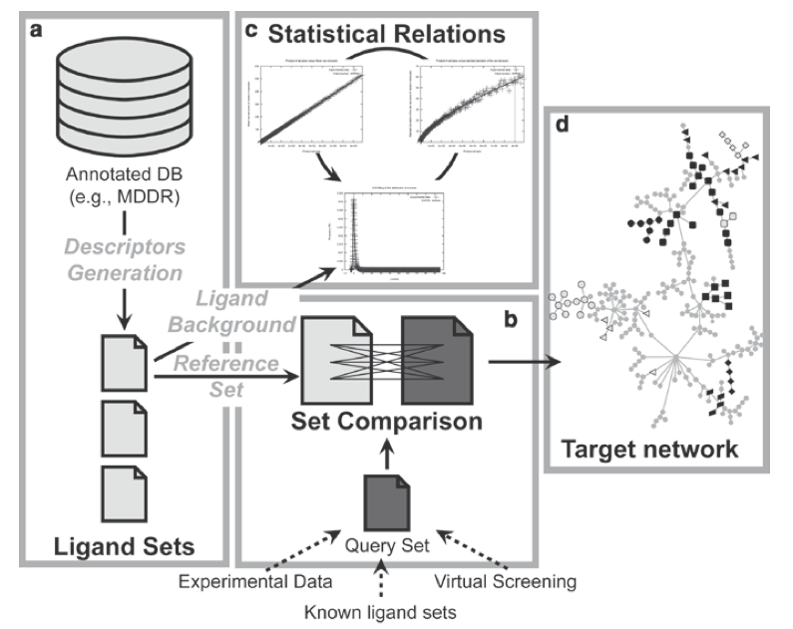
How does SEA work ?
Database：10W 分子
（Ligand Set size： S_{min}=10，S_{max} =300）
抽取1000个整数S_{i} ，范围在S_{min}*S_{min}~S_{max}*S_{max}
对于每个S_{i ，}抽取30个整数因子f_{i} ，建立set a，set b 含有f_{i} ，S_{i}/f_{i}个分子
计算set a，set b的相似性(FP,TC)：C_{a,b}
相似性阈值t_{i} =0~1 (step: 0.01)
r_{a,b}(t_{i}) = ∑C_{a,b} (C_{a,b} > t_{i})
In breif, the apparent raw score from the query comparison need to find the mean raw score and raw score standard deviation. Then the set comparison Z-scores were calculated as a function of the set raw scores, expected raw scores and s.d. The histogram of Z-scores (right) of the random sets conformed to an extreme value distribution, which underlied BLAST comparisons of protein and DNA sequences. Finally, the probability of the score being achieved by random chance alone, given the Z-score, was converted to an expectation value
(E-value).

Slide 26
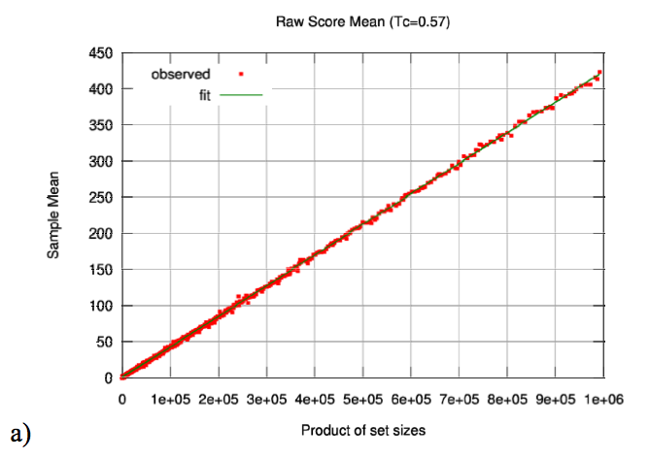
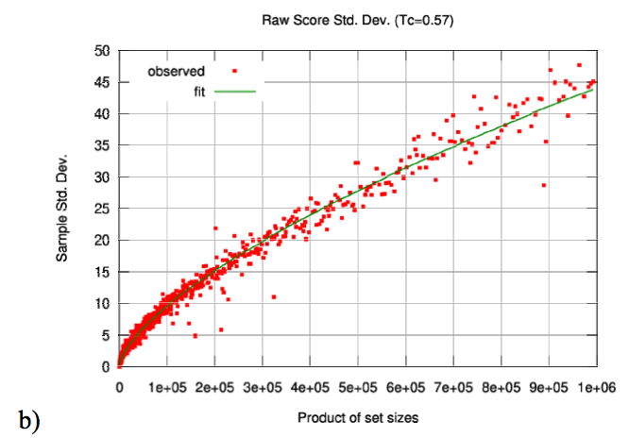
1. Calculating the parameters of the reference database(1)
对于每个t_{i}作图，共100次
横坐标：|set a| * |set b|
set size: S_{i}
纵坐标：r_{a,b}(t_{i})
拟合出均值
沿着图a的横坐标取很多个bin，每个bin不少于5个点
根据均值计算标准差
拟合出标准差方程
Notes:
Plots and fits for (a) mean, (b) standard deviation, and (c) z-score distribution of the random background statistical model calculated from the filtered MDDR database. N = 1,421 for all plots.

Slide 27
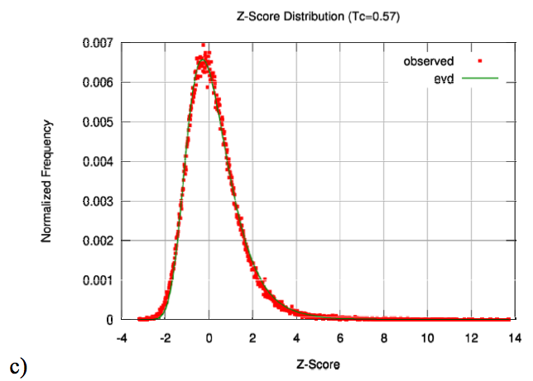

1. Calculating the parameters of the reference database(2)
Transformation of Raw scores to Z-scores
对于每个阈值t_{i}，做Z值的分布，
找出100个t_{i}中最接近极值分布的t_{i}值
图c 代表了随机抽取分子的相似性得分分布（0的概率最高）。
Z值越大，说明两个分子的相似性越大，随机产生的概率越小（越大越相似）

Slide 28
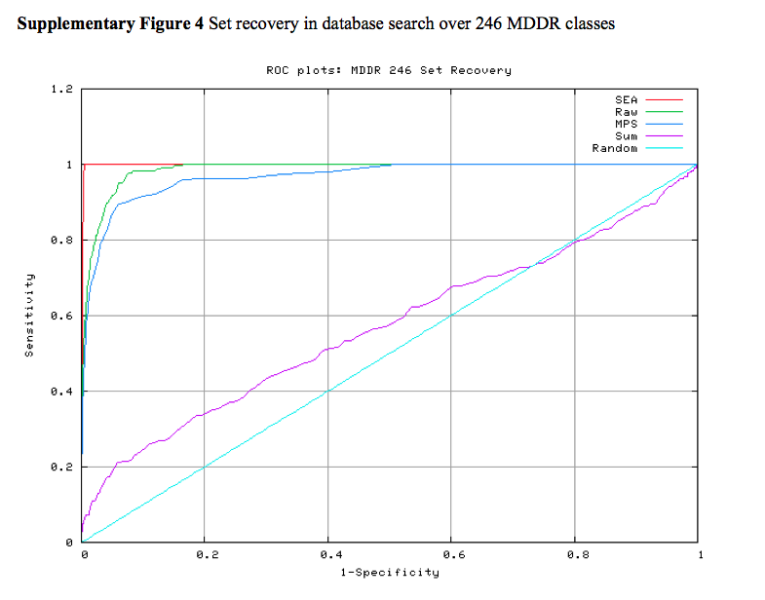


2. Calculating set-wise similarity ensemble
对所有的target set中进行两两比较
用上一步确定的t_{i}计算r_{a,b}(t_{i}) = ∑C_{a,b} (C_{a,b} > t_{i})
通过图a，b 对应size的均值和方差，转化为Z-score
图c 代表了随机抽取分子的相似性得分分布（0的概率最高）。
Z值越大，说明两个分子的相似性越大，随机产生的概率越小（越大越相似）
P值的意义：数据库随机搜索条件下，得到大于或等于Z值的概率 （越小，随机产生的概率越低）

