Slide 1
CrystalDock: A Novel Approach to Fragment-Based Drug Design
Journal Club
Find potential fragments from crystal
UCSD: Jacob D. Durrant*, J. Andrew McCammon
J. Chem. Inf. Model. 2011, 51 2573–2580
2012.3.9

Slide 2
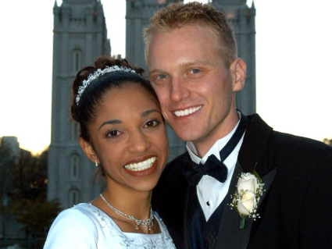
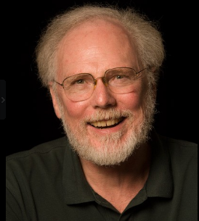
The authors
Jacob D. Durrant is doing CADD research on infectious disease and inflammation in humans. He designs many algorithms and programs on ligand-protein interaction and MD, such as NNScore(Neural-Network-Based), Hbonanza(MD H-bond analysis) and so on(>20 papers during PhD).
J. Andrew McCammon is a professor in UCSD and was elected to the NAS in 2011. He is the pioneer in MD study and published the first MD simulation of protein with M. Karplus in 1977 and also as one of the author of the book “Dynamics of Proteins and Nucleic Acids”(1987).
McCammon, J. A.; Gelin, B. R.; Karplus, M. (1977). "Dynamics of folded proteins". Nature 267 585–590

Slide 3
Core in CADD: Discover and Optimize Lead
MD
Discovery
Lead
Optimize
Potential Drug
Docking results (Auto T&T)
Virtual screening
(Docking, Pharmacophore)
De novo design
Human experience
Fragment-based design
De novo design
Fragment
Database
Reliable known crystal structures?
CrystalDock

Slide 4

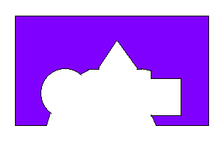
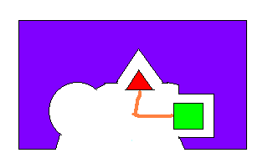
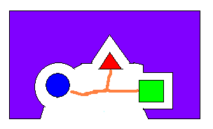
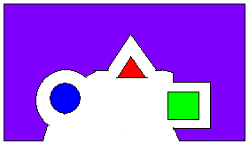
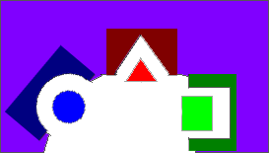
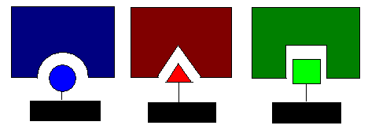



Aim of CrystalDock
Known crystal structures of
Protein-Ligand interaction
Fragment-Based method
Extract the microenvironment and fragments
Microenvironment: the adjacent 3~5 residues near the fragment.
(For green fragment, the green box means to microenvironment)
Use of the known crystal structures information of the P-L interaction
To predict the potential binding fragments and optimize the lead.
Note: CrystalDock is not a traditional docking program, but a tools for identify potential
binding fragments (used for fragment-based drug design).

Slide 5
Contents
Building the fragment-microenvironment database
Procedure of Crystal-dock
Application and Evaluation
The program is written in python, and could be used in Windows, Linux, Mac.

Slide 6
Complex crystal database building
Exclude ligands:
Multiple rotamers
DNA, RNA, amino acid
Not sufficiently close to
potential receptor
Complexes from PDB:
50424
43327 complexes
containing 202584 ligands
Filter ligands
The ligands include the additives in crystal !
Indeed, some ions are also included…

Slide 7
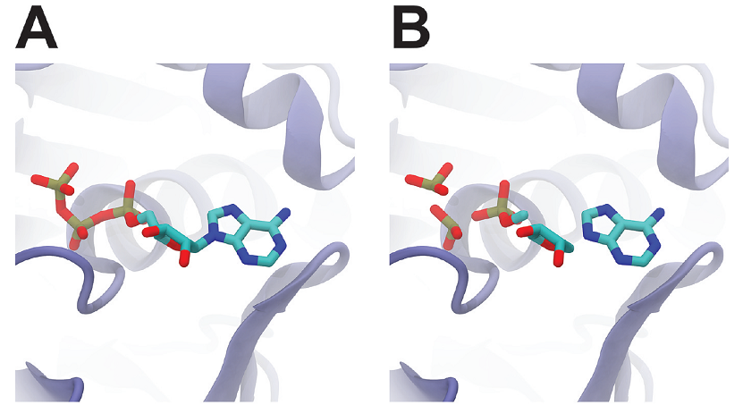
From molecule to fragments
All bonds between heavy atoms not belonging to the same ring were cut
Any fragment with fewer than three heavy atoms was merged with the
neighboring fragment that had the fewest atoms.

Slide 8
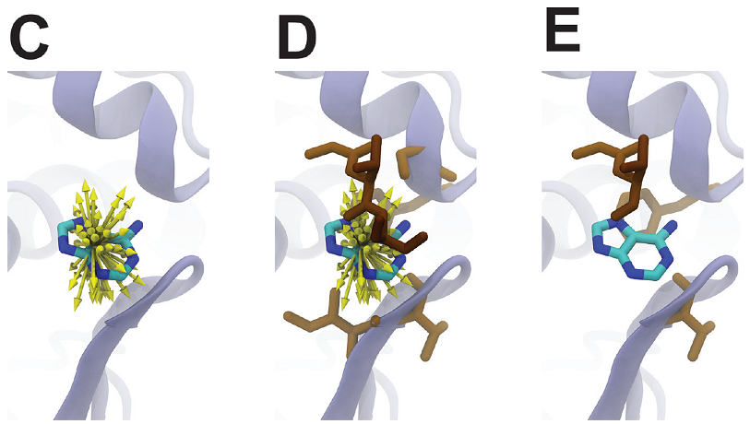
Find residues to build microenvironment
Geometric rays, separated by 10º in all directions, were extended from each fragment
atom out into space(0 to 4 Å, 0.5 Å per step). When the ray find any atoms, record the
residue and end the ray.
The distance cutoff was gradually scaled back from 4 to 0 Å to build multiple fragment-
microenvironment for each fragment
Only those microenvironments with 3, 4, and 5 receptor residues (823,460 in total) were
considered

Slide 9
The main procedure of CrystalDock

Slide 10
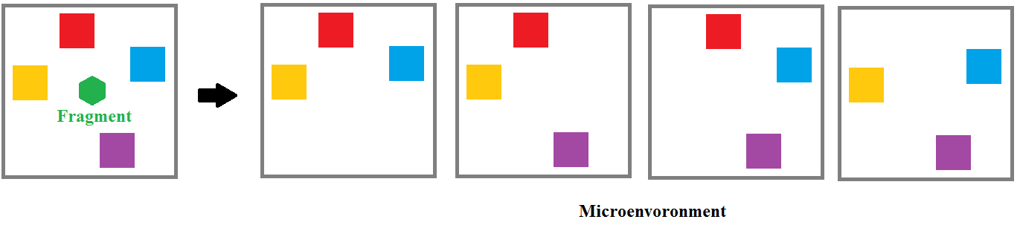
Identify the microenvironment of active-site of assigned protein
The residues could be manually assigned or be found by offering a point(x,y,z)
Geometric rays were also used to identify microenvironment receptor residues (default radius 5 Å)
Get all combinations of active-site residues to build microenvironment containing 3,4,5 residues
(such as: abc,abd,acd,bcd; C_{n}³)
Identified residues

Slide 11
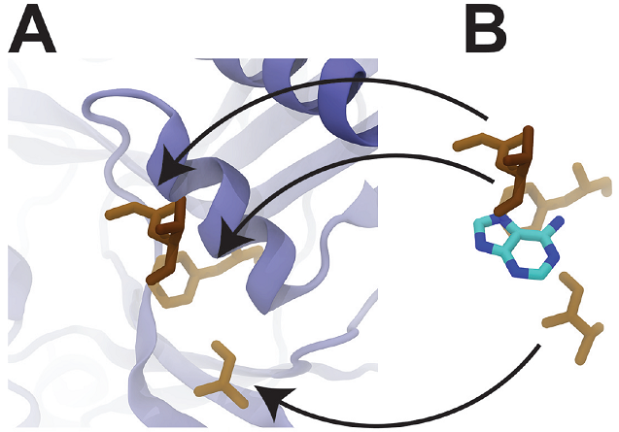
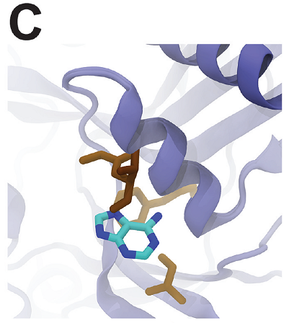
Screening the crystal microenvironments
For each active-site microenvironment, the matched microenvironments in the crystal
microenvironment library are found by screening. After that, the corresponding fragments
Of the matched microenvironment are deposited into the pocket.

Slide 12

Microenvironment screening
Six Filter
Residue identification(same or similar)
Geometric similar(span and fingerprint)
RMSD alignment(Alpha carbon)
Side-chain orientation
RMSD alignment(heavy atoms)
Clash fragment exclusion
These six steps for filtering the microenvironments
are most crucial and time-consuming for the program

Slide 13
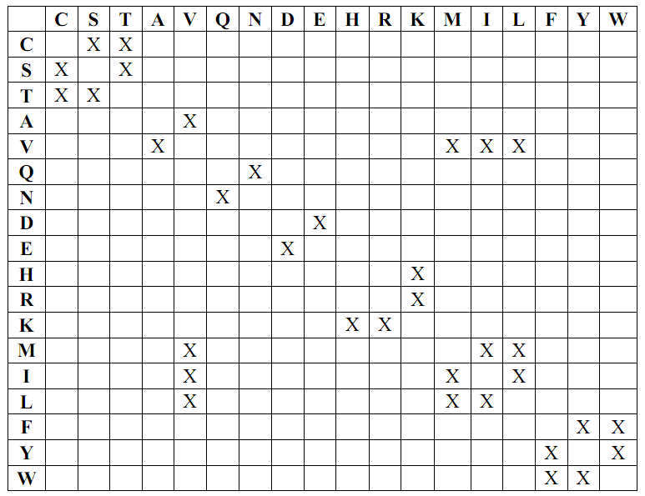
Residue identification
Residue chemical similarity
Only the microenvironments containing the identical or chemically similar residues to the target are used for further study. The similarity matrix above is based on BLOSUM62.

Slide 14
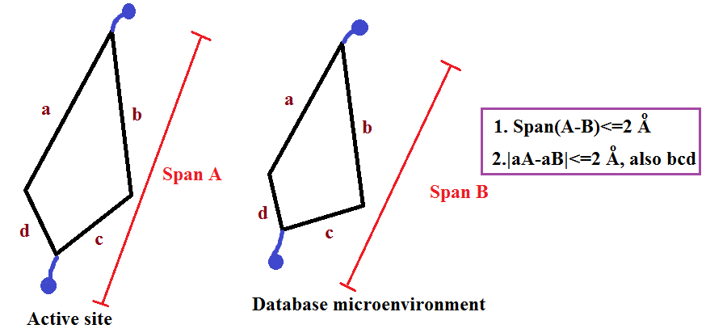
Geometric similar
To find the maximum distance between any two atoms(the span of the microenvironment) in the active-site microenvironments. The difference of maximum distance between target and database structures should less than 2Å
Difference of the distance in the sorted list of all the pairwise distances among all the alpha carbons between active-site and database microenvironments should less than 2Å
Cα
Cα
Cα
Cα
Geometric similar judgment could reduce computational intensive.

Slide 15
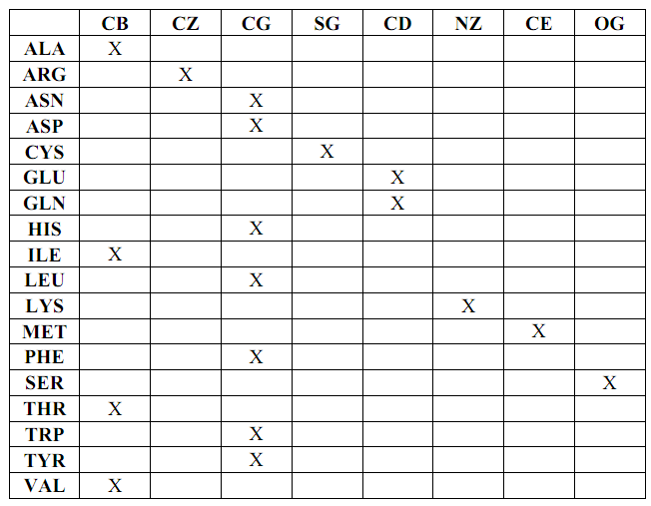
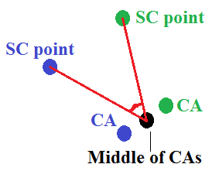
Side-chain orientation filter
After RMSD alignment of Cα, those RMSD larger than 2.5Å were discarded.
The side chain orientation were compared between two MEs. Angle of (sidechainA -- middle point of Cα -- sidechainB) larger than 100° was discarded.
Side-chain orientation filter
Selected sidechain point to determine the orientation of protein side chains

Slide 16
Further steps
RMSD alignment of heavy atoms(without those different atoms in similar residue)<1.5Å
Discard the fragments that within the distance <2Å to the active-side to avoid steric clash.
Identify and keep the non-redundant results(RMSD>=0.5 Å)
Crude ranking based on three principles:
1.same residues >similar residues;
2.Residues of microenvironment:5>4>3;
3.RMSD, the smaller, the better.

Slide 17
Application and Evaluation
Inﬂuenza neuraminidase(神经氨酸酶), a target with abundant ligand-bound structures (222 structures with ∼70 unique ligands in PDB)
Trypanosoma brucei RNA editing ligase 1 (TbREL1),a protein with only one PDB-deposited crystal structure bound to a single ligand (ATP)

Slide 18
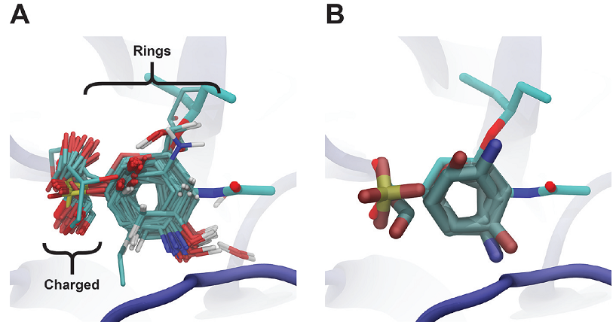
Results of inﬂuenza neuraminidase
Oseltamivir(达菲)
B with only selected positioned fragments shown for the sake of simplicity
A shows 95 distinct PDB structures representing 39 unique ligands. As expected, most of the identiﬁed ringed fragments were derived from known neuraminidase ligands and other experimental inhibitors. A single fragment was also obtained from pentaethylene glycol bound to D-lactate dehydrogenase conﬁrming that CrystalDock is able to identify binding fragments from even distantly related proteins. Interestingly, CrystalDock placed a sulfate ion near the location of the charged oseltamivir carboxylate group (Figure B),implying the potential structural modification method.

Slide 19
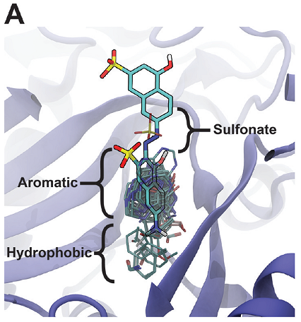
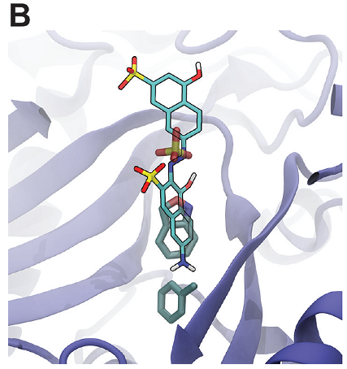
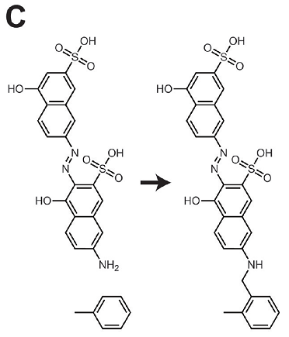
Suggested Modifications of a TbREL1 Naphthalene-Based Inhibitor
Docked pose of V2
V2
The CrystalDock-positioned fragments can be generally clustered into three groups. The third group, which is represented by several mostly hydrophobic fragments, does not correspond to any V2 substructure (lead compound), suggesting a possible route for improving potency. Toluene fragments derived from two unique inhibitors of P38 mitogen-activated protein kinases may be ideal for modification

Slide 20
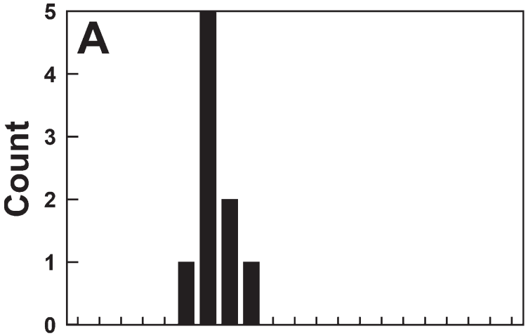
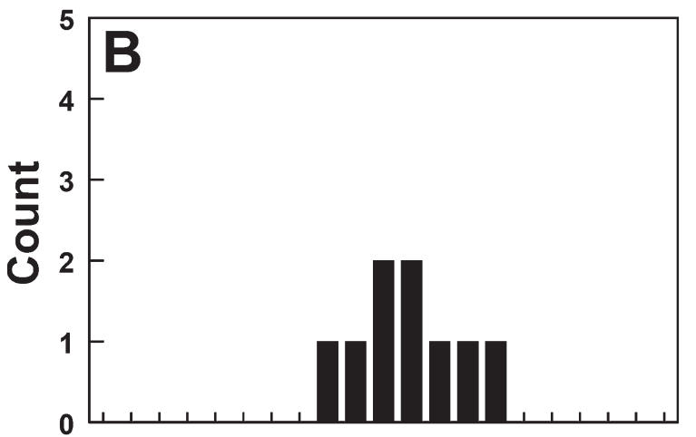

Further evaluation by IT-TI
V2
Modified V2
The ligand binding energies were predicted by Independent-trajectories thermodynamic integration (IT-TI).
Six TI runs were executed for each system: three in which the protein-bound ligand was annihilated, and three in which the solvated ligand was annihilated. From these six TI runs, nine binding-energy estimates were calculated. The predicted binding aﬃnity of V2 was -8.4 + 0.5 kcal/mol, which correlates well with the experimentally measured IC50 value of 1.53 μM.
The predicted binding energy of the new composite compound was -10.7 + 0.9 kcal/mol,
representing a 2.3 kcal/mol improvement

Slide 21
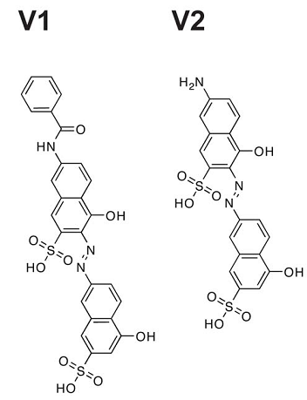
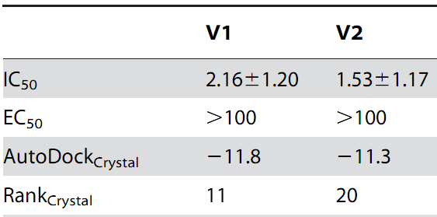
However…
In the previous study by the author, the compound V1, also containing the hydrophobic fragment and with better score in Autodock, shows worse activity.
PLoS Negl. Trop. Dis. 2010 4(8): e803

Slide 22
Shortcoming
Neglect the long-distance electrostatic interaction.
Only offer the possible fragments but not the contact molecules.
Though called as “dock”, it is Not suitable for high-throughput screening.
Lack of efficient scoring function.
Novel fragments which don’t exist in similar microenvironment but are valuable may be neglected.

Slide 23
Conclusion
CrystalDock is a new algorithm for fragment-based drug design based on the fragment- microenvironment information from known crystal complex structures from PDB.
It could be used for identification of the potential binding fragments, even further optimization of lead compounds.

Slide 24
Thank you!

Slide 25
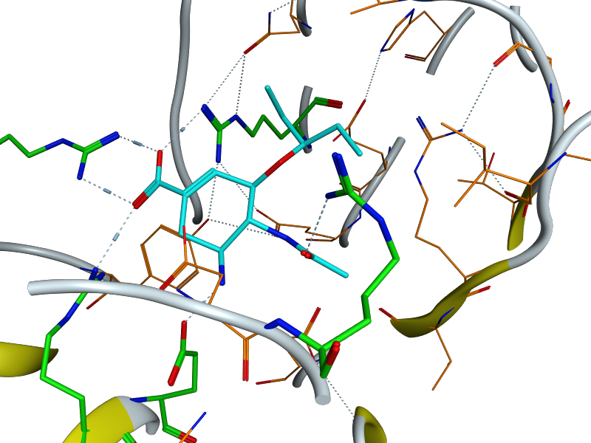
Carboxylate group in Oseltamivir

Slide 26
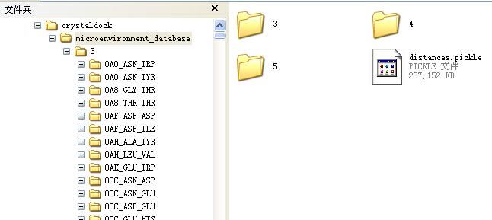
Fragment-Microenvironment database
3.5h in p380 when docking 2838 microenvironments for 13 residues in active-site(just consider the 3 residues microenvironments).

