Slide 1
SECURE WEB APPLICATION

Slide 2
INSTRUCTIONS FOR USE
Install JDK 14
https://www.oracle.com/java/technologies/javase-jdk14-downloads.html
For Windows:
a) Control Panel -> System -> Advanced -> Environment Variables
b) System Variables -> Path -> Add C:\Program Files\Java\jdk-14\bin\
c) System Variables -> New -> Name: JAVA_HOME
Path: C:\Program Files\Java\jdk-14\
For Linux:
a) sudo update-alternatives --config java
<number>

Slide 3
INSTRUCTIONS FOR USE
To Run:
Import the Maven Project in your favorite IDE like Intellij or Eclipse.
OR
Run using this command (cd to this directory): -> Use Ctrl+C to terminate
Windows:
.\maven\bin\mvn exec:java -Dexec.mainClass=org.secknight.secure_web_app.SecureWebAppApplication -e
Linux:
./maven/bin/mvn exec:java -Dexec.mainClass=org.secknight.secure_web_app.SecureWebAppApplication -e
<number>

Slide 4
INSTRUCTIONS FOR USE
To compile and build if you made changes:
Windows:
.\maven\bin\mvn compile
Linux:
./maven/bin/mvn compile
To update the Maven Dependencies use this command:
mvn versions:display-dependency-updates
(Then change the indicated versions in the pom.xml file)
<number>

Slide 5
WELCOME!
For an interactive tutorial on some of the most well known vulnerabilities and how you can protect from them, run the application and visit the website: https://127.0.0.1:8080/
Following you will find a guide to all of the Security Features implemented in this application
<number>

Slide 6
BEFORE WE GET STARTED...
Let’s see how some Spring Framework’s components work!!! We are using Spring Boot as it comes with predefined configurations and the Security module can be easily injected

Slide 7
DATABASE-COMPONENTS
Password Encoder
Encodes the retrieved password from the HttpServletRequest based on the hashing algorithm we have configured (eg.Bcrypt, Argon2)
DaoAuthenticationProvider.class
Retrieves user details from a
UserDetailsService and credentials from the HttpServletRequest. If they match, then the user is authenticated
DatabaseRepositories
(SQLiteUserDao.class)
Handles all queries that Fetch, or
Update entries in a chosen Database using the JDBC Template. Multiple databases can be configured
UserDetailsService.class
Loads User specific data and holds all Database Repositories
I
UserDetails.class
Holds the data stored for an Application User (eg, Username,
Authorities-Permissions and Password)
I

Slide 8
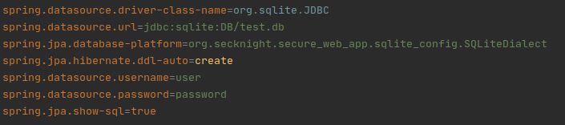
DATABASE-SQLite
We opted to use SQLite because of its portability but any database can be configured by replacing the Qualifier in the UserDetailService.class. However, because by default Spring Boot is not aware of the SQLite Dialect we need to define it ourselves. See classes in package sqlite_config
Database Configuration
(application.properties)

Slide 9
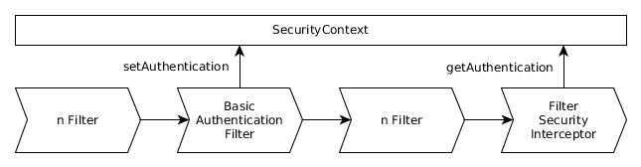
HTTP-REQUEST FILTER CHAIN BASE
Spring Security's web infrastructure is based entirely on standard servlet filters (HttpServletRequests and HttpServletResponses). It has no strong links to any particular web technology. Requests can come from a browser, a web service client, an HttpInvoker or an AJAX application. Spring Security maintains a filter chain internally where each of the filters has a particular responsibility and filters are added or removed from the configuration (FilterRegistrationBean) depending on which services are required. The ordering of the filters is important as there are dependencies between them.

Slide 10
SECURITY FEATURES IMPLEMENTED

Slide 11
1. AUTHENTICATION
We have implemented a Form-Based Authentication since its the most common method used by the majority of the web services.

Slide 12
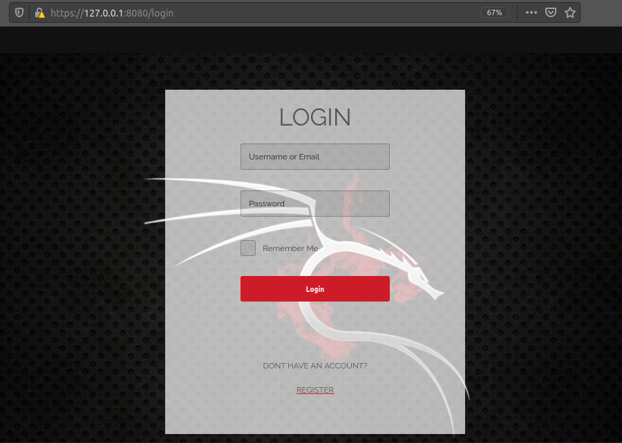
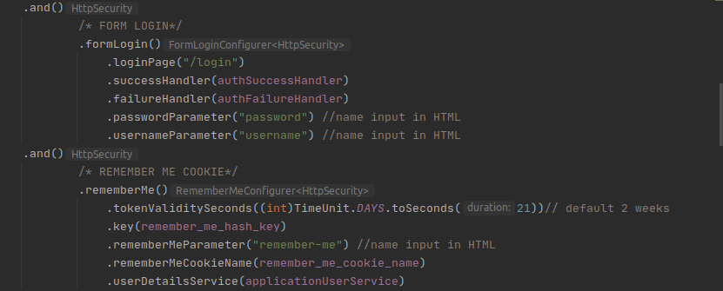
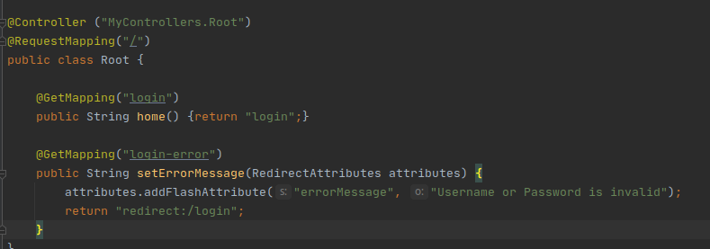
AUTHENTICATION
LOGIN COMPONENTS
The template (login.html)
3. The Config
(ApplicationSecurityConfig.class)
2. The Controller (Root.class)

Slide 13
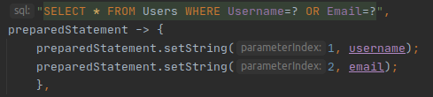
AUTHENTICATION
SQL INJECTION PROTECTION
All authentication related queries are implemented in SQLiteUserDao.class. To protect from SQL Injection attacks we use Prepared Statements. It is a feature where the query and the data are sent to the database server separately, hence there is no room for an attacker to compromise a dynamic query. See the related vulnerability in the website for more information.

Slide 14
AUTHENTICATION
TIMING/SIDE-CHANNEL ATTACKS
SEC-2056: CVE-2012-5055
The DaoAuthenticationProvider authenticates users by utilizing the PasswordEncoder interface to compare the submitted password with the actual password. If a user is not found, the comparison is skipped which, depending on the PasswordEncoder implementation, can result in a significant difference in the amount of time required to attempt to authenticate an actual user versus a user that does not exist. This opens up the possibility of a side channel attack that would enable a malicious user to determine if a username is valid (hence User Enumeration Vulnerability).

Slide 15

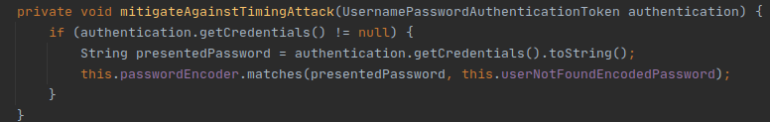
AUTHENTICATION
TIMING/SIDE-CHANNEL ATTACKS
SEC-2056: CVE-2012-5055
Protection: When a username is not found (retrieveUser) we perform the same procedure as it would be if successful but with a random password (“userNotFoundPassword”). Note that random Thread sleeps will not work in this case scenario as they can be normalized.

Slide 16
AUTHENTICATION
BRUTE FORCE LOGIN
A brute-force attack is an attempt to discover a password by systematically trying every possible combination of letters, numbers, and symbols until you discover the one correct combination that works. There are many ways to prevent such an attack but each of them has its benefits as well its disadvantages. For instance locking the account after a defined number of attempts, but an attacker could easily abuse the security measure and lock out hundreds of user accounts. We chose to demonstrate a block based on IP address instead.

Slide 17
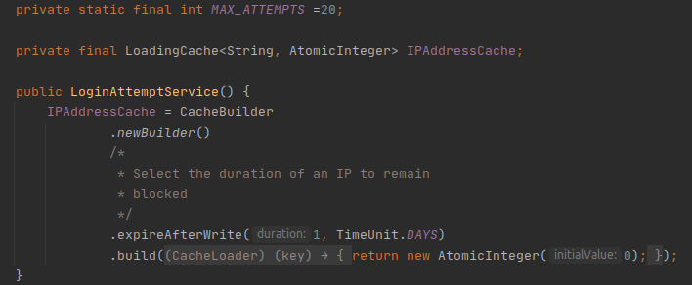
AUTHENTICATION
BRUTE FORCE LOGIN
The LoginAttemptService.class holds a cache with IP address and number of attempts made from that address. You can modify the maximum allowed attempts per IP address before it gets blocked, as well as the duration it remains blocked

Slide 18
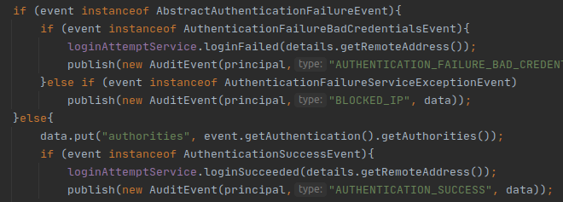
AUTHENTICATION
BRUTE FORCE LOGIN
In the AuthenticationListener.class we notify the service either to invalidate any attempts of an IP address in case of a Successful Authentication or increase the attempts in case of Authentication Failure.

Slide 19
AUTHENTICATION
BRUTE FORCE LOGIN
We have implemented two ways to achieve Login Attempt Block based on IP. Each of them has its pros and cons, thus chose based on your preference.

Slide 20
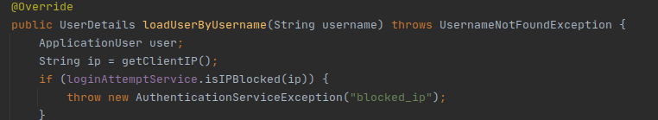
AUTHENTICATION
BRUTE FORCE LOGIN - 1st Method
In ApplicationUserDetailsService.class when the AuthenticationDaoProvider attempts to retrieve a User we check if the current IP address is blocked before we try to search the User in the Database. Hence, if it is blocked we throw an AuthenticationServiceException and display an error page (handled in AuthenticationFailureHandler.class)

Slide 21
AUTHENTICATION
BRUTE FORCE LOGIN - 1st Method
Pros: A user can invalidate all attempts on Authentication Success since they have access to the login page and all directories that do not require authentication
Cons: We do not block the request from the beginning thus our site still receives unnecessary traffic of a user still attempting to login if they are blocked

Slide 22
AUTHENTICATION
BRUTE FORCE LOGIN - 1st Method
Pros: A user can invalidate all attempts on Authentication Success since they have access to the login page and all directories that do not require authentication
Cons: We do not block the request from the beginning thus our site still receives unnecessary traffic of a user still attempting to login if they are blocked

Slide 23
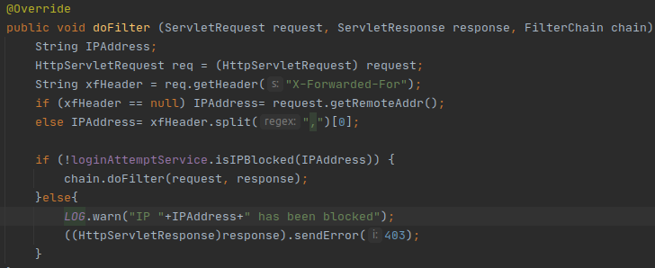
AUTHENTICATION
BRUTE FORCE LOGIN - 2nd Method
We have added a custom filter to the Spring Security’s filter chain (FilterRegistrationBean) which is registered in ApplicationSecurityConfig.class. The implementation of the filter is in LoginAttemptFilter.class. If the IP Address i blocked then the Filter is not chained and hence the user receives an Access Denied message for all requests.

Slide 24
AUTHENTICATION
BRUTE FORCE LOGIN - 2nd Method
Pros: Complete block on the website (not just the login functionality), every request receives an Access Denied Message.
Cons: The client has not access to the login page. Therefore they cannot invalidate the attempts on a successful authentication and wait for the entire duration until their IP is released.

Slide 25
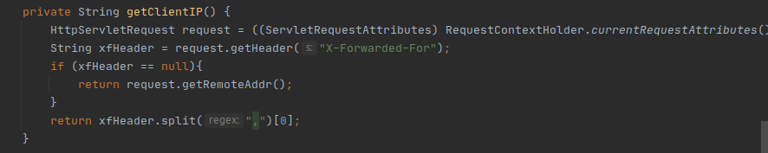
AUTHENTICATION
BRUTE FORCE LOGIN - PROXY
The drawback of those approaches is that they can still be abused to block all clients under an IP address. For instance if a whole organization resides to that IP address none of them will be able to access the site. To mitigate the issue at some extend when the IP address is retrieved we check for the X-Forwarded-For header and block the originated IP address instead.

Slide 26
AUTHENTICATION
PASSWORD ENCODING
As the majority of users will re-use passwords between different applications, it is important to store passwords in a way that prevents them from being obtained by an attacker, even if the application or database is compromised. Before we store the password upon registration we hash it and when a user logins we hash the password again and compare it with the stored one. We have implemented two hash algorithms and you can use any one depending on your server’s performance capacity. Both algorithms are salting the hash by default to prevent Rainbow Table Attacks. See PasswordEncoderConfig.class for more information.

Slide 27
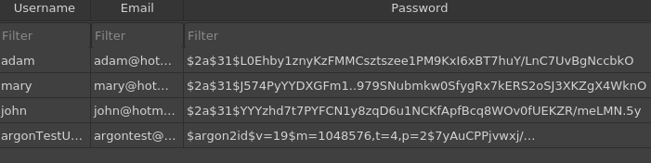
AUTHENTICATION
PASSWORD ENCODING
In the PasswordEncoderConfig.class switch from Bcrypt to Argon and test the last user. Note you will only be able to login with Users that have the encoded password match the preconfigured algorithm. It is recomended to decide beforehand which algorithm to chose. You can implement and support both algorithms until you force all users to switch to the other algorithm by expiring their passwords.

Slide 28
AUTHENTICATION
PASSWORD ENCODING - BCRYPT
BCrypt is the most widely supported of the algorithms and should be the default choice unless there are specific requirements for other algorithms. The default work factor for Bcrypt is 10 (we have set it to 12). By increasing the log rounds you will have a more secure hash however it will take longer to compute. Thus you want verification to take as long as you can stand. Also note that Bcrypt has a maximum password length of 72. That means ‘a’*72 and ‘a’*72 + ‘b’ will produce the same hash. Thus during registration we limit the password to maximum 64 chars (so we will not notify attackers we are using Bcrypt)

Slide 29
AUTHENTICATION
PASSWORD ENCODING - ARGON2
Argon2 is the winner of the 2015 Password Hashing Competition. There are three different versions of the algorithm. We use Argon2id variant which should be used where available, as it provides a balanced approach to resisting both side channel and GPU-based attacks. Rather than a simple work factor like other algorithms, Argon2 has three different parameters that can be configured, meaning that it's more complicated to correctly tune for the environment. It is recommended to test your system’s capabilities and benchmark the times needed for each Argon’s configurations.

Slide 30
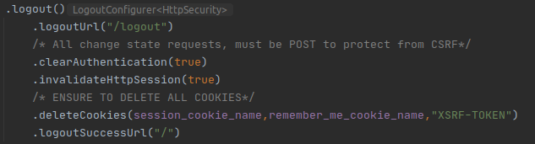
AUTHENTICATION
LOGOUT CONFIGURATIONS
It is important that all change-state requests are type POST since as we will see later Spring appends by default a CSRF token to all POST requests. If the logout link is a GET type an exception will be thrown. Moreover we need to ensure that all cookies are removed on logout and current session is invalidated. Hence when another user attempts to login on the same device they cannot login as the previous user. See ApplicationSecurityConfig.class for more information

Slide 31
AUTHENTICATION
INPUT/FIELD VALIDATION
Input validation is performed to ensure only properly formed data is entering the workflow of our web application. The data we collect must be sanitized and follow the application’s logic structure. In addition for specific inputs such as in Registration procedures, must meed the organization's policy requirements.
Supported input methods:
@Model Attribute: binds a method parameter or method return value to a named model attribute and then exposes it to a web view. Retrieves data from a form submission for instance.
@RequestBody: Retrieves the request body
@RequestParam: Retrieves input from query parameters

Slide 32
AUTHENTICATION
INPUT/FIELD VALIDATION - DEFAULTS
As Spring Framework is based in Java, it offers Data Type (Integer,String etc) validation by default. In addition Thymeleaf (Java Server-Side Template Engine) maps input from a form submission to an object, and if the Data Types do not match throws an exception.
Each request made to the server can be constricted to a set of Content-Types, where if it does not match a BadMethodRequest is thrown. See the “consumes” variable above the annottated requests .
All ModelAttributes must be accompanied by a BindingResult parameter that retrieves any errors and exceptions related to that attribute.

Slide 33
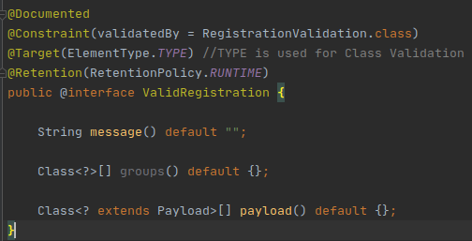

AUTHENTICATION
SPRING VALIDATORS
Spring Framework also offers standard predefined validations in form of annotations. Validations are assigned per field (ElementType.FIELD) or to a whole class (ElementType.TYPE). To create a custom Validator we need to implement an annotated interface that describes the constraints.

Slide 34
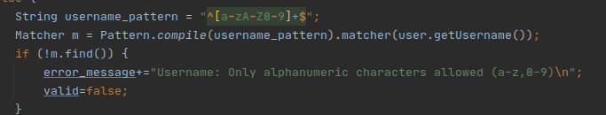
AUTHENTICATION
SPRING VALIDATORS
In RegistrationValidation.class we describe our constraints for the object RegUser. Input validation should be applied on both Syntactic and Semantic level. For instance Username constraint after ensures that the value is not empty or null restricts the input to only alphanumeric characters (change according to the policy of your organization).

Slide 35
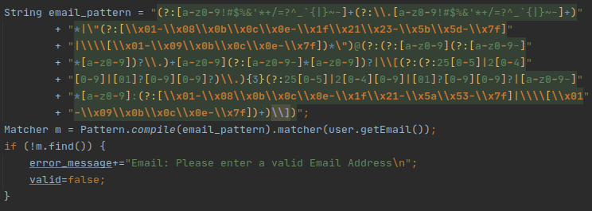
AUTHENTICATION
SPRING VALIDATORS
The same strategies can be applied for email addresses. Here we used a pattern that has 99.9% chance to recognize a valid email address.

Slide 36
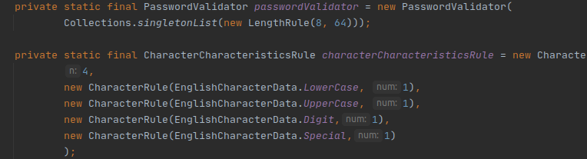
AUTHENTICATION
PASSWORD ENFORCING
A key concern when using passwords for authentication is password strength. A "strong" password policy makes it difficult or even improbable for one to guess the password through either manual or automated means.

Slide 37
AUTHENTICATION
PASSWORD ENFORCING
According to NIST SP800-63B, passwords should be at least 8 characters. The upper limit is set based on the hashing algorithm we will be using. As we mentioned earlier Bcrypt max password length is 72. Additionally, due to how computationally expensive modern hashing functions are, if a user can supply very long passwords then there is a potential denial of service vulnerability, such as the one published in Django in 2013. Finally we can enforce Character Rules as well. For a more advanced password checker see zxcvbn library

Slide 38
2. AUTHORIZATION
Authorization is the process where requests to access a particular resource should be granted or denied. We demonstrate a one to many access control scheme. A User can have many Roles. A Role can have many Permissions. Inherently to give a User a new Permission, firstly a new Role must be created.

Slide 39
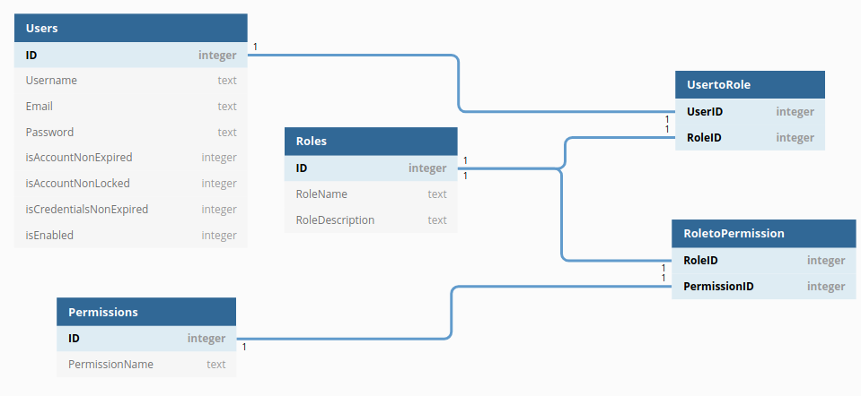
DATABASE-STRUCTURE

Slide 40
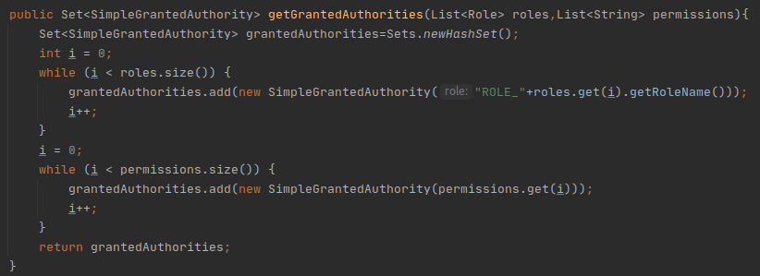
AUTHORIZATION
RETRIEVE AUTHORITIES FROM DB
The authorities of a User are stored as a Set<SimpleGrantedAuthority>
in our UserDetails.class object after they have been retrieved from the Database. Notice that we append the prefix ROLE_ in front of every Role in order for Spring Framework to distinguish them from the permissions.

Slide 41
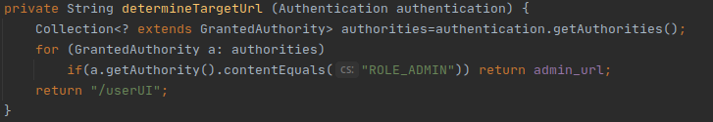
AUTHORIZATION
AUTHENTICATION REDIRECTION
Upon successful authentication in AuthenticationSuccessHandler.class we check the authorities of the current User to redirect them to the proper Interface. For demonstration purposes Users with Role ADMIN are redirected to the AdminUI, while all others to the UserUI.

Slide 42
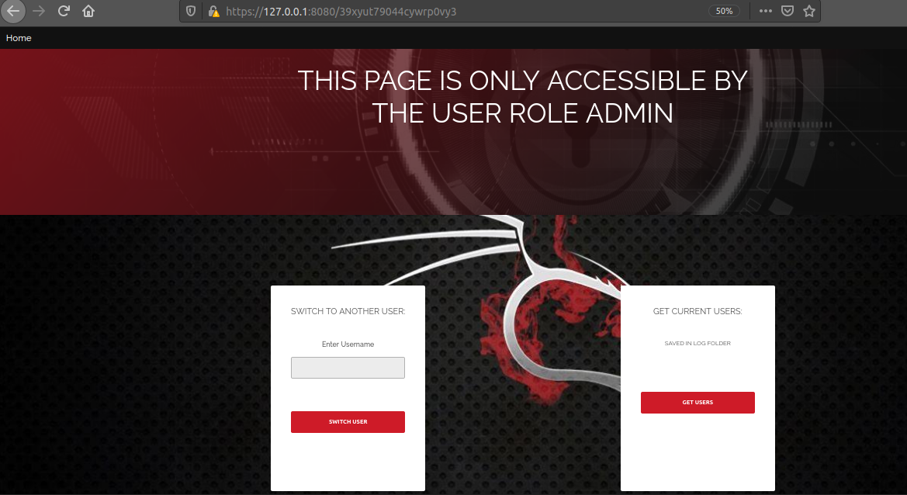
AUTHORIZATION
ADMIN INTERFACE
We are using a random generated string for the Admin URL directory (stored in application.properties). This feature is not considered a security protection. The reason we apply it is just to hide it from tools like dirbuster which attempt to map our website. It is also recommended to create an additional random login directory where only the admin can login.
Username: adam
Password: password1

Slide 43
AUTHORIZATION
ADMIN INTERFACE - SWITCH USER
We added a SwitchUser functionality to the Admin Interface. The reason is an Admin holds complete access to the website, but what happens when we try to access a functionality that involves 3rd party software like sending an email? The admin will be exposed and vulnerabilities may present themselves. Therefore since we do not know user’s passwords (hashed) with this functionality by providing a valid username from the database we can switch to that user. Meaning we will have only their permissions. In addition Spring Security by default adds a new role ROLE_PREVIOUS_ADMINISTRATOR to the impersonated user.

Slide 44
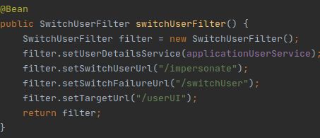
AUTHORIZATION
ADMIN INTERFACE - SWITCH USER
The configuration is described in ApplicationSecurityConfig.class. In the AdminUI.class we just define the Switch object and redirect from the failed url (/switchUser) to the same site with the error message that the target user has not been found. It is important that this functionality is only accessible by the admin.

Slide 45
AUTHORIZATION
USER INTERFACE
This Interface is the home interface for all other Users except Admins. Here we demonstrate some access control options which can be applied to restrict requests based on the User’s Roles and Permissions. To enable this feature we add the annotation @EnableGlobalMethodSecurity(prePostEnabled = true) in the ApplicationSecurityConfig.class.

Slide 46
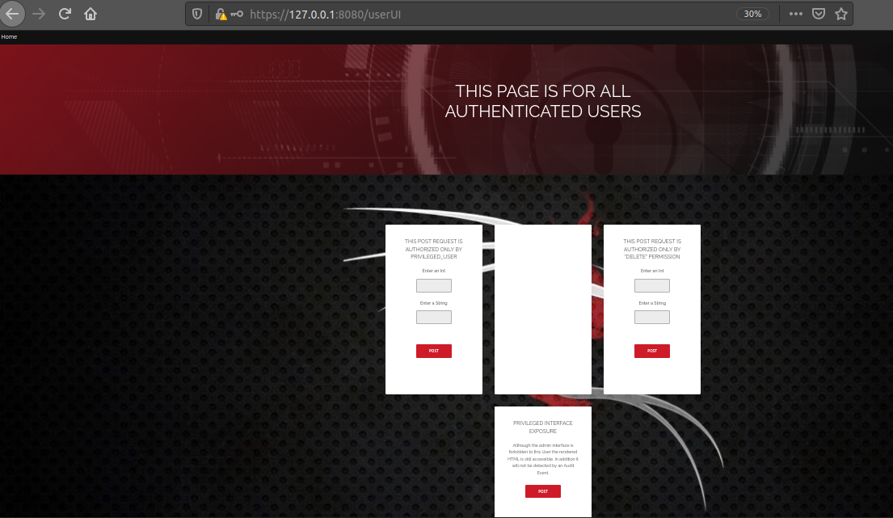
AUTHORIZATION
USER INTERFACE
We can add the annotation @PreAuthorize() above each request to restrict access based on authorities. We use hasAnyRoles for Roles and hasAnyPermissions for Permissions.
Username: john
Pass: password3
Role: PRIVILEDGED_USER
Username: mary
Pass: password2
Role:
SQL_EDITOR
Permissions: create,update,delete

Slide 47
AUTHORIZATION
ACCESS CONTROL - PRIVILEGED INFORMATION EXPOSURE
Although the Admin page is restricted to only the Role Admin, the actual HTML page can still be rendered thus exposing information which otherwise should be accessible by normal users. This vulnerability can occur only by a developer’s mistake by returning the wrong HTML page in a request. We demonstrate this scenario in the User Interface.

Slide 48
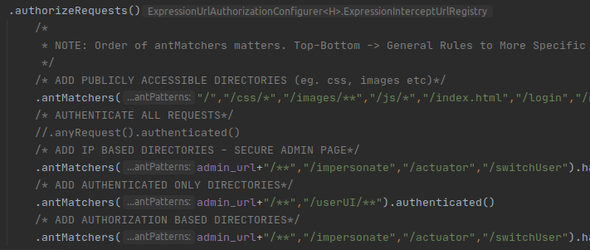
AUTHORIZATION
ACCESS CONTROL CONFIGURATIONS
In ApplicationSecurityConfig.class we define the access control policy for our web app URL directories. We use antMatchers to match the directories names and add permissions to each set. It is important to know that the order of the antMatchers matters. We define firstly rules that are general and gradually we define more strict rules.

Slide 49
AUTHORIZATION
ACCESS CONTROL CONFIGURATIONS
Define publicly accessible directories such as resources (css,js,images) and root directory
Allow access to Admin UI and Switch functionality only from certain IP addresses that we trust and only the Admin can access them. Please note that IP addresses can be spoofed. In case of the Switch functionality, otherwise a normal user can switch to any other user which is a very serious vulnerability.
The User Interfaces are only accessible by authenticated users.

Slide 50
3. AUDITING & LOGGING
It is vital for an application to monitor and log all points where a secure request is made. Therefore, when a security breach has been made Security Analysts can determine the root cause of the problem and also its impact (eg data loss, leaked or corrupted)

Slide 51
AUDIT & LOGGING
LISTENERS & AUDIT MANAGER
We record the most important Authentication and Authorization Events and then publish them to be handled by the AuditManager.class:
AuthenticationListener.class:
AuthenticationFailure (Incorrect Credentials)
AuthenticationSuccess & LogoutSuccess (Monitor when users are logged in and when the logged out)
SwitchUser (Monitor when a User switches to another user)
BlockedIP (IP gets blocked by multiple failed login attempts)
AuthorizationListener.class:
AuthorizationFailure (Monitor when a user attempts to access a resource or URL directory and they do not have the required permissions)

Slide 52
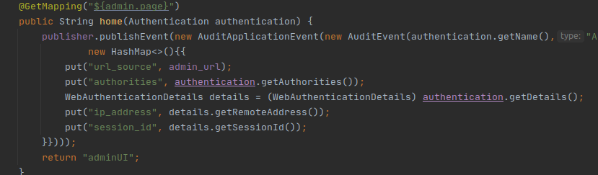
AUDIT & LOGGING
LISTENERS & AUDIT MANAGER
In addition we monitor authorization access to the Admin Interface since it is the most vital directory of our web application. The publisher is located in the AdminUI.class. We can create similar implementations to monitor other important resources.

Slide 53
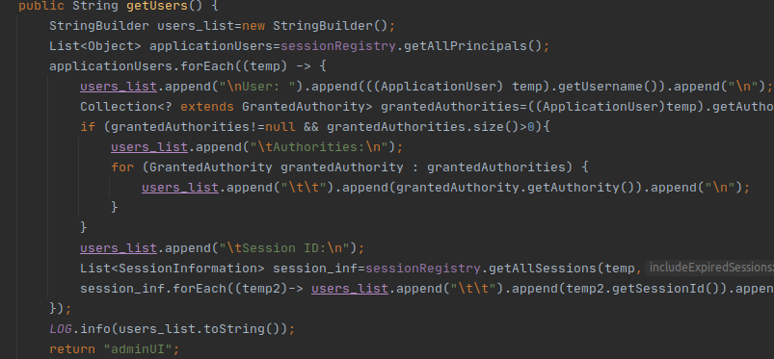
AUDIT & LOGGING
LISTENERS & AUDIT MANAGER
We also log which users are currently logged in so we can monitor any traffic conjunctions to our web application. This feature is implemented in the AdminUI.class as only the Admin must be able to access to this information.

Slide 54
AUDIT & LOGGING
LOGGER
For the logger implementation we use the log4j2 which can be configured with the log4j2-spring.xml (located in resources). It is important to distinguish and separate our log entries. Because at some point our log entries will be too many to be analyzed by hand and an automated Analyzer will be needed. For instance all audit events have a log file of their own under log/audit folder. Also we compress old log files according to the date to handle their exponential growth.

Slide 55
4. SESSION MANAGEMENT
A web session is a sequence of network HTTP request and response transactions associated to the same user. Our application provides session capabilities for both pre and post authentication. Once an authenticated session has been established, the session ID (or token) is temporarily equivalent to the strongest authentication method used by the application. Utilizing the session we apply all our access controls equivalent to the current user’s permissions

Slide 56
SESSION MANAGEMENT
SESSION VULNERABILITIES
The disclosure, capture, prediction, brute force, or fixation of the session ID will lead to session hijacking (or sidejacking) attacks, where an attacker is able to fully impersonate a victim user in the web application. Attackers can perform two types of session hijacking attacks, targeted or generic. In a targeted attack, the attacker's goal is to impersonate a specific (or privileged) web application victim user. For generic attacks, the attacker's goal is to impersonate (or get access as) any valid or legitimate user in the web application. In certain cases, session fixation can be achieved remotely, which bypasses the hurdle of using a shared computer to complete the attack.

Slide 57
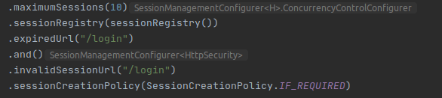
SESSION MANAGEMENT
SESSION MANAGEMENT
The session management implementation defines the exchange mechanism that will be used between the user and the web application to share and continuously exchange the session ID. The configurations are defined in ApplicationSecurityConfig.class

Slide 58
SESSION MANAGEMENT
SESSION MANAGEMENT - SESSION FIXATION PROTECTION
We need to limit the number of active sessions per user so we can implement a session registry. The registry allows us to control and expire inactive sessions. Therefore we can protect users who forgot to logout from public devices and therefore prevent authentication theft. To protect from session fixation each time a user authenticates themselves the session cookie changes. See the IF_REQUIRED setting above. Alternatively if we implement a Rest API sessions must be stateless and we need to set that setting to none.

Slide 59
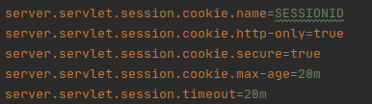
SESSION MANAGEMENT
SESSION COOKIE CONFIGURATIONS
All session cookie configurations are defined in application.properties

Slide 60
SESSION MANAGEMENT
SESSION COOKIE CONFIGURATIONS – ID & EXPIRATION
Spring Framework uses Jakarta EE (J2EE) which by default assigns the name JSESSIONID to the session cookie name. It is recommended to change the default to something more generic to avoid fingerprinting. In addition here we define the timeout/max-age duration of a session in case of inactivity. It is important to define this to avoid account theft when a user forgets to logout from a publicly accessible computer or device.

Slide 61
SESSION MANAGEMENT
SESSION COOKIE CONFIGURATIONS - SECURE
The Secure cookie attribute instructs web browsers to only send the cookie through an encrypted HTTPS (SSL/TLS) connection. This session protection mechanism is mandatory to prevent the disclosure of the session ID through MitM (Man-in-the-Middle) attacks.

Slide 62
SESSION MANAGEMENT
SESSION COOKIE CONFIGURATIONS - HTTPONLY
The HttpOnly cookie attribute instructs web browsers not to allow scripts (e.g. JavaScript or VBscript) an ability to access the cookies via the DOM document.cookie object. This session ID protection is mandatory to prevent session ID stealing through XSS attacks.

Slide 63
SESSION MANAGEMENT
SESSION COOKIE CONFIGURATIONS - SAMESITE
SameSite allows a server define a cookie attribute making it impossible to the browser send this cookie along with cross-site requests. The main goal is mitigate the risk of cross-origin information leakage, and provides some protection against cross-site request forgery attacks.
It takes three possible values: Strict, Lax, and None. With Strict, the cookie is sent only to the same site as the one that originated it; Lax is similar, with an exception for when the user navigates to a URL from an external site, such as by following a link; None has no restrictions on cross-site requests.

Slide 64
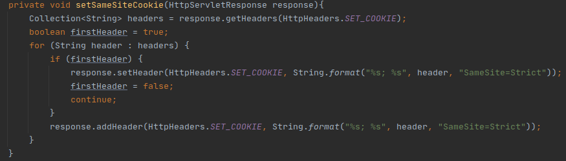
SESSION MANAGEMENT
SESSION COOKIE CONFIGURATIONS - SAMESITE
Due we cannot configure SameSite attribute through application.properties (not yet supported) we apply it to all cookies after a successful authentication. See AuthenticationSuccessHandler.class.

Slide 65
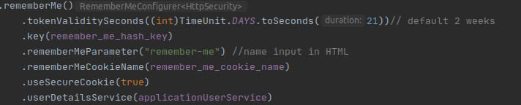
SESSION MANAGEMENT
REMEMBER-ME COOKIE CONFIGURATIONS
Remember-Me Cookie allows a user to remain connected to our web application even if they close the browser (Session Cookies are deleted). See ApplicationSecurityConfig.class. The most important part is the hash key used to encode the cookie. If it is too small or can be exposed then an attacker can infer the user’s credentials. We keep this value in application.properties (must be encrypted) to avoid hard coded passwords in our application.

Slide 66
5. CROSS-SITE REQUEST FORGERY

Slide 67
CROSS-SITE REQUEST FORGERY
VULNERABILITY
Cross-Site Request Forgery (CSRF) is an attack where with a little social engineering help (like sending a link via email or chat), an attacker may force the authenticated users of a web application to execute unintended actions of the attacker’s choosing. A successful CSRF exploit can compromise end user data and operation when it targets a normal user (eg. Make a bank transaction on user’s behalf to the attacker’s account). If the targeted end user is the administrator account, a CSRF attack can compromise the entire web application.

Slide 68

CROSS-SITE REQUEST FORGERY
PROTECTION
Thymeleaf adds a hidden csrf token in every form submission and changes per session. In essence all changing state requests like POST require this token, otherwise an Access Denied exception will be thrown. An attacker cannot possible know this value for a specific user since it is unique per user session, secret and unpredictable (large random value generated by a secure method).

Slide 69
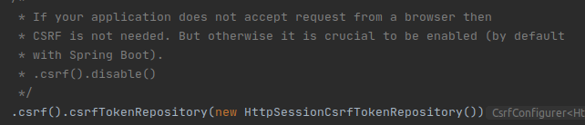
CROSS-SITE REQUEST FORGERY
PROTECTION
We have configured CSRF token to be validated using the request body which is translated to the Header X-CSRF-Header. Although there is an option to store the CSRF token in a cookie, it is not recommended as they are more vulnerable and more prone to be stolen by an attacker. For our REST API ( XXE vulnerability) we retrieve the token in the HTML metadata and then we use an AJAX call to send it directly to the appropriate Header

Slide 70
5. SECURE SOCKET LAYER

Slide 71
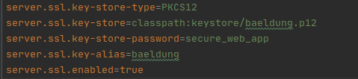
SECURE SOCKET LAYER
CONFIGURATION
We have created a self-signed certificate to demonstrate the transport layer protection. All traffic is redirected only through HTTPS, which means it is encrypted and a Man in the MIddle attack is no longer possible. In addition now all cookies can use the Secure attribute so they cannot be transmitted unencrypted (HTTP). Instructions to generate your own certificate are included in the keystore directory.

Slide 72
6. FIREWALL

Slide 73
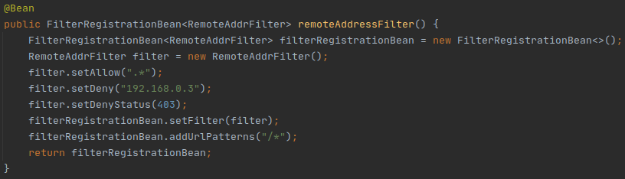
FIREWALL
CONFIGURATION
We have implemented an in-application firewall where you can block undesired IP addresses or accept only from a range. See ApplicationSecurityConfig.class for more information.

