Slide 1

Best Fuel
Dave Knight
Anthony Reed
Yufei Su
Kyle Platt

Slide 2

Features
Planning, navigating and finding gas stations
Manage multiple vehicle profiles
Use planned routes or use current location
Records used stations and prices

Slide 3
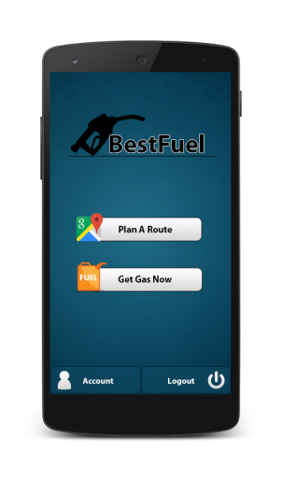

User Scenarios
Scenario 1: at home
Scenario 2: on the road

Slide 4
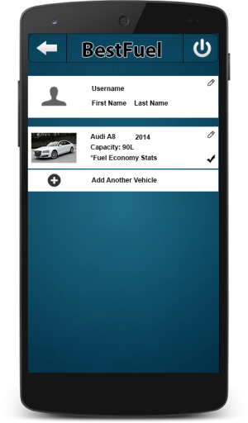
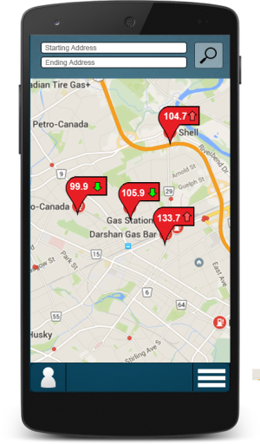

User Interfaces

Slide 5

Challenges
Scalability
Initial Limitations
Privacy
Efficiency
Adaptability

