Slide 1
TEAM 16
Intent-Based SDN
for 5G SLA Enforcement
Declarative network service assurance on a virtual transport network
ST-1 to ST-6 complete
6 of 14 subtasks
ST-7 next
01
Notes:
Introduce the project as a deterministic SDN reference implementation. State that six subtasks are complete and that ST-7, the live control-loop connection, remains next. Avoid describing this as a complete 5G network or a production deployment.
Sources: Verified handoff facts; README.md Status; docs/HANDOVER.md

Slide 2
MOTIVATION
Problem Statement
Limitations of device-level, open-loop network control
01
Manual configuration
Engineers must map ports and install compatible flow rules on every switch along a path.
02
Different SLA requirements
Applications require different bandwidth, latency and packet-loss limits.
03
Static path selection
Fixed routes cannot respond when congestion or link failures invalidate the selected path.
04
No delivery assurance
Installed rules confirm configuration, but they do not prove that the SLA is being delivered.
05
Slow fault recovery
Open-loop networks depend on human monitoring and manual rerouting after an SLA violation.
Intent-Based SDN for 5G SLA Enforcement
02
Notes:
Present the five engineering problems directly. Manual device configuration is difficult to scale, traffic classes need different SLA limits, static paths become invalid as conditions change, configuration does not prove delivery, and open-loop recovery depends on a human operator.
Sources: docs/build_complete_project_guide.py, Section 3; README.md

Slide 3
SOLUTION 1 OF 2
Solution
ST-1 to ST-7 establish and connect the intent-based control pipeline
✓ 6 complete
◐ 1 partial
✓
ST-1
Foundation
Pin the Docker stack, freeze the intent schema and validate submitted intents.
✓
ST-2
Network model
Build the seven-switch Mininet topology, three routes and baseline tests.
✓
ST-3
Shared interfaces
Define common models, the event bus, SQLite persistence and audit records.
✓
ST-4
Intent processing
Expose the REST API and select feasible paths with deterministic pruning.
✓
ST-5
Enforcement
Install OpenFlow 1.3 rules and configure OVS HTB bandwidth queues.
✓
ST-6
Telemetry
Collect probes and counters, persist samples and detect stable SLA violations.
◐
ST-7
Closed-loop recovery
Connect violation events to path recomputation and live rerouting.
Intent-Based SDN for 5G SLA Enforcement
03
Notes:
Explain the first half of the fourteen-subtask solution. ST-1 through ST-6 are complete. ST-7 has a unit-tested ControlLoop, but live event persistence, publication and rerouting are not connected, so ST-7 remains partial.
Sources: README.md Status; docs/HANDOFF_PROMPT.md status table; docs/build_complete_project_guide.py Section 22

Slide 4
SOLUTION 2 OF 2
Solution
ST-8 to ST-14 complete resource control, safe updates, evaluation and delivery
6 of 14 complete
8 unfinished
○
ST-8
Admission control
Check residual capacity before accepting a new SLA.
○
ST-9
Preemption and tuning
Prioritize critical intents and evaluate damping against route oscillation.
○
ST-10
Two-phase updates
Install a new path safely before removing the previous forwarding rules.
○
ST-11
Dashboard and audit
Show topology state, SLA status and the causal event history.
○
ST-12
Evaluation phase one
Run repeated baseline experiments and capture comparable measurements.
○
ST-13
Evaluation phase two
Calculate confidence intervals and generate the final evaluation figures.
○
ST-14
Final delivery
Complete the report, demonstration and submission package.
Intent-Based SDN for 5G SLA Enforcement
04
Notes:
Explain the second half of the solution plan. ST-8 through ST-14 have not started. Together they add admission control, preemption, safe two-phase updates, the operator dashboard, repeatable evaluation and the final project delivery. Across all fourteen subtasks, six are complete, ST-7 is partial and seven are unstarted.
Sources: docs/HANDOFF_PROMPT.md status and roadmap; docs/build_complete_project_guide.py Section 22; docs/build_report.py remaining work

Slide 5
APPROACH
Declarative intent-based networking
Six implemented stages compile and verify a service promise; automatic correction remains next
1
2
3
4
5
6
7
Intent
›
Validate
›
Compute
›
Enforce
›
Measure
›
Detect
›
Correct
YAML promise
Schema + rules
Candidate paths
Flows + queue
Live telemetry
Stable breach
Live reroute
Implemented and live-verified through detection
ST-7 integration incomplete
The current system detects a violation. It does not yet deliver that event to the live rerouting process.
Intent-Based SDN for 5G SLA Enforcement
05
Notes:
Walk left to right. The first six stages operate. The seventh stage has a tested ControlLoop class, but the live telemetry process does not persist or publish its event, so automatic rerouting does not occur.
Sources: README.md Status; src/telemetry/runtime.py; src/telemetry/loop.py

Slide 6
CONFIGURATION
Technology choices and selection rationale
Pinned versions reproduce the virtual SDN stack and preserve Ryu compatibility
Layer | Choice | Role in the system | Selection rationale
Container | Ubuntu 22.04 | Linux network environment | Provides Linux networking for Mininet and Open vSwitch.
Runtime | Python 3.9.25 | Runs project services | Compatible with Ryu 4.34 and legacy eventlet.
Controller | Ryu 4.34 | Programs OVS switches | Python controller with OpenFlow 1.3 support.
Network | Mininet 2.3.1b4 | Creates the virtual topology | Runs the complete test network on one machine.
Switch | Open vSwitch 2.17 | Provides the OpenFlow data plane | Works with Mininet, Ryu and OpenFlow 1.3.
REST API | FastAPI 0.95.2 | Exposes the intent interface | Typed HTTP API that is straightforward to test.
Graph | NetworkX 2.8.8 | Computes candidate paths | Uses tested path algorithms instead of custom graph code.
Intent-Based SDN for 5G SLA Enforcement
06
Notes:
Explain both what each technology does and why the project selected it. Python 3.9 preserves compatibility with Ryu's legacy eventlet chain. Ubuntu in Docker supplies the Linux networking features required by Mininet and Open vSwitch while keeping the experiment reproducible on the Windows host.
Sources: Dockerfile; requirements.txt; docs/decisions.md ADR-001

Slide 7
CONFIGURATION
Network topology and route characteristics
Seven switches, eight hosts and one Ryu controller expose three unequal link-disjoint routes
Route | Path | Bottleneck | One-way | Round trip
Northern | s1 - s2 - s3 - s7 | 100 Mbps | 6 ms | 12 ms
Middle | s1 - s4 - s5 - s7 | 50 Mbps | 15 ms | 30 ms
Southern | s1 - s6 - s7 | 40 Mbps | 24 ms | 48 ms
7
8
3
Why three routes?
One route leaves nowhere to recover. Two routes force the only remaining path after a failure. Three preserve a real planning choice.
switches
hosts
disjoint routes
Bottleneck = narrowest link. Route delay = sum of link delays. Host access links carry no imposed budget.
Intent-Based SDN for 5G SLA Enforcement
07
Notes:
Describe the northern route as fast and wide, the middle route as moderate, and the southern route as slow. The routes share no switch-to-switch links. Their unequal budgets let the project prove that constraints change the selected route.
Sources: topology/topology_spec.py; docs/architecture.md; tests/test_topology.py
Verified architecture count: one Ryu controller (c0) controls the seven Open vSwitch instances in the live scenario.

Slide 8
DATA FLOW
End-to-end processing pipeline
Each module owns a distinct stage; the dashed feedback path remains unfinished
INPUT
VALIDATION
PATH COMPUTATION
ENFORCEMENT
NETWORK
TELEMETRY
DETECTION
YAML intent
Schema + rules
Yen + pruning
Flows + HTB
Mininet / OVS
Probes + counters
Stable breach
M1
M1
M3
M4
Datapath
M5
M5
Violation event returns to path computation
not implemented (ST-7)
Intent-Based SDN for 5G SLA Enforcement
08
Notes:
Follow the main pipeline from input to detection. M2 admission is intentionally absent because it has not been implemented. The dashed return path represents ST-7: the event should trigger a new path computation, but the live runtime does not publish it.
Sources: README.md architecture; src/telemetry/runtime.py; src/telemetry/loop.py

Slide 9
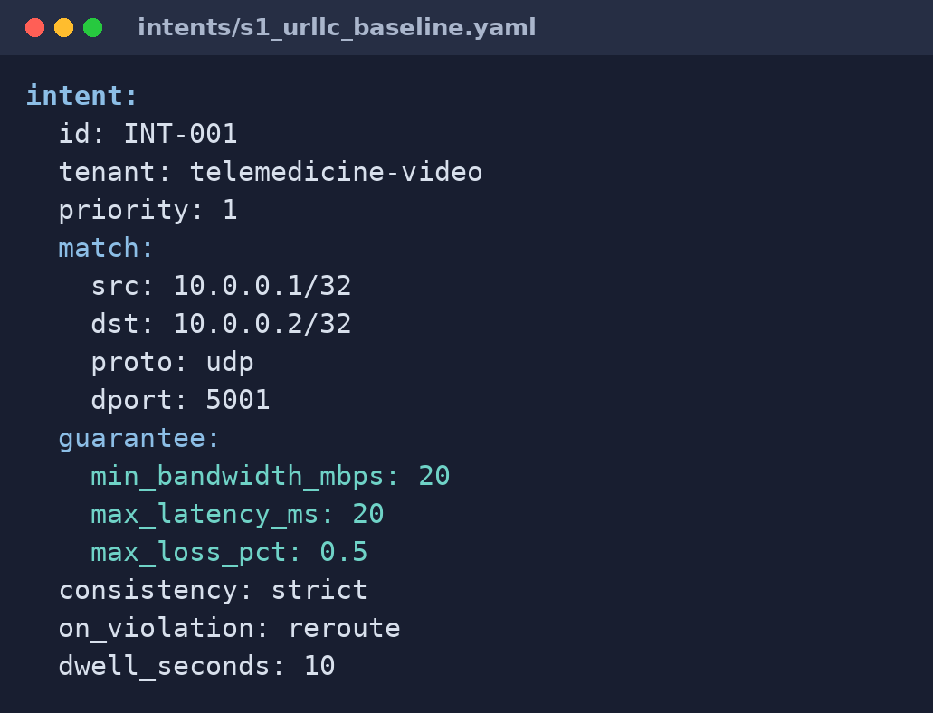
INPUT
The intent specification
INT-001 describes traffic identity, service guarantees and violation policy
VERBATIM REPOSITORY INPUT
Command: type intents\s1_urllc_baseline.yaml
Field | Meaning
match | h1 to h2, UDP port 5001
/32 | one exact IPv4 address
guarantee | 20 Mbps, 20 ms, 0.5% loss
priority 1 | highest service priority
dwell_seconds | wait 10 s before another replan
# Scenario S1 - single URLLC intent on an idle network.
# Exercises M1, M3, M4 happy path. Expected: path installed,
# SLA green, baseline latency recorded.
intent:
id: INT-001
tenant: telemedicine-video
priority: 1
match:
src: 10.0.0.1/32
dst: 10.0.0.2/32
proto: udp
dport: 5001
guarantee:
min_bandwidth_mbps: 20
max_latency_ms: 20
max_loss_pct: 0.5
consistency: strict
on_violation: reroute
dwell_seconds: 10
Strict mode requests a two-phase update, but that mechanism remains ST-10 work.
Intent-Based SDN for 5G SLA Enforcement
09
Notes:
Explain the intent line by line. The tenant is a service label, not a protocol. /32 identifies one exact IPv4 host. The match identifies packets, the guarantee states the requested SLA, and the final fields state the requested violation policy.
Verified source: intents/s1_urllc_baseline.yaml, read with Windows Command Prompt.

Slide 10
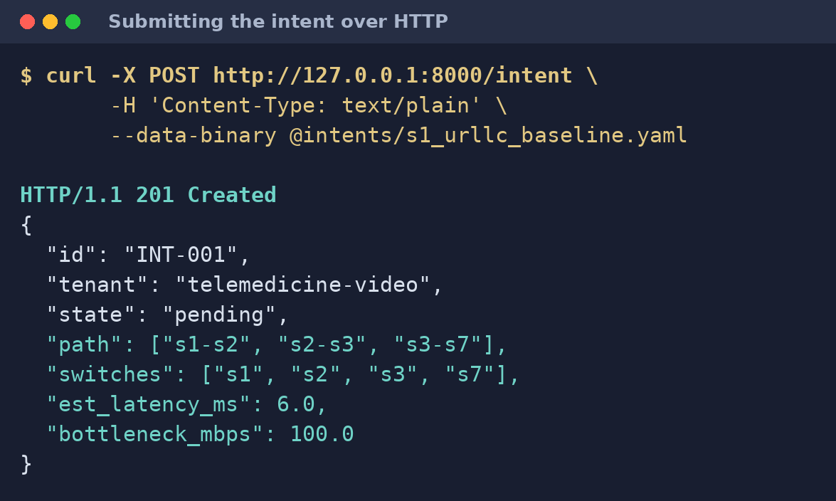
INPUT
Intent submission and acceptance
The REST API returns the selected route and its expected service characteristics
VERBATIM API RESPONSE
HTTP 201 CREATED
Captured from the real FastAPI POST /intent run
HTTP/1.1 201 Created
content-type: application/json
{
"id": "INT-001",
"tenant": "telemedicine-video",
"priority": 1,
"state": "pending",
"path": ["s1-s2", "s2-s3", "s3-s7"],
"switches": ["s1", "s2", "s3", "s7"],
"est_latency_ms": 6.0,
"bottleneck_mbps": 100.0
}
1
Validate
Check structure and meaning
2
Store
Persist the accepted intent
3
Compute
Find feasible routes
4
Return
Report path, latency and bottleneck
Returned path: s1 - s2 - s3 - s7
Intent-Based SDN for 5G SLA Enforcement
10
Notes:
Point out the HTTP 201 response. The API validates and persists the accepted intent, invokes path computation and returns the northern route with a 6 ms estimate and 100 Mbps bottleneck. Pending means API acceptance precedes live installation.
Verified source: real FastAPI POST /intent output from this project.

Slide 11
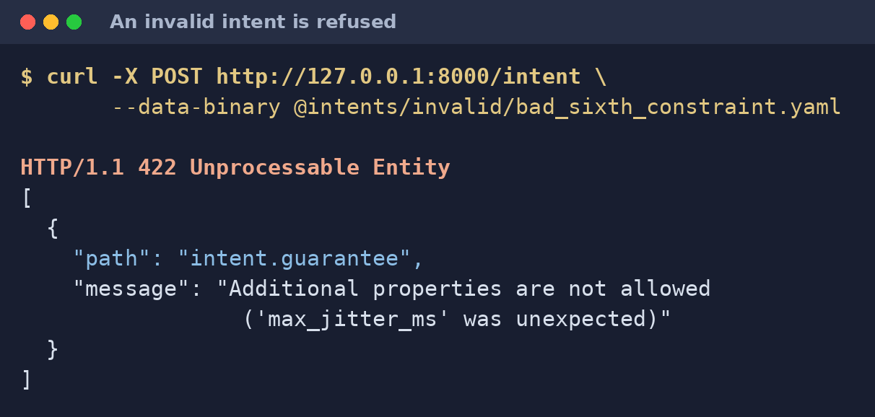
PROCESSING
Deterministic validation
The same input always produces the same acceptance or rejection result
VERBATIM REJECTION RESPONSE
YAML parse
POST of intents/invalid/bad_sixth_constraint.yaml
1
HTTP/1.1 422 Unprocessable Entity
content-type: application/json
[{"path":"intent.guarantee",
"message":"Additional properties are not allowed
('max_jitter_ms' was unexpected)"}]
Readable syntax
2
JSON Schema
Frozen fields and ranges
3
Python rules
Cross-field semantics
No machine learning. No LLM. Validation is rule-based, reproducible and testable.
Intent-Based SDN for 5G SLA Enforcement
11
Notes:
The field max_jitter_ms demonstrates the frozen grammar. Jitter is measured as telemetry, but it is not accepted as an intent constraint. There is no LLM or machine-learning decision in this path.
Verified sources: src/intent_manager/schema.json, src/intent_manager/validator.py and the real HTTP 422 response.

Slide 12
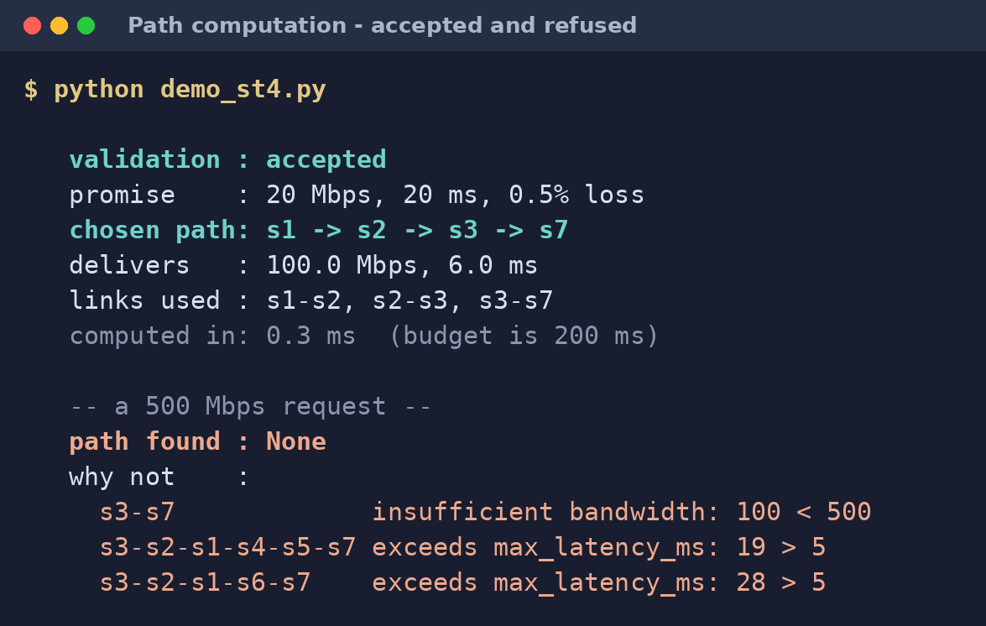
PROCESSING
Constraint-based route selection
Fixed pruning and ranking rules choose a feasible route or return a reason
VERBATIM SOFTWARE DEMO OUTPUT
Route | Bandwidth | Latency | Result
Northern | 100 >= 20 PASS | 6 <= 20 PASS | survives
Middle | 50 >= 20 PASS | 15 <= 20 PASS | survives
Southern | 40 >= 20 PASS | 24 > 20 FAIL | pruned
Command: python demo_st4.py
validation : accepted
promise : 20 Mbps, 20 ms, 0.5% loss
chosen path: s1 -> s2 -> s3 -> s7
delivers : 100.0 Mbps, 6.0 ms
links used : s1-s2, s2-s3, s3-s7
computed in: 0.5 ms (budget is 200 ms)
path found : None
why not :
s3-s7 insufficient bandwidth: 100 < 500
s3-s2-s1-s4-s5-s7 exceeds max_latency_ms: 19 > 5
s3-s2-s1-s6-s7 exceeds max_latency_ms: 28 > 5
No silent failure. Every refusal explains itself.
Two routes survive. The wider 100 Mbps bottleneck selects the northern route.
Pruning order: avoid links, latency, bandwidth, isolation. Ranking: bottleneck, delay, hops, link name.
Intent-Based SDN for 5G SLA Enforcement
12
Notes:
Use the table as the worked example. The demo shows both successful deterministic selection and explainable refusal. Static loss does not prune a path because the topology model has no predicted loss budget.
Verified sources: src/pathing/yen_ksp.py, src/pathing/prune.py, src/pathing/compute.py and the current Windows Command Prompt run of python demo_st4.py.

Slide 13
PROCESSING
Flow rule and queue installation
OpenFlow selects the route; an HTB queue is created, but flow rules are not yet bound to it
8
MATCH
QUEUE CONFIGURATION
eth_type 0x0800 IPv4
ipv4_src / ipv4_dst endpoints
ip_proto 17 UDP
udp_dst 5001 service
20 Mbps queue
flow rules
20,000,000 bits per second
4 switches x 2 directions
Queue attached to s1-eth2; SET_QUEUE binding remains future work
COOKIE
Deterministic 64-bit tag derived from INT-001. It finds, counts and removes only this intent's rules.
0xf886b2decd34ea5
A priority-0 table-miss rule sends unmatched packets to the controller.
Intent-Based SDN for 5G SLA Enforcement
13
Notes:
Separate routing from rate configuration. Rules decide where matching packets leave each switch. The queue sets the configured rate. The cookie is an OpenFlow identifier, not a browser cookie. The controller generates forward and reverse rules.
Sources: src/enforcement/flowmod.py; src/enforcement/queues.py; src/enforcement/controller.py; tests/test_enforcement.py
Important limitation: the live run verifies that the HTB queue exists, not that matching packets are assigned to it. src/enforcement currently has no SET_QUEUE action, so sustained 20 Mbps delivery is not claimed.

Slide 14
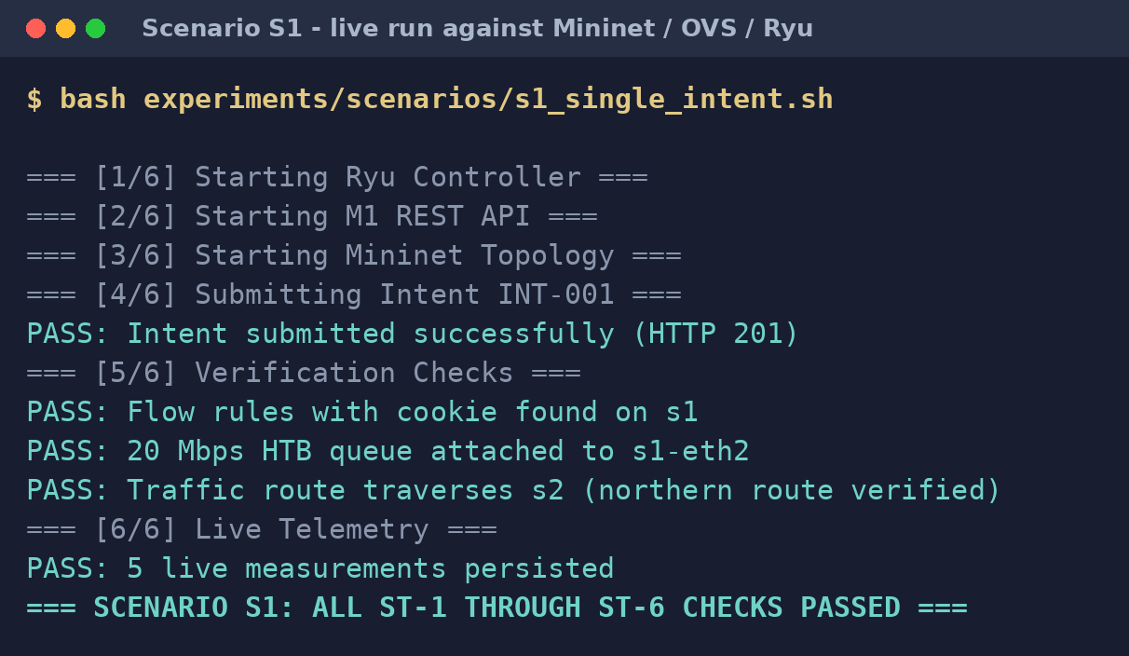
OUTPUT
Live validation on Scenario S1
The saved 24 Sep 2026 run verifies the path, rules, queue and persisted measurements
VERBATIM SAVED LIVE RUN
EACH CHECK PROVES
experiments/results/s1_run.log - 24 Sep 2026
=== [1/6] Starting Ryu Controller ===
=== [2/6] Starting M1 REST API ===
=== [3/6] Starting Mininet Topology ===
=== [4/6] Submitting Intent INT-001 ===
PASS: Intent submitted successfully (HTTP 201)
=== [5/6] Verification Checks ===
PASS: Flow rules with cookie found on s1 (2 rules)
PASS: 20 Mbps HTB queue attached to s1-eth2
PASS: Traffic route traverses s2
(northern route s1-s2-s3-s7 verified)
=== [6/6] Live Telemetry ===
sample delay_ms=7.535409 jitter_ms=None loss_pct=0.0 status=green event=none
sample delay_ms=7.197173 jitter_ms=0.338236 loss_pct=0.0 status=amber event=none
sample delay_ms=7.379792 jitter_ms=0.182619 loss_pct=0.0 status=amber event=none
sample delay_ms=7.332988 jitter_ms=0.046804 loss_pct=0.0 status=red event=sla.violated
sample delay_ms=7.643121 jitter_ms=0.310133 loss_pct=0.0 status=red event=none
PASS: 5 live measurements persisted (4 complete samples)
=== SCENARIO S1: ALL ST-1 THROUGH ST-6 CHECKS PASSED ===
✓ HTTP 201: API accepted INT-001
✓ Cookie: intent rules reached s1
✓ HTB: 20 Mbps queue exists
✓ s2: northern route is installed
✓ 5 rows: telemetry reached SQLite
Virtual datapath: Docker + Mininet + Open vSwitch + Ryu
Intent-Based SDN for 5G SLA Enforcement
14
Notes:
This is verbatim evidence from the saved Scenario S1 log dated 24 September 2026. It proves API acceptance, flow installation, queue existence, the northern route and five persisted telemetry rows on a Docker, Mininet, Open vSwitch and Ryu datapath. It does not prove SET_QUEUE binding or sustained 20 Mbps delivery.
Verified source: experiments/results/s1_run.log. The current Docker Desktop instance was unavailable during this audit, so the historical log is dated explicitly.

Slide 15
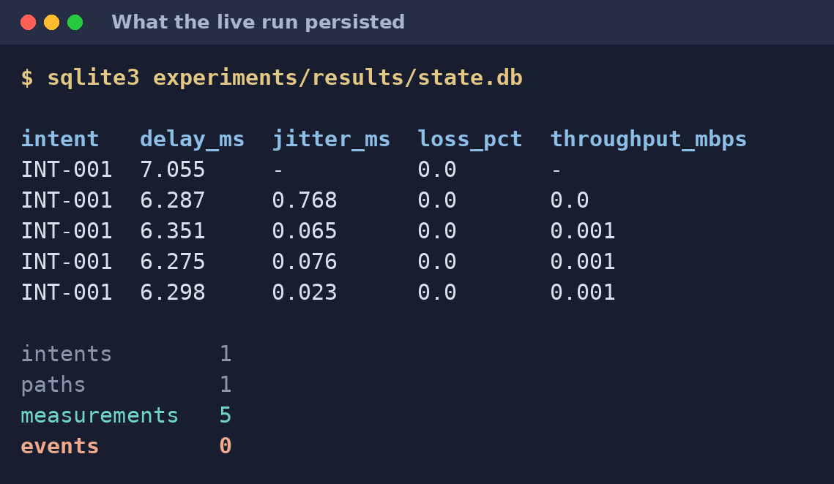
OUTPUT
Persisted telemetry
Five persisted samples from the 24 Sep 2026 live run expose both evidence and the event gap
VERBATIM DATABASE QUERY OUTPUT
Metric | Observed | Interpretation
Delay | 7.197-7.643 ms | Near 6 ms design budget
Jitter | 0.047-0.338 ms | Low variation
Loss | 0.0% | All probes returned
Rate | 0.4-0.8 kbps | Probe load
Python sqlite3 query: experiments/results/state.db
intent_id | delay_ms | jitter_ms | loss_pct | throughput_mbps
INT-001 | 7.535409 | None | 0.0 | None
INT-001 | 7.197173 | 0.338236 | 0.0 | 0.000383580
INT-001 | 7.379792 | 0.182619 | 0.0 | 0.000383445
INT-001 | 7.332988 | 0.046804 | 0.0 | 0.000767234
INT-001 | 7.643121 | 0.310133 | 0.0 | 0.000767212
intents 1
paths 1
measurements 5
events 0
Database counts: intents 1 | paths 1 | measurements 5 | events 0
The delay corroborates the selected route. The zero event count exposes the ST-7 integration gap.
Intent-Based SDN for 5G SLA Enforcement
15
Notes:
The first sample lacks jitter and throughput because both require a previous sample. Delay ranges from 7.197 to 7.643 ms, loss is zero and the recorded traffic is only probe load. Five measurement rows but zero event rows directly expose the ST-7 integration defect.
Verified source: experiments/results/state.db queried during this audit; database file dated 24 September 2026.

Slide 16
ANALYSIS
Interpreting the bandwidth violation
The detector measured the offered load correctly; the scenario did not generate a 20 Mbps workload
Promise
>= 20 Mbps
›
Read counters
1 second apart
›
Probe sends
one small packet
›
Observed
0.001 Mbps
›
Violation
confirmed
Van analogy
A van is rated for one tonne. One envelope is placed inside. The scale reports less than one tonne. The scale works; the load never tested the van's capacity.
Proven: live measurement and violation detection
Not proven: sustained 20 Mbps application throughput
Intent-Based SDN for 5G SLA Enforcement
16
Notes:
The queue was configured and verified, but the scenario generated only probe traffic. Counter-based throughput therefore remained near zero. The next measurement should use iperf3 to create sustained traffic before judging delivered bandwidth.
Sources: src/telemetry/runtime.py; screenshot out_db.png; verified handoff analysis

Slide 17
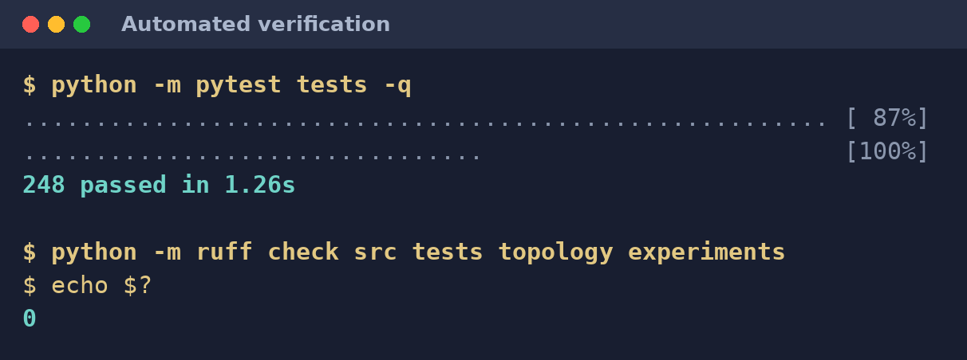
VERIFICATION
Automated test coverage
Software tests provide broad behavioral coverage; one complete scenario provides live-network evidence
VERBATIM CURRENT HOST VERIFICATION
Test area | Cases
Intent validation | 50
Telemetry | 48
Enforcement | 42
Common interfaces | 32
Pathing and API | 32
Control loop | 25
Topology | 19
Windows Command Prompt audit run - 28 Sep 2026
> python -m pytest tests -q
........................................................................ [ 29%]
........................................................................ [ 58%]
........................................................................ [ 87%]
................................ [100%]
248 passed, 2 warnings in 4.05s
> python -m ruff check src tests topology experiments
> echo RUFF_EXIT_CODE=%ERRORLEVEL%
RUFF_EXIT_CODE=0
TESTS ESTABLISH
TESTS DO NOT ESTABLISH
Deterministic logic, boundary handling, persistence behavior and safe rule generation
Physical hardware behavior, sustained 20 Mbps delivery or eight completed live scenarios
248 automated tests; 1 complete live scenario. The numbers describe different evidence.
Intent-Based SDN for 5G SLA Enforcement
17
Notes:
Clarify that 248 is a software-test count. Most tests use fakes and monkeypatching so they run without root, Ryu or Mininet. The live S1 scenario is a separate and smaller category of evidence.
Verified source: current Windows Command Prompt runs on 28 September 2026: 248 passed, 2 warnings in 4.05 seconds; Ruff exit code 0.

Slide 18
STATUS
Subtask completion
Six subtasks are complete; one has tested groundwork; seven remain unstarted
43%
Step | State | Scope
ST-1 to ST-6 | Complete | Foundation, topology, interfaces, API, pathing, enforcement, telemetry
ST-7 | Partial | Control loop tested; live integration missing
ST-8, ST-9 | Not started | Admission and preemption placeholders
ST-10, ST-11 | Not started | Two-phase update and dashboard placeholders
ST-12, ST-13 | Not started | Repeated evaluation and figures
ST-14 | Not started | Final report and demonstration
6 of 14 subtasks
Count of subtasks, not effort or time remaining
6 complete
1 partial
7 not started
Intent-Based SDN for 5G SLA Enforcement
18
Notes:
Do not translate 43 percent into time remaining. The later evaluation tasks require repeated experiments and cannot be compressed into a single run. ST-7 has meaningful code and 25 tests, but it is not complete without live event propagation and rerouting.
Sources: README.md Status; docs/HANDOVER.md; source placeholders; tests/test_control_loop.py

Slide 19
OUTSTANDING WORK
Incomplete event propagation
All components exist independently; the live process does not connect them
Detector
×
Event bus
×
Database
×
ControlLoop
creates correct event
can deliver event
can persist event
can reroute
THREE MISSING CALLS
db.save_event(...)
event never reaches SQLite
LIVE EVIDENCE
5
0
EventBus.publish(...)
subscriber never receives it
measurements
events
ControlLoop(...)
rerouting object never exists live
This blocks automatic rerouting, event-backed audit history and violation-driven evaluation scenarios.
Intent-Based SDN for 5G SLA Enforcement
19
Notes:
This is the central unfinished issue. The runtime receives the event from the detector and prints its name. It does not save it, publish it or construct the control loop. The zero event rows provide direct evidence.
Sources: src/telemetry/runtime.py; src/common/db.py; src/common/events.py; src/telemetry/loop.py; screenshot out_db.png

Slide 20
ROADMAP
Remaining work in priority order
The sequence protects the control loop and evaluation evidence before optional presentation features
1
Connect ST-7
Persist and publish violations; run a live reroute
2
Start evaluation
Automate repeated runs and capture raw results
3
Add admission
Stop accepting promises the network cannot support
4
Test real load
Bind SET_QUEUE and drive sustained iperf3 traffic
5
Complete policies
Preemption, two-phase update, then dashboard
If time contracts, protect measurement work and defer the dashboard.
Intent-Based SDN for 5G SLA Enforcement
20
Notes:
The order reflects dependency and schedule risk. Event propagation unlocks live rerouting. Evaluation must begin early because ten repetitions across four baselines consume elapsed time. The dashboard adds presentation value but does not unlock the control loop.
Sources: Verified handoff roadmap; experiments/run_all.sh; project subtask plan

Slide 21
DEMONSTRATION
Demonstration
Three commands show deterministic decisions, live enforcement and the persistence gap
1
Software pipeline
python demo_st4.py
Validation, route selection and refusal with reasons
2
Live virtual network
docker compose exec -T sdn bash experiments/scenarios/s1_single_intent.sh
Ryu, Mininet, OVS, flow rules, queue and telemetry
3
Persisted evidence
python -c "import sqlite3; ... query experiments/results/state.db"
Measurements present; events absent
Public repository: github.com/platynom/intent-sdn-sla
Intent-Based SDN for 5G SLA Enforcement
21
Notes:
Demonstrate the software-only path first because it is fast and deterministic. Then run the live container scenario. Finish with the database counts so the demonstration shows both the achievement and the precise remaining defect.
Sources: demo_st4.py; experiments/scenarios/s1_single_intent.sh; experiments/results/state.db

