Slide 1
AI-NATIVE SELF-HEALING O-RAN NETWORK USING A DIGITAL TWIN
Digital-Twin-Verified Self-Healing of the O-RAN Open-Fronthaul Synchronization Plane
Telling timing faults from attacks — and healing the clock before the base station fails.
LAYER
CONTRIBUTION
STATUS
Fronthaul S-plane (L1/L2)
Integration + validation + dataset
Emulation tier complete
Tanmay · Project Review
Notes:
Title. This project sits on the O-RAN Open Fronthaul synchronization plane. The one-line story: tell a timing fault from an attack, and heal the clock before the base station fails.

Slide 2
BACKGROUND
Why fronthaul timing is safety-critical
O-RAN splits the base station into O-DU and O-RU, joined by an Ethernet Open Fronthaul. Their clocks are aligned over the Synchronization (S-) plane using PTP (IEEE-1588) and SyncE.
~100 ns
time-error budget (tightest class)
The timing budget is tiny (~100 ns). If it drifts, the base station degrades — and a timing attack can crash it in about two seconds.
~2 s
4
to base-station failure
LLS-C1..C4 sync modes
No comprehensive O-RAN fronthaul security standard exists yet.
Notes:
Context: timing on the fronthaul is safety-critical. 100 ns budget, 2-second crash, and no security standard yet — so this is a real, high-stakes, open area.

Slide 3
THE PREVIOUS PROBLEM
Prior work detects — but stops there
TIMESAFE (ACM ToPS, 2025)
DETECTION ≠ RESPONSE
Showed a PTP timing attack crashes a 5G base station in ~2 s.
Built an ML monitor that DETECTS such attacks at 97.5%.
1
Anomaly detected — done by prior work
2
Fault or attack? — undefined
What it leaves undefined:
No recovery action — the O-RAN spec does not say what to do on detection.
Cannot tell a malicious ATTACK from a benign FAULT (they need opposite fixes).
The digital twin is used only to make data, not to verify a fix.
3
Which recovery action? — undefined
4
Apply before crash — undefined
Notes:
Prior problem: TIMESAFE (peer-reviewed) detects attacks but stops at detection. Steps 2-4 — fault vs attack, which action, apply before crash — are undefined. That is exactly our opening.

Slide 4
THE SPECIALIZED PROBLEM
Discriminate fault vs attack, then heal — verified by a twin — before failure
On the O-RAN S-plane, given passive timing telemetry: (1) detect a sync anomaly, (2) decide H0 fault vs H1 attack, (3) verify each candidate recovery in a digital twin, and (4) commit the best action before the ~2 s failure window — minimizing wrong actions and recovery time.
H0 — benign timing FAULT
H1 — malicious ATTACK
GNSS loss / clock holdover
Packet-delay-variation (congestion)
SyncE quality degradation
Fix: ride holdover / failover to a healthy source
PTP spoofing (fake grandmaster)
Replay of genuine timing messages
Evasive: mimics a fault to hide
Fix: isolate rogue master / failover to trusted ref
Notes:
Our one specialized problem: fault-vs-attack discrimination plus twin-verified recovery, in time. Left and right show why the two need opposite responses.

Slide 5
OUR APPROACH
A governed self-healing loop
1
Sync-anomaly detection
Flag timing windows that leave the healthy baseline.
2
Fault-vs-attack discriminator
Classify H0 fault vs H1 attack from statistical + protocol signatures.
3
Digital-twin verification
Simulate each recovery action; keep only those that hold timing in budget and beat the safe default.
4
Governed recovery commit
Apply the best action (failover / holdover / isolate) within the failure window; log an auditable reason.
Notes:
Four governed stages. The twin being load-bearing at stage 3 — verifying the fix before it is applied — is the part prior work leaves out.

Slide 6
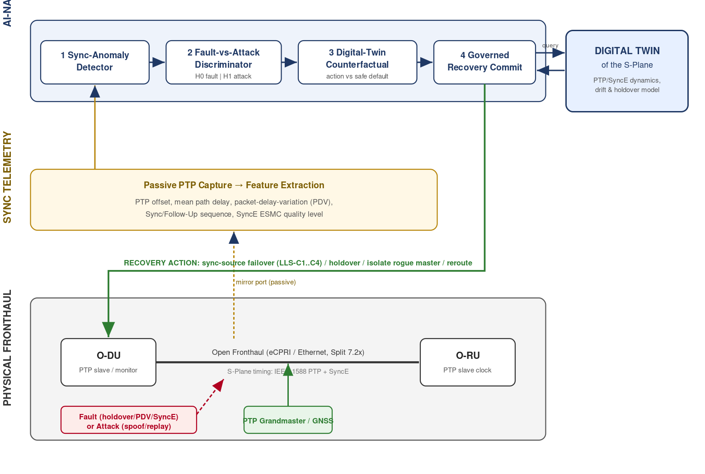
SYSTEM DESIGN
Architecture of the self-healing loop
Physical fronthaul
O-DU + O-RU over Split-7.2x; PTP/SyncE timing.
Sync telemetry
Passive capture: offset, path delay, PDV, SyncE quality.
Self-healing loop
Detect → discriminate → twin-verify → commit.
Digital twin
Forecasts drift per action; gives a fidelity score.
Notes:
The architecture: physical fronthaul at the bottom, passive telemetry in the middle, the AI loop on top, and the twin on the right verifying each recovery.

Slide 7
WHAT IS DONE
A complete, reproducible software prototype
✓
PTP/SyncE simulator
✓
Fault + attack injectors
Healthy timing converges within the 100 ns budget.
Timestamped, auto-labelled scenarios (H0 & H1).
✓
Labelled dataset
✓
Fault-vs-attack discriminator
2,508 windows: 1,614 healthy · 536 fault · 358 attack.
Trained + evaluated vs a detection-only baseline.
✓
Digital twin
✓
Governed loop + benchmark
Per-action drift forecast + fidelity score.
One-command reproduction; tests passing (3/3).
Notes:
Everything in the emulation tier is built and reproducible: simulator, injectors, dataset, discriminator, twin, governed loop, benchmark, tests.

Slide 8
RESULTS · FAULT-VS-ATTACK DISCRIMINATION
The classifier has to work — and it does
98.7%
0.999
40%
4
discriminator accuracy
ROC-AUC
detection-only baseline
errors / 313 (not perfect)
Held-out confusion (H0 / H1)
pred H0
pred H1
Why this is believable, not overfit
Giveaway labels removed — attacks look like normal traffic.
Evasive attacks mimic faults + hide in congestion.
Telemetry read through sensor noise.
Result matches TIMESAFE's own 97.5% — errors on the hard, evasive cases.
true H0
186
2
true H1
2
123
Notes:
98.7% with real errors, not 1.000. We hardened the simulator (removed cheats, added evasive attacks and sensor noise) so the score is earned and matches the literature.

Slide 9
RESULTS · SELF-HEALING BENCHMARK
The governed loop beats every baseline
Method
Recovery
Wrong-action
MTTR (s)
Peak error (ns)
Before 2 s
Governed loop (ours)
0.95
0.05
0.55
86 ✓
Yes
Detection-only (no response)
0.00
0.00
2.0
224 ✗
No
Always-holdover
0.60
0.40
1.18
176 ✗
Yes
Always-failover
0.60
0.00
0.62
176 ✗
Yes
Peak timing error — governed loop stays inside the 100 ns budget; all baselines blow past it.
Takeaway: detection alone recovers nothing; the twin-verified loop recovers 95% within budget and before the crash, with the lowest wrong-action rate.
Notes:
Benchmark: governed loop recovers 0.95 within the 100 ns budget and before the 2 s window; detection-only recovers nothing; the naive baselines either over-act or miss the budget.

Slide 10
STATUS
What is done, and what is left
DONE
NEXT
Emulated S-plane + PTP/SyncE simulator
Fault & attack injectors + labelled dataset (2,508 windows)
Fault-vs-attack discriminator (98.7%)
Digital twin with fidelity score
Governed self-healing loop
Benchmark vs baselines + plots
One-command reproduction; tests pass
Honest realism notes for the viva
Realism tier B: run on real linuxptp + tc netem over a virtual Ethernet link (no hardware).
Optional hardware: PTP-capable NICs + timing switch + GNSS grandmaster for ns-true validation.
Polish and publicly release the labelled dataset + datasheet.
Write up results into the paper / report.
Notes:
Left column: the whole emulation tier is done. Right column: next is tier-B linuxptp/netem (no hardware), optional hardware, dataset release, and the write-up.

Slide 11
CONTRIBUTION
The response step the field left undefined — built, verified, and honest
Fault-vs-attack discrimination
separates two look-alike causes that need opposite fixes
Twin-verified recovery
the digital twin vets each fix before it touches the network
Experimental evidence + dataset
measured against a detection-only baseline; reproducible
Honest scope: integration + experimental validation + released dataset — not a new fundamental algorithm.
Notes:
Close: our contribution is the response step — fault-vs-attack discrimination and twin-verified recovery — with real evidence and a dataset, honestly scoped as integration and validation.

