Slide 1
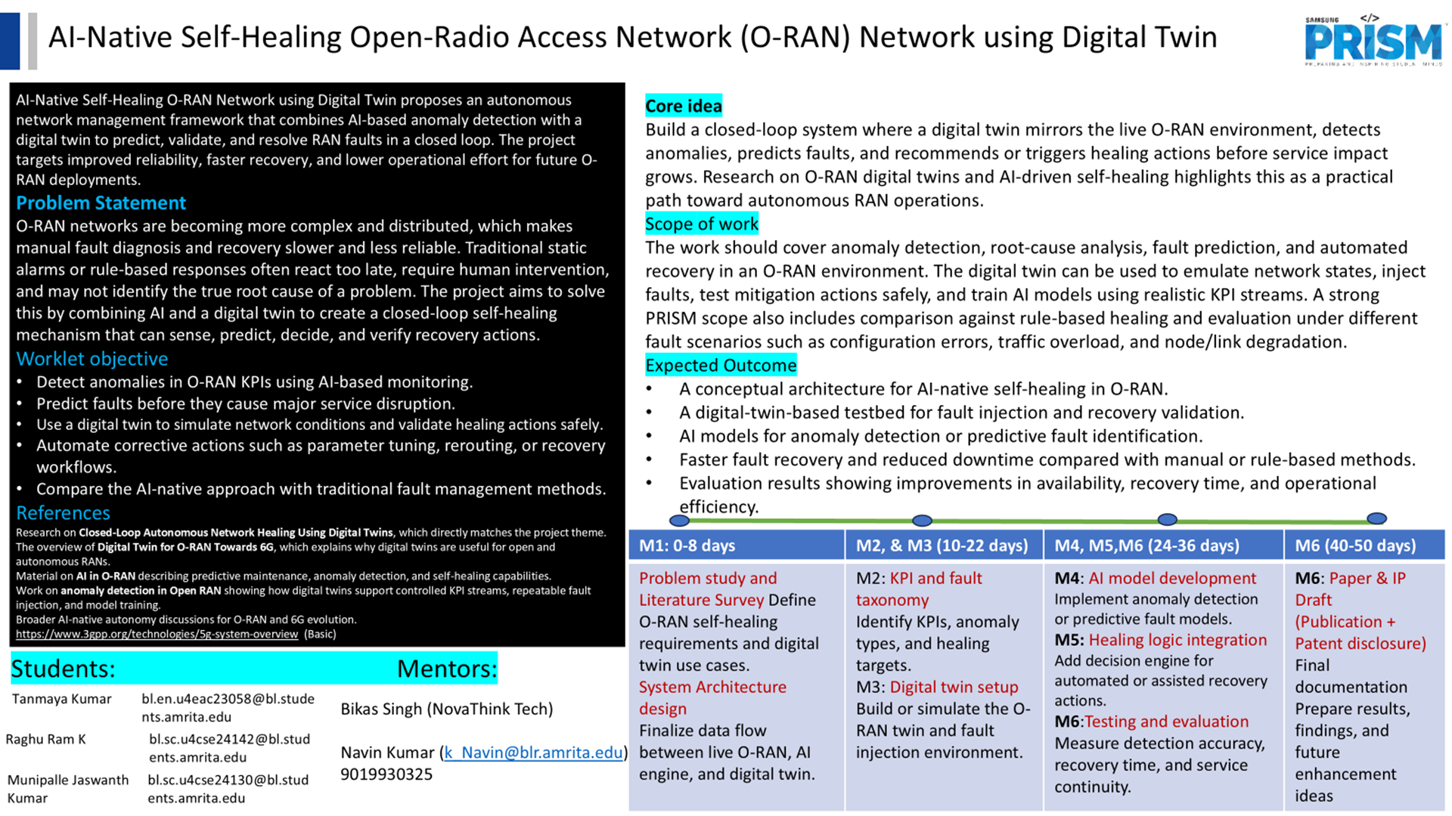

Slide 2
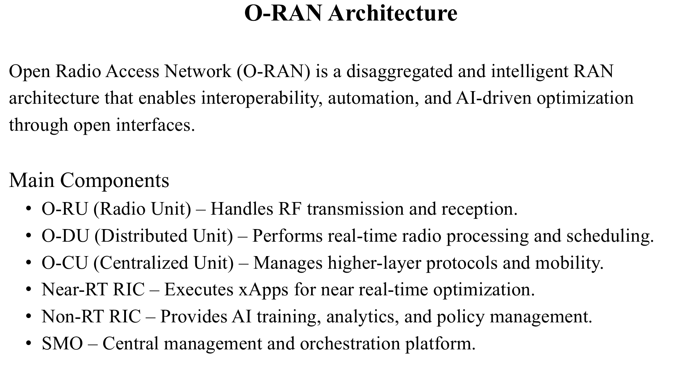

Slide 3
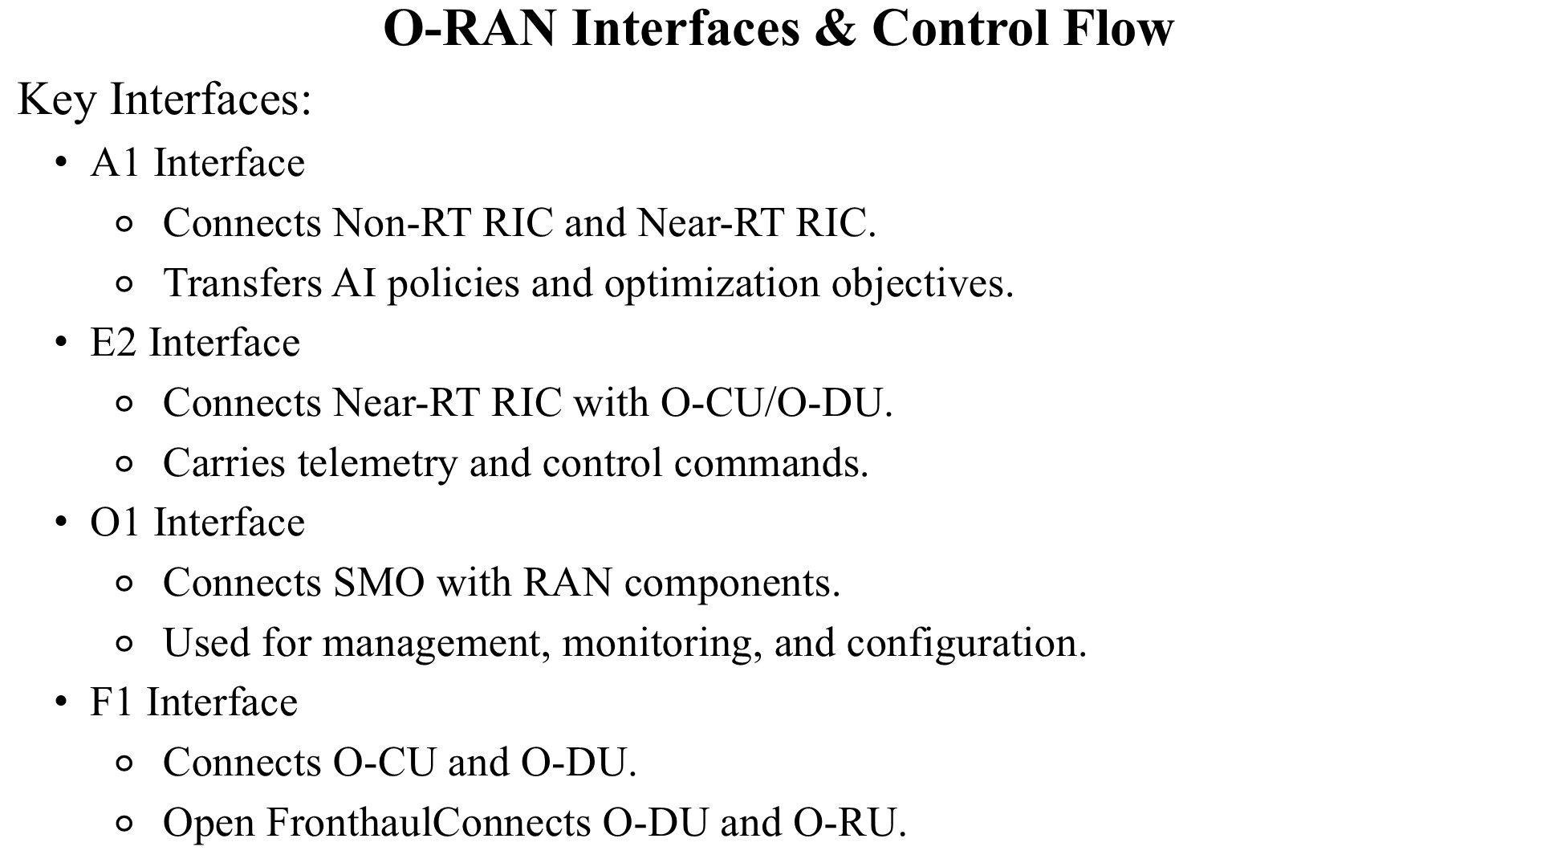

Slide 4
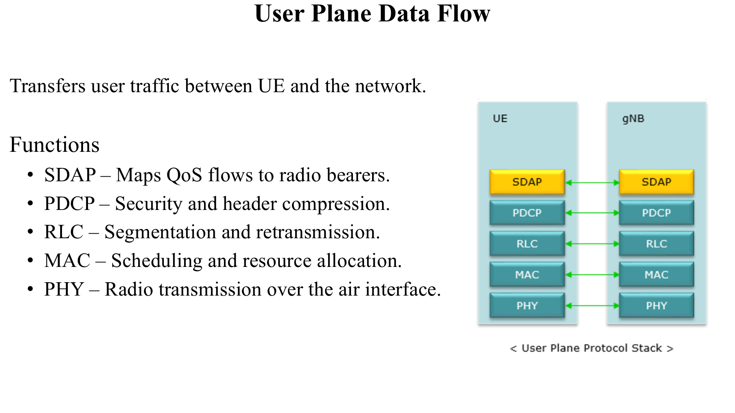

Slide 5
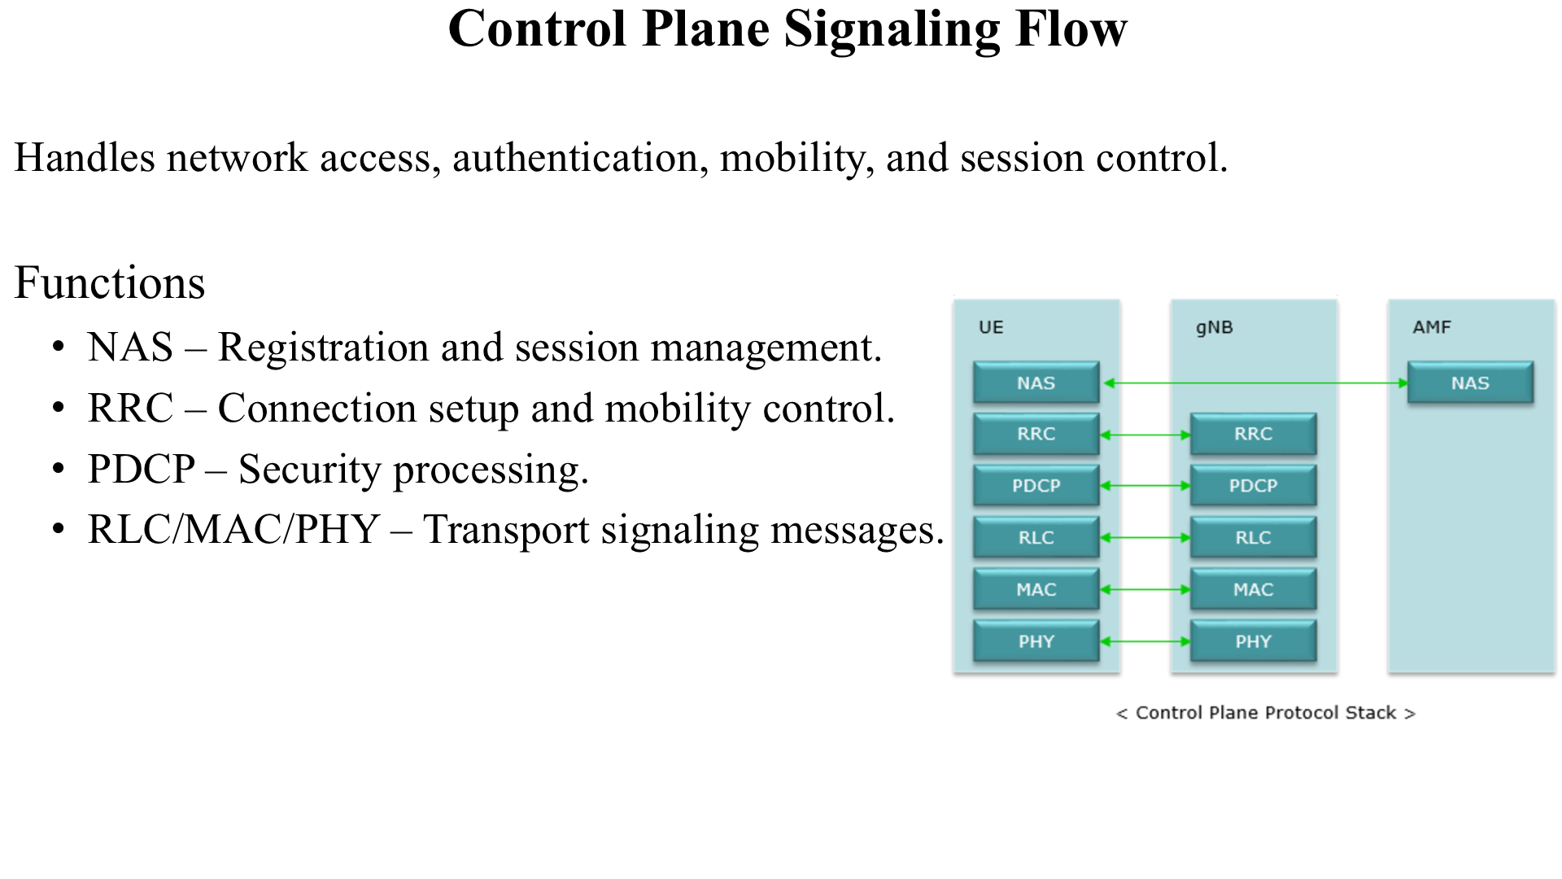

Slide 6


Slide 7
AI-NATIVE SELF-HEALING O-RAN NETWORK USING A DIGITAL TWIN
Complete Technical Methodology
Smallest input element -> calculations -> digital twin -> anomaly/RCA -> healing -> safety gates -> final decision -> reports and metrics
Use this deck to explain exactly what was developed, how every field moves through the system, what each module computes, what outputs are produced, what results were verified, and what remains future work.
One-line thesis
The prototype monitors O-RAN service and radio-performance degradation affecting O-RU/O-DU/O-CU, while the AI self-healing intelligence sits in the SMO/Non-RT RIC and Near-RT RIC/xApp-style layer.
AI-Native Self-Healing O-RAN Technical Methodology | 07

Slide 8
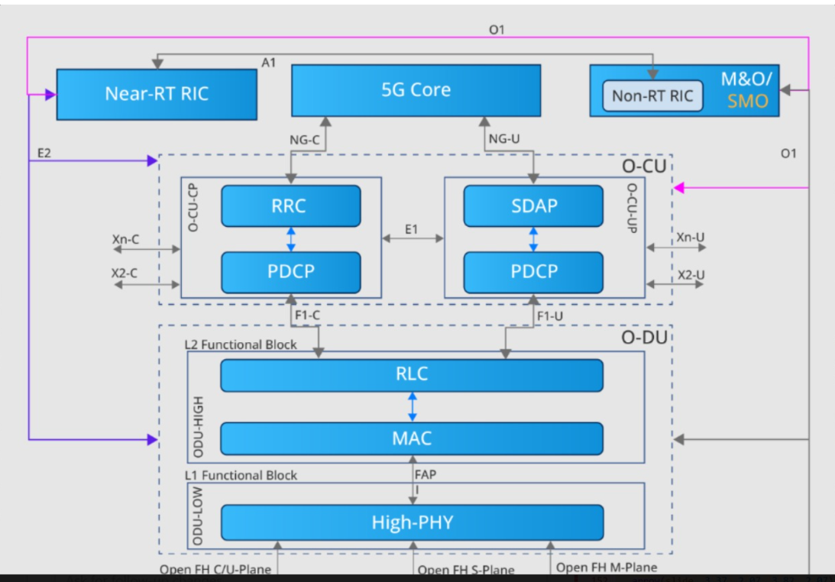
O-RAN REFERENCE
Reference O-RAN architecture used for project positioning
This topology shows where Near-RT RIC, SMO/Non-RT RIC, O-CU, O-DU, High-PHY, and the O-RU/Low-PHY split fit.
How this relates to our prototype
AI-Native Self-Healing O-RAN Technical Methodology | 08
Our system consumes O-CU/O-DU/O-RU telemetry and places AI self-healing intelligence in the RIC/SMO + digital twin layer.

Slide 9
PROJECT POSITIONING
What the project is and is not
This prevents confusion between the real RAN stack and our AI self-healing layer.
What we developed
What we did not implement yet
- AI-native self-healing workflow for O-RAN telemetry.
- Digital twin state assessment for cell/service/slice conditions.
- Anomaly detection, root-cause analysis, and healing recommendation.
- RIC/xApp-style proposal and safety decision chain.
- Reports, dashboard, persistence, validation, and metrics.
- Live OAI/FlexRIC telemetry connection.
- Real E2SM-KPM ingestion.
- Real Near-RT RIC xApp deployment.
- Live per-UE monitoring from a real RAN.
- Real PHY-layer AI using IQ or PHY traces.
O-RU / O-DU / O-CU = monitored network components
SMO / Non-RT RIC + Near-RT RIC/xApp layer = where the monitoring, intelligence, and healing decisions sit
AI-Native Self-Healing O-RAN Technical Methodology | 09

Slide 10
O-RAN CONTEXT
Generic O-RAN path behind the workflow
The workflow diagram starts after telemetry enters from the O-RAN network.
UE
User device
O-RU
Low-PHY + RF
O-DU
High-PHY + MAC/RLC
O-CU
RRC/PDCP/SDAP
5G Core
AMF/UPF
RIC / SMO intelligence
Digital twin, AI/ML, xApps, policy
The workflow operates above the RAN: O-RU/O-DU/O-CU provide telemetry, while RIC/SMO-side intelligence analyzes and returns control-ready decisions.
O-RAN infrastructure
Our intelligence layer
Correct interpretation
- O-RU: Low-PHY, RF, antenna, beamforming.
- O-DU: High-PHY, MAC, RLC, scheduler.
- O-CU: RRC, PDCP, SDAP, mobility/session control.
- 5G Core: AMF/UPF/network services.
- Telemetry collector.
- Digital twin.
- AI/ML anomaly + RCA.
- Self-healing decision engine.
- xApp/RIC-ready control payload.
This is O-RAN work because it targets telemetry, RIC/SMO intelligence, and RAN control decisions. It does not replace O-RU, O-DU, O-CU, or 5G Core.
AI-Native Self-Healing O-RAN Technical Methodology | 10

Slide 11
LITERATURE BASE
Priority-folder papers and how they shaped the prototype (1/2)
Full citations are shown with the implementation contribution for papers 1-6.
#
Full paper citation
Main idea extracted
Implemented contribution
1
O-RAN xApps: Survey and Research Challenges, Elsevier Computer Networks, 2025.
RIC, xApps, rApps, E2/A1/O1 architecture
Shared engine + xApp-ready runtime
2
Anomaly Detection for Mitigating xApp and E2 Interface Threats in O-RAN Near-RT RIC, IEEE, 2025.
E2 telemetry and xApp threat monitoring
Anomaly/security validation layer
3
COMIX: Generalized Conflict Management in O-RAN xApps, IEEE Access, 2025.
Generalized xApp conflict management
Conflict check before automation
4
xApp Distillation: AI-Based Conflict Mitigation in B5G O-RAN, Elsevier Computer Networks, 2026.
AI-based conflict mitigation policy
Distillation-style mitigation state
5
Drift Handling Framework for Open Radio Access Networks, Elsevier Computer Networks, 2024.
Model drift and lifecycle safety
Drift check + registry/rollback concept
6
Adversarial Machine Learning Threat Analysis and Remediation in O-RAN, Elsevier JNCA, 2024.
Poisoning/evasion/unsafe action defense
AML guard and attack evaluation
Purpose: cite the priority literature directly and show how each paper became an implemented engineering feature.
AI-Native Self-Healing O-RAN Technical Methodology | 11

Slide 12
LITERATURE BASE
Priority-folder papers and how they shaped the prototype (2/2)
Full citations are shown with the implementation contribution for papers 7-12.
#
Full paper citation
Main idea extracted
Implemented contribution
7
Digital-Twin-Driven End-to-End Network Slicing Toward 6G, IEEE, 2024.
SLA and slice-aware digital twin
Slice/SLA impact scoring
8
Time-Sensitive Networking Digital Twin for STRIDE-Based Security Testing, Springer, 2025.
PTP sync and timing security
Timing/PTP safety check
9
CERBERUS: Secure Automated Multi-Operator Management in B5G Through Dynamic Policy-Based ZSM, Springer, 2025.
Policy governance and automation audit
ZSM/SMO policy gate
10
A Comprehensive Survey on AI-Enabled Digital Twin Network in 6G, IEEE Access, 2024.
Twin readiness and orchestration
DTN readiness check
11
SpotLight: An Open RAN System for Dynamic Spectrum Access and Anomaly Detection, ACM MobiCom, 2024.
Spectrum anomaly and dynamic access
Spectrum/DSA guard
12
Project local production-hardening requirements and implementation report, 2026.
Scale, audit, validation, demo readiness
SQLite, reports, Docker, validation
Purpose: continue the citation-to-implementation mapping with readable text for presentation.
AI-Native Self-Healing O-RAN Technical Methodology | 12

Slide 13
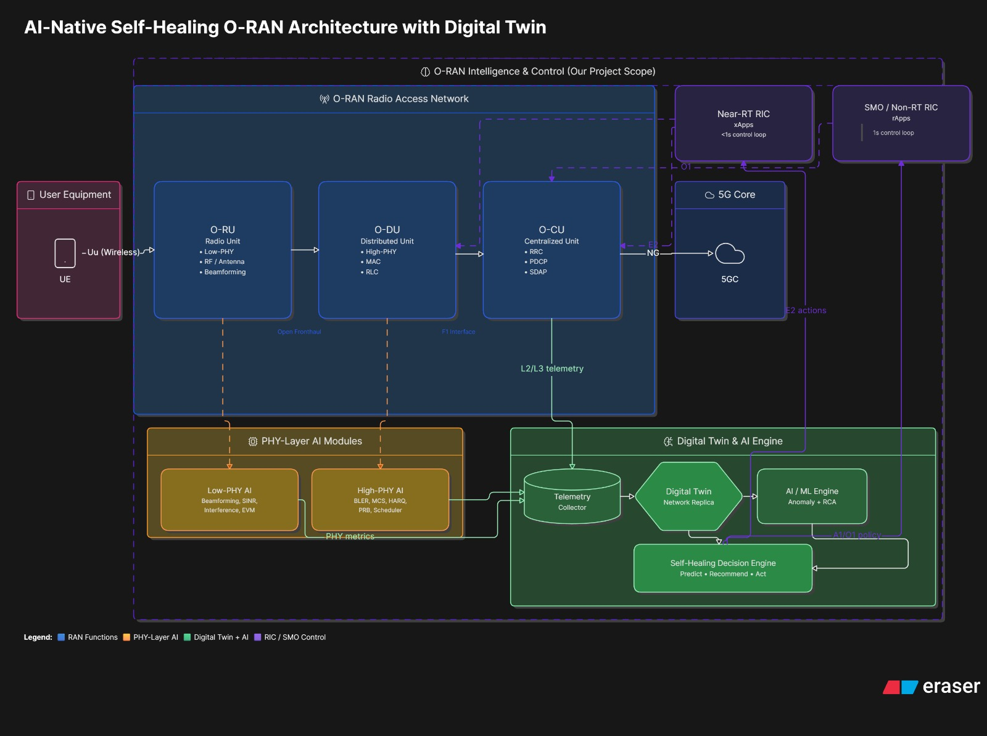
ARCHITECTURE
Where the complete project sits
This is the architecture image now used to justify project scope.
AI-Native Self-Healing O-RAN Technical Methodology | 13

Slide 14
SMALLEST UNIT
Smallest input element: one telemetry record
One row represents one cell/service/slice condition at one time step.
Meaning
timestamp: 2026-06-11 10:00:00
cell_id: cell_001
service_class: URLLC
device_count: 8,000
active_devices: 1,200
latency_ms: 18
throughput_mbps: 42
packet_loss_pct: 2.8
prb_utilization_pct: 91
sinr_db: 7
bler_pct: 12
cqi: 6
handover_failures: 4
timing_offset_us: 3.2
spectrum_interference: high
slice_priority: critical
- A telemetry record is the atomic unit of our pipeline.
- It carries identity fields, device population, radio KPIs, service KPIs, mobility/control fields, timing fields, and security/model fields.
- Every later decision is calculated from one or more telemetry records.
AI-Native Self-Healing O-RAN Technical Methodology | 14

Slide 15
INPUT ORIGIN
Where the telemetry input comes from
Real deployment source versus current prototype source.
Real O-RAN deployment
Current prototype
O-RU / O-DU / O-CU generate telemetry. That telemetry can be carried through E2, O1, E2SM-KPM, OAI, srsRAN, or FlexRIC pathways into RIC/SMO intelligence.
A local simulator generates structured KPI records. The records are designed to be OAI/FlexRIC-ready, but they are not live-connected yet.
Real path:
O-RU/O-DU/O-CU -> E2/O1 telemetry -> RIC/SMO
Current path:
Local simulator -> generated KPI records -> digital twin pipeline
AI-Native Self-Healing O-RAN Technical Methodology | 15

Slide 16
INPUT CATEGORIES
Raw input categories read by the system
The input is not just one value; it is a structured telemetry object.
Identity fields
Device fields
Radio KPI fields
- timestamp
- cell_id
- sector_id
- slice_id
- service_class
- represented_devices
- active_devices
- affected_devices
- device_type
- sinr_db, rsrp, rsrq
- bler_pct, cqi, mcs
- prb_utilization_pct, interference_level
Service KPI fields
Mobility/control fields
Safety/model fields
- latency_ms
- throughput_mbps
- packet_loss_pct
- jitter_ms
- availability_pct
- handover_failures
- rrc_reestablishment_rate
- session_drop_rate
- ptp_offset
- sync_status
- timing_drift
- attack_flag
- model_version
- drift_score
AI-Native Self-Healing O-RAN Technical Methodology | 16

Slide 17
FIELD MEANING
What each input category tells the system
The system uses the category to decide what type of fault may be happening.
Radio behavior
Service behavior
- SINR, RSRP, RSRQ, BLER, CQI, MCS, PRB utilization, and interference describe O-RU/O-DU radio quality.
- These fields help detect interference, weak signal, spectrum stress, scheduler pressure, and link adaptation issues.
- Latency, throughput, packet loss, jitter, and availability describe user/service experience.
- These fields help detect SLA degradation, congestion, service instability, and slice impact.
Control/mobility behavior
Timing/security/model behavior
Handover failures, RRC re-establishment, and session drops point toward O-CU/RRC/PDCP/session behavior.
PTP offset, sync status, attack flags, model version, and drift score decide whether automation is safe.
AI-Native Self-Healing O-RAN Technical Methodology | 17

Slide 18
DEVICE CLASSES
Service/device classes represented in the digital twin
The same KPI can be severe for one service and acceptable for another.
eMBB
mMTC
URLLC
FWA
V2X
Enhanced Mobile Broadband. High-data-rate users such as phones, video, gaming, and broadband-heavy applications. Key need: throughput.
Massive Machine-Type Communication. Large IoT sensor populations. Key need: scale, energy efficiency, and reliable small-data access.
Ultra-Reliable Low-Latency Communication. Critical control, robotic, safety, or industrial traffic. Key need: very low latency and reliability.
Fixed Wireless Access. Home or office broadband delivered through radio. Key need: stable capacity and coverage.
Vehicle-to-Everything. Connected vehicles and mobility safety use cases. Key need: low latency, mobility, reliability.
AI-Native Self-Healing O-RAN Technical Methodology | 18

Slide 19
NORMALIZATION
Why KPI normalization is needed
Raw values have different units, so the system converts them into comparable risk values.
Problem
Solution
- Latency is measured in milliseconds.
- Packet loss is measured in percent.
- SINR is measured in dB.
- PRB utilization is measured in percent.
- A direct comparison between these raw values is not meaningful.
- Convert every KPI into a risk-like score.
- Use service-specific limits.
- Higher normalized risk means worse condition.
- Feed comparable scores into anomaly detection, RCA, and safety scoring.
normalized_risk = observed_value / allowed_or_target_value
For inverse KPIs like SINR: risk = max(0, target_sinr - actual_sinr) / target_sinr
AI-Native Self-Healing O-RAN Technical Methodology | 19

Slide 20
NORMALIZATION FORMULAS
Example calculations for one URLLC telemetry record
The calculations turn raw KPIs into risk values.
Input:
URLLC latency_ms = 18
URLLC latency_limit = 10
packet_loss_pct = 2.8
allowed_packet_loss = 1
prb_utilization_pct = 91
sinr_db = 7
target_sinr = 15
Calculations:
latency_risk = 18 / 10 = 1.8
packet_loss_risk = 2.8 / 1 = 2.8
prb_risk = 91 / 100 = 0.91
sinr_risk = (15 - 7) / 15 = 0.533
Interpretation:
latency and packet loss are severely above target; PRB is high; SINR is degraded.
AI-Native Self-Healing O-RAN Technical Methodology | 20

Slide 21
SERVICE THRESHOLDS
Service-class-aware thresholds
The same KPI value is judged differently based on service class.
URLLC
eMBB
mMTC
- Latency limit: strict.
- Reliability: critical.
- Packet loss tolerance: very low.
- Priority: critical.
- 18 ms latency can be severe.
- Throughput is the main concern.
- Latency tolerance is higher than URLLC.
- Priority often medium.
- 18 ms latency may be acceptable.
- Throughput drop is more important.
- Massive device scale.
- Small data bursts.
- Latency tolerance usually higher.
- Device access success matters.
- Battery/coverage concerns matter.
Therefore the system always evaluates KPI + service_class together, not KPI alone.
AI-Native Self-Healing O-RAN Technical Methodology | 21

Slide 22
DIGITAL TWIN
Digital twin state update
The digital twin is the system's internal memory and decision-oriented replica.
Stored per cell/service/slice
Example twin state:
cell_001 / URLLC
latency trend: increasing
packet loss trend: increasing
SINR trend: decreasing
PRB utilization: high
risk: critical
probable fault: interference + congestion
affected devices: 2,100
- Current KPIs.
- Previous KPIs.
- Trend direction.
- Risk score.
- Fault state.
- Affected devices.
- Active devices.
- Recommended action.
- Decision status.
AI-Native Self-Healing O-RAN Technical Methodology | 22

Slide 23
DIGITAL TWIN ROLE
What the digital twin does and does not do
This prevents overclaiming.
What it does
What it does not do yet
- Maintains a structured virtual state of the network.
- Tracks cells, services, KPIs, risks, device populations, and incidents.
- Supports what-if reasoning before automation.
- Feeds anomaly, RCA, healing, safety, and reporting.
- It is not a full RF/PHY simulator.
- It does not run a live RAN.
- It does not currently ingest real OAI/FlexRIC E2 data.
- It does not model every real UE individually from a live network.
Correct claim: decision-oriented O-RAN digital twin for self-healing workflow, not a carrier-grade full-stack radio twin.
AI-Native Self-Healing O-RAN Technical Methodology | 23

Slide 24
ANOMALY DETECTION
Anomaly detection logic
An anomaly means the telemetry pattern is outside expected or service-safe behavior.
Rules:
if latency_ms > SLA_latency_limit:
latency_anomaly = true
if packet_loss_pct > packet_loss_limit:
packet_loss_anomaly = true
if prb_utilization_pct > 85:
congestion_anomaly = true
if sinr_db < 10:
radio_quality_anomaly = true
if timing_offset_us > allowed_limit:
timing_anomaly = true
Example result:
latency_ms = 18, URLLC limit = 10 -> anomaly
packet_loss_pct = 2.8 -> anomaly
prb_utilization_pct = 91 -> anomaly
sinr_db = 7 -> anomaly
Anomaly vector:
latency_anomaly = 1
packet_loss_anomaly = 1
congestion_anomaly = 1
radio_quality_anomaly = 1
timing_anomaly = 0
AI-Native Self-Healing O-RAN Technical Methodology | 24

Slide 25
FAULT SIGNATURES
Fault signature matching
The anomaly vector is compared against known fault patterns.
Congestion signature
Interference signature
Timing/PTP fault
xApp conflict
- High PRB utilization.
- High latency.
- Throughput drop.
- Packet loss possible.
- Scheduler pressure.
- Low SINR.
- High BLER.
- Packet loss.
- Throughput drop.
- Spectrum risk.
- Timing offset high.
- Sync status bad.
- Packet errors.
- O-DU/O-RU timing risk.
- Opposing actions.
- Control instability.
- Oscillating decisions.
- Unsafe automation.
Example: high PRB + high latency + low SINR + high packet loss can match congestion and interference together.
AI-Native Self-Healing O-RAN Technical Methodology | 25

Slide 26
RCA
Root Cause Analysis calculation
RCA selects the most likely root cause from weighted evidence.
Congestion score:
0.4 * prb_risk
+ 0.3 * latency_risk
+ 0.2 * throughput_drop_risk
+ 0.1 * packet_loss_risk
Timing score:
0.6 * timing_offset_risk
+ 0.4 * sync_error_risk
Interference score:
0.4 * sinr_risk
+ 0.3 * bler_risk
+ 0.2 * packet_loss_risk
+ 0.1 * spectrum_risk
Decision:
root_cause = max(score)
Example:
congestion_score = 0.82
interference_score = 0.89
timing_score = 0.10
root_cause = interference
AI-Native Self-Healing O-RAN Technical Methodology | 26

Slide 27
SEVERITY
Severity calculation
Severity tells how urgent and dangerous the incident is.
severity_score =
0.35 * SLA_risk
+ 0.25 * service_priority
+ 0.20 * affected_device_ratio
+ 0.20 * RCA_confidence
affected_device_ratio = affected_devices / active_devices
Classification
- score > 0.80 = critical.
- 0.60 to 0.80 = high.
- 0.40 to 0.60 = medium.
- below 0.40 = low.
- URLLC and safety-critical slices increase priority.
Example: 2,100 affected out of 8,000 active devices gives affected_device_ratio = 0.2625.
AI-Native Self-Healing O-RAN Technical Methodology | 27

Slide 28
HEALING
Healing recommendation generation
The recommendation depends on the root cause and service impact.
If congestion
If interference
If timing/PTP
If xApp conflict
- Load balancing.
- Traffic steering.
- PRB/resource adjustment.
- Move non-critical users.
- Monitor scheduler pressure.
- Change channel.
- Adjust beam.
- Reduce interference source.
- Spectrum/DSA action.
- Escalate if critical.
- Block automation.
- Escalate sync issue.
- Mark O-DU/O-RU risk.
- Prevent unsafe control.
- Suppress lower-priority action.
- Choose safer action.
- Require human approval.
- Prevent control oscillation.
AI-Native Self-Healing O-RAN Technical Methodology | 28

Slide 29
XAPP PROPOSAL
Turning healing into xApp-style control
The recommendation becomes a structured proposal for future Near-RT RIC execution.
Meaning
xapp_proposal:
action_type: traffic_steering
target_cell: cell_001
target_slice: URLLC
reason: interference + congestion
priority: high
expected_effect: reduce latency and packet loss
risk: medium
- An xApp is a near-real-time control application associated with the Near-RT RIC.
- Our prototype does not deploy a real xApp yet.
- It creates xApp-style payloads so the decision format is RIC-ready.
- This links the research prototype to practical O-RAN control architecture.
AI-Native Self-Healing O-RAN Technical Methodology | 29

Slide 30
XAPP CONFLICT
xApp conflict check
A healing action can be technically valid but unsafe if it conflicts with another action.
Conflict example:
Action A:
move URLLC users from cell_001 to cell_002
Action B:
reduce load on cell_002
Conflict:
Both actions fight each other.
The system checks
- Does this action conflict with another action?
- Does it harm a higher-priority service?
- Does it cause oscillation?
- Does it overload another cell?
- Should it be blocked, modified, or escalated?
This is why guarded automation is safer than simply executing every baseline recommendation.
AI-Native Self-Healing O-RAN Technical Methodology | 30

Slide 31
AML GUARD
Adversarial Machine Learning guard
AML guard prevents the system from trusting suspicious telemetry or model input.
Suspicious cases
Example:
SINR jumps from 5 dB to 40 dB in one second,
but throughput remains zero.
Possible result:
automation_allowed = false
reason = suspicious telemetry
- Sudden impossible KPI jump.
- Telemetry inconsistency.
- Attack flag present.
- Model confidence too low.
- Input pattern does not match physical reality.
1.0
verified AML attack guard rate
AI-Native Self-Healing O-RAN Technical Methodology | 31

Slide 32
DRIFT
Drift and model lifecycle check
Drift means the current data/model behavior no longer matches expected conditions.
What drift means
Our lifecycle structure
- KPI distribution changes over time.
- Model assumptions become less reliable.
- Normal network behavior changes after load, mobility, spectrum, or policy changes.
- A model that worked before may become unsafe later.
- Model registry concept.
- Versioning.
- Rollback structure.
- Confidence-aware automation.
- Future support for trained model benchmarking.
If drift is high, the decision becomes more conservative: Monitor or Human Approval instead of Allow.
AI-Native Self-Healing O-RAN Technical Methodology | 32

Slide 33
SLA IMPACT
Slice and SLA impact check
The system checks whether a healing action helps one service but damages another.
Safe tradeoff example
Unsafe tradeoff example
Move non-critical eMBB traffic away to protect a critical URLLC slice. This may be acceptable if eMBB still remains inside SLA limits.
Move URLLC traffic into an already congested cell. This may reduce one local issue but create a worse critical-slice violation.
Decision principle: healing is not allowed if it fixes one symptom while creating a higher-priority SLA violation.
AI-Native Self-Healing O-RAN Technical Methodology | 33

Slide 34
TIMING AND SPECTRUM
Timing/PTP and Spectrum/DSA checks
These checks connect the workflow to O-RAN radio behavior and PHY-related risk.
Timing / PTP security
Spectrum / DSA check
- PTP means Precision Time Protocol.
- Timing synchronization is critical for RAN coordination.
- High timing offset or unstable sync makes automation risky.
- The system may Block or require Human Approval.
- DSA means Dynamic Spectrum Access.
- The system checks interference, channel stress, and spectrum risk.
- Low SINR or high interference can trigger spectrum-aware healing.
- The system can recommend reassignment, monitoring, or escalation.
AI-Native Self-Healing O-RAN Technical Methodology | 34

Slide 35
ZSM AND DTN
ZSM/SMO policy and DTN readiness
Policy and twin confidence decide whether automation is allowed.
ZSM / SMO policy
DTN readiness
- ZSM means Zero-touch Service Management.
- SMO means Service Management and Orchestration.
- Policy controls what the system is allowed to automate.
- Critical slices may require approval.
- Low-risk optimizations may be allowed.
- DTN means Digital Twin Network.
- The twin must be fresh, complete, and confident.
- Required KPIs must be present.
- If the twin is stale or incomplete, automation should not run.
- Readiness is part of the safety score.
AI-Native Self-Healing O-RAN Technical Methodology | 35

Slide 36
SAFETY SCORE
Automation safety score
The final score combines confidence, policy, and risk gates.
Inputs:
rca_confidence = 0.91
sla_risk = high
xapp_conflict = false
aml_risk = low
drift_risk = medium
timing_risk = low
policy_allowed = true
dtn_ready = true
Conceptual score:
safety_score =
+ RCA confidence
+ policy allowance
+ DTN readiness
- AML risk
- drift risk
- xApp conflict risk
- timing risk
- SLA harm risk
Decision bands
- score >= 0.75 -> Allow.
- 0.50 to 0.75 -> Monitor.
- 0.30 to 0.50 -> Human Approval.
- score < 0.30 -> Block.
- Critical slices and suspicious inputs make the system more conservative.
AI-Native Self-Healing O-RAN Technical Methodology | 36

Slide 37
FINAL DECISION
Final decision classes
The system does not blindly execute recommendations.
ALLOW
MONITOR
BLOCK
HUMAN APPROVAL
The action is safe enough to execute or prepare as a RIC/xApp-ready control output.
The system keeps observing because risk exists but immediate action is not necessary.
The action is unsafe due to conflict, attack risk, policy violation, timing issue, or low confidence.
The action may be useful, but criticality or uncertainty requires operator review.
Example: decision = HUMAN_APPROVAL | reason = critical URLLC slice + interference + medium drift risk
AI-Native Self-Healing O-RAN Technical Methodology | 37

Slide 38
INCIDENT OUTPUT
Output record produced by the workflow
Every incident becomes traceable and reportable.
incident_id: inc_001
cell_id: cell_001
service_class: URLLC
root_cause: interference
secondary_cause: congestion
severity: critical
affected_devices: 2100
recommended_action: traffic steering + spectrum check
safety_score: 0.46
decision: HUMAN_APPROVAL
reason: critical slice and safety risk
Why this matters
- The incident is auditable and traceable.
- The affected O-RAN area is identifiable.
- The root cause is explicit.
- The healing recommendation is explicit.
- The safety result is explicit.
- The action is auditable instead of hidden.
AI-Native Self-Healing O-RAN Technical Methodology | 38

Slide 39
PERSISTENCE
Where outputs are stored and shown
The system was hardened beyond one-time console output.
SQLite audit
JSON/JSONL outputs
Frontend dashboard
Reports
Local database persistence for incident/audit records so decisions can be reviewed after the run.
Machine-readable run artifacts, event logs, xApp records, and evaluation files.
Visual display of state, results, device population, incidents, and decisions.
Incident/evaluation reports for presentation, proof-of-concept, and documentation.
AI-Native Self-Healing O-RAN Technical Methodology | 39

Slide 40
EVALUATION METRICS
How the system is evaluated
The prototype compares predicted problems and root causes with known/simulated labels.
Precision
Recall
F1 score
RCA accuracy
true positives / predicted positives. Measures how many detected incidents were actually correct.
true positives / actual positives. Measures how many real problems the system successfully caught.
Balance between precision and recall. Useful when both false alarms and missed incidents matter.
Correct RCA predictions / total RCA cases. Measures how often the right root cause was identified.
AI-Native Self-Healing O-RAN Technical Methodology | 40

Slide 41
AI/ML EVALUATION STORAGE
Where the AI/ML evaluation results are stored
These artifacts are the proof trail for anomaly detection, RCA, healing, and guard performance.
AI/ML logic evaluated
Primary stored artifacts
Important metric groups
- Anomaly detection over KPI records.
- Root Cause Analysis on actionable faults.
- Healing recommendation approval/blocking.
- xApp conflict mitigation states.
- AML attack guard behavior.
- Drift lifecycle and automation mode.
- outputs/runs/local_hardening_full/evaluation.json
- outputs/runs/local_hardening_full/summary.json
- outputs/runs/local_hardening_full/evaluation_report.md
- outputs/runs/local_hardening_full/incident_report.md
- outputs/runs/local_hardening_full/twin_assessments.csv
- outputs/runs/local_hardening_full/simulated_kpis.csv
- Fault detection: precision, recall, F1.
- RCA: correct root cause accuracy.
- Healing: approved/blocked actions.
- Safety: baseline vs guarded actions.
- Guards: AML, drift, xApp, timing, spectrum, DTN.
AI-Native Self-Healing O-RAN Technical Methodology | 41

Slide 42
VERIFIED RESULTS
Verified local prototype results
These are the current reported results from the local hardening full run.
4,800
0.8026
0.9048
0.8506
0.9568
records evaluated
precision
recall
F1 score
RCA accuracy
875
513
362
1.0
baseline executable actions
guarded executable actions
unsafe baseline actions prevented
AML attack guard rate
Run identity
Full run: outputs/runs/local_hardening_full | Sync validation: passed using scripts/validate_local.ps1
AI-Native Self-Healing O-RAN Technical Methodology | 42

Slide 43
DEVICE POPULATION
Large-scale virtual device population
This makes the lakhs/millions device claim visible on a laptop.
1,867,043
200,453
47,990
virtual devices represented
active virtual devices
estimated affected devices
What this means
Why it matters
The system represents large-scale device populations per cell/service class. It does not yet monitor every live real UE from a physical RAN.
It supports presentation-level scale, affected-device estimation, representative UE samples, and digital twin population impact reasoning.
AI-Native Self-Healing O-RAN Technical Methodology | 43

Slide 44
BASELINE VS GUARDED
Why guarded automation matters
The project proves that safety layers reduce unsafe automation.
Baseline automation
Guarded automation
- Executes more recommendations.
- Does not apply the full guard stack.
- May act during xApp conflict, drift, attack risk, policy risk, or timing uncertainty.
- Baseline executable actions: 875.
- Checks conflict, AML, drift, SLA, timing, spectrum, ZSM, and DTN readiness.
- Allows fewer but safer actions.
- Guarded executable actions: 513.
- Unsafe baseline actions prevented: 362.
AI-Native Self-Healing O-RAN Technical Methodology | 44

Slide 45
DEVELOPED FILES
Main implementation and hardening artifacts
These are the major local additions and structures developed in the project.
Core modules
Config and validation
Docs and outputs
- oran_twin/device_population.py
- oran_twin/model_registry.py
- oran_twin/persistence.py
- Digital twin/anomaly/RCA/healing engine modules.
- xApp-style runner/backend/frontend paths.
- configs/device_population_profiles.json
- configs/model_registry.json
- scripts/validate_local.ps1
- Dockerfile
- docker-compose.yml
- .dockerignore
- docs/LOCAL_PRODUCTION_HARDENING_REPORT.md
- docs/DEMO_SCRIPT.md
- outputs/runs/local_hardening_full
- PPT/literature mapping decks.
- Incident and evaluation reports.
AI-Native Self-Healing O-RAN Technical Methodology | 45

Slide 46
BEFORE VS AFTER
Before and after system improvement
This shows the engineering maturity gained during development.
Before
After
- Cell/service KPI simulation only.
- Basic anomaly and RCA logic.
- Limited device-scale representation.
- No strong xApp conflict/safety chain.
- No local persistence/reporting hardening.
- OAI/FlexRIC-ready but not live-connected.
- Large-scale virtual device population.
- Digital twin + anomaly + RCA + healing workflow.
- xApp-style conflict mitigation.
- AML, drift, SLA, timing, spectrum, ZSM, DTN guard checks.
- Automation safety score and final decision.
- SQLite audit, health checks, reports, Docker, validation, model registry.
AI-Native Self-Healing O-RAN Technical Methodology | 46

Slide 47
END-TO-END FLOW
Complete smallest-to-largest process
This is the whole pipeline in one view.
Single KPI value
-> Telemetry record
-> Cell/service/slice state
-> Digital twin update
-> KPI normalization
-> Anomaly detection
-> Fault signature match
-> RCA
-> Severity scoring
-> Healing recommendation
-> xApp proposal
-> Safety guard checks
-> Automation safety score
-> Allow / Monitor / Block / Human Approval
-> RIC/xApp control payload + dashboard/report/database
AI-Native Self-Healing O-RAN Technical Methodology | 47

Slide 48
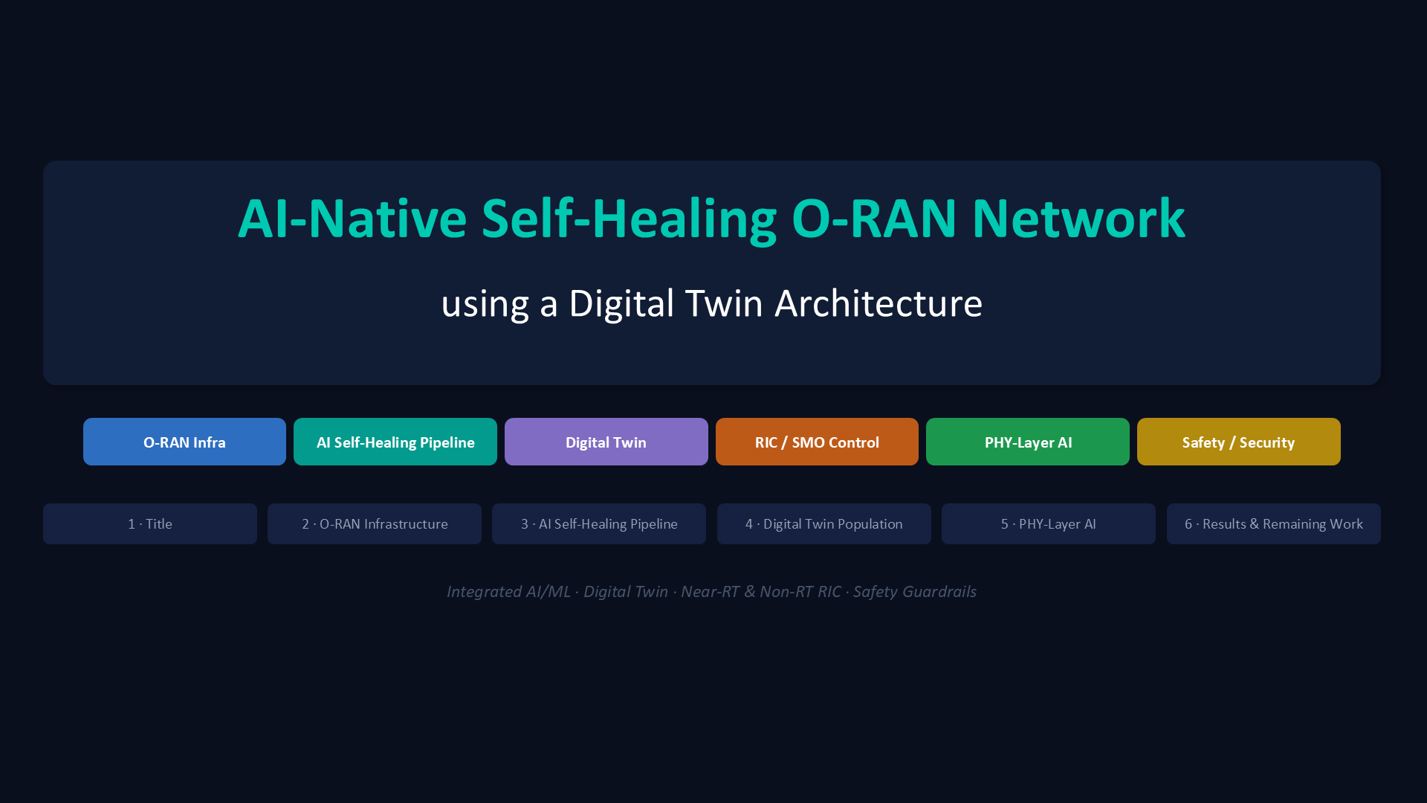

Slide 49
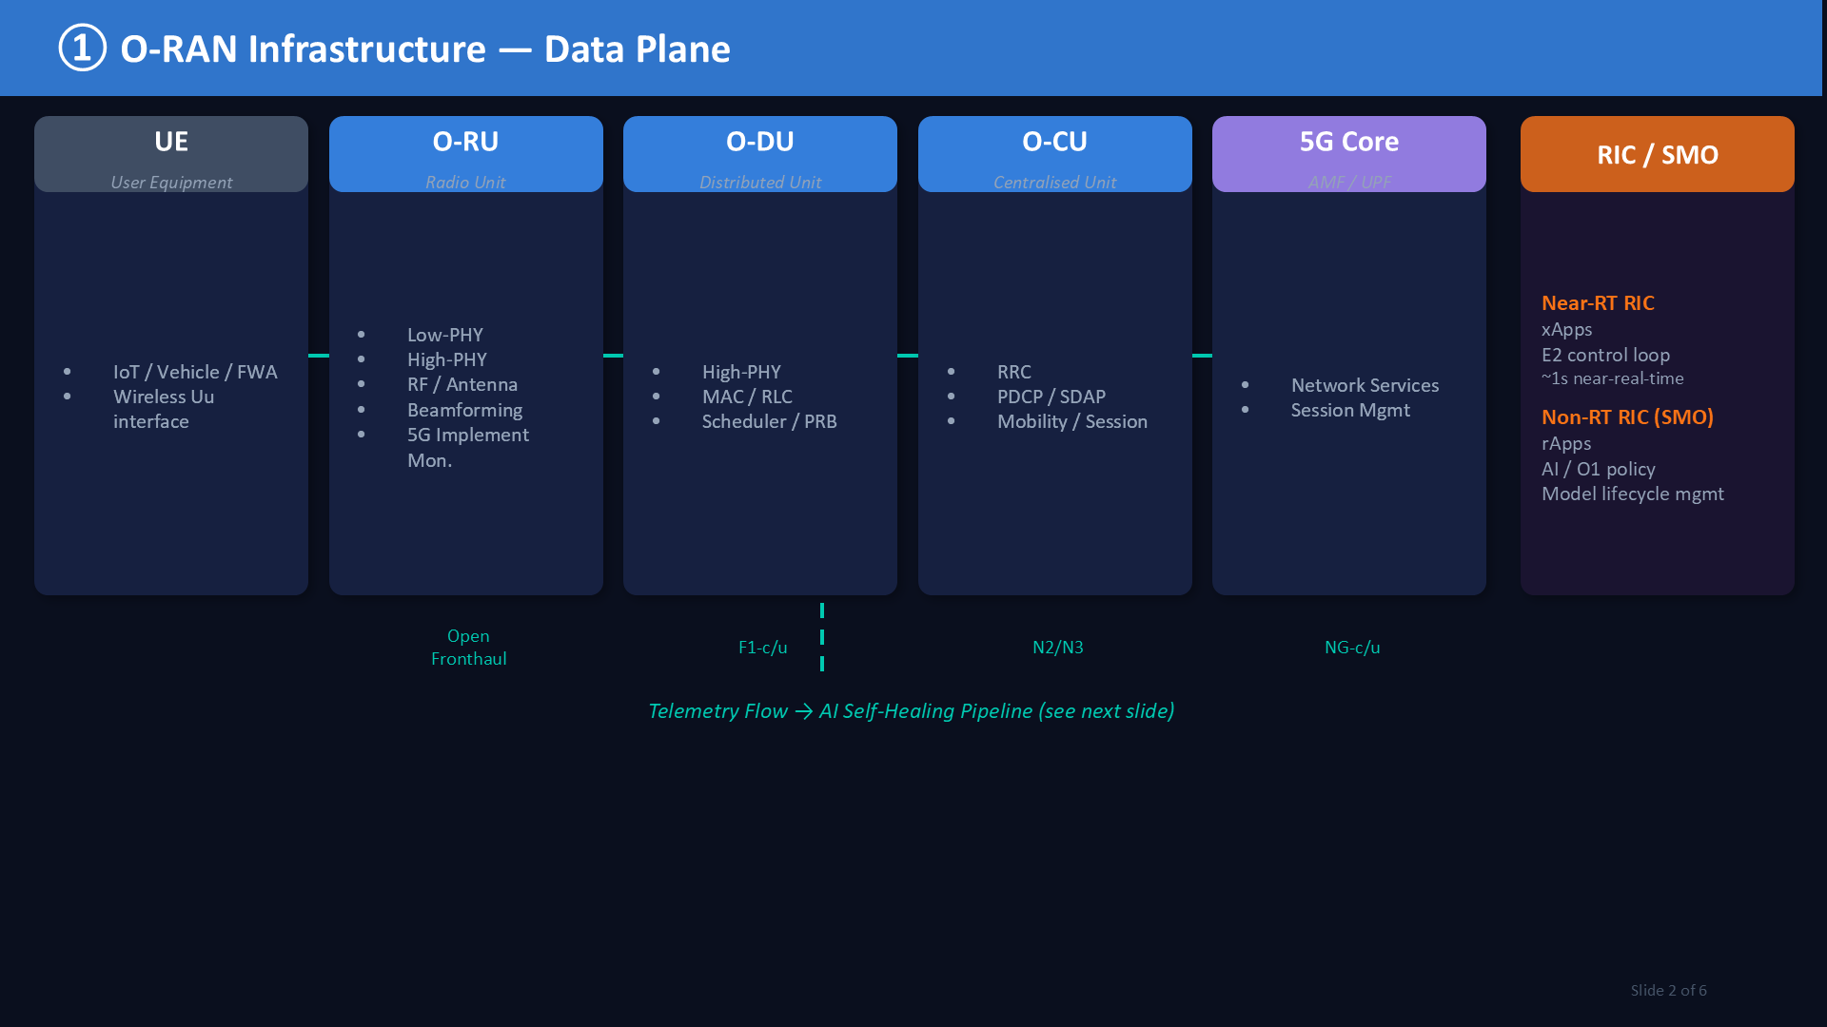

Slide 50
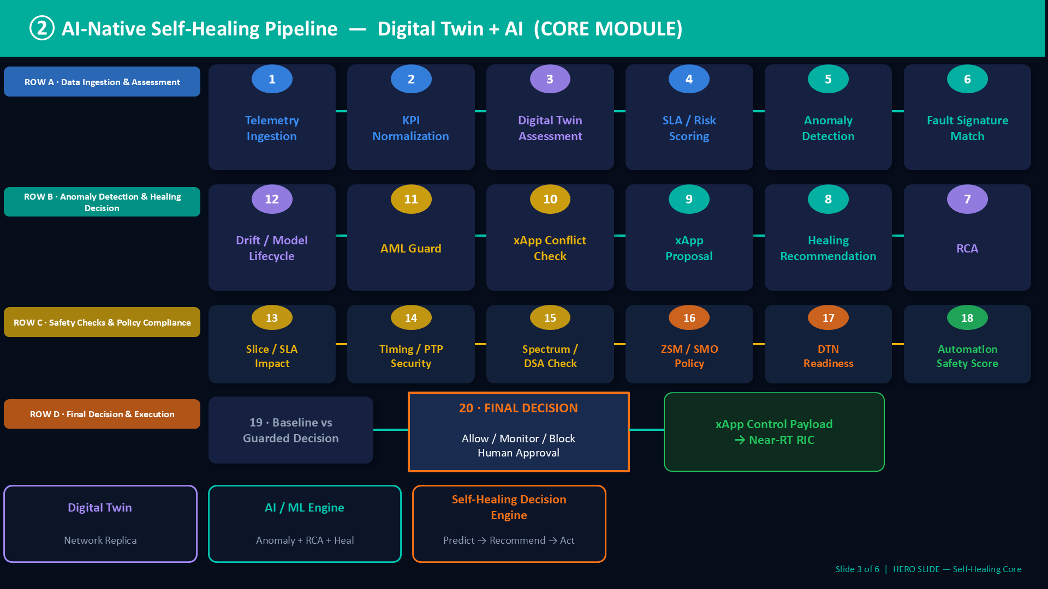

Slide 51
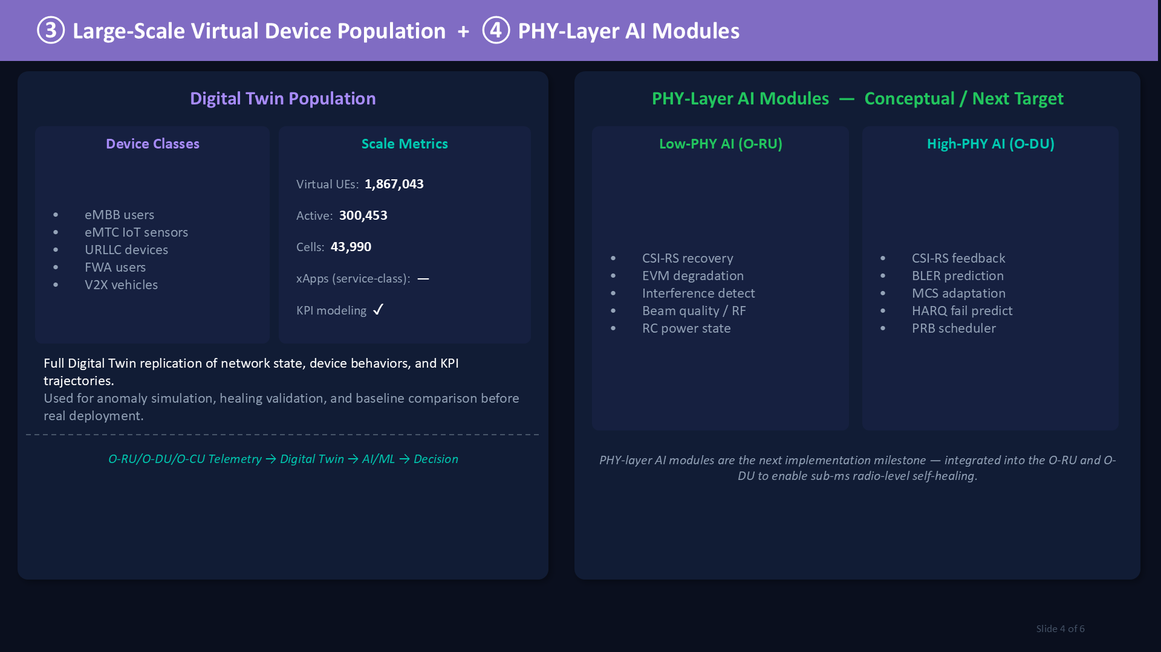

Slide 52
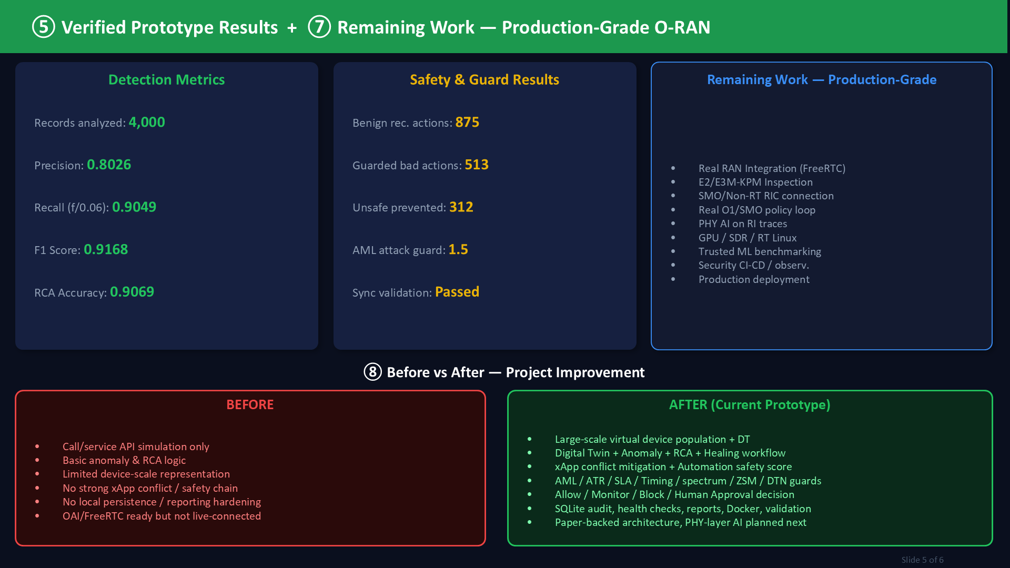

Slide 53
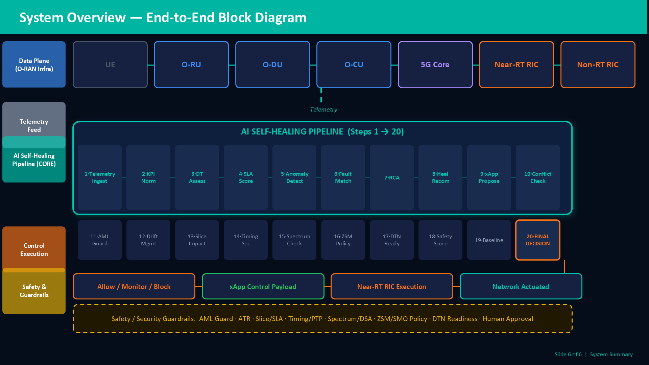

Slide 54
WHAT IS NOT DONE
Remaining work for production-grade O-RAN
This is the honest boundary of the current prototype.
Real RAN integration
ML benchmarking
PHY-layer AI
- Live OAI / srsRAN / FlexRIC telemetry.
- Real E2SM-KPM KPI ingestion.
- Real Near-RT RIC xApp deployment.
- Real O1/SMO policy integration.
- Live per-UE monitoring.
- Train ML anomaly models.
- Train or benchmark RCA models.
- Compare trained ML to rule/window baseline.
- Add model confidence testing.
- Add rollback gates based on metrics.
- Use IQ/PHY traces.
- Low-PHY/O-RU AI.
- High-PHY/O-DU AI.
- SDR/GPU/real-time Linux validation.
- Deeper telecom/DSP validation.
AI-Native Self-Healing O-RAN Technical Methodology | 54

Slide 55
FINAL CLAIM
Correct final project claim
Use this wording in presentation.
Recommended wording
This project implements an AI-native self-healing intelligence layer for O-RAN using a digital twin. It monitors service and radio-performance degradation affecting O-RU, O-DU, and O-CU, performs anomaly detection, RCA, healing recommendation, xApp conflict checks, and safety gating, and produces RIC/xApp-ready control outputs with reports and evaluation metrics.
Important boundary
The current implementation is a local research prototype with simulated O-RAN-ready telemetry. Real OAI/FlexRIC integration, live xApp deployment, real per-UE telemetry, trained ML benchmarking, and real PHY-layer AI remain future work.
AI-Native Self-Healing O-RAN Technical Methodology | 55

