Slide 1
SISTEMAS OPERATIVOS
SO
E – M 2022

Slide 2
Java by Sun Microsystems
James Gosling, Mike Sheridan and Patrick Naughton, initiated a language Project in June 1991
A team of Engineers part of the Green Project
For small, embedded systems in electronic apliances, in digital systems, like CATV (TVs and set-top boxes)
Names: 1st- Greentalk, 2nd- Oak
In 1995, Oak renamed as Java

Slide 3
Java by Sun Microsystems
Java name
Island of Indonesia, a java coffee producer
Java principles
Object-Oriented, Secured, Multithreaded
Interpreted, Platform-independent, Portable
Java 1.0 release, 1996
Oracle bought Sun Microsystems: 2009
with Java inside

Slide 4
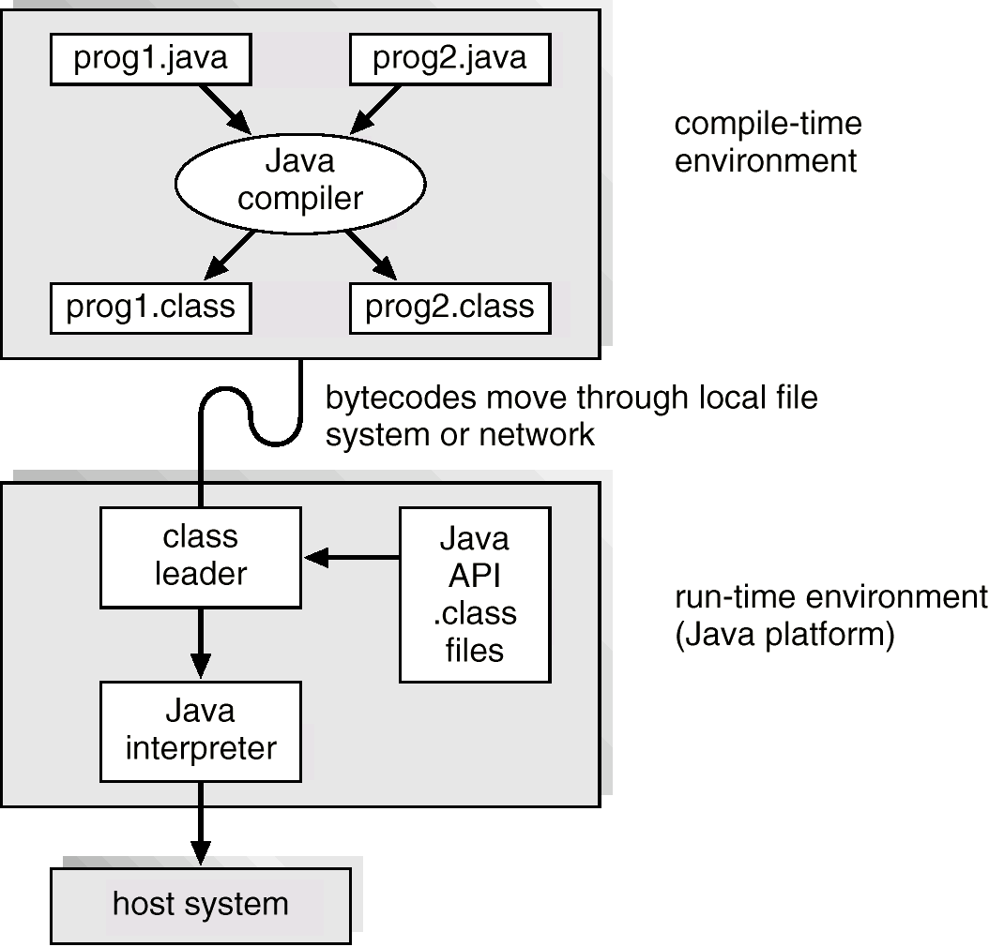
Java Development (Environment) Kit
JDK
JRE

Slide 5
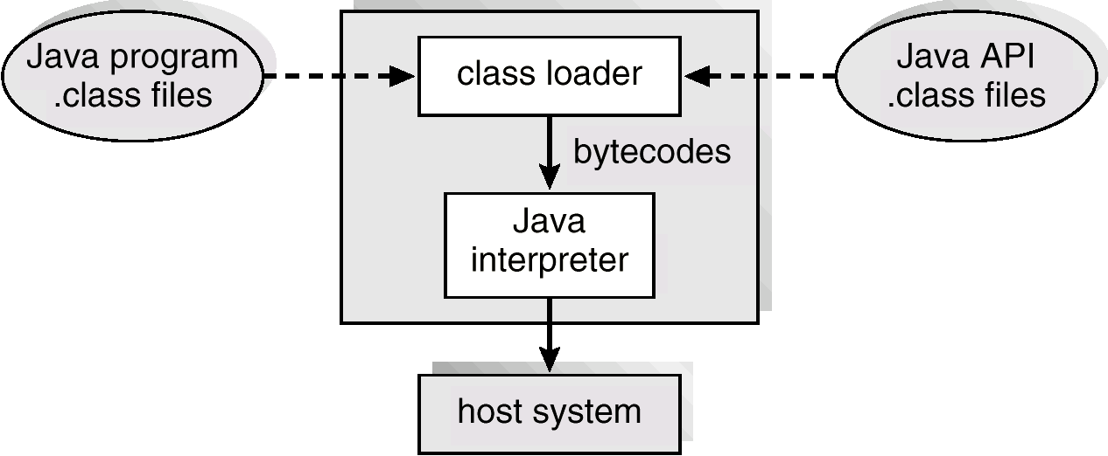
The Java Virtual Machine - JVM
Virtual Machine supporting processing.
Virtual OS with no support for users and storage.

Slide 6
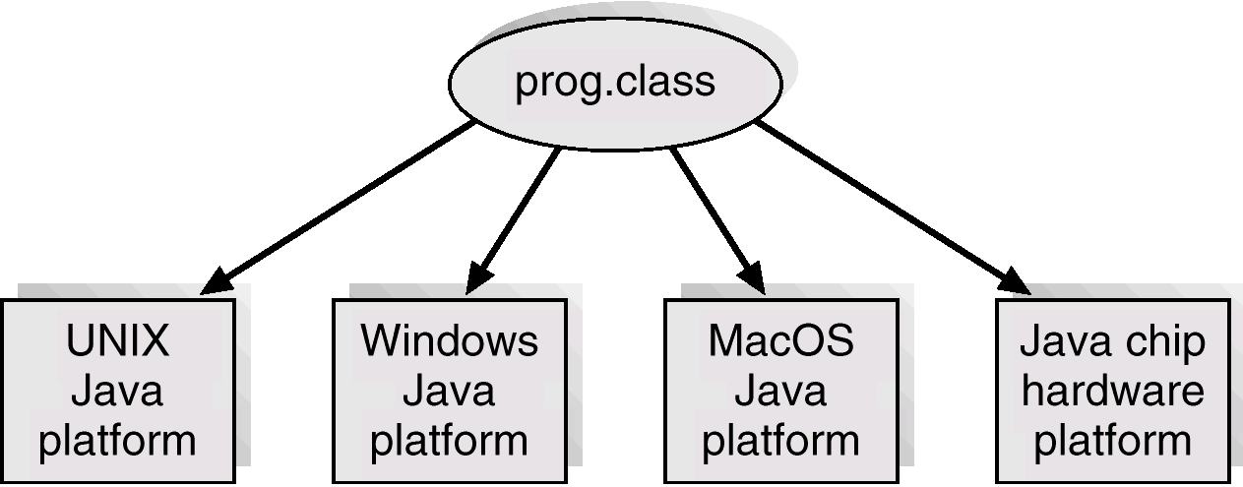
Java .class File on Cross Platforms

Slide 7
References
Presentación de Ramon Ríos.
Capítulos: Operating System Concepts; Silberschatz, Galvin, Gagne.
Enero – mayo 2022

