Slide 1
Verifying Algorithmic Versions of the Lovász Local Lemma
Rongen Lin, Hongjin Liang, and Xinyu Feng
Nanjing University

Slide 2
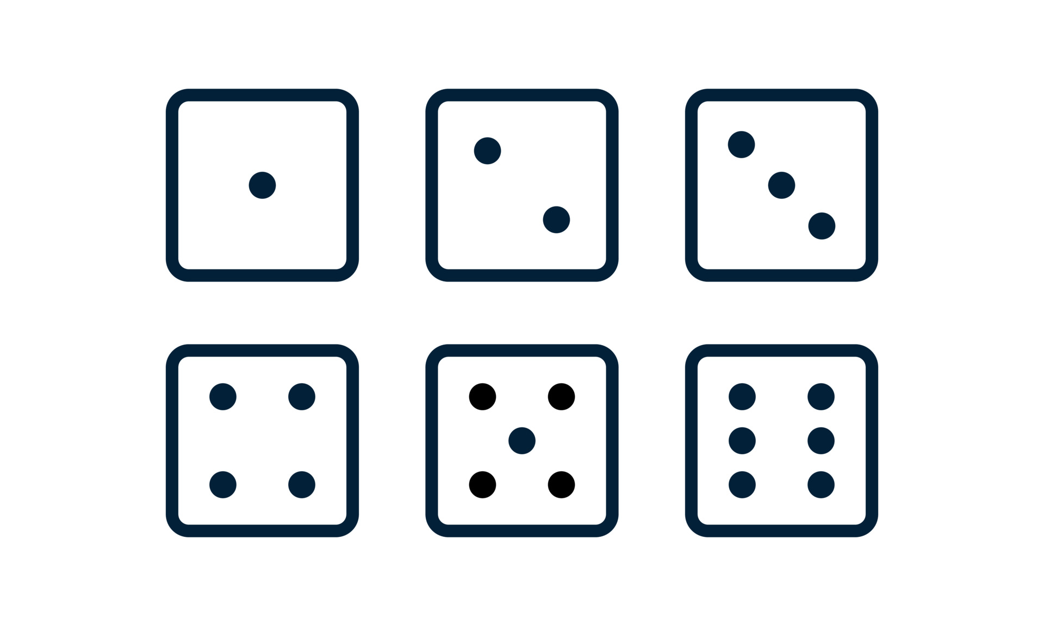

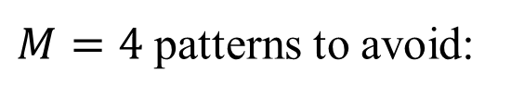
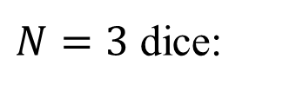

A dice-rolling example
?
?
?
$N=3$ dice:
$M=4$ patterns to avoid:
?
?
A good roll:
?
For larger $N,M$,
Does there exist a roll of $N$ dice that avoids all $M$ patterns?
YES under a loose condition! By Lovász Local Lemma (LLL) [EL75, Spe77].
(called “EL-condition”)

Slide 3
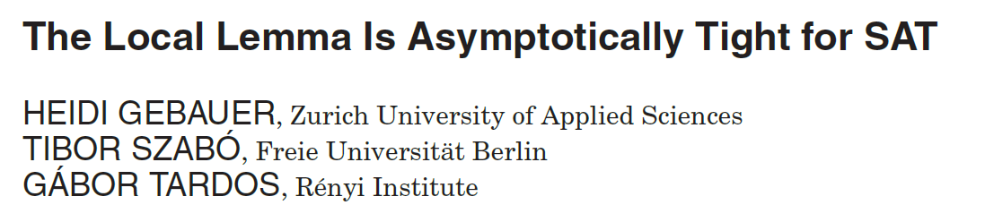
Lovász Local Lemma
Widely used in combinatorics! Because many comb. problems are like “rolling dice while avoiding special patterns”.
Example: the SAT problem is like “rolling …”, so LLL applies well!
[JACM 2016]

Slide 4
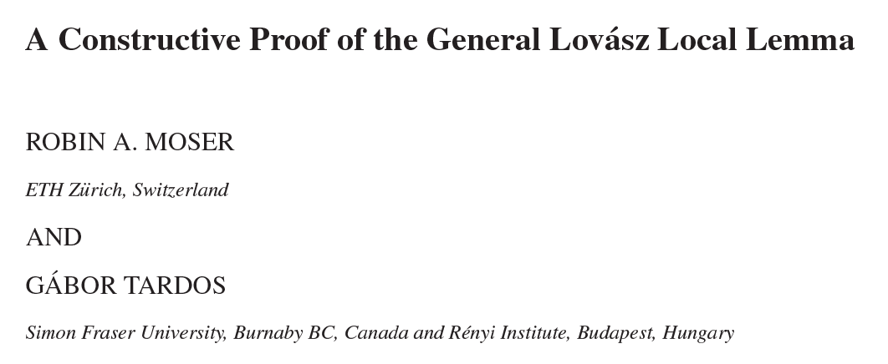
A dice-rolling example (cont’d)
Does there exist a roll of $N$ dice that avoids all $M$ patterns?
YES under a loose condition! By LLL.
Great, but we want more:
How to efficiently and algorithmically construct a good roll?
Solution: Moser-Tardos (MT) algorithm [JACM 2010, Gödel Prize 2020].

Slide 5
The MT algorithm: How does it construct a good roll?
Simple idea: roll, then reroll some dice until we get a good roll!
Roll all the dice:
Patterns to avoid:
Some pattern is matched
Reroll the dice that the pattern depends on!
?
?
?
After rerolling:
?
?
After rerolling:
?
A good roll

Slide 6

The MT algorithm is simple yet efficient!
[MT10] (proved in the Theory A style):
Terminates with prob. 1;
A constant upper bound of the expected rounds of rolling.
Reroll…
$$⋮$$
Our motivation:
The MT algo. is a probabilistic program, so we formally verify it by applying PL techniques!
A good roll

Slide 7
Our contributions
Formal verification of 6 important properties of the MT algo. and its extensions, including all 3 “probabilistic” results in [MT10] (Gödel Prize 2020).
2 proof recipes as byproducts:
Loop truncation for simplifying the proof of total correctness of prob. programs.
Resampling-table-based coupling for probabilistic relational reasoning.
A verified new property of the MT algo.
This talk: verifying one of the most important results in [MT10].
The MT algo.:
Terminates with prob. 1;
A constant upper bound of the expected rounds of sampling.

Slide 8
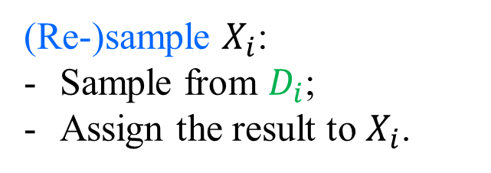
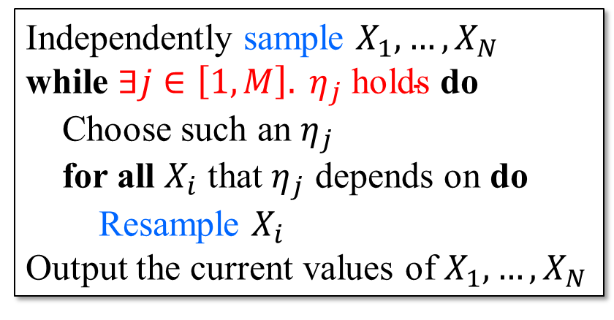
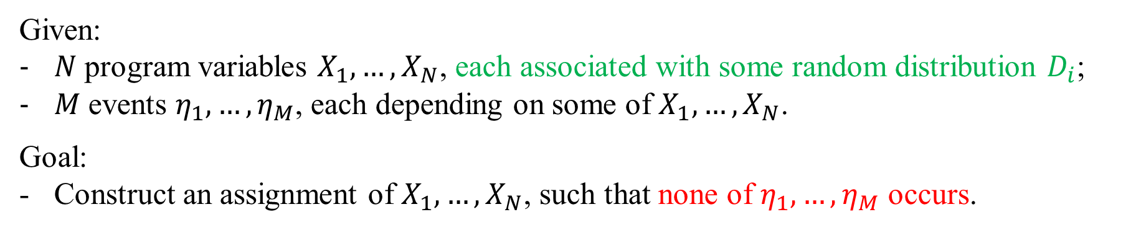
The MT algorithm: The general form
Given:
$N$program variables $X_{1},…, X_{N}$, each associated with some random distribution $D_{i}$;
$M$events $η_{1},…, η_{M}$, each depending on some of $X_{1},…, X_{N}$.
Goal:
Construct an assignment of $X_{1},…, X_{N}$, such that none of $η_{1},…, η_{M}$ occurs.
(“dice”)
(“patterns”)
Independently sample $X_{1},…, X_{N}$
while $∃j∈\left[1, M\right]. η_{j} \text{holds}$ do
Choose such an $η_{j}$
for all $X_{i}$ that $η_{j}$ depends on do
Resample $X_{i}$
Output the current values of $X_{1},…, X_{N}$
(Re-)sample $X_{i}$:
Sample from $D_{i}$;
Assign the result to $X_{i}$.

Slide 9
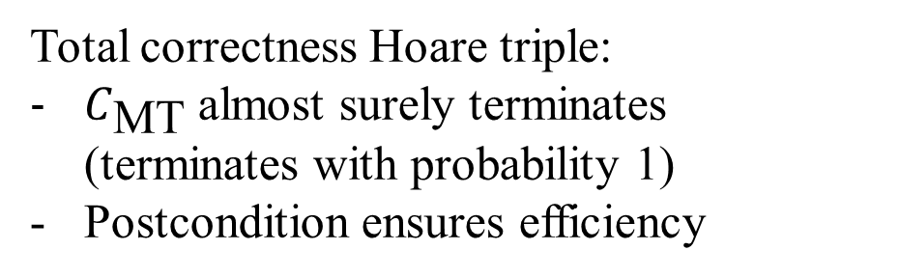
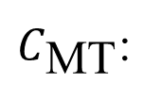

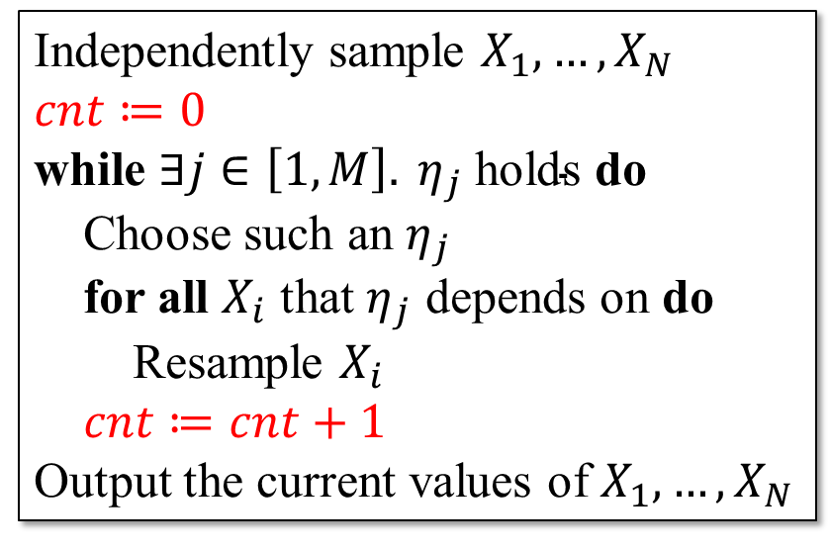
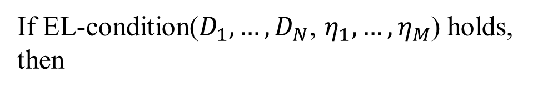
Proof goal
A special constraint
If EL-condition($D_{1},…, D_{N}$, $η_{1},…, η_{M}$) holds, then
$C_{\text{MT}}$:
Independently sample $X_{1},…, X_{N}$
$cnt≔0$
while $∃j∈\left[1, M\right]. η_{j} \text{holds}$ do
Choose such an $η_{j}$
for all $X_{i}$ that $η_{j}$ depends on do
Resample $X_{i}$
$cnt≔cnt+1$
Output the current values of $X_{1},…, X_{N}$
$$\begin{aligned}\#\text{⊨} \left[true\right] C_{\text{MT}} \left[\text{𝔼}\left[cnt\right]≤r_{\text{EL}}\right]\end{aligned}$$
A constant real number
Total correctness Hoare triple:
$C_{\text{MT}}$almost surely terminates (terminates with probability 1)
Postcondition ensures efficiency
How to prove it?

Slide 10

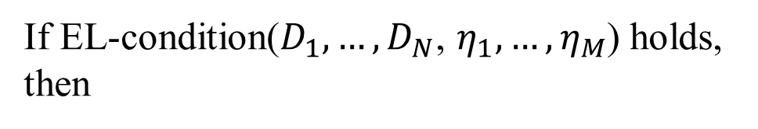

Existing approaches for almost sure termination do NOT apply
Based on probabilistic ranking functions (e.g. supermartingales [CS13, FH15, …])
Very crucial for $C_{\text{MT}}$’s almost sure termination
But very complicated!
Unclear how to be encoded in ranking functions
If EL-condition($D_{1},…, D_{N}$, $η_{1},…, η_{M}$) holds, then
$$\begin{aligned}\#\text{⊨} \left[true\right] C_{\text{MT}} \left[\text{𝔼}\left[cnt\right]≤r_{\text{EL}}\right]\end{aligned}$$

Slide 11









Alternative idea in [MT10]
Reduce
$$\begin{aligned}\#\text{⊨} \left[true\right] C_{\text{MT}} \left[\text{𝔼}\left[cnt\right]≤r_{\text{EL}}\right]\end{aligned}$$
to proving:
$$∀wt. Pr\left[∃Λ ∈ ⟦C_{\text{MT}}⟧. Rel(wt,Λ)\right]≤p\left(wt\right).$$
A special math structure
called “witness tree”
A special relation
A real number depending on $wt$
$$Λ$$
An execution trace
Initial state
Terminating states
$$Λ$$
All execution traces of $C_{\text{MT}}$
including infinite ones
$$Λ$$
$$Λ$$
How to formally define $⟦C_{\text{MT}}⟧$?
…
$Λ$ (infinite trace)

Slide 12



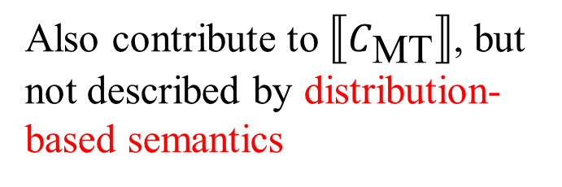

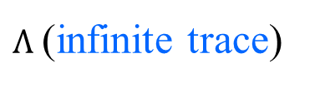


Challenge: How to formally define $⟦C_{\text{MT}}⟧$?
Difficult to define $⟦C_{\text{MT}}⟧$ in distribution-based semantics
Can be defined in measure-theoretic trace-based semantics, but too complex
$$Λ$$
Terminating states
Initial state
$$Λ$$
Only describes these states!
$$Λ$$
$$Λ$$
…
Also contribute to $⟦C_{\text{MT}}⟧$, but not described by distribution-based semantics
$Λ$ (infinite trace)

Slide 13
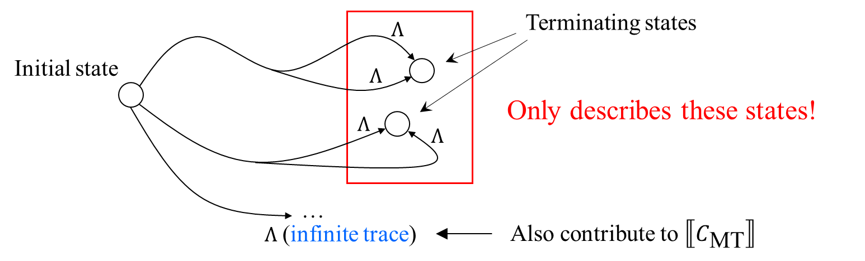
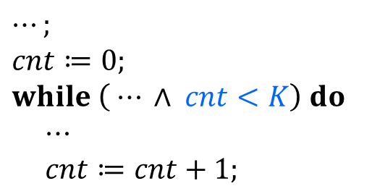

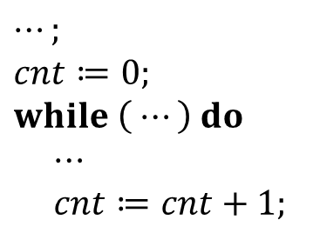
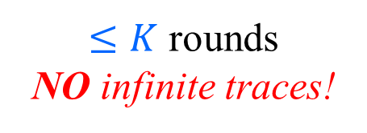
Our solution (proof recipe #1): Loop Truncation
Idea: still use distribution-based semantics, but do a code transformation
$$C_{\text{MT}}:$$
$$C_{\text{MT}}^{′}\left(K\right):$$
$⋯;$
$cnt≔0;$
$while \left( ⋯\right) do$
$⋯$
$cnt≔cnt+1;$
$⋯;$
$cnt≔0;$
$while \left( ⋯ ∧ cnt<K\right) do$
$⋯$
$cnt≔cnt+1;$
$≤K$ rounds
NO infinite traces!
$$×$$

Slide 14
Our solution (proof recipe #1): Loop Truncation
Idea: still use distribution-based semantics, but do a code transformation
$$C_{\text{MT}}:$$
$$C_{\text{MT}}^{′}\left(K\right):$$
$⋯;$
$cnt≔0;$
$while \left( ⋯\right) do$
$⋯$
$cnt≔cnt+1;$
$⋯;$
$cnt≔0;$
$while \left( ⋯ ∧ cnt<K\right) do$
$⋯$
$cnt≔cnt+1;$
$≤K$ rounds
NO infinite traces!
Theorem:
$$\text{⊨} \left[true\right] C_{\text{MT}} \left[\text{𝔼}\left[cnt\right]≤r_{\text{EL}}\right] ⟸ ∀K∈ℕ. \text{⊨} \left[true\right] C_{\text{MT}}^{′}\left(K\right) \left[\text{𝔼}\left[cnt\right]≤r_{\text{EL}}\right]$$

Slide 15



Our proof path
$$\text{⊨} \left[true\right] C_{\text{MT}} \left[\text{𝔼}\left[cnt\right]≤r_{\text{EL}}\right]$$
$$⇑$$
Loop Truncation
$$∀K∈ℕ. \text{⊨} \left[true\right] C_{\text{MT}}^{′}\left(K\right) \left[\text{𝔼}\left[cnt\right]≤r_{\text{EL}}\right]$$
$$⇑$$
$$∀wt. \text{⊨} \left[true\right] C_{\text{MT}}^{′}\left(K\right) \left[Pr\left[∃Λ ∈ ⟦C_{\text{MT}}^{′}\left(K\right)⟧. Rel(wt,Λ)\right]≤p\left(wt\right)\right]$$
$$⇑$$
Defined in distribution-based semantics
?
[MT10]’s idea: reduce to relational reasoning

Slide 16
Relational reasoning in [MT10]
To prove
$$Pr\left[∃Λ ∈ ⟦C_{\text{MT}}^{′}\left(K\right)⟧. Rel(wt,Λ)\right]≤p\left(wt\right)$$
Idea: construct an auxiliary probabilistic program check$\left(wt\right)$, then prove
Not difficult, by probabilistic Hoare logic [BEG+18]
$$Pr\left[∃Λ ∈ ⟦C_{\text{MT}}^{′}\left(K\right)⟧. Rel(wt,Λ)\right]≤Pr\left[\text{check}\left(wt\right) \text{outputs} 1\right]=p\left(wt\right)$$
Relational reasoning

Slide 17





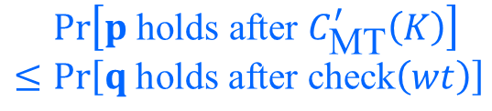
Our proof path
$$\text{⊨} \left[true\right] C_{\text{MT}} \left[\text{𝔼}\left[cnt\right]≤r_{\text{EL}}\right]$$
$$⇑$$
Loop Truncation
$$∀K∈ℕ. \text{⊨} \left[true\right] C_{\text{MT}}^{′}\left(K\right) \left[\text{𝔼}\left[cnt\right]≤r_{\text{EL}}\right]$$
$$⇑$$
$$∀wt. \text{⊨} \left[true\right] C_{\text{MT}}^{′}\left(K\right) \left[Pr\left[∃Λ ∈ ⟦C_{\text{MT}}^{′}\left(K\right)⟧. Rel(wt,Λ)\right]≤p\left(wt\right)\right]$$
$$⇑$$
Defined in distribution-based semantics
$$≤Pr\left[p \text{holds} \text{after} C_{\text{MT}}^{′}\left(K\right)\right] \\ ≤Pr\left[q \text{holds} \text{after} \text{check}\left(wt\right)\right]$$
$$\begin{aligned}\#\text{⊨} \left\{true\right\} C_{\text{MT}}^{′}\left(K\right)≤\text{check}\left(wt\right) \left\{p, q\right\}\end{aligned}$$
$$∧$$
$$⋯$$
How to do relational reasoning?

Slide 18
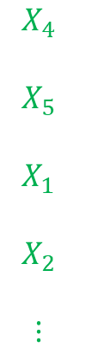
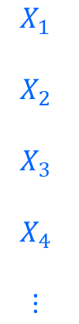
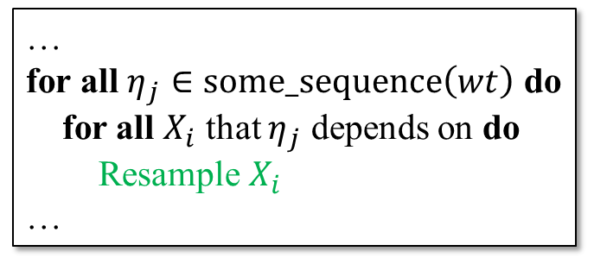
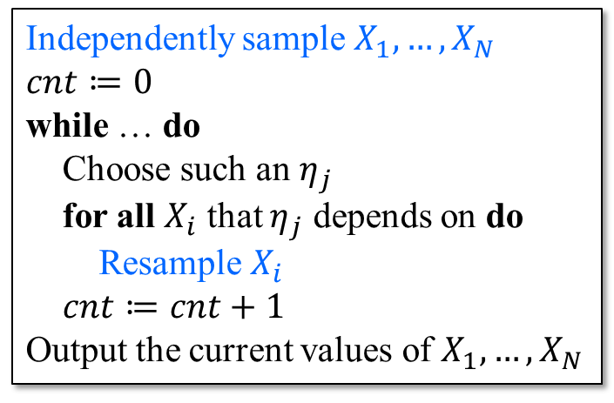



How to do relational reasoning?
Most of existing approaches: only support “synchronous coupling” $⇒$ do NOT apply
[GAH+24]: supports “asynchronous coupling”, but still hard to apply for the MT algo.
$$C_{\text{MT}}^{′}\left(K\right)$$
$$\text{check}\left(wt\right)$$
Independently sample $X_{1},…, X_{N}$
$cnt≔0$
while … do
Choose such an $η_{j}$
for all $X_{i}$ that $η_{j}$ depends on do
Resample $X_{i}$
$cnt≔cnt+1$
Output the current values of $X_{1},…, X_{N}$
Sampling histories
…
for all $η_{j}∈\text{some}\text{_}\text{sequence}\left(wt\right)$ do
for all $X_{i}$ that $η_{j}$ depends on do
Resample $X_{i}$
…
$$X_{1}$$
$$X_{2}$$
$$X_{3}$$
$$X_{4}$$
$$⋮$$
$$X_{4}$$
$$X_{5}$$
$$X_{1}$$
$$X_{2}$$
$$⋮$$
NOT synchronous!

Slide 19
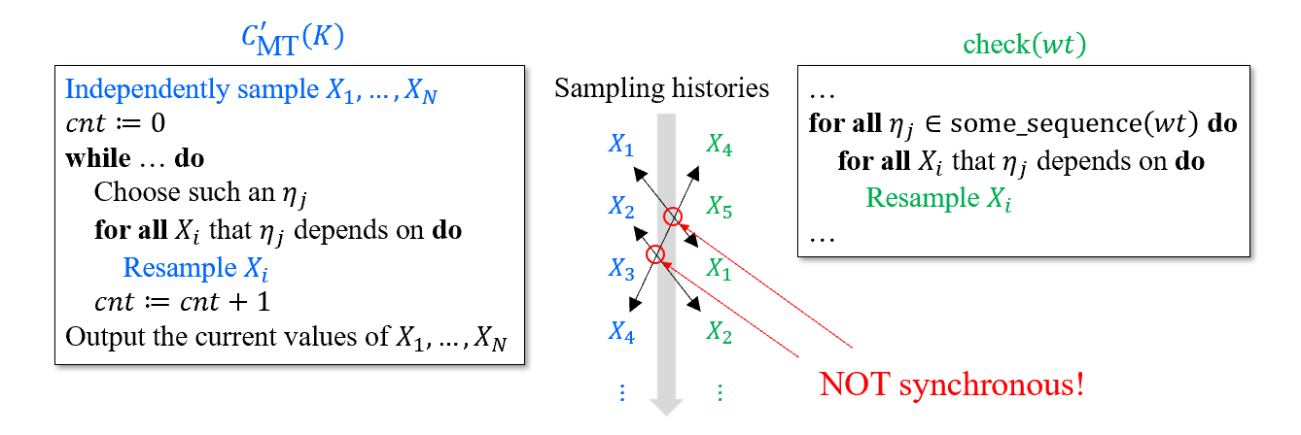
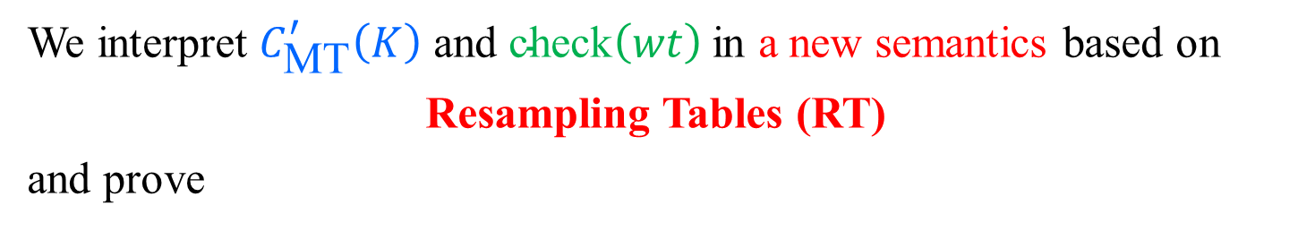
Our solution (proof recipe #2): RT-Based Coupling
To prove
Relational Reasoning
$$\begin{aligned}\#\text{⊨} \left\{true\right\} C_{\text{MT}}^{′}\left(K\right)≤\text{check}\left(wt\right) \left\{p, q\right\}\end{aligned}$$
We interpret $C_{\text{MT}}^{′}\left(K\right)$ and $\text{check}\left(wt\right)$in a new semantics based on
Resampling Tables (RT)
and prove
reduce to
$$\begin{aligned}{\text{⊨}}_{\text{RT}}\left\{ ⋯\right\} C_{\text{MT}}^{′}\left(K\right) \left\{ ⋯\right\}\end{aligned}$$
$$\begin{aligned}{\text{⊨}}_{\text{RT}}\left[ ⋯\right] \text{check}\left(wt\right) \left[ ⋯\right]\end{aligned}$$
Unary Reasoning
and
Whether synchronous or not,
we do not care!

Slide 20
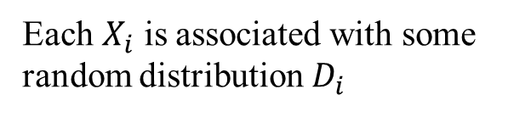






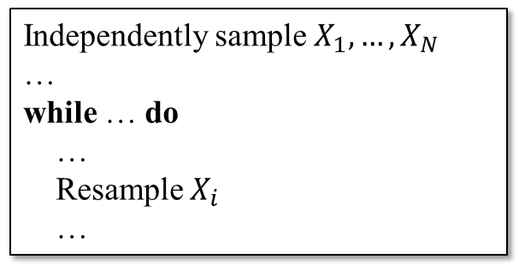

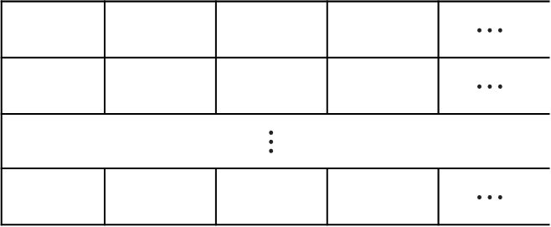




RT-based semantics
1. Introduce a random resampling table ($RT$) in the initial program configuration.
An infinite number of samplings
$$0$$
$$1$$
$$2$$
$$3$$
$$⋯$$
$$X_{1}$$
$$RT_{1,0}$$ | $$RT_{1,1}$$ | $$RT_{1,2}$$ | $$RT_{1,3}$$ | $$⋯$$
$$RT_{2,0}$$ | $$RT_{2,1}$$ | $$RT_{2,2}$$ | $$RT_{2,3}$$ | $$⋯$$
$$⋮$$
$$RT_{N,0}$$ | $$RT_{N,1}$$ | $$RT_{N,2}$$ | $$RT_{N,3}$$ | $$⋯$$
Independently sample $X_{1},…, X_{N}$
…
while … do
…
Resample $X_{i}$
…
$$X_{2}$$
$$RT$$
$$⋮$$
$$X_{N}$$
Generated by sampling from $D_{2}$
Each $X_{i}$ is associated with some random distribution $D_{i}$

Slide 21
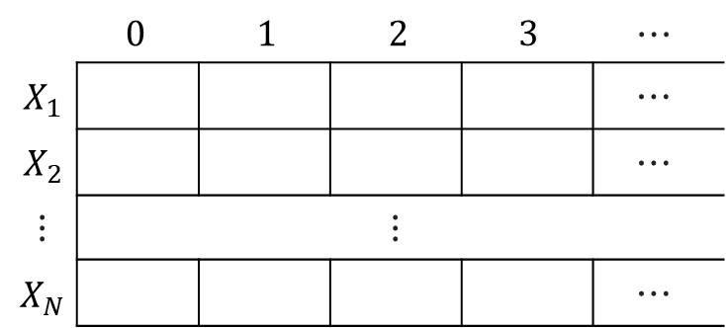

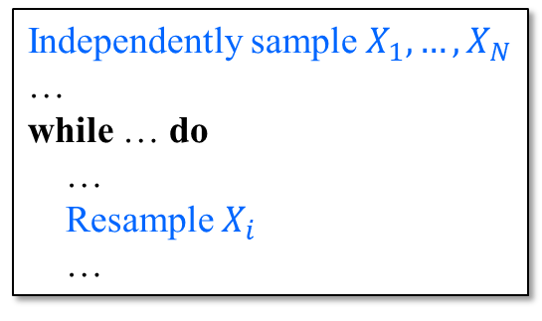
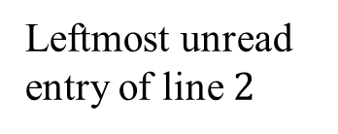

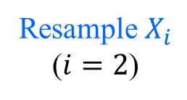

RT-based semantics
2. Re-interpret sampling operations in the program as deterministic table queries on $RT$.
$$RT$$
Independently sample $X_{1},…, X_{N}$
…
while … do
…
Resample $X_{i}$
…
Leftmost unread entry of line $2$
Resample $X_{i}$ ($i=2$)
$$X_{2}=RT\left[2, 3\right]$$
Deterministic table queries on $RT$

Slide 22
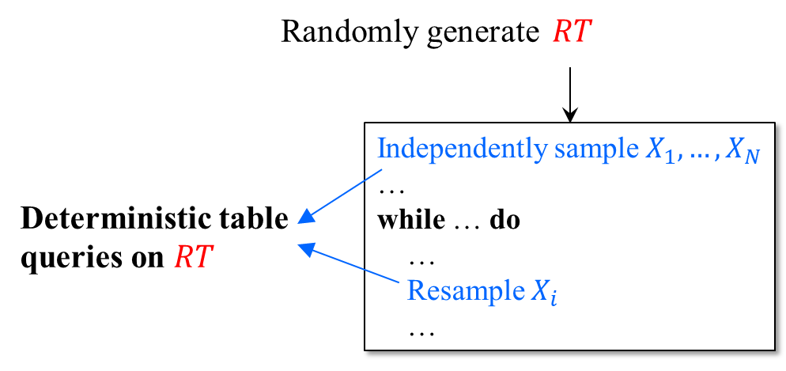
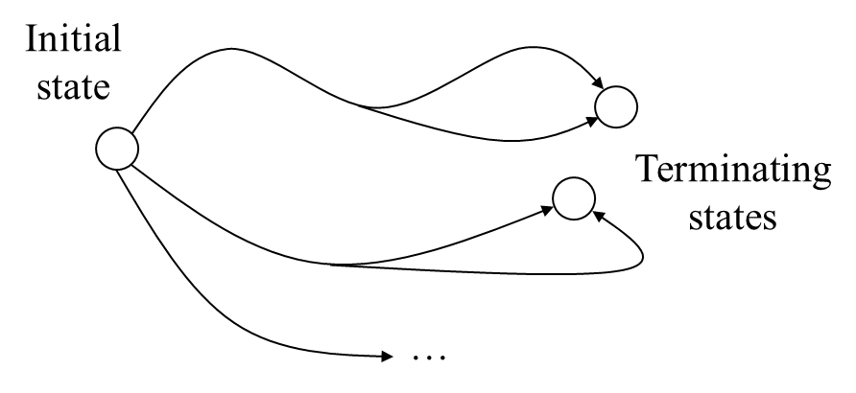
Semantics equivalence
Theorem The RT-based semantics is equivalent to the distribution-based semantics.
In initial config, introduce

Slide 23





Our proof path
$$⋯$$
Defined in distribution-based semantics
$$⇑$$
$$\begin{aligned}\#\text{⊨} \left\{true\right\} C_{\text{MT}}^{′}\left(K\right)≤\text{check}\left(wt\right) \left\{p, q\right\}\end{aligned}$$
$$∧$$
$$⋯$$
Equivalent!
$$⇑$$
$$\begin{aligned}{\text{⊨}}_{\text{RT}}\left\{true\right\} C_{\text{MT}}^{′}\left(K\right)≤\text{check}\left(wt\right) \left\{p, q\right\}\end{aligned}$$
Defined in RT-based semantics
$$⇑$$
?

Slide 24



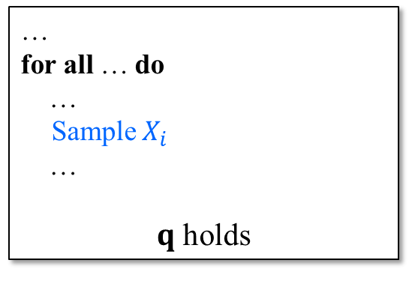



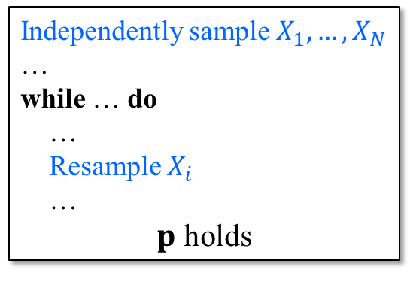
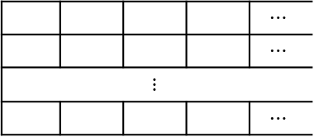
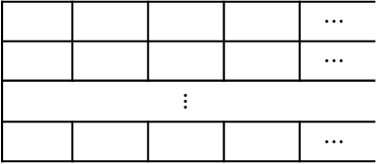



Next: reduce relational reasoning to unary reasoning
$$\begin{aligned}{\text{⊨}}_{\text{RT}}\left\{true\right\} C_{\text{MT}}^{′}\left(K\right)≤\text{check}\left(wt\right) \left\{p, q\right\}\end{aligned}$$
Our goal
which means:
$$RT_{1,0}$$ | $$RT_{1,1}$$ | $$RT_{1,2}$$ | $$RT_{1,3}$$ | $$⋯$$
$$RT_{2,0}$$ | $$RT_{2,1}$$ | $$RT_{2,2}$$ | $$RT_{2,3}$$ | $$⋯$$
$$⋮$$
$$RT_{N,0}$$ | $$RT_{N,1}$$ | $$RT_{N,2}$$ | $$RT_{N,3}$$ | $$⋯$$
$$RT_{1,0}$$ | $$RT_{1,1}$$ | $$RT_{1,2}$$ | $$RT_{1,3}$$ | $$⋯$$
$$RT_{2,0}$$ | $$RT_{2,1}$$ | $$RT_{2,2}$$ | $$RT_{2,3}$$ | $$⋯$$
$$⋮$$
$$RT_{N,0}$$ | $$RT_{N,1}$$ | $$RT_{N,2}$$ | $$RT_{N,3}$$ | $$⋯$$
$$RT$$
$$RT$$
$$C_{\text{MT}}^{′}\left(K\right)$$
Independently sample $X_{1},…, X_{N}$
…
while … do
…
Resample $X_{i}$
…
$p$ holds
…
for all … do
…
Sample $X_{i}$
…
$q$ holds
$$\text{check}\left(wt\right)$$
$$Pr[$$
$$]$$
$$≤$$
$$Pr[$$
$$]$$

Slide 25
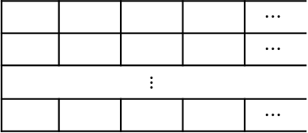
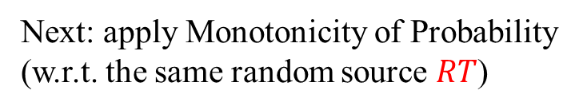

Reduce relational reasoning to unary reasoning
$$\begin{aligned}{\text{⊨}}_{\text{RT}}\left\{true\right\} C_{\text{MT}}^{′}\left(K\right)≤\text{check}\left(wt\right) \left\{p, q\right\}\end{aligned}$$
To prove
(1) Let $C_{\text{MT}}^{′}\left(K\right)$and $\text{check}\left(wt\right)$ use the same $RT$.
$$RT_{1,0}$$ | $$RT_{1,1}$$ | $$RT_{1,2}$$ | $$RT_{1,3}$$ | $$⋯$$
$$RT_{2,0}$$ | $$RT_{2,1}$$ | $$RT_{2,2}$$ | $$RT_{2,3}$$ | $$⋯$$
$$⋮$$
$$RT_{N,0}$$ | $$RT_{N,1}$$ | $$RT_{N,2}$$ | $$RT_{N,3}$$ | $$⋯$$
Next: apply Monotonicity of Probability (w.r.t. the same random source $RT$)
$$RT$$
$$C_{\text{MT}}^{′}\left(K\right)$$
Independently sample $X_{1},…, X_{N}$
…
while … do
…
Resample $X_{i}$
…
$p$ holds
…
for all … do
…
Sample $X_{i}$
…
$q$ holds
$$\text{check}\left(wt\right)$$
$$Pr[$$
$$]$$
$$≤$$
$$Pr[$$
$$]$$

Slide 26

Reduce relational reasoning to unary reasoning
$$\begin{aligned}{\text{⊨}}_{\text{RT}}\left\{true\right\} C_{\text{MT}}^{′}\left(K\right)≤\text{check}\left(wt\right) \left\{p, q\right\}\end{aligned}$$
To prove
(1) Let $C_{\text{MT}}^{′}\left(K\right)$and $\text{check}\left(wt\right)$ use the same $RT$.
$$RT_{1,0}$$ | $$RT_{1,1}$$ | $$RT_{1,2}$$ | $$RT_{1,3}$$ | $$⋯$$
$$RT_{2,0}$$ | $$RT_{2,1}$$ | $$RT_{2,2}$$ | $$RT_{2,3}$$ | $$⋯$$
$$⋮$$
$$RT_{N,0}$$ | $$RT_{N,1}$$ | $$RT_{N,2}$$ | $$RT_{N,3}$$ | $$⋯$$
$$RT$$
$$C_{\text{MT}}^{′}\left(K\right)$$
Independently sample $X_{1},…, X_{N}$
…
while … do
…
Resample $X_{i}$
…
$p$ holds
…
for all … do
…
Sample $X_{i}$
…
$q$ holds
$$\text{check}\left(wt\right)$$
$$⟹$$

Slide 27



Reduce relational reasoning to unary reasoning
$$\begin{aligned}{\text{⊨}}_{\text{RT}}\left\{true\right\} C_{\text{MT}}^{′}\left(K\right)≤\text{check}\left(wt\right) \left\{p, q\right\}\end{aligned}$$
To prove
(2) Find an intermediate property $R$ for the same $RT$.
$$RT_{1,0}$$ | $$RT_{1,1}$$ | $$RT_{1,2}$$ | $$RT_{1,3}$$ | $$⋯$$
$$RT_{2,0}$$ | $$RT_{2,1}$$ | $$RT_{2,2}$$ | $$RT_{2,3}$$ | $$⋯$$
$$⋮$$
$$RT_{N,0}$$ | $$RT_{N,1}$$ | $$RT_{N,2}$$ | $$RT_{N,3}$$ | $$⋯$$
$$RT$$
$$C_{\text{MT}}^{′}\left(K\right)$$
Independently sample $X_{1},…, X_{N}$
…
while … do
…
Resample $X_{i}$
…
$p$ holds
Property of
…
for all … do
…
Sample $X_{i}$
…
$q$ holds
$$\text{check}\left(wt\right)$$
$$⟹$$
$$R$$
$$⟹$$

Slide 28


Reduce relational reasoning to unary reasoning
$$\begin{aligned}{\text{⊨}}_{\text{RT}}\left\{true\right\} C_{\text{MT}}^{′}\left(K\right)≤\text{check}\left(wt\right) \left\{p, q\right\}\end{aligned}$$
To prove
(3) Now we can reason about $C_{\text{MT}}^{′}\left(K\right)$and $\text{check}\left(wt\right)$individually.
$$RT_{1,0}$$ | $$RT_{1,1}$$ | $$RT_{1,2}$$ | $$RT_{1,3}$$ | $$⋯$$
$$RT_{2,0}$$ | $$RT_{2,1}$$ | $$RT_{2,2}$$ | $$RT_{2,3}$$ | $$⋯$$
$$⋮$$
$$RT_{N,0}$$ | $$RT_{N,1}$$ | $$RT_{N,2}$$ | $$RT_{N,3}$$ | $$⋯$$
$$RT$$
Unary property of $C_{\text{MT}}^{′}\left(K\right)$
Unary property of $\text{check}\left(wt\right)$
$$C_{\text{MT}}^{′}\left(K\right)$$
Independently sample $X_{1},…, X_{N}$
…
while … do
…
Resample $X_{i}$
…
$p$ holds
Property of
…
for all … do
…
Sample $X_{i}$
…
$q$ holds
$$\text{check}\left(wt\right)$$
$$⟹$$
$$R$$
$$⟹$$

Slide 29
Reduce relational reasoning to unary reasoning
to:
$$\begin{aligned}{\text{⊨}}_{\text{RT}}\left\{true\right\} C_{\text{MT}}^{′}\left(K\right)≤\text{check}\left(wt\right) \left\{p, q\right\}\end{aligned}$$
Reduce
and
$$\begin{aligned}{\text{⊨}}_{\text{RT}}\left\{true\right\} C_{\text{MT}}^{′}\left(K\right) \left\{p⇒R\right\}\end{aligned}$$
$$\begin{aligned}{\text{⊨}}_{\text{RT}}\left[R\right] \text{check}\left(wt\right) \left[q\right]\end{aligned}$$
Unary property of $C_{\text{MT}}^{′}\left(K\right)$
Unary property of $\text{check}\left(wt\right)$
$$C_{\text{MT}}^{′}\left(K\right)$$
Independently sample $X_{1},…, X_{N}$
…
while … do
…
Resample $X_{i}$
…
$p$ holds
…
for all … do
…
Sample $X_{i}$
…
$q$ holds
$$\text{check}\left(wt\right)$$
$$⟹$$
$$R$$
$$⟹$$

Slide 30
Reduce relational reasoning to unary reasoning
to:
$$\begin{aligned}{\text{⊨}}_{\text{RT}}\left\{true\right\} C_{\text{MT}}^{′}\left(K\right)≤\text{check}\left(wt\right) \left\{p, q\right\}\end{aligned}$$
Reduce
and
$$\begin{aligned}{\text{⊨}}_{\text{RT}}\left\{true\right\} C_{\text{MT}}^{′}\left(K\right) \left\{p⇒R\right\}\end{aligned}$$
$$\begin{aligned}{\text{⊨}}_{\text{RT}}\left[R\right] \text{check}\left(wt\right) \left[q\right]\end{aligned}$$
Proved using a simple deterministic Hoare-style logic

Slide 31






Our proof path
$$⋯$$
$$⇑$$
$$\begin{aligned}\#\text{⊨} \left\{true\right\} C_{\text{MT}}^{′}\left(K\right)≤\text{check}\left(wt\right) \left\{p, q\right\}\end{aligned}$$
$$∧$$
$$⋯$$
$$⇑$$
$$\begin{aligned}{\text{⊨}}_{\text{RT}}\left\{true\right\} C_{\text{MT}}^{′}\left(K\right)≤\text{check}\left(wt\right) \left\{p, q\right\}\end{aligned}$$
RT-Based Coupling
$$⇑$$
$$∧$$
$$\begin{aligned}{\text{⊨}}_{\text{RT}}\left\{true\right\} C_{\text{MT}}^{′}\left(K\right) \left\{p⇒R\right\}\end{aligned}$$
$$\begin{aligned}{\text{⊨}}_{\text{RT}}\left[R\right] \text{check}\left(wt\right) \left[q\right]\end{aligned}$$

Slide 32








Our full proof path
$$\text{⊨} \left[true\right] C_{\text{MT}} \left[\text{𝔼}\left[cnt\right]≤r_{\text{EL}}\right]$$
$$⇑$$
Loop Truncation
$$∀K∈ℕ. \text{⊨} \left[true\right] C_{\text{MT}}^{′}\left(K\right) \left[\text{𝔼}\left[cnt\right]≤r_{\text{EL}}\right]$$
$$⇑$$
$$∀wt. \text{⊨} \left[true\right] C_{\text{MT}}^{′}\left(K\right) \left[Pr\left[∃Λ ∈ ⟦C_{\text{MT}}^{′}\left(K\right)⟧. Rel(wt,Λ)\right]≤p\left(wt\right)\right]$$
$$⇑$$
$$\begin{aligned}\#\text{⊨} \left\{true\right\} C_{\text{MT}}^{′}\left(K\right)≤\text{check}\left(wt\right) \left\{p, q\right\}\end{aligned}$$
$$∧$$
$$⋯$$
$$⇑$$
$$\begin{aligned}{\text{⊨}}_{\text{RT}}\left\{true\right\} C_{\text{MT}}^{′}\left(K\right)≤\text{check}\left(wt\right) \left\{p, q\right\}\end{aligned}$$
RT-Based Coupling
$$⇑$$
$$∧$$
$$\begin{aligned}{\text{⊨}}_{\text{RT}}\left\{true\right\} C_{\text{MT}}^{′}\left(K\right) \left\{p⇒R\right\}\end{aligned}$$
$$\begin{aligned}{\text{⊨}}_{\text{RT}}\left[R\right] \text{check}\left(wt\right) \left[q\right]\end{aligned}$$

Slide 33
Conclusion
We formally verify 6 known properties + 1 new property about the MT algo. and its extensions, including all 3 “probabilistic” results from [MT10] (Gödel Prize 2020).
We propose 2 proof recipes as byproducts:
Loop truncation for simplifying the proof of total correctness of prob. programs. (Also a proof method for PAST: a.s. termination + finite steps in expectation)
Resampling-table-based coupling for probabilistic relational reasoning. (Handling goals beyond the reach of Synchronous Coupling methods)
More applications beyond the MT algo. and its extensions.
Please refer to our paper for more details.

Slide 34
Thanks!

