Slide 1
A Program Logic for Concurrent Randomized Programs in the Oblivious Adversary Model
Weijie Fan
Nanjing University (NJU)
Joint work with Hongjin Liang (NJU), Xinyu Feng (NJU) and Hanru Jiang (BIMSA)

Slide 2
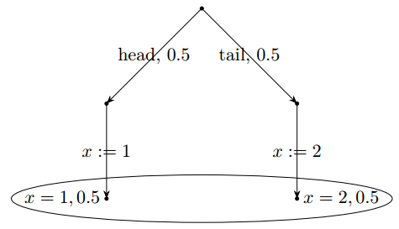



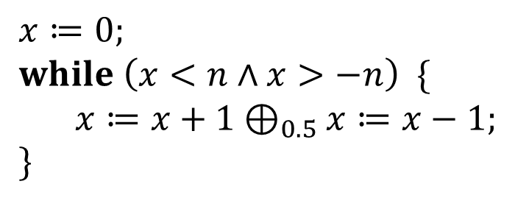
Randomized Programs
Probabilistic choice: $C_{1}⊕_{p}C_{2}$
One-dimensional random walk
$$x≔1⊕_{0.5}x≔2$$
$$x≔0; \\ while \left(x<n∧x>−n\right) \{ \\ x≔x+1⊕_{0.5}x≔x−1; \\ \}$$
Execution:
coin flip
The final state distribution satisfies $E\left(x\right)=0$
final state distribution
$\operatorname{Pr}\left(x=1\right)=0.5$: Run the program many times, about half of them $x=1$
$E\left(x\right)=1.5$: Run the program many times, the average value of $x$ is about 1.5

Slide 3

Concurrent Programs
$$C_{1}∥…∥C_{n}$$
Interleaving semantics
t3
t1
Steps of different threads can interleave.
t2
t2
t1
t1
The interleaving is determined by the scheduler.
t1
t3

Slide 4

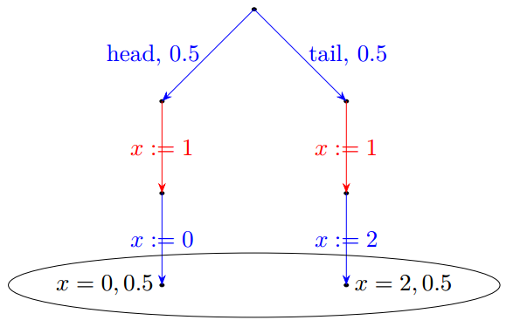
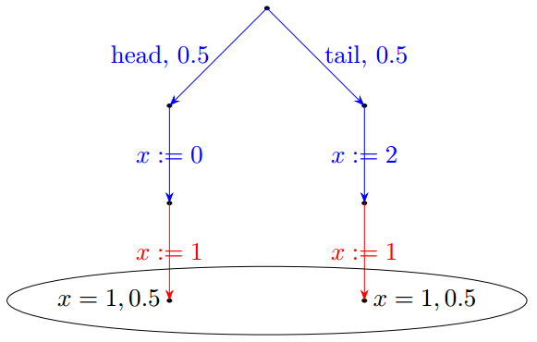
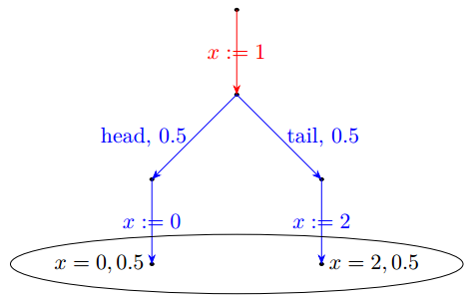



Concurrent Randomized Programs
The coin-flip and the subsequent branches can be interrupted in between.
Is that all?
schedule:
t1, t2, t1
t1, t1, t2
t2, t1, t1
$$E\left(x\right)=1$$
$$E\left(x\right)=1$$
$$E\left(x\right)=1$$

Slide 5
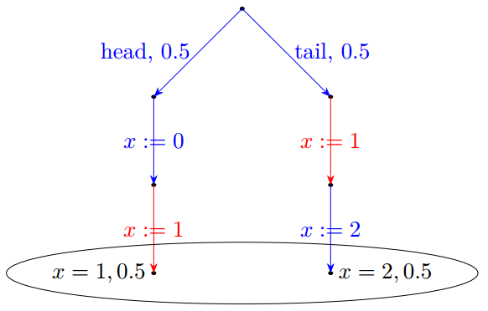
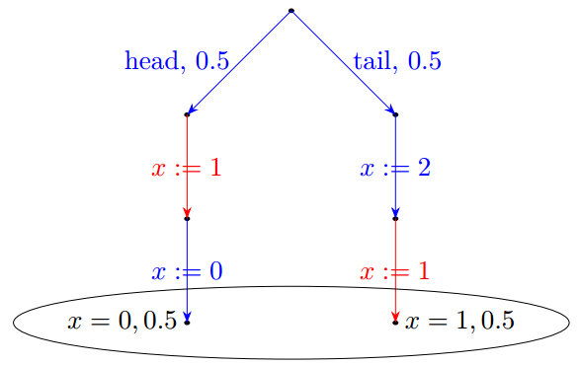


Concurrent Randomized Programs
$$E\left(x\right)≠1$$
$$E\left(x\right)≠1$$
In the last two cases, the scheduler can observe the result of the coin flip
and adapt the scheduling during the execution.
“adversary models” are used to describe schedulers based on what they can observe.

Slide 6


Adversary Models
OA: cannot rely on any information during execution. The scheduling is determined before execution.
Oblivious Adversary (OA)
$$E\left(x\right)=1$$
SA: knows all past information.
The scheduling is dynamically generated during execution.
Strong Adversary (SA)
$$E\left(x\right)≠1$$
A program may have more behaviors in SA model than in OA model.

Slide 7
Verifying Concurrent Randomized Algorithms
How to verify the correctness of this program?
Program logics for SA model
McIver et al. 2016, Tassarotti et al. 2019, Fesefeldt et al. 2022
No program logic for OA model
Logics for SA model not applicable for OA model, because algorithms may have stronger properties in OA model.

Slide 8
Our Contributions
A Program Logic for OA Model
Two Key Techniques
Layer-based reasoning on top of a new abstract operational semantics for taking advantage of OA model
“split” mechanism for compositional reasoning of branching statements
Verify four typical algorithms in OA model, including
conciliator: a core phase in a consensus algorithm [Chor et al. 1994]
group election: a core phase in a test-and-set algorithm [Alistarh et al. 2011]

Slide 9
Outline of This Talk
Correctness of concurrent randomized programs in OA model
Key techniques of our program logic
layer-based reasoning and abstract operational semantics
“split” mechanism for branching statements
Example: conciliator

Slide 10
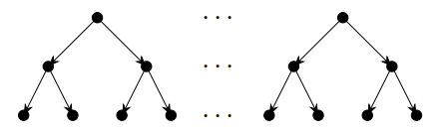


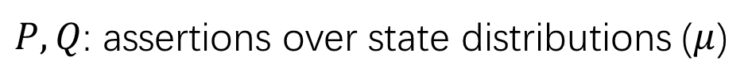



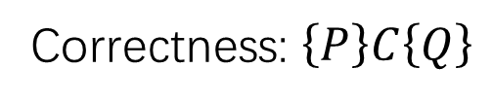



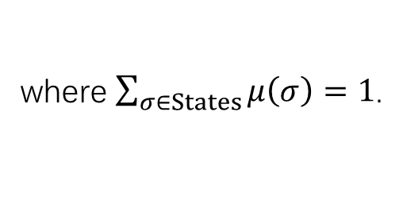

Correctness of Sequential Randomized Programs
Execution model:
Given an initial state $σ_{i}$, the executions form a tree.
Considering all possible initial states, the executions form a forest.
$$μ$$
$$σ_{1}$$
…
$$σ_{k}$$
$$μ⊨P$$
$$μ:States→\left[0, 1\right]$$
where $\sum_{σ∈States}{μ\left(σ\right)}=1$.
…
$$μ^{′}⊨Q$$
$$μ^{′}$$
$$\left\{true\right\}$$
Correctness: $\left\{P\right\}C\left\{Q\right\}$
$x≔0⊕_{0.5}x≔1$
$P, Q$: assertions over state distributions ($μ$)
$$\left\{\operatorname{Pr}\left(x=0\right)=0.5∧\operatorname{Pr}\left(x=1\right)=0.5\right\}$$

Slide 11
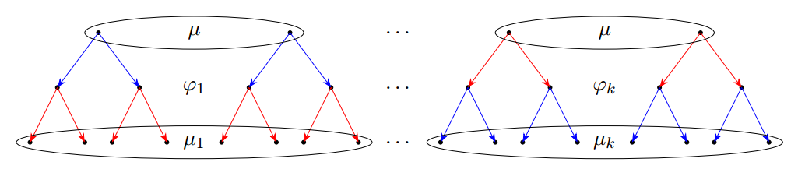

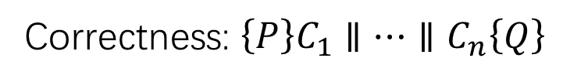





Correctness of Concurrent Randomized Programs
Execution model:
Given a schedule $φ_{i}$ and the distribution $μ$ of initial states,
the executions form a forest.
Considering all possible schedules, the executions form a set of forests.
$$μ⊨P$$
…
$$∀i. μ_{i}⊨Q$$
Correctness: $\left\{P\right\}C_{1}∥…∥C_{n}\left\{Q\right\}$
$$\left\{true\right\}$$
$\left(x≔0⊕_{0.5}x≔2\right)∥x≔1$
$$\left\{E\left(x\right)=1\right\}$$

Slide 12
Outline of This Talk
Correctness of concurrent randomized programs in OA model
Key techniques of our program logic
layer-based reasoning and abstract operational semantics
“split” mechanism for branching statements
Example: conciliator

Slide 13
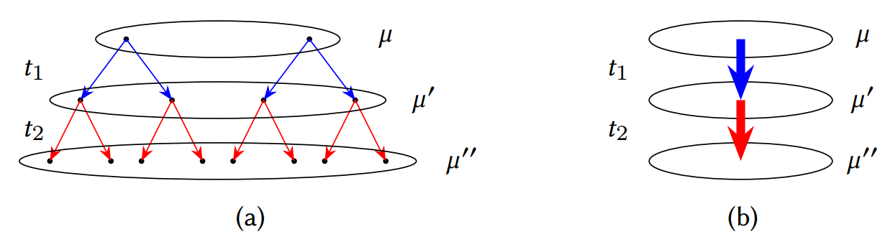
Layer-Based Reasoning
How to take advantage of OA model to verify stronger properties?
A state-transition semantics
A new abstract operational semantics:
In each horizontal layer, it is always the same thread to execute.
States of the same layer as a whole (a distribution).
Edges between two layers as a whole (a transition between distributions).

Slide 14
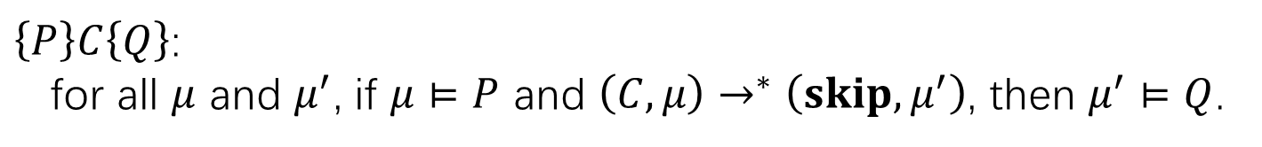

Abstract Operational Semantics
Small-step transitions: $\left(C, μ\right)\underset{→}{t}\left(C^{′}, μ^{′}\right)$.
Interleaving semantics, but transitions over state distributions ($μ$)
instead of over states.
$\left\{P\right\}C\left\{Q\right\}$:
for all $μ$ and $μ^{′}$, if $μ⊨P$ and $\left(C, μ\right)→^{∗}\left(skip, μ^{′}\right)$, then $μ^{′}⊨Q$.
Can apply classical concurrency reasoning techniques, e.g. invariants.

Slide 15
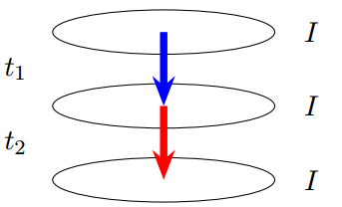
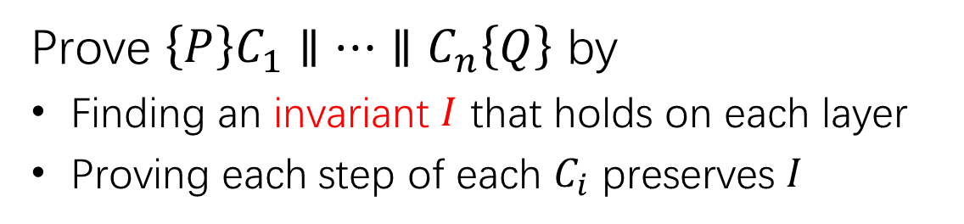
Layer-Based Reasoning with Invariants
Prove $\left\{P\right\}C_{1}∥…∥C_{n}\left\{Q\right\}$ by
Finding an invariant $I$ that holds on each layer
Proving each step of each $C_{i}$ preserves $I$
NOT work in SA model where different threads may execute at the same layer

Slide 16



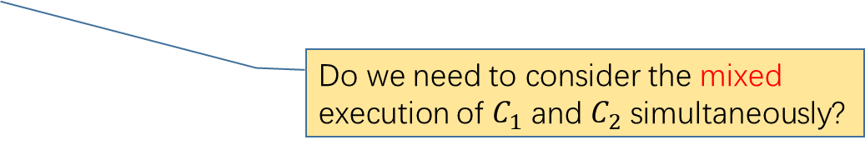








Problems with Layer-Based Reasoning
Different states in the same layer may lead to different code
(i.e., different program counters), due to branching statements.
$$x≔1⊕_{0.5}x≔2;$$
$$\text{if} \left(x=1\right)$$
$$\text{then} C_{1};$$
$$C_{4}$$
$$x≔1$$
$$x≔2$$
$$\text{else} C_{2};$$
$$C_{1}$$
$$C_{2}$$
$$C_{4}$$
$$C_{4}$$
Do we need to consider the mixed execution of $C_{1}$ and $C_{2}$ simultaneously?
Breaks compositionality for conditional statements!

Slide 17


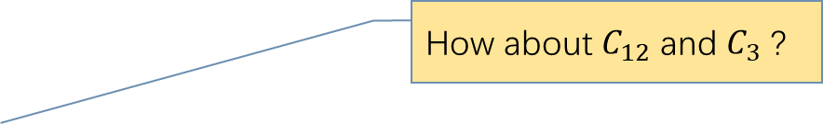














Problems with Layer-Based Reasoning
What if two branches take different number of steps?
$x≔1⊕_{0.5}x≔2$;
$$\text{if} \left(x=1\right)$$
$$\text{then} C_{11}; C_{12};$$
$$x≔1$$
$$x≔2$$
$$C_{4}$$
$$\text{else} C_{21};$$
How about $C_{12}$ and $C_{3}$ ?
$$C_{11}$$
$$C_{21}$$
$$C_{3};$$
$$C_{12}$$
$$C_{3}$$
Breaks sequential compositionality!
$$C_{4}$$
$$C_{4}$$
$$C_{3}$$
$$\text{skip}$$

Slide 18




Problems with Layer-Based Reasoning
What if two branches take different number of steps?
Even worse, let’s consider while-loops:
$$\left(\text{while} \left(b\right) \text{do} C\right);C′$$
equivalent to
$$\text{if} \left(b\right) \text{then} \left(C;\text{while}\left(b\right) \text{do} C\right)$$
branches taking different number of steps
$$\text{else} \text{skip};$$
$$C′$$

Slide 19

















Our Idea: split for Compositional Reasoning
Introduce an auxiliary statement to split the layer into small partitions.
$$\left\langle x≔1⊕_{0.5}x≔2\right\rangle ;$$
$$\text{split}(x=1)$$
$$\text{if} \left(x=1\right)$$
$$\text{then} C_{1};$$
$$C_{4}$$
$$x≔1$$
$$x≔2$$
$$\text{else} C_{2};$$
$$x=1$$
$$x≠1$$
$$\text{split}(x=1)$$
$$x=1$$
$$x≠1$$
$$C_{1}$$
$$C_{2}$$
$$C_{4}$$
$$C_{4}$$
The executions always take the same branch
from states in the same partition.

Slide 20







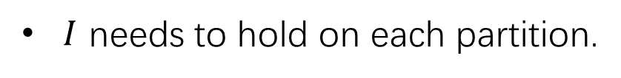





The $\text{split}\left(b\right)$ Statement
Splits $μ$ into $μ_{1}$ and $μ_{2}$ such that $μ_{1}⊨\left\lceil b\right\rceil$ and $μ_{2}⊨$ $\left\lceil ¬b\right\rceil$.
We insert $\text{split}\left(b\right)$ before $\text{if} \left(b\right) then C_{1} else C_{2}$, so that the executions from $μ_{1}$ take $then$-branch and the executions from $μ_{2}$ take $else$-branch.
$I$ needs to hold on each partition.
$$\text{split}\left(b\right)$$
$$\left\lceil b\right\rceil$$
$$\left\lceil ¬b\right\rceil$$
$$μ$$
$$\left(I∧⌈b⌉\right) ⨁ \left(I∧⌈¬b⌉\right)$$
$$I∧\left\lceil b\right\rceil$$
$$μ_{1}$$
$$μ_{2}$$
$$I∧\left\lceil ¬b\right\rceil$$
$$\text{if} \left(b\right) then C_{1} else C_{2}$$
$$\text{if} \left(b\right) then C_{1} else C_{2}$$

Slide 21
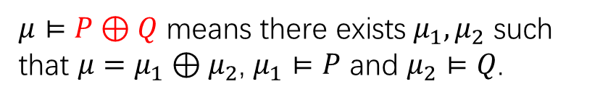





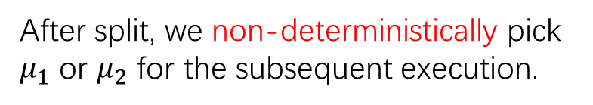










Logic Rule for $\text{split}\left(b\right)$
$$\left\{\left(I∧⌈b⌉\right) ⨁ \left(I∧⌈¬b⌉\right)\right\}$$
$μ⊨\left\lceil b\right\rceil$: all states in $μ$ satisfy $b$.
$\text{split}$ turns $⨁$into $∨$.
$$\text{split}\left(b\right)$$
$μ⊨P⊕Q$ means there exists $μ_{1}, μ_{2}$ such that $μ=μ_{1}⊕μ_{2}$, $μ_{1}⊨P$ and $μ_{2}⊨Q$.
$$\left\{\left(I∧⌈b⌉\right) ∨ \left(I∧⌈¬b⌉\right)\right\}$$
Note the logical implication does not hold:
$$\left(\left\lceil b\right\rceil ⊕\left\lceil ¬b\right\rceil \right) ⇏ \left(\left\lceil b\right\rceil ∨\left\lceil ¬b\right\rceil \right)$$
$$μ_{1}$$
$$μ_{2}$$
$x=0$, 0.5
$x=1$, 0.5
After split, we non-deterministically pick $μ_{1}$ or $μ_{2}$ for the subsequent execution.
$$μ=μ_{1}⊕μ_{2}$$
$$μ⊨\left\lceil x=0\right\rceil ⊕\left\lceil x≠0\right\rceil$$
Therefore, $\left\lceil b\right\rceil ∨\left\lceil ¬b\right\rceil$ holds after $\text{split}\left(b\right)$.
but $μ⊭\left\lceil x=0\right\rceil ∨\left\lceil x≠0\right\rceil$

Slide 22


Logic Rules for Branching Statements
$$\left\{\left(I∧⌈b⌉\right) ⨁ \left(I∧⌈¬b⌉\right)\right\}$$
$\text{split}$ turns $⨁$into $∨$.
$$\text{split}\left(b\right)$$
$$\left\{\left(I∧⌈b⌉\right) ∨ \left(I∧⌈¬b⌉\right)\right\}$$
$$\text{split}\left(b\right);\text{if} \left(b\right) \text{then} C_{1} \text{else} C_{2}$$
$$\text{split}\left(b\right);\text{while} \left(b\right) \text{do} C$$

Slide 23









Closed Assertions for split
Let $\hat{C}$ represent instrumentation of $C$ with split statements.
$$P$$
$$P$$
$$Q$$
$$Q$$
$$Q$$
$$Q$$
$$\text{closed}(Q)$$
$$\left\{P\right\}\hat{C}\left\{Q\right\}$$
$$\left\{P\right\}C\left\{Q\right\}$$
We introduce $\text{closed}(Q)$ to bridge the semantics gap.
Please refer to our paper for the formal definition of $\text{closed}(Q)$.

Slide 24
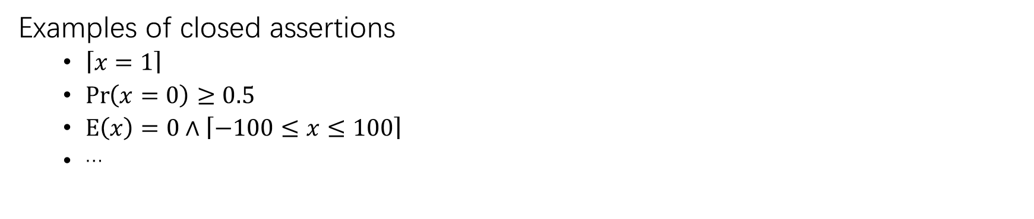

Closed Assertions for split
Is $\text{closed}(Q)$ too strong?
Only post-conditions need to be closed!
Many randomized algorithms have closed postconditions specifying
the bound of the probability of a random event
the bound of the expected value of a random variable
Examples of closed assertions
$\left\lceil x=1\right\rceil$
$\operatorname{Pr}\left(x=0\right)≥0.5$
$\text{E}\left(x\right)=0∧\left\lceil −100≤x≤100\right\rceil$
…

Slide 25
Outline of This Talk
Correctness of concurrent randomized programs in OA model
Key techniques of our program logic
layer-based reasoning and abstract operational semantics
“split” mechanism for branching statements
Example: conciliator

Slide 26








Example: Conciliator
The core phase of a randomized consensus algorithm [Chor et al. 1994].
$$\left\{s=0∧\left(∀i. v_{i}≠0\right)\right\}$$
t4
$$while \left(s=0\right) do \\ s≔v_{1}⊕_{p}skip; \\ y_{1}≔s$$
$$while \left(s=0\right) do \\ s≔v_{n}⊕_{p}skip; \\ y_{n}≔s$$
…
$$s≔v_{1}$$
propose $v_{1}$
t3
$$s$$
t1
$$y_{1}≔s$$
decide $y_{1}$
$$\left\{Pr⁡(y_{1}=y_{2}=…= y_{n})≥{\left(1−p\right)}^{n−1}\right\}$$
All thread decide the same value with some probability
t2
Correct in OA model, but not in SA model.
Verified using our logic!

Slide 27
Conclusions
A Program Logic for OA Model
Two Key Techniques
Layer-based reasoning on top of a new abstract operational semantics for taking advantage of OA model
“split” mechanism for compositional reasoning of branching statements
Verify four typical algorithms in OA model, including
conciliator: a core phase in a consensus algorithm [Chor et al. 1994]
group election: a core phase in a test-and-set algorithm [Alistarh et al. 2011]

Slide 28
Thank you!

