Slide 1
Abstraction for Conflict-Free Replicated Data Types
Hongjin Liang and Xinyu Feng
Nanjing University

Slide 2



Replicated Data Types
Client Program
Client Program
Replicated Data Types
Client Program
Are the local copies of the data the same?
Data is replicated in modern database systems.
Various protocols are proposed to ensure data consistency.

Slide 3





Conflict-Free Replicated Data Types (CRDTs)
Widely used in real world systems, e.g.
How to specify the correctness of CRDTs?
Data consistency between different nodes
Strong Eventual Consistency (SEC)
✓ Verified in many existing works (e.g. [Gomes et al’17, Nagar and Jagannathan’19])
☹ SEC does not encode functionality of the data type, thus does not provide sufficient information for client reasoning.

Slide 4

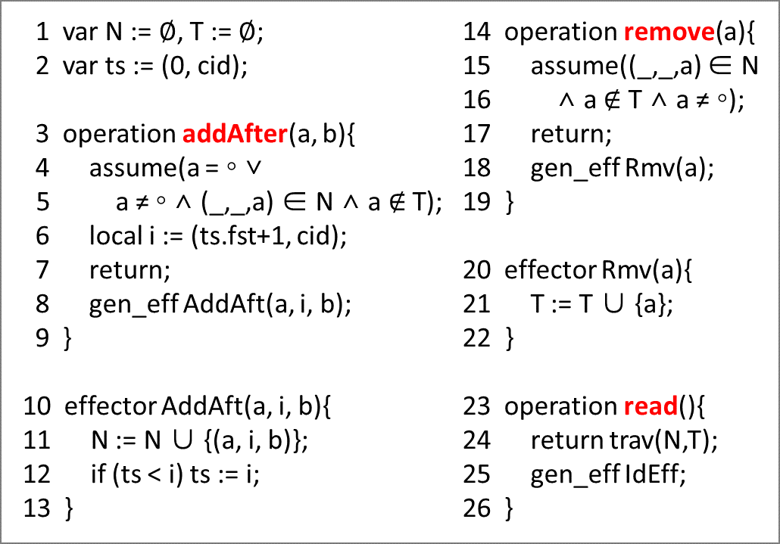


Example: Collaborative Editing
u := read();
if (‘cute’ ∈ u)
addAfter(‘cats’, ‘are’);
Bob
Alice
CRDT Impl of Sequence
addAfter(‘cats’, ‘cute’);
x := read();
SEC can help verify that the final states of different nodes converge.
But we also want to verify the functional correctness of the whole program:
e.g. the final states and the value of x are ‘cats cute’ or ‘cats are cute’

Slide 5
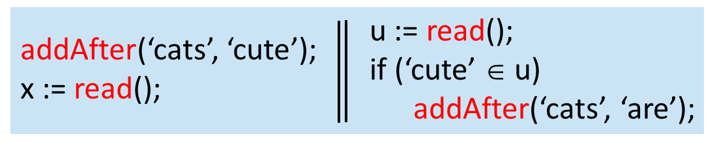

How to verify functional correctness of whole programs
Client Program $C_{1}∥C_{2}∥…∥C_{n}$
CRDT Impl of
Sequence
CRDT Implementation
Need to verify both the CRDT impl and the client program!

Slide 6
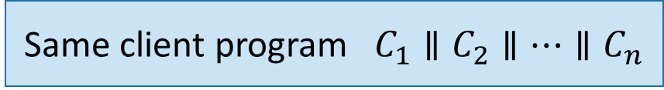
How to verify functional correctness of whole programs
Different client programs
Same client program $C_{1}∥C_{2}∥…∥C_{n}$
Same CRDT implementation
Different CRDT impl of the data type
Verify the CRDT impl once and for all?
Verify the client program once and for all?
To do modular and layered verification, abstraction is necessary!

Slide 7
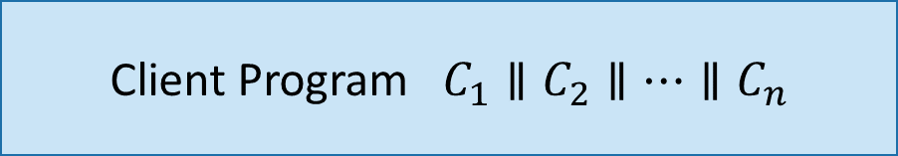
Our Contributions
Client Program $C_{1}∥C_{2}∥…∥C_{n}$
Program logic for clients
Abstraction: Strong Eventual Consistency
+ Functional Correctness Based on Atomic Specification
Contextual refinement
for sound composition
Separate verification
Proof method for CRDTs
CRDT Implementation

Slide 8
Our Contributions
Client Program $C_{1}∥C_{2}∥…∥C_{n}$
Program logic for clients
Verified several interesting client programs
Abstraction: Strong Eventual Consistency
+ Functional Correctness Based on Atomic Specification
Contextual refinement
for sound composition
Separate verification
Verified replicated growable array (RGA), continuous sequence, add-wins set, remove-wins set, 2P-set, LWW-element set, grow-only set, LWW register, replicated counter, …
Proof method for CRDTs
CRDT Implementation

Slide 9
Outline of this talk
Overview of CRDTs
Abstraction for CRDTs
Other results

Slide 10
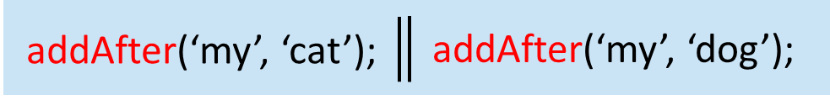

Overview of CRDTs
Naïve RDTs may not ensure data consistency: final states of different nodes may not converge
Naïve impl of
replicated sequence
addAfter(‘my’, ‘cat’)
A
‘my cute’
‘my cat cute’
‘my dog cat cute’
not converge!
‘my cute’
‘my dog cute’
‘my cat dog cute’
B
addAfter(‘my’, ‘dog’)
Because addAfter(a, b) and addAfter(a, c) are not commutative!
We call them “conflicting”.
addAfter(a, b)
o
addAfter(a, c)
$$≠$$
addAfter(a, c)
o
addAfter(a, b)
CRDTs’ solution: turn conflicting (non-commutative) operations into commutative ones

Slide 11

Conflict-Free Replicated Data Types
Idea: turn conflicting (non-commutative) operations into commutative ones
Continuous sequence:
addAfter(‘my’, ‘cat’, 4)
A
‘my1 cute9’
‘my1 cat4 cute9’
‘my1 cat4 dog8 cute9’
converge!
‘my1 cute9’
‘my1 dog8 cute9’
‘my1 cat4 dog8 cute9’
B
addAfter(‘my’, ‘dog’, 8)
Conflict Resolution Policy: real number tags to indicate positions in the sequence
Commutativity of conflicting operations:
addAfter(‘my’, ‘cat’, 4)
o
addAfter(‘my’, ‘dog’, 8)
=
addAfter(‘my’, ‘dog’, 8)
o
addAfter(‘my’, ‘cat’, 4)

Slide 12
Conflict-Free Replicated Data Types
Idea: turn conflicting (non-commutative) operations into commutative ones
Conflict resolution policies:
Uniform-conflict-resolving (UCR): do not give privilege to particular operations
addAfter(‘my’, ‘cat’, 4)
Continuous sequence gives equal treatment to addAfter(‘my’, ‘cat’) and addAfter(‘my’, ‘dog’)
addAfter(‘my’, ‘dog’, 8)
Other examples: timestamp-based algorithms (e.g. last-writer-wins register)
X-wins: rely on functionality and semantic relationship between operations
e.g. add-wins set, remove-wins set

Slide 13
Conflict-Free Replicated Data Types
Conflict resolution policies:
Uniform-conflict-resolving (UCR): do not give privilege to particular operations
e.g. continuous sequence, timestamp-based algorithms
X-wins: rely on functionality and semantic relationship between operations
e.g. add-wins set, remove-wins set
Abstraction for CRDTs
Abstract converging consistency (ACC) for UCR CRDTs
 Focus of this talk
Extended ACC for X-wins CRDTs
 More challenging! See our paper!

Slide 14
Outline of this talk
Overview of CRDTs
Abstraction for CRDTs
Other results

Slide 15

Our Goal
What is client-reasoning-friendly abstraction?
Client Program $C_{1}∥C_{2}∥…∥C_{n}$
two nodes’ states converge if they receive the same set of updates
Abstraction: Strong Eventual Consistency (SEC)
+ Functional Correctness
CRDT Implementation

Slide 16

What is client-reasoning-friendly abstraction?
1) Hide the impl details: use atomic abstraction of the actual operations
addAfter(‘cats’, ‘cute’);
x := read();
u := read();
if (‘cute’ ∈ u)
addAfter(‘cats’, ‘are’);
Continuous sequence:
Atomic spec:
Generate addAfter(‘cats’, ‘cute’, 4) with a real-number tag to indicate position in the sequence
addAfter(‘cats’, ‘cute’)
‘cats1’
‘cats1 cute4’

Slide 17
What is client-reasoning-friendly abstraction?
1) Hide the impl details: use atomic abstraction of the actual operations
2) Each single client wants a view of sequential executions of all the actions
addAfter(‘cats’, ‘cute’)
addAfter(‘cats’, ‘are’)
read()
addAfter(‘cats’, ‘cute’, 4)
read()
A
‘cats1’
‘cats1 cute4’
‘cats1 are2 cute4’
‘cats1’
‘cats1 cute4’
‘cats1 are2 cute4’
B
read()
addAfter(‘cats’, ‘are’, 2)

Slide 18
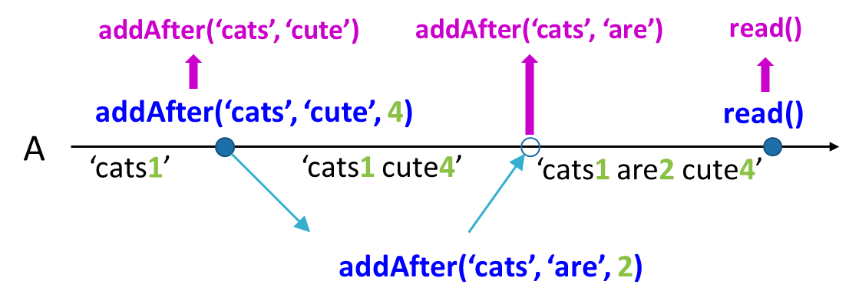
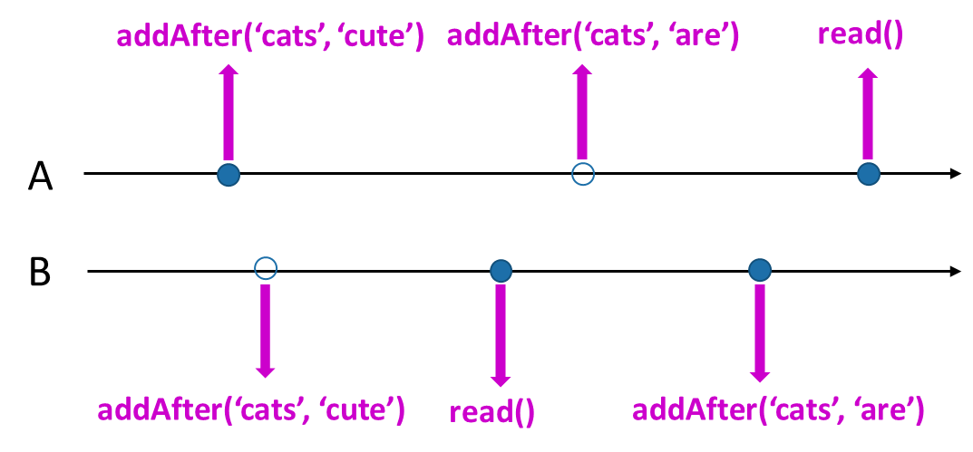
What is client-reasoning-friendly abstraction?
1) Hide the impl details: use atomic abstraction of the actual operations
2) Each single client wants a view of sequential executions of all the actions
a) Locally (from single client’s point of view):
What’s the relationship between abstract execution order and real-time order on this node?
Crucial for functional correctness
b) Globally (from whole program’s point of view), to ensure state convergence (SEC):
What’s the relationship between abstract execution orders of different nodes?

Slide 19
a) Locally (from single client’s point of view):
What’s the relationship between abstract execution order and real-time order on this node?
They must lead to the same state and same observed results (to ensure functional correctness)
Natural idea: directly map the real-time execution sequence to the abstract one
(let the abstract execution order be the same as real-time order)
‘cats are cute’
addAfter(‘cats’, ‘cute’)
addAfter(‘cats’, ‘are’)
read()
returns ‘cats are cute’
Lead to same states & same observed results
addAfter(‘cats’, ‘cute’, 4)
read()
returns ‘cats are cute’
A
‘cats1’
‘cats1 cute4’
‘cats1 are2 cute4’
‘cats1 are2 cute4’
addAfter(‘cats’, ‘are’, 2)

Slide 20
Problem: direct mapping may NOT work
‘my cute’
‘my cat cute’
‘my dog cat cute’
✗
addAfter(‘my’, ‘cat’)
addAfter(‘my’, ‘dog’)
addAfter(‘my’, ‘cat’, 4)
A
‘my1 cute9’
‘my1 cat4 cute9’
‘my1 cat4 dog8 cute9’
‘my1 cute9’
‘my1 dog8 cute9’
‘my1 cat4 dog8 cute9’
B
addAfter(‘my’, ‘dog’, 8)

Slide 21
Problem: direct mapping may NOT work
‘my dog cat cute’
addAfter(‘my’, ‘cat’)
addAfter(‘my’, ‘dog’)
‘my cat dog cute’
addAfter(‘my’, ‘cat’, 4)
A
‘my1 cute9’
‘my1 cat4 cute9’
‘my1 cat4 dog8 cute9’
‘my1 cute9’
‘my1 dog8 cute9’
‘my1 cat4 dog8 cute9’
B
addAfter(‘my’, ‘dog’, 8)
Need to allow the abstract execution order to be different from the real-time order (while preserving the program order of the current node)

Slide 22
What is client-reasoning-friendly abstraction?
1) Hide the impl details: use atomic abstraction of the actual operations
2) Each single client wants a view of sequential executions of all the actions
a) Locally (from single client’s point of view), to ensure functional correctness:
What’s the relationship between abstract execution order and real-time order on this node?
They can be different, but must lead to the same state
b) Globally (from whole program’s point of view), to ensure state convergence (SEC):
What’s the relationship between abstract execution orders of different nodes?
Sometimes they have to be different ...

Slide 23
Different nodes may observe different abstract execution orders
④
① ②
③
conf-resolving
po
conf-resolving
‘my cat dog
is black white’
① addAfter(‘my’, ‘cat’)
② addAfter(‘is’, ‘white’)
③ addAfter(‘is’, ‘black’)
④ addAfter(‘my’, ‘dog’)
dog
black
① addAfter(‘my’, ‘cat’, 4)
② addAfter(‘is’, ‘white’, 14)
A
‘my1 cat4 dog8
is10 black12 white14’
‘my1 is10’
‘my1 cat4 is10’
‘my1 cat4 is10 white14’
‘my1 is10’
‘my1 is10 black12’
‘my1 dog8 is10 black12’
‘my1 cat4 dog8
is10 black12 white14’
B
③ addAfter(‘is’, ‘black’, 12)
④ addAfter(‘my’, ‘dog’, 8)
‘my cat dog
is black white’
③ addAfter(‘is’, ‘black’)
④ addAfter(‘my’, ‘dog’)
① addAfter(‘my’, ‘cat’)
② addAfter(‘is’, ‘white’)
cat
white
②
③ ④
①
conf-resolving
po
conf-resolving

Slide 24
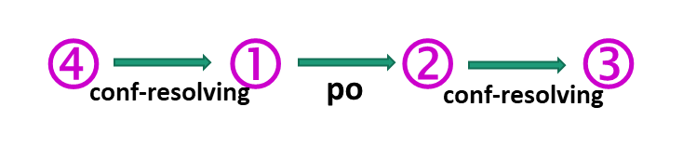
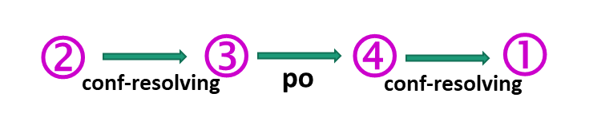
Different nodes may observe different abstract execution orders, but conflicting operations should follow the same abstract order (to ensure SEC)
① addAfter(‘my’, ‘cat’, 4)
② addAfter(‘is’, ‘white’, 14)
A
‘my1 cat4 dog8 is10 black12 white14’
‘my1 is10’
‘my1 cat4 is10’
‘my1 cat4 is10 white14’
‘my1 is10’
‘my1 is10 black12’
‘my1 dog8 is10 black12’
‘my1 cat4 dog8 is10 black12 white14’
B
③ addAfter(‘is’, ‘black’, 12)
④ addAfter(‘my’, ‘dog’, 8)

Slide 25

Abstract Converging Consistency (ACC) for UCR-CRDTs
CRDT impl
Atomic operations
ACC(O, (S, $⋈$))
Conflict relation between abstract atomic operations
iff
for any real-time execution of O,
each node can find a sequential execution of abstract atomic operations of S, such that
a) the abstract execution order and real-time order can be different, but they must lead to the same state
Functional correctness
b) different nodes may observe different abstract execution orders, but conflicting operations should follow the same abstract order
State convergence (SEC)

Slide 26

ACC is insufficient for X-wins CRDTs
ACC(O, (S, $⋈$))
iff
…
conflicting operations should follow the same abstract order
not specify any constraints on the order
But for X-wins CRDTs like add-wins set and remove-wins set, we may rely on the specific policy (X-wins) to reason about clients.

Slide 27
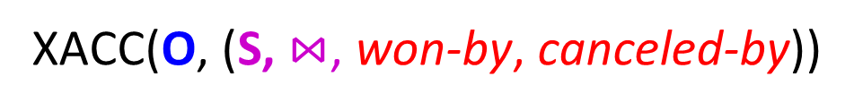

Extended ACC for X-wins CRDTs
For UCR-CRDTs:
ACC(O, (S, $⋈$))
For X-wins CRDTs:
XACC(O, (S, $⋈$, won-by, canceled-by))
New specifications to encode the X-wins policy
Assume causal delivery
Satisfied by add-wins set and remove-wins set

Slide 28
Outline of this talk
Overview of CRDTs
Abstraction for CRDTs
Other results

Slide 29

Properties of ACC (and XACC)
If ACC(O, (S, $⋈$)), then SEC(O).
Compositionality: If ACC(O₁, (S₁, $⋈_{1}$)) and ACC(O₂, (S₂, $⋈_{2}$)),
then ACC(O₁$⨄$ O₂, (S₁ $⨄$S₂, $⋈_{1}$ ${⨄⋈}_{2}$)).

Slide 30


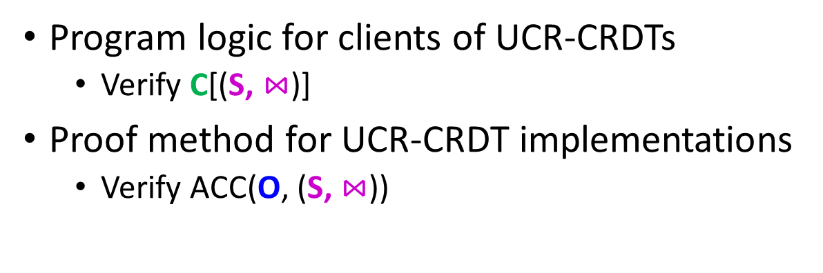
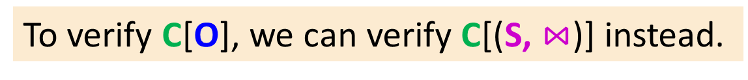
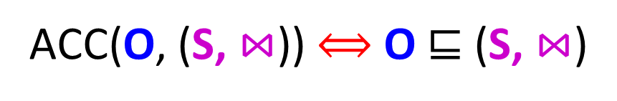
Abstraction Theorem
ACC(O, (S, $⋈$)) $⟺$ O $⊑$ (S, $⋈$)
(Similar for XACC.)
Contextual Refinement:
O $⊑$ (S, $⋈$)
iff
∀C. Behaviors(C[O]) ⊆ Behaviors(C[(S, $⋈$)])
To verify C[O], we can verify C[(S, $⋈$)] instead.
Program logic for clients of UCR-CRDTs
Verify C[(S, $⋈$)]
Proof method for UCR-CRDT implementations
Verify ACC(O, (S, $⋈$))
Correctness of C[O]

Slide 31

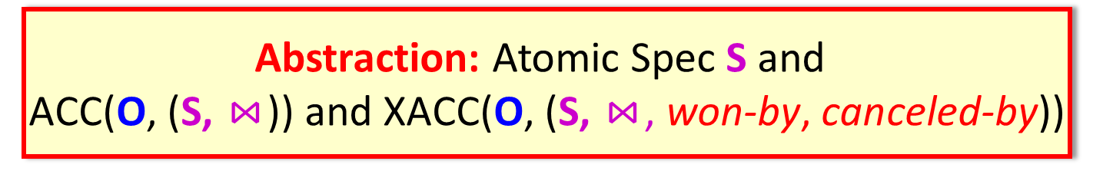
Conclusion
Client Program $C_{1}∥C_{2}∥…∥C_{n}$
Program logic for clients
Abstraction: Atomic Spec S and
ACC(O, (S, $⋈$)) and XACC(O, (S, $⋈$, won-by, canceled-by))
Contextual refinement
for sound composition
Separate verification
Proof method for CRDTs
CRDT Implementation

Slide 32
Conclusion
Client Program $C_{1}∥C_{2}∥…∥C_{n}$
Program logic for clients
Verified several interesting client programs
Abstraction: Atomic Spec S and
ACC(O, (S, $⋈$)) and XACC(O, (S, $⋈$, won-by, canceled-by))
Contextual refinement
for sound composition
Separate verification
Verified replicated growable array (RGA), continuous sequence, add-wins set, remove-wins set, 2P-set, LWW-element set, grow-only set, LWW register, replicated counter, …
Proof method for CRDTs
CRDT Implementation

Slide 33
Thanks!

