Slide 1
Abstraction for Conflict-Free Replicated Data Types
Hongjin Liang and Xinyu Feng
Nanjing University

Slide 2



Replicated Data Types
Client Program
Client Program
Replicated Data Types
Client Program
Are the local copies of the data the same?
Data is replicated in modern database systems.
Various protocols are proposed to ensure data consistency.

Slide 3


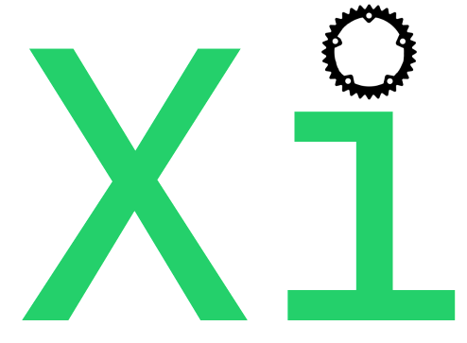


Conflict-Free Replicated Data Types (CRDTs)
Widely used in real world systems, e.g.
How to specify the correctness of CRDTs?
Data consistency between different nodes
Strong Eventual Consistency (SEC)
✓ Verified in many existing works (e.g. [Gomes et al’17, Nagar and Jagannathan’19])
☹ SEC does not encode functionality of the data type, thus does not provide sufficient information for client reasoning.

Slide 4

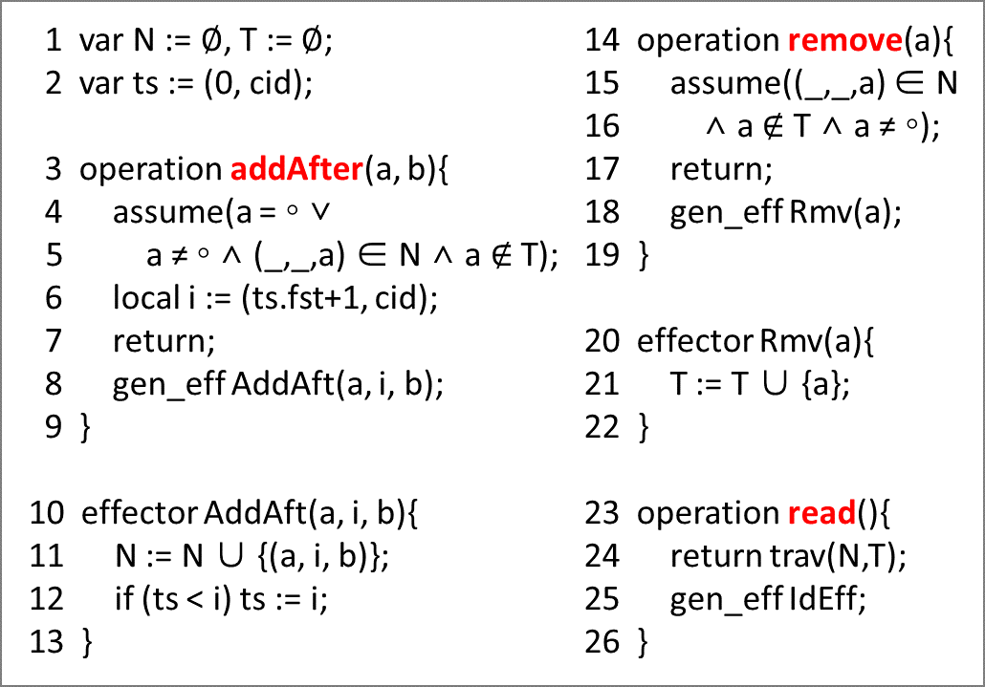


Example: Collaborative Editing
u := read();
if (‘cute’ ∈ u)
addAfter(‘cats’, ‘are’);
Bob
Alice
CRDT Impl of Sequence
addAfter(‘cats’, ‘cute’);
x := read();
SEC can help verify that the final states of different nodes converge.
But we also want to verify the functional correctness of the whole program:
e.g. the final states and the value of x are ‘cats cute’ or ‘cats are cute’

Slide 5
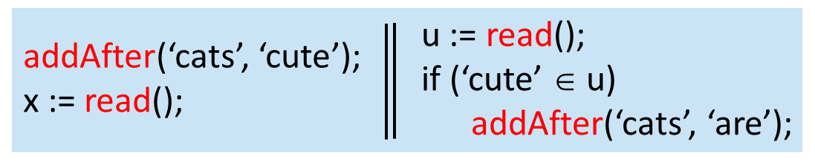
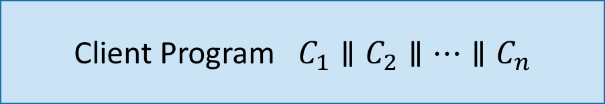
How to verify functional correctness of whole programs
Client Program $C_{1}∥C_{2}∥…∥C_{n}$
CRDT Impl of
Sequence
CRDT Implementation
Need to verify both the CRDT impl and the client program!

Slide 6
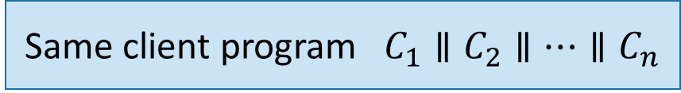
How to verify functional correctness of whole programs
Different client programs
Same client program $C_{1}∥C_{2}∥…∥C_{n}$
Same CRDT implementation
Different CRDT impl of the data type
Verify the CRDT impl once and for all?
Verify the client program once and for all?
To do modular and layered verification, abstraction is necessary!

Slide 7
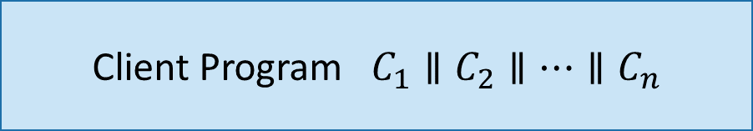
Our Contributions
Client Program $C_{1}∥C_{2}∥…∥C_{n}$
Program logic for clients
Abstraction: Strong Eventual Consistency
+ Functional Correctness Based on Atomic Specification
Contextual refinement
for sound composition
Separate verification
Proof method for CRDTs
CRDT Implementation

Slide 8
Our Contributions
Client Program $C_{1}∥C_{2}∥…∥C_{n}$
Program logic for clients
Verified several interesting client programs
Abstraction: Strong Eventual Consistency
+ Functional Correctness Based on Atomic Specification
Contextual refinement
for sound composition
Separate verification
Verified replicated growable array (RGA), continuous sequence, add-wins set, remove-wins set, 2P-set, LWW-element set, grow-only set, LWW register, replicated counter, …
Proof method for CRDTs
CRDT Implementation

Slide 9
Thanks!

