Slide 1
Verifying Optimizations of Concurrent Programs in the Promising Semantics
Junpeng Zha, Hongjin Liang and Xinyu Feng
Nanjing University
Notes:
Hello, I’m Junpeng Zha from Nanjing University. My topic is “Verifying Optimizations of Concurrent Programs in the Promising Semantics”.

Slide 2


Optimizations of concurrent prog. are error-prone
Those sound for sequential programs may be unsound with concurrency
C11 atomic primitive (e.g. relaxed read)
while(x > 10) {
rlx
$r$ = y;
}
Shared location
(valued 0 initially)
print($r$);
Non-atomic memory access
Notes:
Optimizations of concurrent programs are error-prone.
On the one hand, sound optimizations for sequential programs may be unsound with concurrency.
Consider the following example. We use x and y to represent shared locations. They are valued 0 initially. A location taking a red subscript means that we use C11 atomic primitives to access such location. Otherwise, the memory access is non-atomic.

Slide 3




Optimizations of concurrent prog. are error-prone
Those sound for sequential programs may be unsound with concurrency
New register saving value of loop invariant
$r′$ = y;
while(x > 10) {
rlx
while(x > 10) {
LICM
rlx
$r$ = y;
(* Loop invariant *)
}
$r$ = $r′$;
}
print($r$);
print($r$);
Never be written in the loop
LICM is sound for sequential programs
Notes:
For this program, we find that y will never be written in the loop, so the read y to the register r is a loop invariant. Loop invariant code motion will allocate a new register r’ to save the result of reading y, and then replace the read y in the loop with the value in r’. Such optimization is correct for sequential programs, but may be incorrect for concurrent programs.

Slide 4
Optimizations of concurrent prog. are error-prone
Always returns 0
(no write for x in prog.)
Those sound for sequential programs may be unsound with concurrency
Read-write race
$r′$ = y;
while(x > 10) {
rlx
while(x > 10) {
LICM
rlx
$r$ = y;
y = 5;
y = 5;
}
$r$ = $r′$;
}
print($r$);
Unreachable
print($r$);
Data race free & print 0 in C11
Undefined behavior in C11
LICM is unsound in C11 [Batty, et al. POPL’11]
Notes:
For example, LICM is unsound in C11 concurrency. Consider that there is another thread writing 5 to y. We can find that the target program contains read-write race on accessing y and has undefined behaviors in C11 model. However, for the source program, since there is no write for x in the program, the relaxed read x always returns 0 and the loop body never executes. So, read y to r will never be executed and the source program is data race free and will print 0.

Slide 5
Optimizations of concurrent prog. are error-prone
Soundness is related to specific memory models
Read-write race
$r′$ = y;
while(x > 10) {
rlx
while(x > 10) {
LICM
rlx
$r$ = y;
y = 5;
y = 5;
}
$r$ = $r′$;
Important to verify optimizations in specific memory models!
}
print($r$);
Unreachable
Unreachable
print($r$);
Print 0 in PS
Print 0 in PS
Not a counterexample in promising semantics (PS) [Kang, et al. POPL’17]
Actually, LICM is sound in PS!
Gives semantics to racy programs
Notes:
On the other hand, the soundness of the optimizations for concurrent programs is related to specific memory models. For example, such transformation is not a counterexample in the promising semantics, which gives semantics to racy programs. So, the target program is not undefined behavior in the promising semantics. Like read y to r in the source program, assigning r’ to r in the target is unreachable.
And the target program also prints 0. Actually, we have proved that LICM is sound in PS in our work.
The common optimization LICM, which is sound for sequential programs, is unsound in C11 model, but sound in the promising semantics. So, it important to verify optimizations in specific memory models.

Slide 6
Prior works on verifying opt. of concurrent prog.
Either use strong memory models;
CASCompCert [Jiang, et al. PLDI’19]: SC semantics
CompCertTSO [Ševčík, et al. J.ACM’13]: TSO semantics
Or, only work with code snippets
E.g., [Vafeiadis’15] (for C11); [Chakraborty’17] (for LLVM); [Cho’21] (for PS)
Works with local syntactic code patterns
May not apply for real-world compiler opt.
Relies on semantics info. of context, and requires program analyses
Notes:
Prior works on verifying optimizations for concurrent programs either use strong memory models, such as SC and TSO semantics; or only work with code snippets.
However, optimizations on code snippets just work with local syntactic code patterns and may not apply for real-world optimization algorithms, which rely on semantics information of contexts and require various program analyses.

Slide 7
Our work: verifying optimization algorithms in the promising semantics PS2.1 [Cho, et al. PLDI’21]
PS2.1: an operational semantics for C11-like memory models
Covers most C11 features
Implementable for hardware (x86-TSO, ARM and Power)
No “out-of-thin-air” values
Notes:
In this work, we verify optimization algorithms in the promising semantics 2.1. It is an operational semantics for C11-like memory models and implementable for mainstream hardware platforms, and has no “out-of-thin-air” values.

Slide 8
Contributions of Our Work
Verification framework for optimizations in PS2.1
Defining correctness of optimizations
Thread-local simulation as optimization correctness, allowing separate compilation
Verification techniques to simplify proofs
Simulation on a non-preemptive semantics to reduce interleaving
Consider only write-write race free source programs
- allowing read-write racy programs to support reasonable optimizations (e.g., LICM in LLVM)
Verifying four optimization algorithms in PS2.1
Adapting sequential optimizations (ConstProp, CSE, LICM and DCE) for PS2.1
Carefully allowing optimizations across certain C11 atomic primitives
All fully verified in our framework and mechanized in Coq
Notes:
In more detail, we make the following contributions.
First, we develop a verification framework for optimizations in the promising semantics2.1. The correctness of optimizations is defined as a thread-local simulation, which allows separate compilation.
We use two verification techniques to simplify proofs: (1) defining the simulation on a non-preemptive semantics to reduce interleaving; and (2) considering only write-write race free source programs. We allow read-write racy programs to support reasonable optimizations, such as LICM in LLVM.
We verify four optimization algorithms (ConstProp, CSE, LICM and DCE) in the promising semantics. We first adapt their corresponding sequential optimizations for the promising semantics, by carefully allowing optimizations across certain C11 atomic primitives and verify them in our framework as well as in the Coq proof assistant.

Slide 9
Outline of This Talk
Overview of PS
Thread-Local Simulation
Non-preemptive Semantics
Write-Write Race Freedom
Notes:
In the following introduction, we will first give an overview of the promising semantics, then introduce our thread-local simulation. Finally, we introduce the non-preemptive semantics and write-write race freedom.

Slide 10
Overview of PS
Memory: all historical writes as timestamped messages
Loc.
Initial message on location x
x = 1;
x = 3;
x
0
y = 5;
y
0
Timestamp
Notes:
The memory in the promising semantics records all historical writes as timestamped messages. Initially, each location has an initial message valued 0.
Consider a sequence of memory writes on the right side.

Slide 11
Overview of PS
Memory: all historical writes as timestamped messages
Select an unused timestamp to insert the message
New message generated by (x = 1)
Loc.
x = 1;
x = 3;
x
0
1
3
y = 5;
y
0
5
Timestamp
Notes:
When executing write 1 to the location x, the promising semantics will select an unused timestamp to insert a new message valued 1 at the location x. Similarly, write 3 to x will add a new message valued 3 at the location x, and write 5 to y inserts a new message valued 5 at the location y.

Slide 12


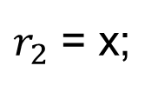
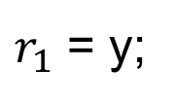
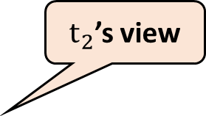
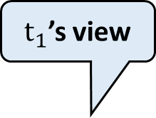
Overview of PS
A thread can read more than one prior writes
Necessary to model the (SB) behavior
Per-thread view: last observed timestamp on each location
Read: any message at/later than thread view
$t_{1}$’s view
$t_{2}$’s view
Thread $t_{1}$
Thread $t_{2}$
Loc.
x = 1;
y = 1;
(SB)
x
0
$r_{1}$ = y;
// 0
$r_{2}$ = x;
// 0
y
0
Timestamp
Notes:
A thread in the promising semantics can read more than one prior writes. It is necessary to model the store buffering behavior shown on the right side.
To model the store buffering behavior, each thread has its own view on the memory, which records the last observed timestamp on each location; and can read any message at or later than its view. Initially, each thread view records the timestamps of the initial messages.

Slide 13
Overview of PS
A thread can read more than one prior writes
Necessary to model the (SB) behavior
Per-thread view: last observed timestamp on each location
Read: any message at/later than thread view
$t_{1}$’s view
$t_{2}$’s view
Thread $t_{1}$
Thread $t_{2}$
Loc.
x = 1;
y = 1;
(SB)
x
0
1
$r_{1}$ = y;
// 0
$r_{2}$ = x;
// 0
y
0
Timestamp
Notes:
We consider that the thread t1 writes 1 to x first. In this step, we just care about the memory on the location x. The execution inserts a new message valued 1 at the location x

Slide 14
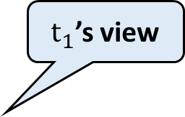
Overview of PS
A thread can read more than one prior writes
Necessary to model the (SB) behavior
Per-thread view: last observed timestamp on each location
Read: any message at/later than thread view
$t_{2}$’s view
$t_{1}$’s view
Thread $t_{1}$
Thread $t_{2}$
Loc.
x = 1;
y = 1;
(SB)
x
0
1
$r_{1}$ = y;
// 0
$r_{2}$ = x;
// 0
y
0
1
Timestamp
Notes:
Similarly, t2 performs write 1 to y by the same way.

Slide 15

Overview of PS
A thread can read more than one prior writes
Necessary to model the (SB) behavior
Per-thread view: last observed timestamp on each location
Read: any message at/later than thread view
$t_{2}$’s view
$t_{1}$’s view
Thread $t_{1}$
Thread $t_{2}$
Loc.
x = 1;
y = 1;
(SB)
x
0
1
$r_{1}$ = y;
// 0
$r_{2}$ = x;
// 0
y
0
readable by $t_{1}$
1
Return 0 or 1
Timestamp
Notes:
Then, we consider that t1 reads the location y. As we have introduced, a thread can read any message at or later than its thread view. So, it can return 0 or 1. We can find that although t2 has already written 1 to y, t1 can still read the initial value 0 of y.

Slide 16
Overview of PS
A thread can read more than one prior writes
Necessary to model the (SB) behavior
Per-thread view: last observed timestamp on each location
Read: any message at/later than thread view
$t_{2}$’s view
$t_{1}$’s view
Thread $t_{1}$
Thread $t_{2}$
Loc.
x = 1;
y = 1;
(SB)
x
0
1
$r_{1}$ = y;
// 0
$r_{2}$ = x;
// 0
y
0
1
Timestamp
Notes:
For the same reason, read x in t2 can also return 0.

Slide 17

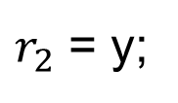

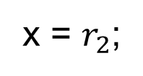
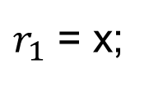

Overview of PS
A thread can promise a future write
Necessary to model the (LB) behavior
$t_{1}$’s view
$t_{2}$’s view
Loc.
Thread $t_{1}$
Thread $t_{2}$
$r_{1}$ = x;
// 1
$r_{2}$ = y;
// 1
x
0
(LB)
y = 1;
x = $r_{2}$;
y
0
1
Promise (y = 1) of $t_{1}$
Timestamp
Notes:
In the promising semantics, a thread can promise its future writes. It is necessary to model the load buffering behavior shown on the right side.
Let’s see how the promising semantics models the load buffering behavior. Before t1 reads x to r1, it can promise write 1 to y.

Slide 18

Overview of PS
A thread can promise a future write
Necessary to model the (LB) behavior
$t_{1}$’s view
$t_{2}$’s view
Loc.
Thread $t_{1}$
Thread $t_{2}$
$r_{1}$ = x;
// 1
$r_{2}$ = y;
// 1
x
0
(LB)
y = 1;
x = $r_{2}$;
readable by $t_{2}$
y
0
1
Promise (y = 1) of $t_{1}$
Timestamp
Notes:
Next, t2 reads t1’s promise to get the value 1.

Slide 19
Overview of PS
A thread can promise a future write
Necessary to model the (LB) behavior
$t_{1}$’s view
$t_{2}$’s view
Loc.
Thread $t_{1}$
Thread $t_{2}$
$r_{1}$ = x;
// 1
$r_{2}$ = y;
// 1
x
0
(LB)
y = 1;
x = $r_{2}$;
y
0
1
Promise (y = 1) of $t_{1}$
Timestamp
Notes:
Then, t2 writes the value of r2 to x and t1 reads such memory write on x.

Slide 20
Overview of PS
A thread can promise a future write
Necessary to model the (LB) behavior
$t_{1}$’s view
$t_{2}$’s view
Loc.
Thread $t_{1}$
Thread $t_{2}$
$r_{1}$ = x;
// 1
$r_{2}$ = y;
// 1
x
0
(LB)
y = 1;
x = $r_{2}$;
y
0
1
Promise (y = 1) of $t_{1}$
Timestamp
Notes:
Finally, the thread t1 actually performs write 1 to y.

Slide 21
Overview of PS
A thread can promise a future write
Necessary to model the (LB) behavior
Promise needs to be certified to avoid “out-of-thin air” read
Certification: thread will perform promised writes anyway
$t_{1}$’s view
$t_{2}$’s view
Loc.
Thread $t_{1}$
Thread $t_{2}$
$r_{1}$ = x;
// 1
$r_{2}$ = y;
// 1
x
0
(LB)
y = 1;
x = $r_{2}$;
y
0
1
Timestamp
Notes:
Note, a thread can promise a write only if the promise can be certified to avoid “out-of-thin air” read.

Slide 22
Outline of This Talk
Overview of PS
Thread-Local Simulation
Non-preemptive Semantics
Write-Write Race Freedom
Notes:
Next, we introduce our thread-local simulation.

Slide 23
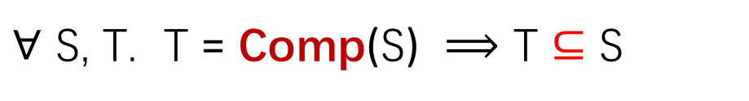
Compilation Correctness
Correct(Comp)：
S
$∀$ S, T. T = Comp(S) $⟹$ T $⊆$ S
Refinement:
T has no more observable behaviors (e.g. I/O events by print) than S
Comp
T
Notes:
The classic compilation correctness is that the target program T compiled has no more observable behaviors than the source program S.

Slide 24



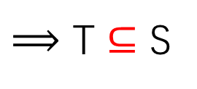
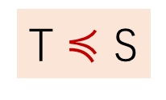




Simulation as Proof Technique
Correct(Comp)：
S
$∀$ S, T. T = Comp(S) $⟹$ T $⊆$ S
T $≼$ S
$⟹$ T $⊆$ S
Comp
Simulation
Whole program simulation ...
$$e$$
$$\text{S}$$
*
T
$$≼$$
$$≼$$
$$≼$$
Observable event
$$e$$
$$\text{T}$$
Notes:
To prove the correctness, we usually establish the simulation between T and S. It means that when T takes a step, S can take zero or more steps and the simulation still holds. And if T generates an observable event, S generates the same observable event.
However, the simulation shown here relates the whole programs and does not support separate compilation.

Slide 25






Thread-Local Simulation for Separate Compilation
$${\text{S}}_{1}$$
$$∥$$
$${\text{S}}_{2}$$
Comp1
Comp2
$${\text{T}}_{1}$$
$$∥$$
$${\text{T}}_{2}$$
Notes:
Consider the following condition, the whole program consists of two components S1 and S2 executing concurrently. Here, Comp1 compiles S1 to T1 and Comp2 compiles S2 to T2 separately.

Slide 26




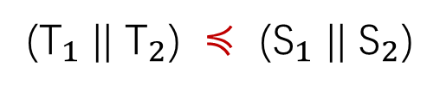



Thread-Local Simulation for Separate Compilation
Establish whole program simulation by verifying Comp1 and Comp2 separately
$${\text{S}}_{1}$$
$$∥$$
$${\text{S}}_{2}$$
(${\text{T}}_{1}$ || ${\text{T}}_{2}$) $≼$ (${\text{S}}_{1}$ || ${\text{S}}_{2}$)
Comp1
Comp2
$${\text{T}}_{1}$$
$$∥$$
$${\text{T}}_{2}$$
${\text{T}}_{1}$ $≼$ ${\text{S}}_{1}$ $∧$ ${\text{T}}_{2}$ $≼$ ${\text{S}}_{2}$
How to define simulation for single threads, i.e., ${\text{T}}_{1}$ $≼$ ${\text{S}}_{1}$ ?
$$e$$
$${\text{S}}_{1}$$
*
switch to other threads
$$≼$$
$$≼$$
$$≼$$
$$≼$$
$$e$$
$${\text{T}}_{1}$$
Notes:
We hope to establish the whole program simulation by verifying Comp1 and Comp2 separately. For this purpose, we need to establish the simulations for single threads, called thread-local simulation, between T1 and S1, and between T2 and S2 respectively.
However, the question is: how to define the simulation for single threads? Unlike the whole program simulation, when establishing the simulation between T1 and S1, the program will switch to other threads at some program points and the simulation needs to take into account the interactions with environments.

Slide 27
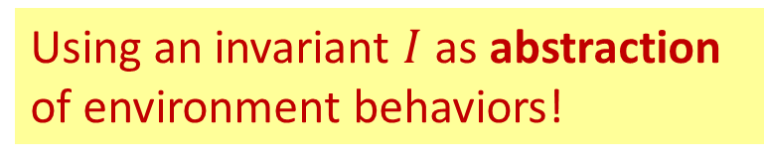
Thread-Local Simulation for Separate Compilation
Establish whole program simulation by verifying Comp1 and Comp2 separately
$${\text{S}}_{1}$$
$$∥$$
$${\text{S}}_{2}$$
(${\text{T}}_{1}$ || ${\text{T}}_{2}$) $≼$ (${\text{S}}_{1}$ || ${\text{S}}_{2}$)
Comp1
Comp2
$${\text{T}}_{1}$$
$$∥$$
$${\text{T}}_{2}$$
${\text{T}}_{1}$ $≼$ ${\text{S}}_{1}$ $∧$ ${\text{T}}_{2}$ $≼$ ${\text{S}}_{2}$
How to define simulation for single threads, i.e., ${\text{T}}_{1}$ $≼$ ${\text{S}}_{1}$ ?
$$e$$
$${\text{S}}_{1}$$
*
Consider environment interference without seeing the code?
$$≼$$
$$≼$$
$$≼$$
$$≼$$
Using an invariant $I$ as abstraction of environment behaviors!
$$e$$
$${\text{T}}_{1}$$
Notes:
However, how do we consider the environment interference in the thread-local simulation without seeing the codes of other threads? Our approach here is using an invariant as an abstraction of environment behaviors.

Slide 28

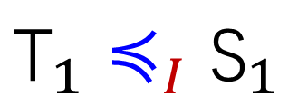
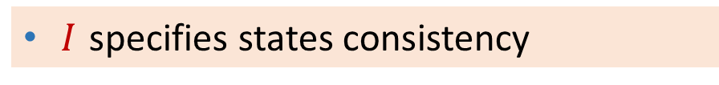
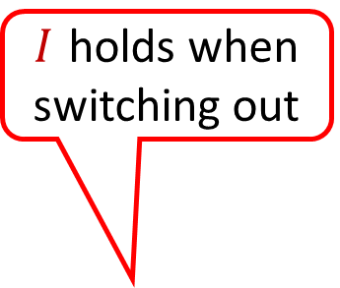
Invariant Parameterized Thread-Local Simulation
$I$ specifies states consistency
${\text{T}}_{1}$ $≼_{I}$ ${\text{S}}_{1}$
Timestamps mapping of tgt and src msgs
Values consistency of tgt and src msgs
Invariant parameter
$I$ holds when switching out
$$e$$
$${\text{S}}_{1}$$
*
$$≼$$
$$≼$$
$$I$$
$$≼$$
$$≼$$
$$e$$
$${\text{T}}_{1}$$
Notes:
Specifically, our thread-local simulation takes an invariant I as a parameter. The invariant I specifies the consistency of the target and source states, including the timestamp mapping and the value consistency of the target and source messages, when T1 and S1 switch out.

Slide 29
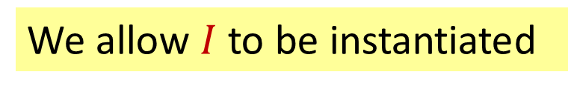
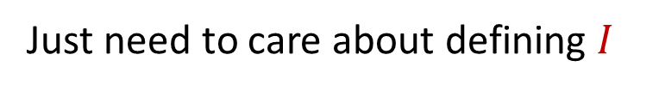
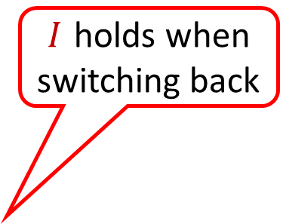

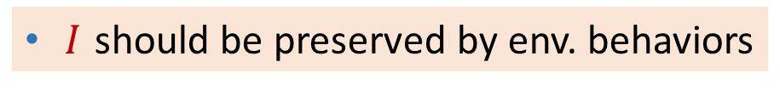

Invariant Parameterized Thread-Local Simulation
We allow $I$ to be instantiated
$I$ specifies states consistency
${\text{T}}_{1}$ $≼_{I}$ ${\text{S}}_{1}$
Timestamps mapping of tgt and src msgs
Values consistency of tgt and src msgs
Invariant parameter
$I$ holds when switching back
$I$ should be preserved by env. behaviors
$$e$$
$${\text{S}}_{1}$$
*
Don’t care of specific env. code
$$I$$
$$≼$$
$$≼$$
$$I$$
$$≼$$
$$I$$
$$≼$$
Just need to care about defining $I$
$$e$$
$${\text{T}}_{1}$$
Notes:
The environment behaviors should preserve the invariant I, so, when switching back, the invariant I still holds. With the invariant I, we don’t need to care of the specific codes of the environment and just care about the definition of the invariant I. In our work, we allow the invariant I to be instantiated.

Slide 30

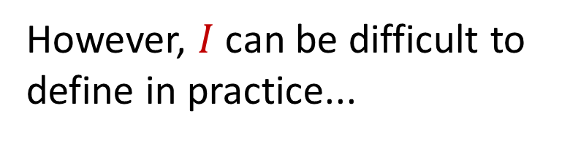
Invariant Parameterized Thread-Local Simulation
However, $I$ can be difficult to define in practice...
$I$ specifies states consistency
Fine-grained interleaving
➔ consistency has to be weak
Timestamps mapping of tgt and src msgs
Values consistency of tgt and src msgs
$I$ should be preserved by env. behaviors
$$e$$
$${\text{S}}_{1}$$
*
$$I$$
$$≼$$
$$≼$$
$$I$$
$$≼$$
$$I$$
$$≼$$
$$e$$
$${\text{T}}_{1}$$
Notes:
However, I can be difficult to define in practice.
First, if the interference of other threads is so frequent, the states consistency has to be weak, since the consistency is required to hold at too many points.

Slide 31



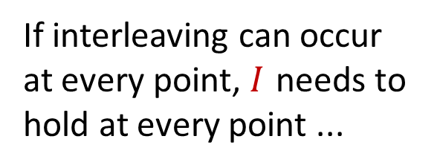




Invariant Parameterized Thread-Local Simulation
However, $I$ can be difficult to define in practice...
$I$ specifies states consistency
Fine-grained interleaving
➔ consistency has to be weak
Timestamps mapping of tgt and src msgs
Values consistency of tgt and src msgs
$I$ should be preserved by env. behaviors
$$e$$
If interleaving can occur at every point, $I$ needs to hold at every point ...
$${\text{S}}_{1}$$
*
$$I$$
$$≼$$
$$I$$
$$≼$$
$$I$$
$$≼$$
$$I$$
$$≼$$
$$I$$
$$≼$$
$$e$$
$${\text{T}}_{1}$$
Notes:
Consider that if the interleaving occurs at every program point, the invariant I needs to hold at every point.

Slide 32
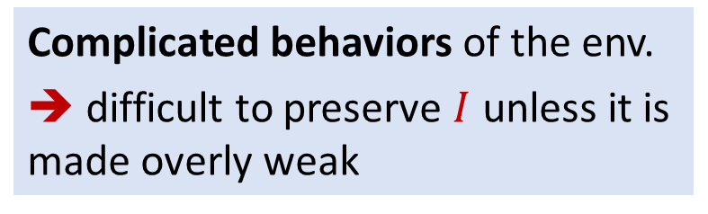
Invariant Parameterized Thread-Local Simulation
However, $I$ can be difficult to define in practice...
$I$ specifies states consistency
Fine-grained interleaving
➔ consistency has to be weak
Timestamps mapping of tgt and src msgs
Values consistency of tgt and src msgs
$I$ should be preserved by env. behaviors
Complicated behaviors of the env.
➔ difficult to preserve $I$ unless it is made overly weak
$$e$$
$${\text{S}}_{1}$$
*
$$I$$
$$≼$$
$$≼$$
$$I$$
$$≼$$
$$I$$
$$≼$$
Racy reads/writes of other thread
$$e$$
$${\text{T}}_{1}$$
Notes:
Second, the behavior of the environment may be complicated. For example, other threads may perform racy reads and writes concurrently. Too complicated environment behavior will make it difficult to preserve the invariant I unless I is made overly weak.

Slide 33
Invariant Parameterized Thread-Local Simulation
However, $I$ can be difficult to define in practice...
$I$ specifies states consistency
Fine-grained interleaving
➔ consistency has to be weak
Timestamps mapping of tgt and src msgs
Key idea 1: We introduce a non-preemptive semantics to reduce interleaving
Values consistency of tgt and src msgs
$I$ should be preserved by env. behaviors
Complicated behaviors of the env.
➔ difficult to preserve $I$ unless it is made overly weak
$$e$$
$${\text{S}}_{1}$$
*
Key idea 2: We disallow source prog. with write-write races
$$I$$
$$≼$$
$$≼$$
$$I$$
$$≼$$
$$I$$
$$≼$$
$$e$$
$${\text{T}}_{1}$$
Notes:
To solve such two problems, we introduce two techniques respectively: (1) a non-preemptive semantics to reduce interleaving and (2) only allowing write-write race free source programs.

Slide 34
Outline of This Talk
Overview of PS
Thread-Local Simulation
Non-preemptive Semantics
Write-Write Race Freedom
Notes:
We first introduce the non-preemptive semantics.

Slide 35








Non-preemptive Semantics (NP-PS)
NP-PS has less interleaving than PS
$r_{1}$ = $r_{2}$ + 3;
$r_{1}$ = $r_{2}$ + 3;
x = 3;
x = 3;
After executing
atomic primitive
y = 3;
y = 3;
rlx
rlx
...
...
$r_{2}$ = x;
$r_{2}$ = x;
print($r_{2}$);
print($r_{2}$);
After generating observable event
x = $r_{2}$ + 1;
x = $r_{2}$ + 1;
PS: thread can switch at any point
NP-PS: thread switches at specific points only
Notes:
The non-preemptive semantics has less interleaving than the promising semantics. Consider the following program, the thread can switch at any point in the promising semantics. But for the same program in the non-preemptive semantics, thread switching is only permitted at specific points. The points are: (1) after executing atomic primitives; and (2) after generating observable events.

Slide 36

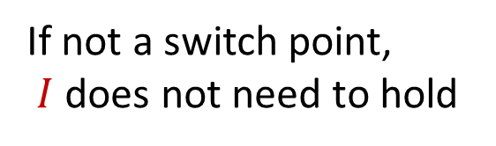




Non-preemptive Semantics (NP-PS)
NP-PS has less interleaving than PS
NP-PS is equivalent to PS
Define thread-local simulation on NP-PS
If not a switch point,
$I$ does not need to hold
Allow $I$ to hold at fewer points than on PS
$${\text{S}}_{1}$$
*
*
$$I$$
$$≼$$
$$≼$$
$$I$$
$$≼$$
$$I$$
$$≼$$
$${\text{T}}_{1}$$
Notes:
The non-preemptive semantics in our work is equivalent to the promising semantics. Defining the thread-local simulation on the non-preemptive semantics allows the invariant I to hold at fewer points than on the promising semantics. In our thread-local simulation, if a program point is not a switch point, I does not need to hold, since there is no interference of other threads.

Slide 37
Outline of This Talk
Overview of PS
Thread-Local Simulation
Non-preemptive Semantics
Write-Write Race Freedom
Notes:
Finally, we introduce the write-write race freedom.

Slide 38






Write-Write Race Freedom
Write-write races: informally, when a thread makes a write, it can see other threads writing the same location (including promises)
However, this straightforward definition would view too many programs as racy, including the following one (which should be race free!).
Revision: Promises should be considered only if they can all be certified.
Initially, x = y = z = 0

Also find explanation in our paper!
Thread $t_{1}$
Thread $t_{2}$
$r_{1}$ = y ;
$r_{2}$ = x ;
rlx
rlx
if($r_{1}$ == 1)
if($r_{2}$ == 1) {
z = 1;
z = 2;
 Find detailed introduction in our paper!
else
y = 1;
rlx
x = 1;
}
rlx
Notes:
A straight-forward definition of write-write race in the promising semantics is that when a thread makes a write, it can see other threads writing the same locations, as well as the promises of other threads. However, this straightforward definition would view too many programs as racy, including the following one, which should be race free. To revise the straightforward definition, we require races to be checked only when promises are certified. The detailed explanation can be found in our paper.

Slide 39
Allow Read-Write Races
For supporting optimizations which may introduce read-write races
Optimized code with read-write race may become the source code for subsequent optimization passes
S
May introduce read-write races
May contain read-write races
LICM
To prove its correctness, we must allow source prog. to have read-write races
M
DCE
T
Notes:
However, we allow the source program to have read-write races. It is crucial to support optimizations, which may introduce read-write races such as LICM. The code optimized by these optimizations may become the source code for subsequent optimization passes. Consider that the source program S is optimized by LICM and DCE successively. LICM may introduce read-write races and the intermediate code M may contain read-write races. To prove the correctness of subsequent optimizations, such as DCE, we must allow source programs to have read-write races.

Slide 40

Conclusion
Verification framework for optimizations in PS2.1
Defining correctness optimizations
Thread-local simulation as optimization correctness, allowing separate compilation
Verification techniques to simplify proofs
Simulation on a non-preemptive semantics to reduce interleaving
Consider only write-write race free source programs
Verifying four optimization algorithms in PS2.1
ConstProp, CSE, LICM and DCE
All proofs have been mechanized in Coq
https://plax-lab.github.io/publications/promisingcomp/
Notes:
Conclusion. We develop a verification framework for optimizations in the promising semantics 2.1. We verify four optimizations in our framework. All proofs have been mechanized in Coq.

Slide 41
Thank you!
Notes:
Thank you.

Slide 42
Conclusion
Verification framework for optimizations in PS2.1
Defining correctness optimizations
Thread-local simulation as optimization correctness, allowing separate compilation
Verification techniques to simplify proofs
Simulation on a non-preemptive semantics to reduce interleaving
Consider only write-write race free source programs
Verifying four optimization algorithms in PS2.1
ConstProp, CSE, LICM and DCE
All proofs have been mechanized in Coq
https://plax-lab.github.io/publications/promisingcomp/

