Slide 1
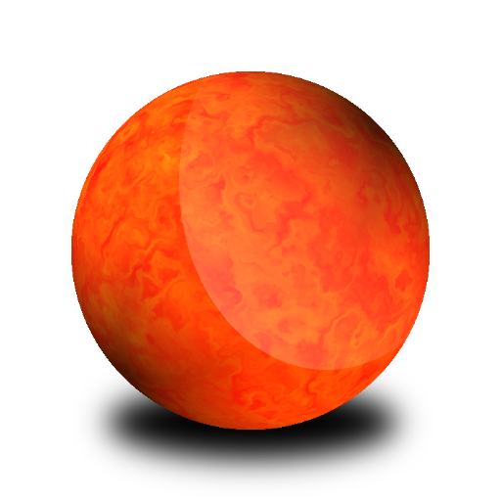




My Customer Journey from Mars
Top of the range Travel agency
Specialized in "To Earth travel"
Australia is the most profitable for us
Notes:
Choose a name for your company

Slide 2
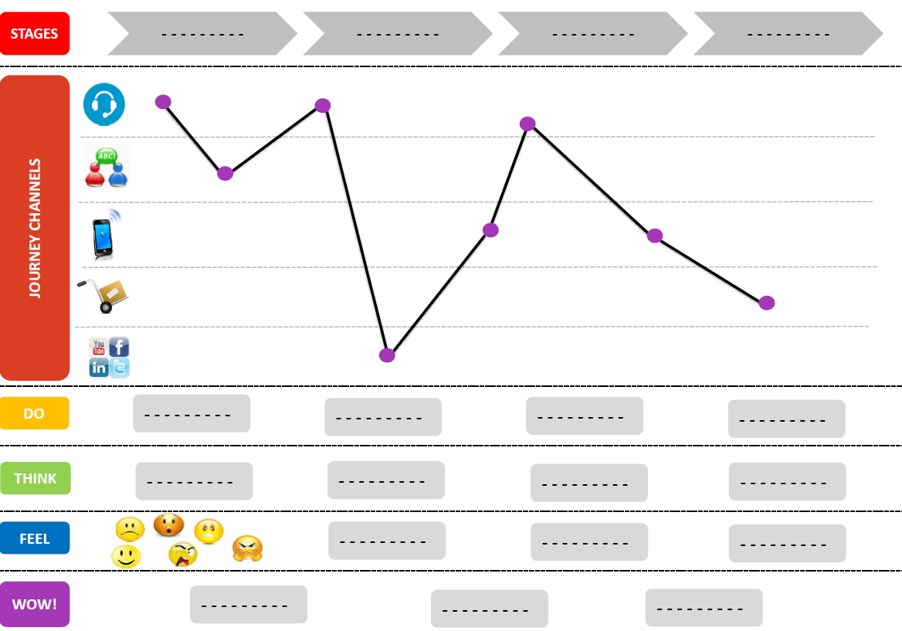
What is a Customer Journey
It is a succession of :
Interactions
Feeling
Thoughts
a customer has when he/she interacts with a company across a series of channels in a predefined scope.

Slide 4
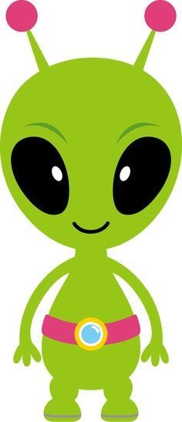
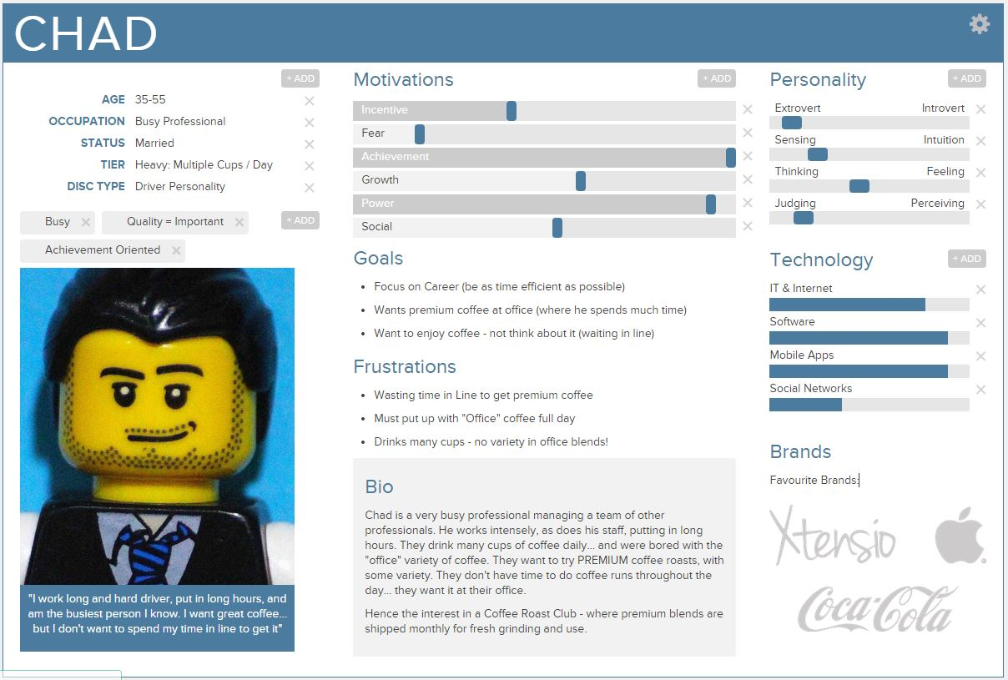
Create a persona
Martian
30K years old on earth = 20 years old on mars

Slide 5

Create an elevator pitch
For (Target customer),
that (Problem description),
our product (Product name),
offers (Main functionalities),
unlike (Alternative solutions),
our product (How it solves need better than alternatives).
Make him want to come to Earth (Earth vs Mars)

Slide 6
Stages / Activities
Imagine the big steps / STAGES of his travel

Slide 7
Channels
Which channels are used for each stages ?

Slide 8

User tasks
What are the user tasks for each stage ?
Notes:
House of user stories

Slide 9
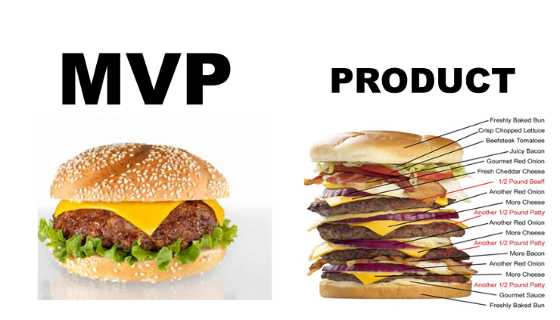
M.V.P Minimum Viable Product
Martians can stay only 10 days on earth
Otherwise they die.

Slide 10
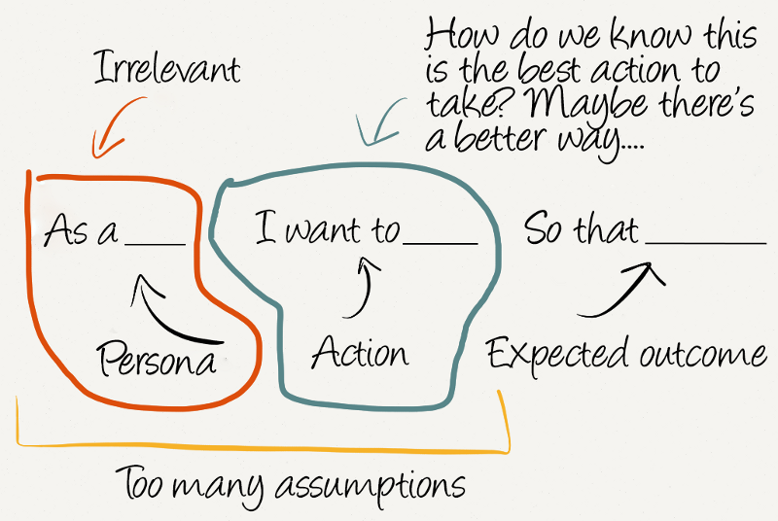
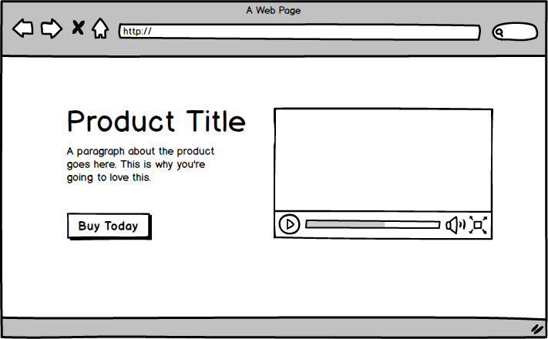
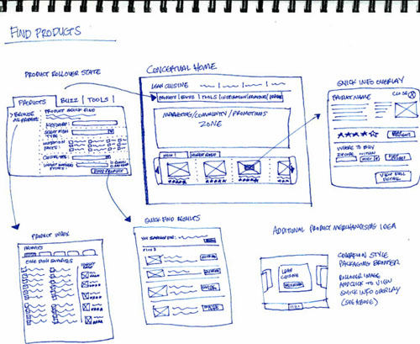
User stories
Create user stories related to the user tasks
I.N.V.E.S.T
Mockup
3 C
Acceptance criteria
In your Definition of Ready you specified :
User story must contain a Mockup
Notes:
House of user stories

Slide 11
Make the martians dream
Pitch your service

