Slide 1
Multiagent Learning and Equilibrium in Pricing Games
Katerina Papadaki
Joint work with:
Bernhard von Stengel, Galit Ashkenazi-Golan
Edward Plumb, Sahar Jahani
Department of Mathematics
London School of Economics

Slide 2
Overview
This is work in progress
Aim of this study
Pricing game
Learning framework
Learning environment
Some initial results
Conclusion and continuation

Slide 3
Aim the of study
To explore larger games with machine learning
We consider a duopoly game (2 firms) with demand inertia (price this period affects demand next period).
We use this base game to develop a learning framework that we can apply to other games.

Slide 4
Pricing game
Duopoly with demand inertia: multistage pricing game.
This was analysed theoretically by Selten (oligopoly version):
R. Selten (1965), Game-theoretic analysis of an oligopolic model with buyers’ interia. [German] Zeitsch. gesammte Staatswiss. 21, 301–304
One of the first subgame perfect equilibriums computed (by Selten in 1965).
Keser (1993) used this game in an experimental study where she run a tournament between game theorists.
C. Keser (1993), Some results of experimental duopoly markets with
demand inertia. Journal of Industrial Economics 41, 133–151
1992 PhD thesis: Springer Lecture Notes Econ. Math. Systems 391

Slide 5
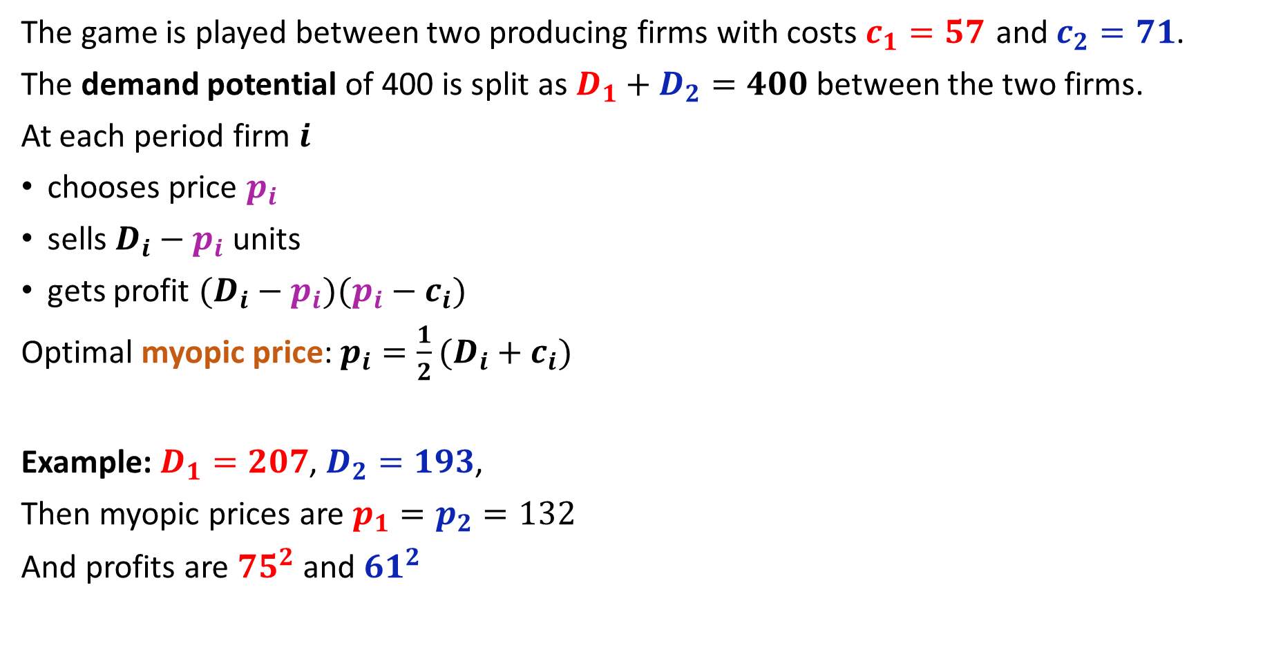
Duopoly game with demand inertia
The game is played between two producing firms with costs $c_{1}=57$ and $c_{2}=71$.
The demand potential of 400 is split as $D_{1}+D_{2}=400$ between the two firms.
At each period firm $i$
chooses price $p_{i}$
sells $D_{i}−p_{i}$ units
gets profit $(D_{i}−p_{i})(p_{i}−c_{i})$
Optimal myopic price: $p_{i}=\frac{1}{2}(D_{i}+c_{i})$
Example: $D_{1}=207$, $D_{2}=193$,
Then myopic prices are $p_{1}=p_{2}=132$
And profits are ${75}^{2}$ and ${61}^{2}$

Slide 6

Duopoly game with demand inertia
$c_{1}=57$, $c_{2}=71$, $D_{1}+D_{2}=400$
Units sold = $D_{i}−p_{i}$, profit = $(D_{i}−p_{i})(p_{i}−c_{i})$
Optimal myopic price: $p_{i}=\frac{1}{2}(D_{i}+c_{i})$
Played over 25 periods $t=1,…,25$:
$$D_{1}^{1}=D_{2}^{1}=200$$
$D_{1}^{t+1}=D_{1}^{t}+(p_{2}^{t}−p_{1}^{t}$)/2
$D_{2}^{t+1}=D_{2}^{t}+(p_{1}^{t}−p_{2}^{t}$)/2

Slide 7
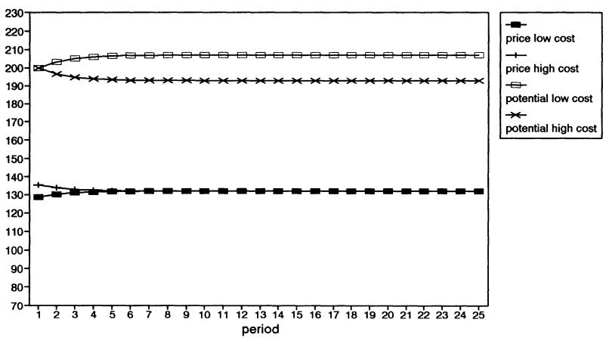
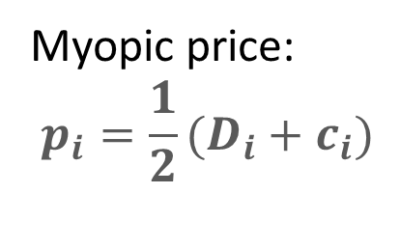
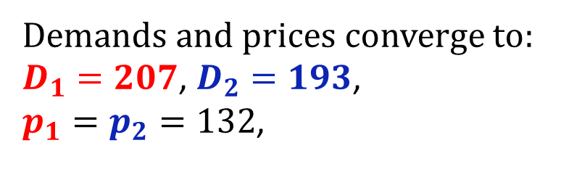
Myopic policy – cooperative solution
Myopic price:
$$p_{i}=\frac{1}{2}(D_{i}+c_{i})$$
Demand potential
Total profits:
156K
109K
prices
Demands and prices converge to:
$D_{1}=207$, $D_{2}=193$,
$p_{1}=p_{2}=132$,

Slide 8
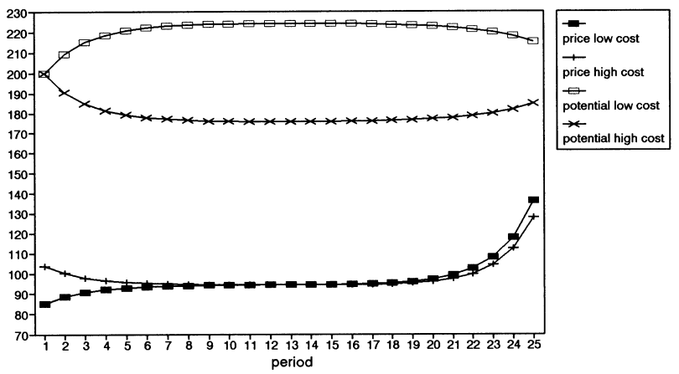
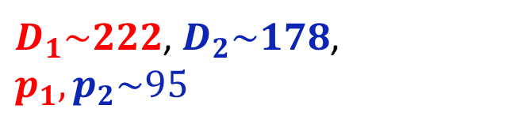
Subgame Perfect Equilibrium
Demand potential
Computed via backward Induction.
prices
Total profits:
137K
61K
$D_{1}\sim 222$, $D_{2}\sim 178$,
$p_{1},p_{2}\sim 95$

Slide 9








Keser’s tournament
Each participant submitted a strategy in the form of a flow chart both for low cost and high cost firms.
First round 45 participants submitted:
strategies were played against each other
cumulative payoffs ranked and sent to participants as feedback
Second round 34 participants
Evolutionary dynamics:
Keser applied replicator dynamics to 34x34 matrix
Eliminated most strategies
Leaving 4x4 with positive probability.
We look at this mixed equilibrium later.
$$H_{1}$$
$$H_{2}$$
$$H_{n}$$
$$L_{1}$$
$$P_{12}^{H}$$
$$P_{12}^{L}$$
$$L_{2}$$
$$L_{n}$$

Slide 10

Learning framework
Base game: Duopoly pricing game with demand inertia played over 25 periods.
Suppose we have $n$ agents, where each agent has one strategy for low cost and one for high cost firms.
Population game: An $n×n$, bimatrix game (low cost firm vs high cost firm) between these strategies.
Agent $A_{i}$ has strategy $L_{i}$ for low cost firms and $H_{i}$ for high cost firms.
$$H_{1}$$
$$H_{2}$$
$$H_{n}$$
$$L_{1}$$
$$P_{12}^{H}$$
$$P_{12}^{L}$$
Population game
$$L_{2}$$
$$L_{n}$$

Slide 11
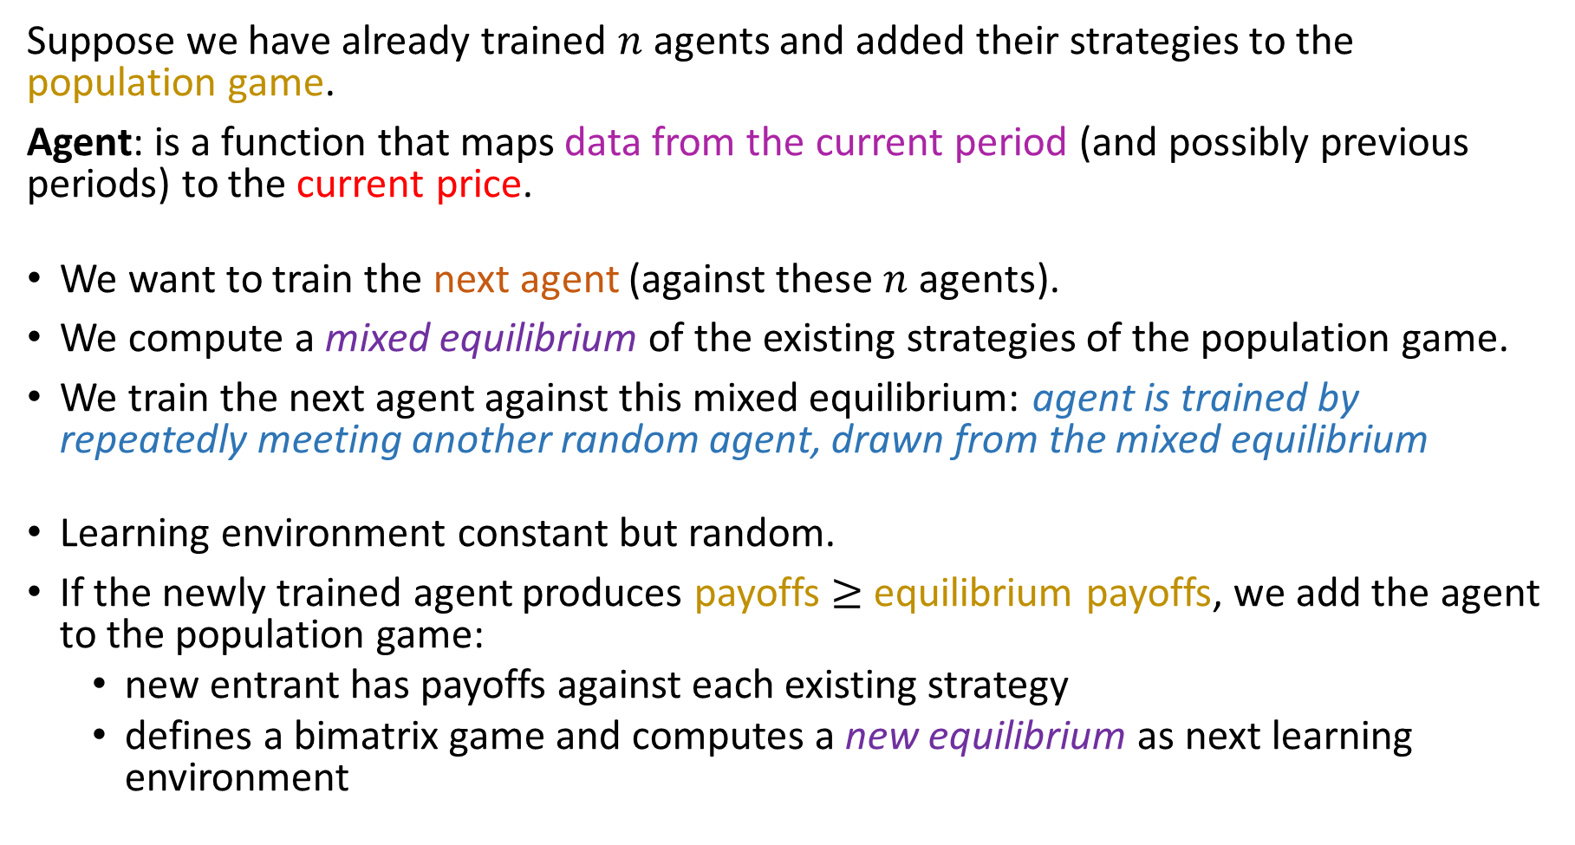
Learning framework
Suppose we have already trained $n$ agents and added their strategies to the population game.
Agent: is a function that maps data from the current period (and possibly previous periods) to the current price.
We want to train the next agent (against these $n$ agents).
We compute a mixed equilibrium of the existing strategies of the population game.
We train the next agent against this mixed equilibrium: agent is trained by repeatedly meeting another random agent, drawn from the mixed equilibrium
Learning environment constant but random.
If the newly trained agent produces payoffs $≥$ equilibrium payoffs, we add the agent to the population game:
new entrant has payoffs against each existing strategy
defines a bimatrix game and computes a new equilibrium as next learning environment

Slide 12
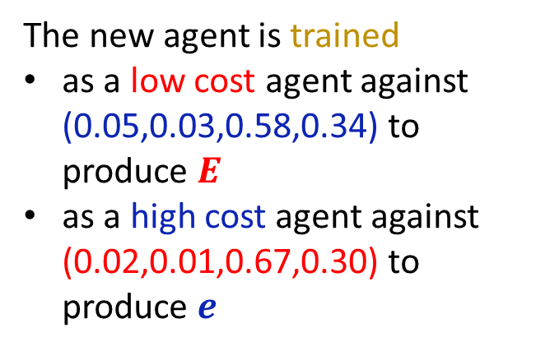
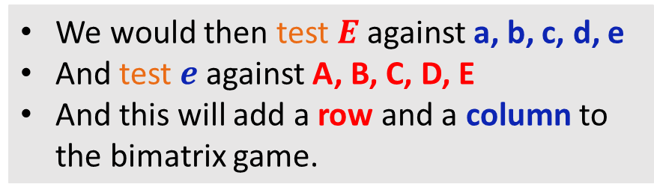
Example of the learning framework
The new agent is trained
as a low cost agent against (0.05,0.03,0.58,0.34) to produce $E$
as a high cost agent against (0.02,0.01,0.67,0.30) to produce $e$
We would then test $E$ against a, b, c, d, e
And test $e$ against A, B, C, D, E
And this will add a row and a column to the bimatrix game.

Slide 13


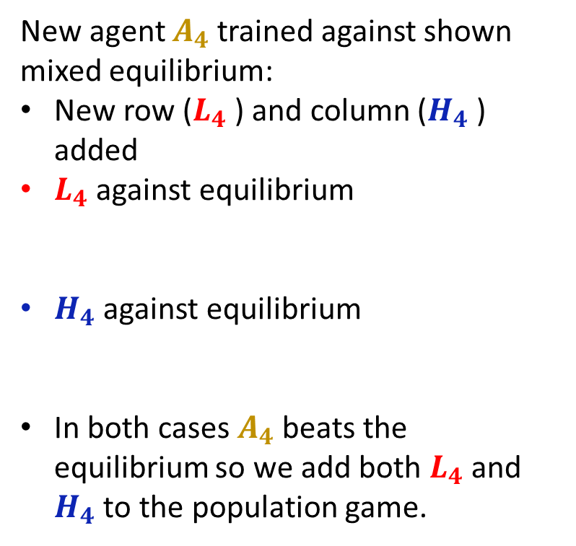














Example of the learning framework
How do we decide if we are keeping new row ($L_{4}$ ) or new column ($H_{4}$ )?
$$0.3$$
$$0.3$$
$$0.4$$
New agent $A_{4}$ trained against shown mixed equilibrium:
New row ($L_{4}$ ) and column ($H_{4}$ ) added
$L_{4}$ against equilibrium
$H_{4}$ against equilibrium
In both cases $A_{4}$ beats the equilibrium so we add both $L_{4}$ and $H_{4}$ to the population game.
$$H_{1}$$
$$H_{2}$$
$$H_{3}$$
$$H_{4}$$
$$L_{1}$$
$$P_{12}^{H}$$
1
$$0.5$$
$$P_{12}^{L}$$
1
$$0.4$$
$$L_{2}$$
2
1
1.5
3
1.9
$$0.1$$
$$L_{3}$$
2
2
3
0
2
$$L_{4}$$
3
2
1
3
1.6
1.1

Slide 14
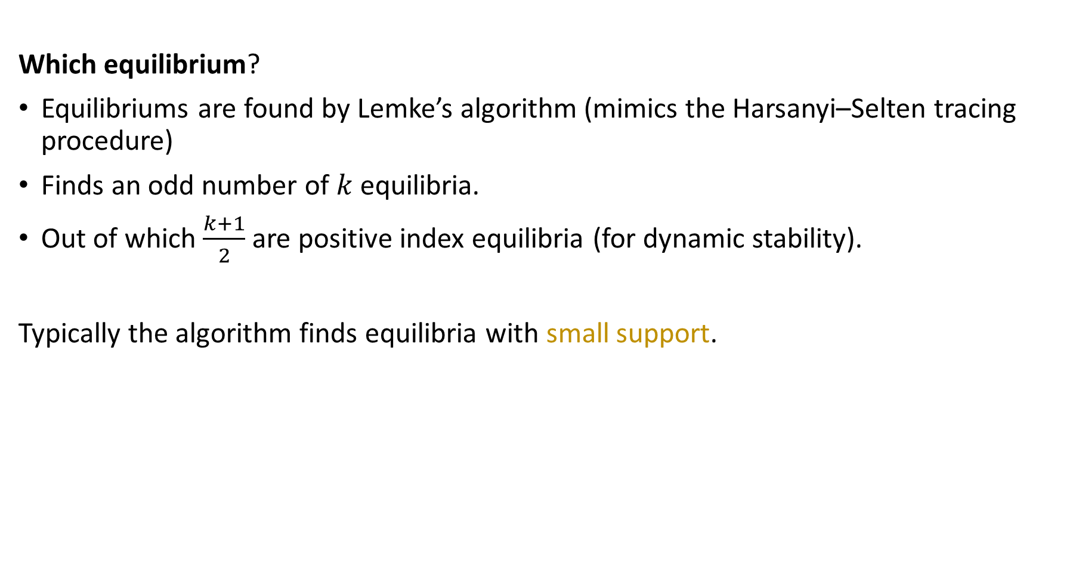
Learning framework
Which equilibrium?
Equilibriums are found by Lemke’s algorithm (mimics the Harsanyi–Selten tracing procedure)
Finds an odd number of $k$ equilibria.
Out of which $\frac{k+1}{2}$ are positive index equilibria (for dynamic stability).
Typically the algorithm finds equilibria with small support.

Slide 15
Learning framework - advantages
It is modular rather than a huge simulation:
the base game (pricing game)
is complex (too complex?) as an interesting learning scenario
allows competition and cooperation
potentially has “hand-made” good strategies
can be replaced by another game
• the population game . . . uses game theory
provides via equilibria a “stable” learning environment
has typically mixed, non-unique equilibria
allows different equilibrium concepts (mixed, evolutionary)
⇒ can independently investigate different aspects

Slide 16
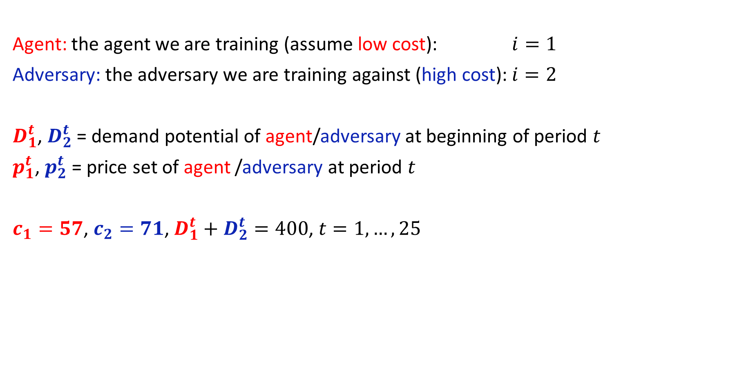
Learning environment
Agent: the agent we are training (assume low cost): $i=1$
Adversary: the adversary we are training against (high cost): $i=2$
$D_{1}^{t}$, $D_{2}^{t}$ = demand potential of agent/adversary at beginning of period $t$
$p_{1}^{t}$, $p_{2}^{t}$ = price set of agent /adversary at period $t$
$c_{1}=57$, $c_{2}=71$, $D_{1}^{t}+D_{2}^{t}=400$, $t=1,…,25$

Slide 17
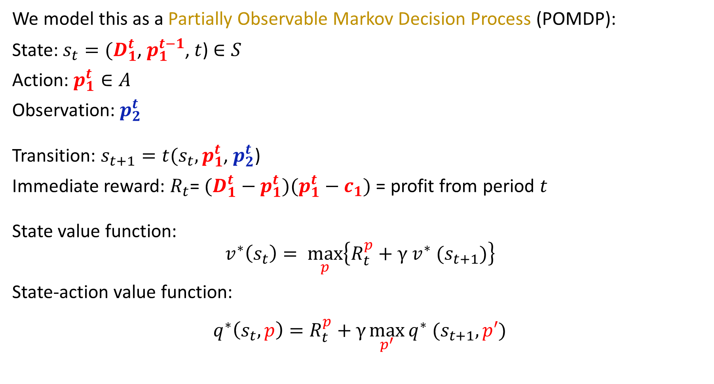
Learning environment
We model this as a Partially Observable Markov Decision Process (POMDP):
State: $s_{t}=(D_{1}^{t}$, $p_{1}^{t−1}$, $t$) $∈S$
Action: $p_{1}^{t}∈A$
Observation: $p_{2}^{t}$
Transition: $s_{t+1}=t(s_{t},p_{1}^{t}$, $p_{2}^{t}$)
Immediate reward: $R_{t}$= $(D_{1}^{t}−p_{1}^{t})(p_{1}^{t}−c_{1})$ = profit from period $t$
State value function:
$$v^{∗}\left(s_{t}\right)= \max_{p}\left\{R_{t}^{p}+γ v^{∗} (s_{t+1})\right\}$$
State-action value function:
$$q^{∗}\left(s_{t},p\right)=R_{t}^{p}+γ\max_{p^{′}}{q^{∗} (s_{t+1},p′)}$$

Slide 18
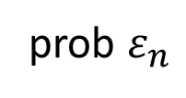
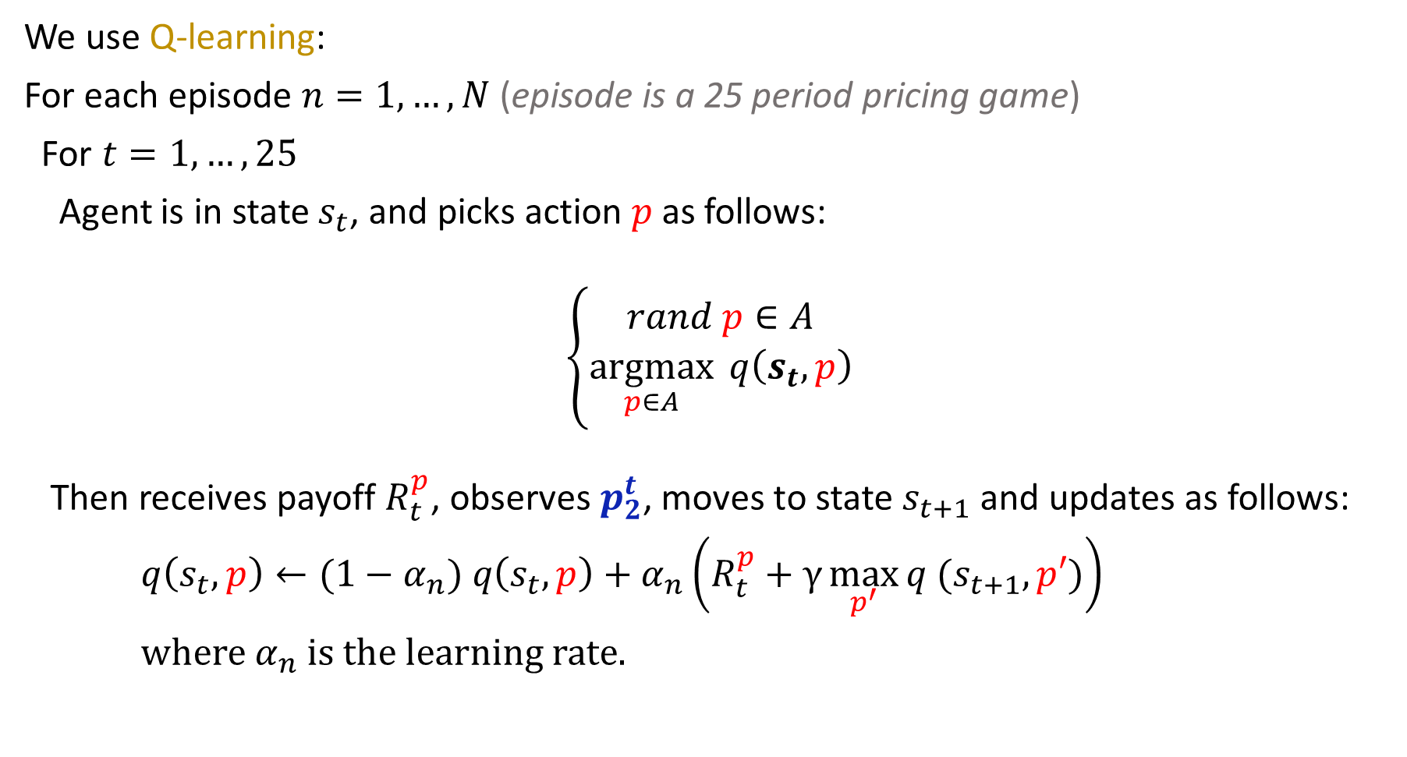


Learning environment
$$γ=1$$
$$ε_{n} =1−n/N$$
$$α_{n} =\frac{a}{b+n}$$
We use Q-learning:
For each episode $n=1,…,N$ (episode is a 25 period pricing game)
For $t=1,…,25$
Agent is in state $s_{t}$, and picks action $p$ as follows:
$$\left\{\begin{matrix}rand p∈A \\ \underset{p∈A}{argmax}{ q\left(s_{t},p\right)}\end{matrix}\right.$$
Then receives payoff $R_{t}^{p}$, observes $p_{2}^{t}$, moves to state $s_{t+1}$ and updates as follows:
$q\left(s_{t},p\right)←(1−α_{n}) q\left(s_{t},p\right)+α_{n}\left(R_{t}^{p}+γ\max_{p^{′}}{q (s_{t+1},p′)}\right)$
where $α_{n}$is the learning rate.
prob $ε_{n}$
prob 1- $ε_{n}$

Slide 19
Some initial Results
C132 = constant price 132
C95 = constant price 95
Training against:
(0.5,0.5) of (C132,C95)
While training, we play against C132 and C95
TC132 = train/play against C132
TC95 = train/play against C95

Slide 21
Some initial Results
S132 = sophisticated strategy starts at 132
S125 = sophisticated strategy starts at 125
Training against:
(0.5,0.5) of (S132,S125)
While training, we play against S132 and S125

Slide 22
Some initial Results

Slide 23
Conclusion and continuation
Distinguishes between very different simple strategies.
Complex strategies? Train longer?
Include more memory in the state.
Exploration probability depend on number of visits to a state.
Q-table already too big.
Q-table needs to be replaced by a neural network (deep Q-learning).
Other RL methods such as policy gradient.

Slide 24
Thank you

Slide 25
Some initial Results
C132 = constant price 132
C95 = constant price 95
Training against:
(0.5,0.5) of (C132,C95)
While training, we play against C132 and C95
TC132 = train/play against C132
TC95 = train/play against C95

Slide 26
Some initial Results
Training agents using Q-learning:
Round = 500,000 episodes
I132 = starts at 132 and imitates opponents price
G132 = complicated strategy that starts at the price of 132
Training against:
(0.5,0.5) of (I132,G132)
While training, we play against I132 and G132

Slide 27
Policy gradient
lr = 0.0001
Aadversary's strategy | low, agent's payoff | low, adversary's payoff | high, agent's payoff | high, adversary's payoff
myopic | 176443 | 50539 | 118022 | 95734
constant 132 | 276049 | -25963 | 207197 | -13449
constant 95 | 117703 | 52607 | 66850 | 98427
guess | 118905 | 95285 | 86611 | 131345
lr = 0.0005
Aadversary's strategy | low, agent's payoff | low, adversary's payoff | high, agent's payoff | high, adversary's payoff
myopic | 176099 | 51548 | 118321 | 94330
constant 132 | 276049 | -25963 | 186477 | 17177
constant 95 | 111855 | 54384 | 59063 | 110050
guess | 132293 | 85868 | 88671 | 133895
low cost/ high cost | mixed agent | lr=0.00005 / myopic | lr=0.00005 / const 96 | lr=0.00005 / guess
low | myopic/ const 95/ guess | 173423 | 94059 | 116460
high | myopic/ const 95/ guess | 115274 | 47784 | 76926

Slide 28
Example of a mixed equilibrium

Slide 30








$$H_{1}$$
$$H_{2}$$
$$H_{n}$$
$$L_{1}$$
$$P_{12}^{H}$$
$$P_{12}^{L}$$
$$L_{2}$$
$$L_{n}$$

Slide 31

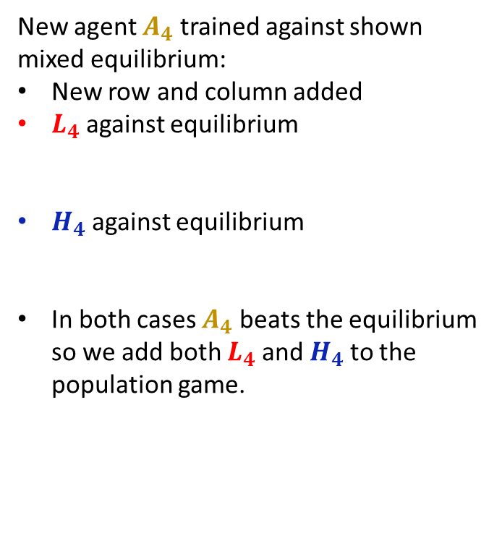










$$0.3$$
$$0.3$$
$$0.4$$
New agent $A_{4}$ trained against shown mixed equilibrium:
New row and column added
$L_{4}$ against equilibrium
$H_{4}$ against equilibrium
In both cases $A_{4}$ beats the equilibrium so we add both $L_{4}$ and $H_{4}$ to the population game.
$$H_{1}$$
$$H_{2}$$
$$H_{3}$$
$$H_{4}$$
$$L_{1}$$
$$P_{12}^{H}$$
1
$$0.5$$
1.5
$$P_{12}^{L}$$
1
1.9
$$0.4$$
$$L_{2}$$
2
1
1.6
3
1.1
$$0.1$$
$$L_{3}$$
2
2
3
0
2
$$L_{4}$$
3
2
1
3

