Slide 1
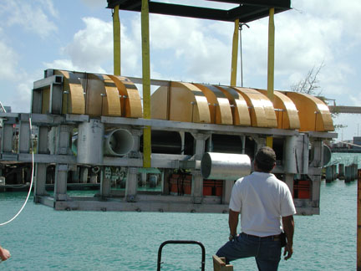
Semi-Autonomous Underwater Vehicle for Intervention Missions (SAUVIM)
J. Yuh, S.K. Choi, and T.W. Kim
Autonomous Systems Laboratory, University of Hawaii
IROS2003 Digest Template.
Use PowerPoint Software.
Use Arial fonts of 28pt in bold face and 20pt for the title and authors with their affiliations, respectively.
Use 4 bullet points. Each point uses Times New Roman fonts of 24pt.

