Slide 1
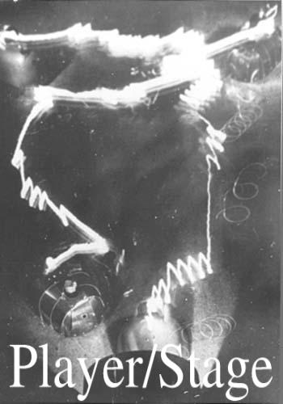
On Abstractions For Portable, Reusable Robot Code
Richard Vaughan Brian Gerkey, Andrew Howard
HRL Laboratories University of Southern California
Seek a standard abstract interface for robot devices
Key abstractions:
  character device model
  interface/driver model
  client/server model
Experience from the Player/Stage Project, an open platform used around the world [http://playerstage.sf.net]

