Slide 1
CODED
VISUALISATIONS

Slide 2
OVERVIEW
ONE.
FOUR.
Introduction
Starting at the top
TWO.
FIVE.
Basic building blocks
Peeking inside
THREE.
SIX.
Landscape
Bottom up

Slide 3
ONE
The term ‘coded visualisation’ does not exist.
Just a convenient term to define the scope of this course.

Slide 4
HANDS-ON
<svg height="100" width="100"> <circle cx="50" cy="50" r="40" stroke="black" stroke-width="3" fill="red" /> </svg>
FILES // src/one.html | src/one_ans.html

Slide 5
ONE
Why bother?
Why not just drag and drop?
FILE // network.html

Slide 6
OVERVIEW
ONE.
FOUR.
Introduction
Starting at the top
TWO.
FIVE.
Basic building blocks
Peeking inside
THREE.
SIX.
Landscape
Bottom up

Slide 7
TWO
What makes a visualisation?

Slide 8
HANDS-ON
Let’s hand code a chart
FILE // two.html

Slide 9
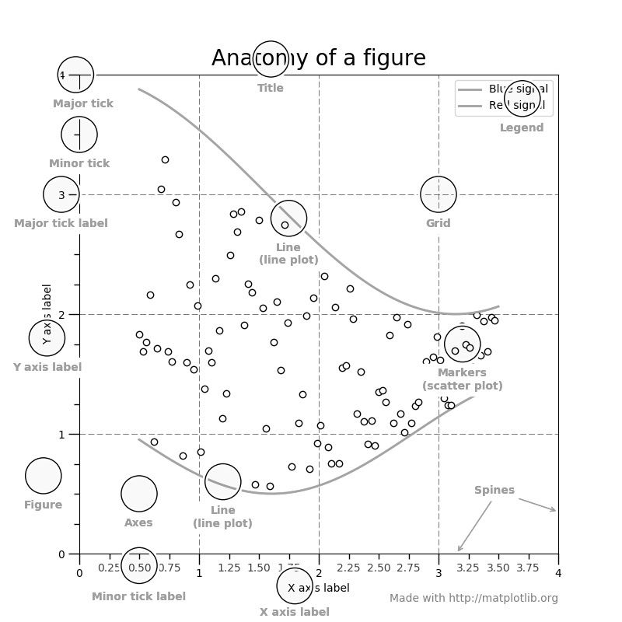
TWO
Tedious, tedious, tedious

Slide 10
OVERVIEW
ONE.
FOUR.
Introduction
Starting at the top
TWO.
FIVE.
Basic building blocks
Peeking inside
THREE.
SIX.
Landscape
Bottom up

Slide 11
THREE
LANGUAGES
LIBRARIES
FRAMEWORKS

Slide 12
THREE
Visualisation in Python
FILE // three_fancyhistograms.ipynb

Slide 13
THREE
Visualisation in a browser
FILE // three_dashboard.html

Slide 14
THREE
Full-stack

Slide 15
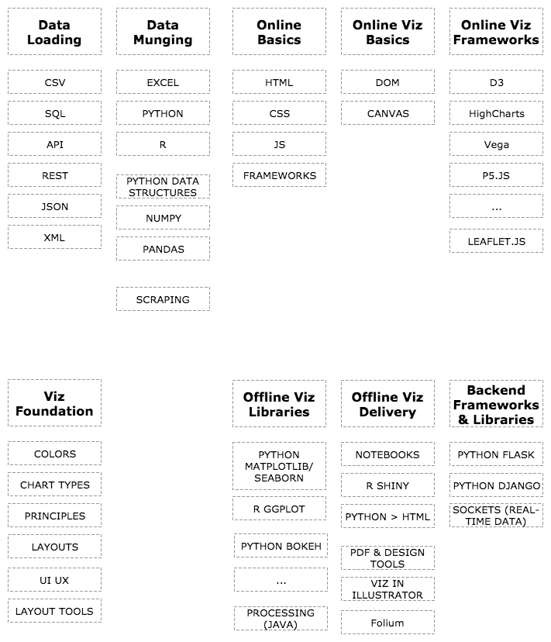

Slide 16
OVERVIEW
ONE.
FOUR.
Introduction
Starting at the top
TWO.
FIVE.
Basic building blocks
Peeking inside
THREE.
SIX.
Landscape
Bottom up

Slide 17
FOUR
Let’s check out Dash
https://plot.ly/dash/getting-started
FILE // app.py

Slide 18
FOUR
Let’s generate a local Plot.ly chart
FILE // four_plotly.ipynb

Slide 19
OVERVIEW
ONE.
FOUR.
Introduction
Starting at the top
TWO.
FIVE.
Basic building blocks
Peeking inside
THREE.
SIX.
Landscape
Bottom up

Slide 20
FIVE
Let’s take a look at the source code of a Plot.ly generated visualisation
FILE // temp_plot.html

Slide 21
FIVE
Let’s take a look at the source code of a Vega visualisation
FILE // five_vega.html

Slide 22
OVERVIEW
ONE.
FOUR.
Introduction
Starting at the top
TWO.
FIVE.
Basic building blocks
Peeking inside
THREE.
SIX.
Landscape
Bottom up

Slide 23
SIX
A tour of essential web development concepts
HTML
CSS
JAVASCRIPT
FILE // six_skeleton.html | six_d3_p5.html

Slide 24
SIX
Javascript – the ever-evolving, confusing landscape
old school, new school (ES6)
Out of this course’s scope
How to tell – 2 hints
let vs var
arrow functions

Slide 25
SIX
let vs var – why does it matter
…
var increment = function (n) { return n+1; }
let increment = n => n+1;

Slide 26
D3 LAB
ONE.
FOUR.
Set-up
Scales
TWO.
FIVE.
Defining the canvas
A line and many dots
THREE.
SIX.
Data
Axis
FILE // lab.html

Slide 27
THE
END
FIN

Slide 28
CREATE

