Slide 1
The Structural Transformation of the Silver Market
From Precious Metal to Critical Industrial Commodity
Prepared by: Jordan Playil
Role: Data & Market Analyst
Date: 14/01/2026

Slide 2
PURPOSE OF THE ANALYSIS
Why This Analysis Was Conducted
To determine whether recent silver price strength is:
  Cyclical and speculative
  Or fundamentally structural
To assess long-term implications for:
  Investors
  Corporates
  Strategic capital allocation
Key Question:
Is silver being repriced — or merely experiencing a temporary rally?

Slide 3
DATA SOURCES & CREDIBILITY
Where the Data Came From
Demand & Supply Data:
The Silver Institute (industry authority)
Price Data:
Kaggle (historical silver price dataset)
Why These Sources Matter
Widely used by:
  Miners
  Banks
  Institutional investors
No proprietary assumptions or synthetic data

Slide 4
DATA ENGINEERING & PREPARATION
What Was Done Before Any Analysis
Standardised demand & supply categories
Resolved inconsistencies across years
Normalised all values to million ounces
Segregated historical vs forecast data
Removed duplicates and alignment errors
Every visual in this deck is built on cleaned, validated data.

Slide 5
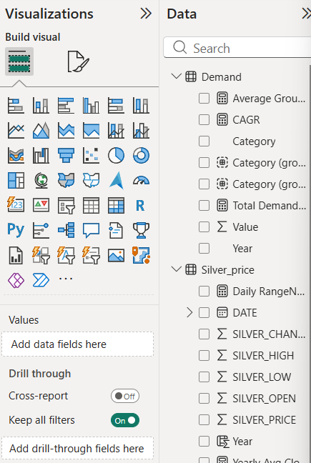
POWER BI & DAX MODELING
How the Analysis Was Built
End-to-end model created in Power BI
Star-schema structure:
  Fact tables: Demand, Supply, Price
  Dimensions: Year, Category, Sub-Category
Custom DAX Measures Created
Total Demand & Supply
Demand–Supply Deficit
Category Contribution (%)
CAGR by Category
Yearly Max Low and High

Slide 6
ANALYTICAL FRAMEWORK
Methodology Used
Demand structure analysis
Supply elasticity assessment
Market balance (deficit/surplus)
Price response to imbalance
Forward trend extrapolation
This mirrors institutional commodity research methodology

Slide 7
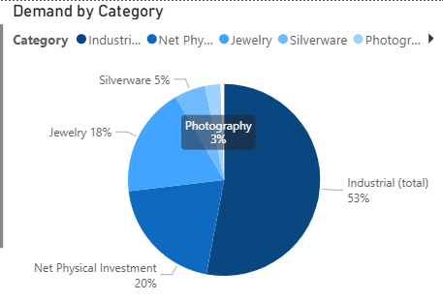
DEMAND COMPOSITION (STRUCTURAL SHIFT)
How Silver Demand Has Changed
Industrial demand grew from:
  ~500M oz (2016) → ~880M oz (2024)
+76% growth | ~7.5% CAGR
Now represents ~70% of total demand
Declining Segments
Jewelry & silverware
Photography

Slide 8
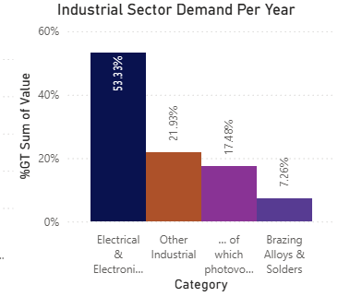
INDUSTRIAL DEMAND BREAKDOWN
What’s Driving Industrial Growth
Solar photovoltaic manufacturing
Electrification & EVs
Data centers & 5G infrastructure
Electronics & IoT
Silver is now a critical industrial input, not just a precious metal.

Slide 9
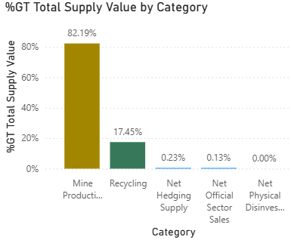
SUPPLY STRUCTURE
Supply Reality Check
Mine production:
  ~800–850M oz annually
  Flat for 8+ years
Recycling:
  ~18–20% of total supply
  Minimal price responsiveness

Slide 10
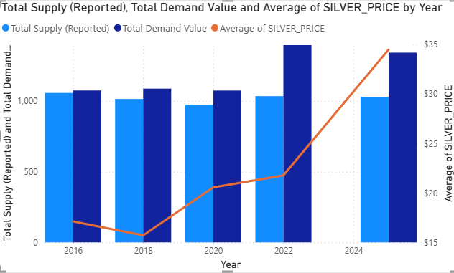
STRUCTURAL DEFICIT DRIVES PRICE
What’s Happening
Supply not responding to price
150–250M oz deficits post-2020
Deficits widening, not cyclical
Price: $17 → $35+ (2020–2025)
Why It Matters
Supply structurally inflexible
Price responding rationally
Deficit explains ~70–80% of the price move
Structural shortage → structural repricing

Slide 11
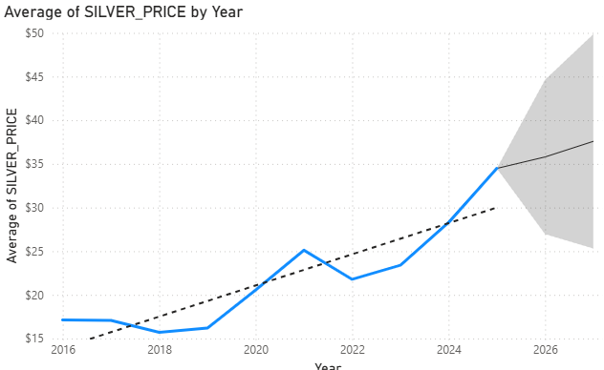
FORWARD PRICE OUTLOOK
Trend-Based Projection
Most Probable 2027 Scenario:
Base Case: $60–64 per oz
Risk skewed upward
Why
20% supply shortfall
Flat mine output
Inelastic industrial demand

Slide 12
INVESTOR IMPLICATIONS
What This Means for Capital Allocation
Silver offers asymmetric upside
Structural, not cyclical thesis
Exposure to:
  Energy transition
  Infrastructure spending
  Inflation hedging

Slide 13
MODEL LIMITATIONS & TRANSPARENCY
What This Model Does Not Claim
Exact timing of price moves
Immunity to macro shocks
Perfect forecasting accuracy
What It Does Provide
Directional certainty
Structural clarity
Fundamentally grounded conclusions

Slide 14
SUMMARY
Analysis based on historical data (2016 – Q1 2025)
Demand & supply data sourced from The Silver Institute
Price trends based on historical market data
Forward price outlook is indicative, influenced by:
  Investor sentiment
  Geopolitical tensions
  Inflation & monetary policy
  Global economic conditions
This is not financial advice
Purpose is to provide data-driven insights
Key Insight: Silver is no longer just a precious metal —
it is a strategic industrial and macro-sensitive asset

