Slide 1
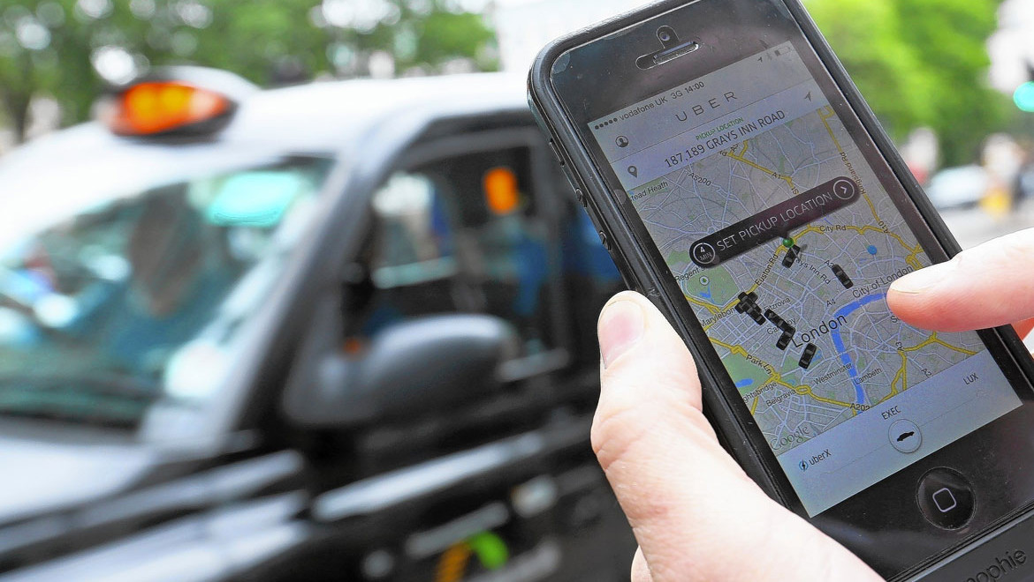
MID TERM REPORT COMPUTATIONAL INTELLIGENCE
“Share-A-Ride Problem with Adjustable Compartment”
GROUP-5
葉雨璇 – M10601008
高傲凡 – M10601014
Panca Jodiawan –M10601806
Yudisuda Indrakarna – M10601812

Slide 2




OUTLINES
Share-A-Ride Problem with Adjustable Compartment
01
INTRODUCTION
02
ALGORITHM DESIGN
03
NUMERICAL EXAMPLE
04
OPTIMIZATION RESULT
05
ANALYTICAL RESULT
06
CONCLUSIONS

Slide 3




PROBLEM DEFINITION
ILLUSTRATION
7
4
Legend
6
Passenger pickup
Passenger delivery
Package pickup
Package delivery
3
1
8
2
0
5
From | To | Passenger | Package | Distance | Service | Earliest | Latest | Decision
0 | 2 | 1 | 0 | 2,93036 | 5 | 440 | 800 | 464,061
2 | 6 | 0 | 0 | 14,9265 | 5 | 468 | 828 | 484,061
6 | 3 | 0 | 1 | 1,92869 | 5 | 249 | 609 | 501,974
3 | 4 | 0 | 2 | 4,3858 | 5 | 155 | 515 | 514,451
4 | 7 | 0 | 1 | 2,2903 | 5 | 313 | 673 | 558,302
7 | 8 | 0 | 0 | 7,57557 | 5 | 454 | 814 | 692,591
8 | 1 | 1 | 0 | 7,66057 | 5 | 350 | 710 | 709,842
1 | 5 | 0 | 0 | 17,5092 | 5 | 400 | 760 | 732,48
5 | 0 | 0 | 0 | 4,68513 | 0 | 0 | 0 | 742,165
692,591
697,591
519,451
0
464,061
469,061
709,842
563,302
732,48
742,165
489,061
737,48
714,842
506,974
501,974
484,061
514,451
558,302

Slide 4
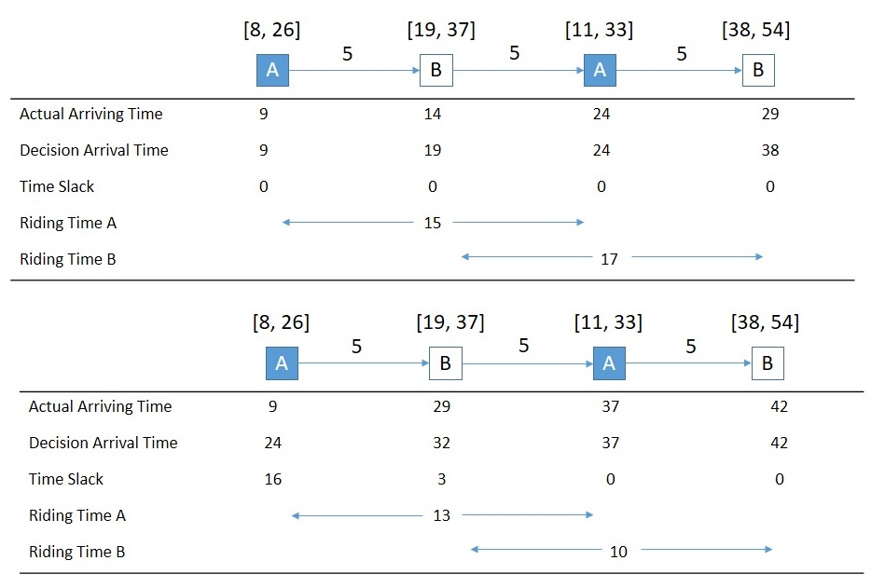
ALGORITHM DESIGN+
NUMERICAL EXAMPLE
Route
5 | 6 | 3 | 2 | 7 | 8 | 4 | 1
0.59 | 0.48 | 0.19 | 0.56 | 0.35 | 0.7 | 0.81 | 0
Time Slack
Time slack utilization
From node 0 – 5
Earliest time : 400
Latest time : 760
Time slack : 0.585 (the table show two rounded digits)
Time difference : 760 – 400 = 360
Added time : 0.585 x 360 = 210.6
Real visiting time : 400 + 210.6 = 610.6
32 Unit Time
23 Unit Time

Slide 5
Objective Calculation
Calculate passenger fare

Slide 6
Objective Calculation
Package fare profit
Package fare profit is 15.7828.

Slide 7
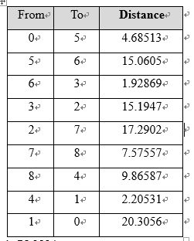
Objective Calculation
The cost of distance traveled
The value of distance cost is 75.2834.

Slide 8
Objective Calculation
The fourth part prevails for passenger only.
Example for sarpac14.
The total value is 12.72749.

Slide 9


Objective Calculation
Summing up all four parts, the total objective value of Penalty : 22.34841

Slide 10
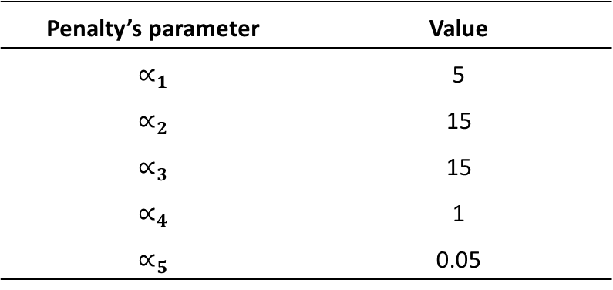
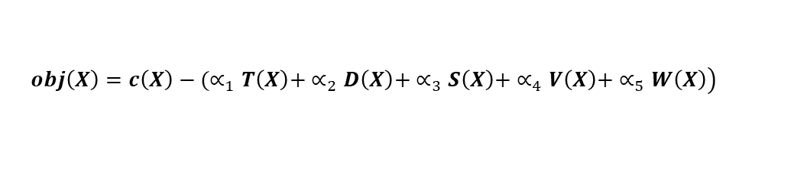
Penalty mechanism
$$\left.obj\left(X\right)=c\left(X\right)−(∝_{1}T\left(X\right)+ ∝_{2}D\left(X\right)+ ∝_{3}S\left(X\right)+ ∝_{4}V\left(X\right)+ ∝_{5}W\left(X\right)\right)$$
T(X) : Violation on a taxi’s maximum travel time
D(X) : Violation on visiting a request’s delivery node before its pick-up node
S(X) : Violation on serving a request by more than one taxis
V(X) : Violation on taxi’s capacity lower bound and upper bound
W(X) : Violation on nodes’ time windows
Penalty’s parameter | Value
$$∝_{1}$$ | 5
$$∝_{2}$$ | 15
$$∝_{3}$$ | 15
$$∝_{4}$$ | 1
$$∝_{5}$$ | 0.05

Slide 11
Penalty mechanism
$$\left.obj\left(X\right)=c\left(X\right)−(∝_{1}T\left(X\right)+ ∝_{2}D\left(X\right)+ ∝_{3}S\left(X\right)+ ∝_{4}V\left(X\right)+ ∝_{5}W\left(X\right)\right)$$
Penalty’s parameter | Value | Penalty Cost
T(X) | 21.506 | 107.529
D(X) | 3 | 45
S(X) | 0 | 0
V(X) | -10 | 10
W(X) | 693.166 | 34.6082
Total Penalty : 197.137
Results : 22.34841 – 197.137 = -174.788.

Slide 12
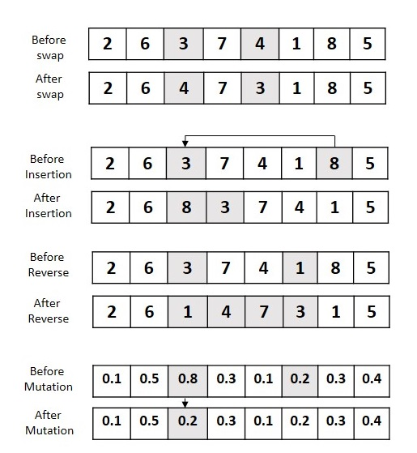
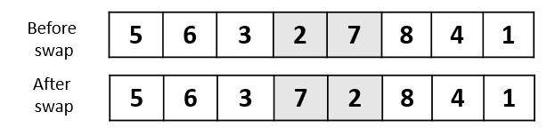
Neighborhood Structures
Examples :

Slide 13
Two conditions :
Penalty mechanism
Repair mechanism
Repair Mechanism
Select the first pick-up node, say i, from the infeasible solution. From left to the right, find the first feasible position in the current route, say k, for node i and then insert node i into the route at the feasible position; otherwise, repeat step 1 for the next route.
Select the first feasible position for the delivery node, say j, associated with the pick-up node i and then insert node j into route k. If there is no feasible position for node j in route k, then delete node i from node k and repeat step 1 for node i starting from the next route.

Slide 14

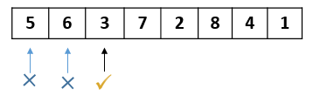
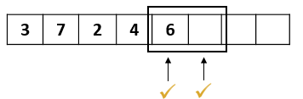



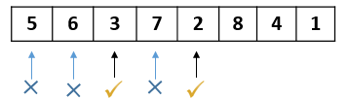
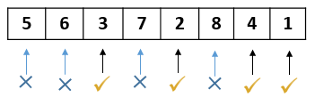
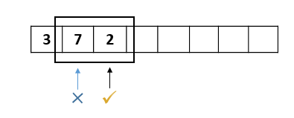
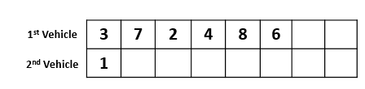

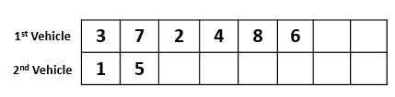
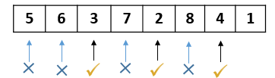
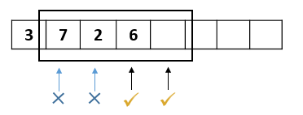

1.
6.
2.
3.
7.
4.
5.

Slide 15
Experimental Result
Optimization Result
One Factor at a Time (OFAT)
Parameter | Value
T₀ | 10
T_{F} | 0.01
α | 0.99
I_{iter} | 800
N_{non-impove} | 2000
Best parameter setting
Iteration = 800
Initial temperature = 8
= 0.99
Final temperature = 0.01
Nnon-improve = 2000

Slide 16

Final Solution
The best performance of SA
7
4
6
3
8
1
2
0
5

Slide 17
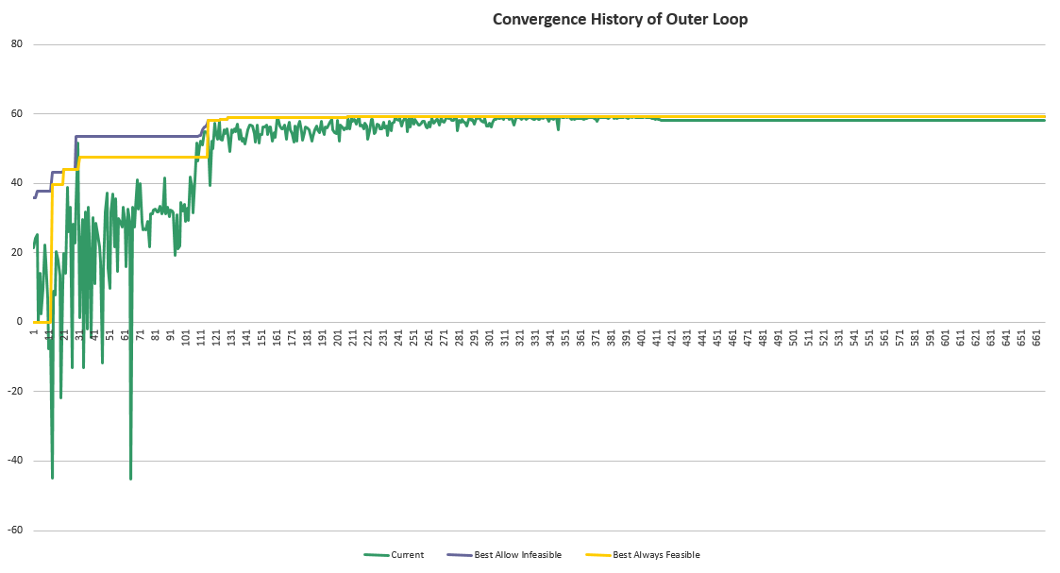
Convergence History(1/2)
X : Temperature reduction
Y : The profit that taxi can obtain
Outer loop
Current solution
Best allow infeasible solution
Best always feasible solution
81 91 101 111 121 131 141 151

Slide 18
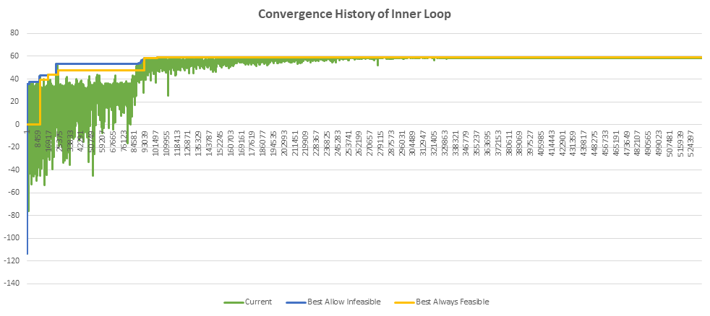
Convergence History(2/2)
X : Temperature *1,000 iterations
Y : The profit that taxi can obtain
Inner loop
Current solution
Best allow infeasible solution
Best always feasible solution
84581 93039 101497 109955

Slide 19

Analytical Result
CPLEX Comparison
Simulated Annealing
Compare with CPLEX
sarpac14
Normal time window
GAP(%)=(Best-AMPL)/Best x 100%
sarpac14n
Narrow time window

Slide 20
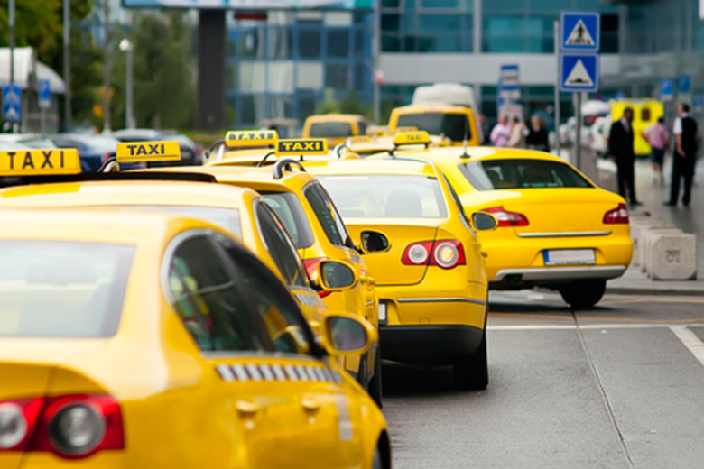
PROBLEM SUMMARY
find a set of taxi routes that maximizes the total profit of a taxi company that comes from serving both passenger and package requests by considering capacity flexibility of taxi
ALGORITHM
Simulated Annealing is utilized by modifying some parts. The modification is penalty and repair mechanism. This mechanism is determined based on a particular probability. The performance of SA is valued by its gaps to optimal solution, which is -0.1096.
FUTURE DIRECTION
The model is only limited to one passenger allowed inside the taxis. One may extent this to a generalized one where more than one customer is allowed inside the taxis. Another algorithm can be also proposed to provide better solution

