Slide 1

Datamining - Final presentation
M10601014 高傲凡
M10603005 陳佳吟
M10601806 Panca
M10701803 Jesica
M10701201 黃琮淇

Slide 2

Introduction
Feed Forward Neural Network has been used extensively to solve classification problem.
Combining the Feed Forward Neural Network with metaheuristics techniques have been conducted in order to find a better performance
Integration of Feed Forward Neural Network with Metaheuristics (Particle Swarm Optimization and Gravitational Search Algorithm) is presented to show the improvement.
Limitation
Several parameters – iterations, gravitational constant, and alpha – will not be varied in the experiment

Slide 3



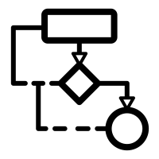



Outlines
Two popular benchmark datasets are used for algorithms testing
Dataset
Parameter Testing
Algorithms’ parameters adjustment is conducted in order to find the best performance
Algorithm
Analysis
Two population based algorithms are utilized in order to compare performances with pure BPN
Several analyses are performed for comparison’s and algorithm characteristics identification’s purpose
Conclusion
Literature Review
Summary and Insight are presented
Combination of Feed Forward Neural Network with Metaheuristics is discussed

Slide 4

Literature Review
Author | Topics
Yaghini, M., Khoshraftar, M. M., & Fallahi, M. (2013) | IOPSO-BPA
Leema, N., Nehemiah, H. K., & Kannan, A. (2016) | DEGI with BPN
Leema, N., H. et al., (2016) | DEGI-BP
Khehra, B. S., & Pharwaha, A. P. S. (2016) | LM-MLFFB-ANN
Amar, M. N., Zeraibi, N., & Redouane, K. (2018) | ANN-GWO
Baklacioglu, T., Turan, O., & Aydin, H. (2018) | BPN-GA

Slide 5
Literature Review
Author | Topics | keyword
Sangjae Lee, Wu Sung Choi | A multi-industry bankruptcy prediction model using back-propagation neural network and multivariate discriminant analysis | Bankruptcy prediction Back-propagation neural network (BNN) Multivariate discriminate analysis (MDA) A multi-industry investigation
P.SIBI , S.ALLWYN JONES , P.SIDDARTH | Analysis of different activation functions using back propagation neural networks | Artificial Neural Network (ANN), Back Propagation Network (BPN), Activation Function
SeyedAli Mirjalili, Siti Zaiton Mohd Hashim, Hossein Moradian Sardroudi | Training feedforward neural networks using hybrid particle swarm optimization and gravitational search algorithm | FNN；Neural network Learning neural network Gravitational search algorithm(GSA) Particle swarm optimization(PSO) Evolutionary algorithm Multilayer perceptron
Jing-Ru Zhang , Jun Zhang etc. | A hybrid particle swarm optimization–back-propagation algorithm for feedforward neural network training | Particle swarm optimization algorithm; Feedforward neural network; BP algorithm; Adaptive particle swarm optimization

Slide 6
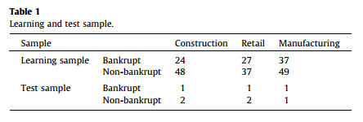
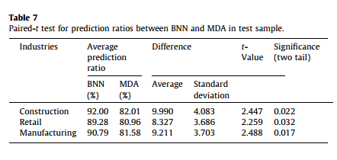
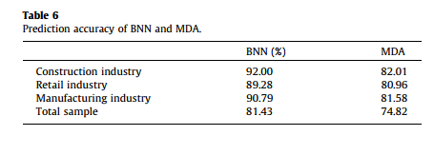
A multi-industry bankruptcy prediction model using back-propagation neural network and multivariate discriminant analysis
Setting
Database: From KIS database
Layer
Input nodes: 6 hidden nodes : 6
output nodes : 1
Result
BPN is better than MDA

Slide 7
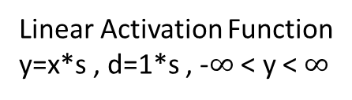
Analysis of different activation functions using back propagation neural networks
Linear Activation Function
y=x*s , d=1*s , -$∞$ < y < $∞$
Elliot Activation Function
y=((x*s)/2)/1+|x*s|)+0.5 ,
d=s*1/(2*(1+|x*s|)*(1+|x*s|)), 0 < y < 1
Sigmoid Activation Function
y=1/(1+exp(-2*s*x) , d=2*s*y*(1-y) , 0 < y < 1
Sigmoid Symmetric Activation Function
y=tanh(s*x)=2/(1+exp(-2*s*x)-1, d=s*(1-(y*y)) , -1 < y < 1
Elliot Symmetric Activation Function
y=(x*s)/1+|x*s|) ,
d=s*1/(1+|x*s|)*(1+|x*s|), -1 < y < 1
Gaussian Activation Function
y=exp(-x*s*x*s), d=-2*x*s*y*s , 0 < y < 1
Linear Piecewise Activation Function
y=x*s , d=1*s , 0 < y < 1
Gaussian Symmetric Activation Function
y=exp(-x*s*x*s)*2-1, d=-2*x*s*(y+1)*s , -1 < y < 1
Linear Piece Symmetric Activation Function
y=x*s , d=1*s , -1 < y < 1

Slide 8
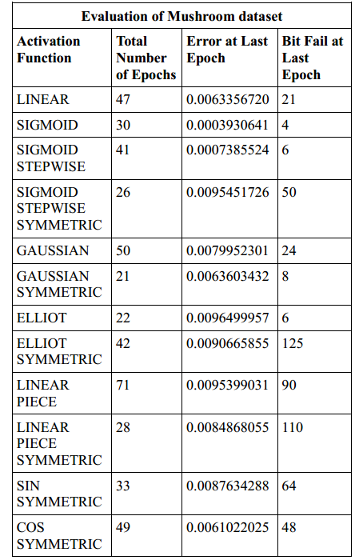
Analysis of different activation functions using back propagation neural networks
Result
When a network gets trained up successfully, every activation function has approximately the same effect on it.

Slide 9
Analysis of different activation functions using back propagation neural networks
Setting
Database: From KIS database
Layer
Input nodes: 6 hidden nodes : 6
output nodes : 1
Result
BPN is better than MDA

Slide 10
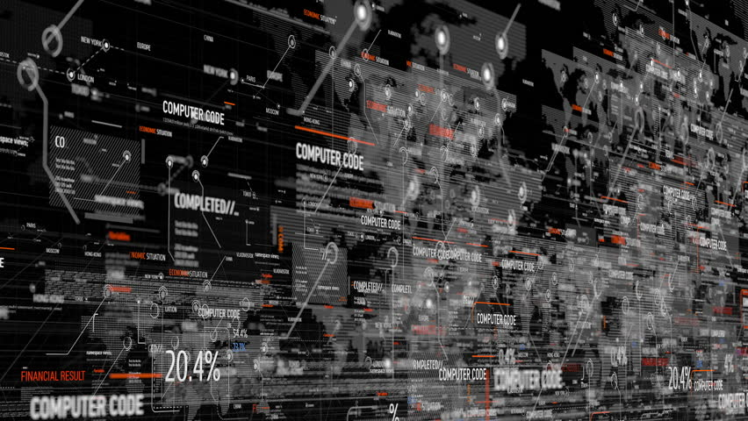
Algorithms
01
02
03
Particle Swarm Optimization
Hybrid Particle Swarm Optimization & Gravitational Search Algorithm
Back Propagation Neural Network
Literature Review
Algorithms
Datasets
Parameter Testing
Analysis
Conclusion

Slide 11
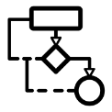
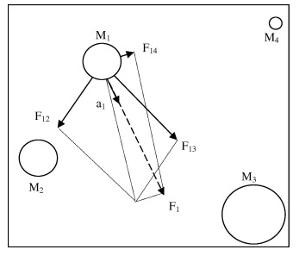
Solution Representation
Weight I-H | Bias H | Weight H-O | Bias O
Weight I-H : Weight of an arc that connects an input node to a hidden node
Weight H - O : Weight of an arc that connects a hidden node to an output node
Bias H : Bias of a hidden node
Bias O : Bias of an output node
Gravitational Search Algorithm
Rashedi.et.al (2009)
Each object has its own position, inertial mass, and gravitational mass. Position corresponds to the solution and masses are determined by the fitness value.
This algorithm is based on the law of gravity which is also categorized as population based optimization algorithm
The heavy masses correspond to good solutions and move slower than lighter ones.
A heavy object has a larger attraction force which tend to pull lighter objects toward it.

Slide 12


Hybrid Particle Swarm Optimization &
Gravitational Search Algorithm
Generate initial population
Evaluate the fitness for all agents
Update the G and gbest for the population
No
Meeting end criterion
Update velocity and position
Calculate M, forces, and acceleration for all agents
yes
Return the best solution (gbest)
G : Gravitational Constant which will be updated every iteration
M : All types of mass (gravitational and inertial masses)
ω : weight
c_{i}(t) : acceleration of agent i at iteration t

Slide 13
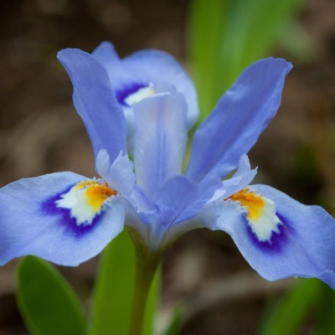

Iris Dataset
4
Attributes
Petal length
3
Classes
Petal width
Sepal length
150
Samples
Sepal width
Wine Dataset
Alcohol
Total Phenols
Hue
13
Attributes
Malic Acid
Flavanoids
OD280/OD315
3
Classes
Ash
Nonflavanoid phenols
Proline
Alcalinity of Ash
Proanthocyanins
178
Samples
Magnesium
Color_intensity
Literature Review
Algorithms
Datasets
Parameter Testing
Analysis
Conclusion

Slide 14

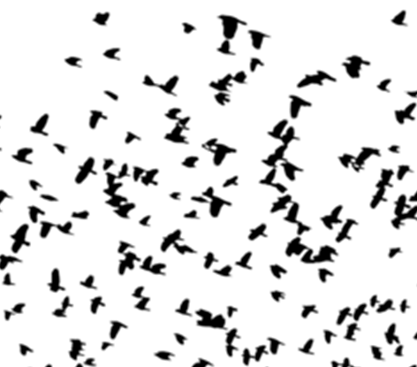




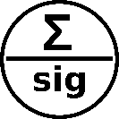

Back Propagation
Algorithm
Particle Swarm Optimization – Back Propagation Algorithm
Hybrid Particle Swarm Optimization &
Gravitational Search Algorithm
Learning Rate
Swarm Size
Swarm Size
[0.05]
[50, 70, 100]
[20, 30, 40]
Weight constant
[0.7, 0.8, 0.9]
Weight constant
Gravitational constant
Alpha constant
[0.7, 0.8, 0.9]
PSO Iteration
[ 1 ]
[ 20 ]
[10]
Iteration
[1000]
Sigmoid activation function
Hidden Nodes
[Number of Input – Number of Input + 4]
Literature Review
Algorithms
Datasets
Parameter Testing
Analysis
Conclusion

Slide 15
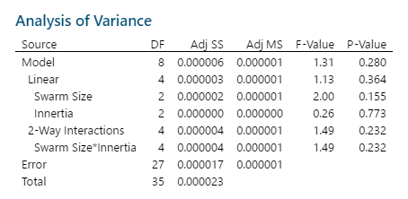
Particle Swarm Optimization
General Factorial Design with Two Factors

Slide 16
Particle Swarm Optimization
Residual Checking
Parameter Selection

Slide 17
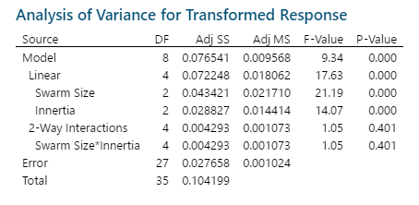
Hybrid Particle Swarm Optimization &
Gravitational Search Algorithm
General Factorial Design with Two Factors

Slide 18
Hybrid Particle Swarm Optimization &
Gravitational Search Algorithm
Residual Checking
Parameter Selection

Slide 19


Impact of parameter in algorithms toward the performance
K-Fold Cross Validation is utilized to validate the performance of algorithms
Literature Review
Algorithms
Datasets
Parameter Testing
Analysis
Conclusion

Slide 20

Parameter Analysis
Swarm Size
Weight
There is no any impact of weight towards the performance of algorithm
There is no any impact of swarm size towards the performance of algorithm
Particle Swarm Optimization

Slide 21
Parameter Analysis
Swarm Size
Weight
Among tested weights, 0.8 perform the best. The largest weight, 0.9, seemingly works unstably.
Generally, increasing swarm size will lower the RMSE which means enhance the performance of the algorithm
Hybrid Particle Swarm Optimization &
Gravitational Search Algorithm

Slide 22
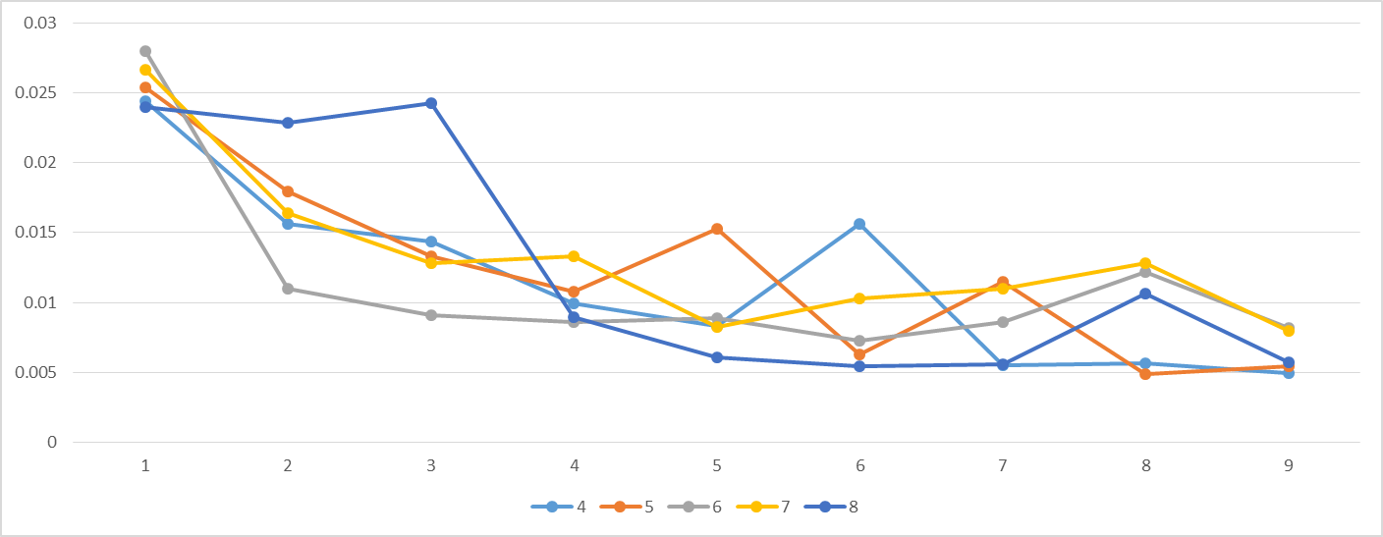
K-Fold Cross Validation
Average : 0.011311
Stdev : 0.006433
Average : 0.012613
Average : 0.012306
Stdev : 0.008512
Stdev : 0.006671
Average : 0.013272
Stdev : 0.008512
Average : 0.011607
Stdev : 0.006474
Back Propagation Algorithm

Slide 23
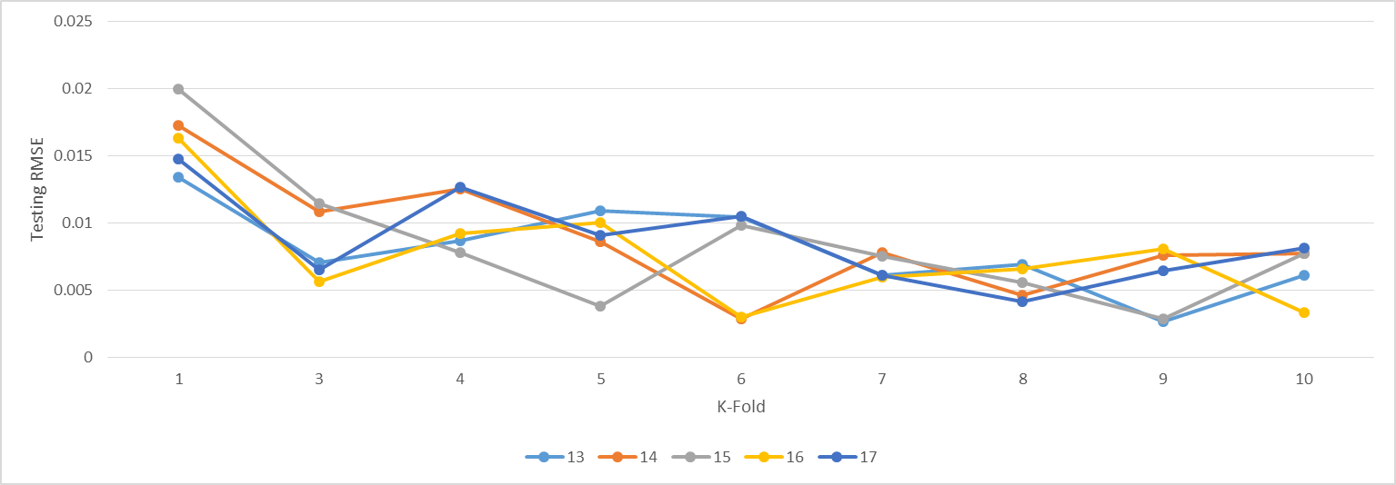
K-Fold Cross Validation
Average : 0.0092
Stdev : 0.005279
Average : 0.009134
Average : 0.00891
Stdev : 0.003513
Stdev : 0.004034
Average : 0.008205
Stdev : 0.0043
Average : 0.008718
Stdev : 0.003693
Back Propagation Algorithm

Slide 24
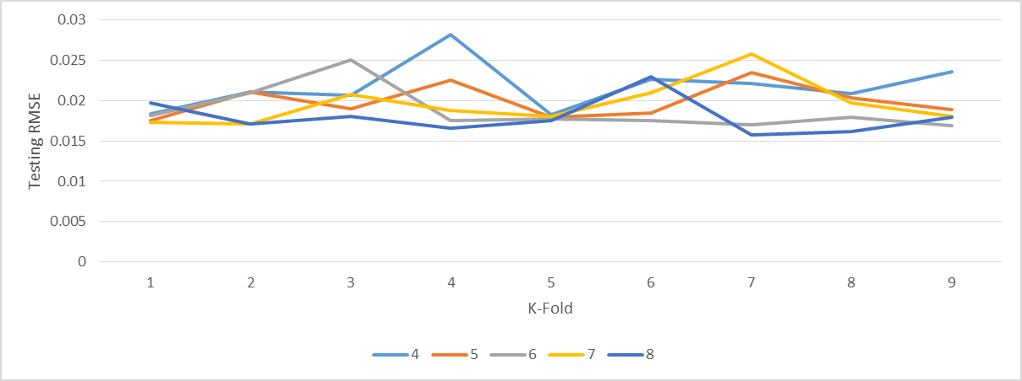
K-Fold Cross Validation
Average : 0.018771
Stdev : 0.002657
Average : 0.021735
Stdev : 0.002993
Average : 0.019599
Average : 0.017983
Average : 0.019913
Stdev : 0.002209
Stdev : 0.002209
Stdev : 0.002102
Particle Swarm Optimization -
Back Propagation Algorithm

Slide 25
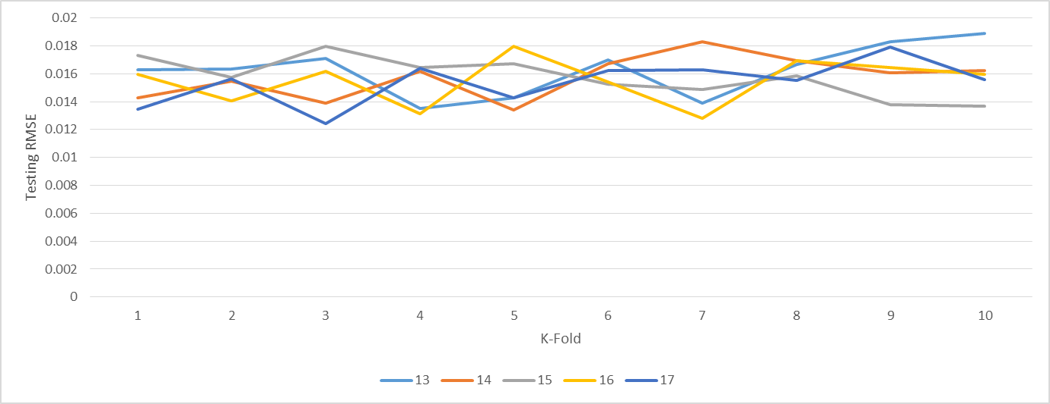
K-Fold Cross Validation
Average : 0.016221
Average : 0.015763
Stdev : 0.001812
Stdev : 0.001409
Average : 0.015739
Average : 0.015489
Average : 0.015376
Stdev : 0.001599
Stdev : 0.001514
Stdev : 0.001652
Particle Swarm Optimization -
Back Propagation Algorithm

Slide 26
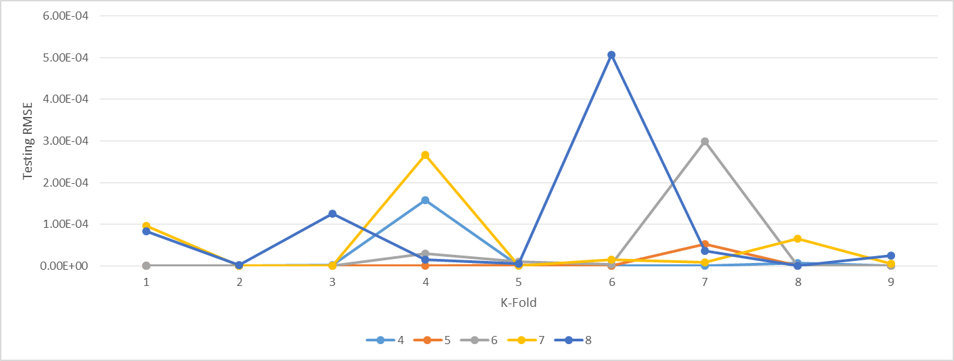
K-Fold Cross Validation
Average : 1.86E-05
Stdev : 5.23E-05
Average : 5.06E-05
Stdev : 8.76-05
Average : 3.82E-05
Average : 6.29E-06
Stdev : 9.84E-05
Stdev : 1.76E-05
Average : 8.89E-05
Stdev : 1.62E-04
Hybrid Particle Swarm Optimization &
Gravitational Search Algorithm

Slide 27
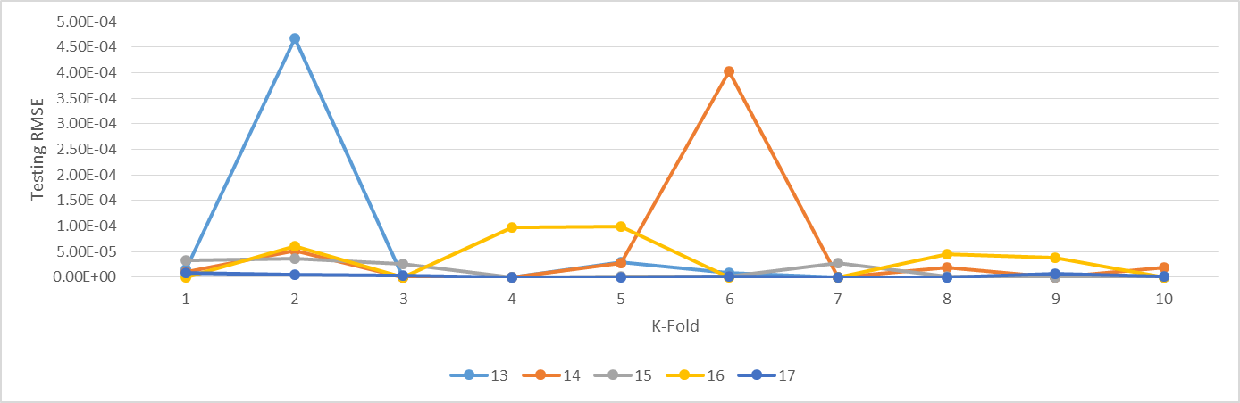
K-Fold Cross Validation
Average : 5.21E-05
Average : 3.41E-05
Stdev : 0.000146
Stdev : 4.05E-05
Average : 1.27E-05
Stdev : 1.55E-05
Average : 5.31E-05
Average : 2.76E-06
Stdev : 0.000124
Stdev : 3.13E-06
Hybrid Particle Swarm Optimization &
Gravitational Search Algorithm

Slide 28
Comparison
Iris Dataset
Mean
0.011311
6.29E-06
Standard Deviation
0.006433
1.76E-05
Hybrid Particle Swarm Optimization and Gravitational Search Algorithm
Back Propagation Algorithm
Particle Swarm Optimization
Wine Dataset
Mean
0.008205
Standard Deviation
0.0043
Hybrid Particle Swarm Optimization and Gravitational Search Algorithm
Back Propagation Algorithm
Particle Swarm Optimization

Slide 29
Conclusion
Hybrid Particle Swarm Optimization and Gravitational Search Algorithm
VS
Particle Swarm Optimization
&
Back Propagation Algorithm
Literature Review
Algorithms
Datasets
Parameter Testing
Analysis
Conclusion

