Slide 1

Q2 PROJECT STATUS UPDATE
Multi-Agent GenAI for COBOL-to-KDM Conversion
COBOL
AGENTS
A research prototype for recovering structure, data flow, and business rules from legacy COBOL.
KDM
PROJECT
TECHNOLOGY
STATUS
VALIDATE
Legacy COBOL Modernization
ANTLR · Python · Pydantic · Gemini · XML
Research prototype
Q2 Project Status Update
01
Notes:
Welcome the audience and frame this update around our Q2 research prototype. We are focusing on making legacy-system understanding more structured, explainable, and useful for modernization.

Slide 2

01 / WHY THIS MATTERS
Legacy knowledge is trapped in procedural code
The modernization challenge is to recover what the system means—not simply translate what the syntax says.
01
02
03
Critical systems
Distributed intent
Scarce expertise
COBOL remains embedded in banking, insurance, government, and business operations.
Program behavior is spread across procedures, data definitions, and implicit control flow.
Manual understanding is slow and depends on specialized legacy-system knowledge.
Modernization needs recovered knowledge, not syntax translation alone.
Q2 Project Status Update
02
Notes:
The core challenge here is knowledge recovery. We need to surface what the system actually does, which data it touches, and which business rules it encodes. And since legacy knowledge is trapped in procedural code, manual understanding is far too slow.

Slide 3

02 / OBJECTIVE
The prototype turns source code into structured knowledge
OBJECTIVE
STRUCTURE
Convert COBOL source into a KDM-oriented representation through a multi-agent analysis pipeline.
Programs, paragraphs, data items, and types
INTERACTIONS
Calls, reads, writes, and computations
The target is not another text dump. It is an analyzable model of what the program contains, touches, calls, and means.
SEMANTICS
Natural-language business-rule descriptions
DESTINATION
XML for downstream modernization analysis
Q2 Project Status Update
03
Notes:
Moving from that legacy challenge, our objective is to turn source code into structured knowledge. We want to convert COBOL source into a KDM-oriented representation through a multi-agent analysis pipeline.

Slide 4

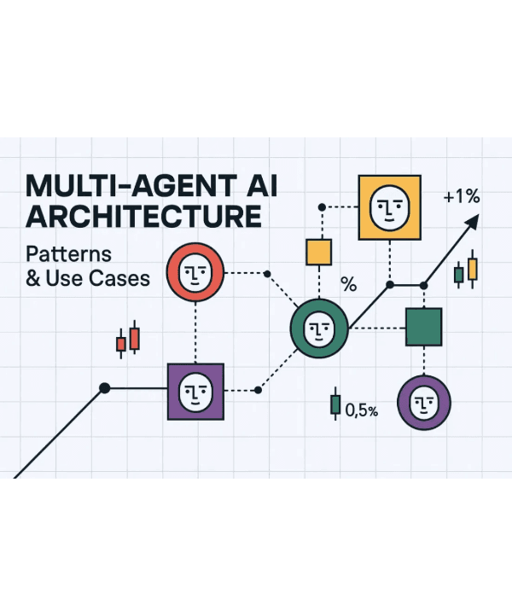
03 / RESEARCH DESIGN
Specialization is the core design choice
"Can specialized analysis agents improve extraction quality and explainability versus a single mapper or deterministic rules alone?"
BASELINE 1
BASELINE 2
PROPOSED
Deterministic Extraction Only
General-Purpose GenAI Mapper
Specialized Multi-Agent Pipeline
EVALUATION MEASURES
Entity Accuracy
Call/Flow Accuracy
Business Rule Quality
KDM Validity Rate
API Cost & Latency
Hallucination Rate
Q2 Project Status Update
04
Notes:
To test this approach, specialization becomes our core design choice. We are asking whether specialized analysis agents can improve extraction quality and explainability versus a single mapper or deterministic rules alone.

Slide 5

04 / ARCHITECTURE
The pipeline separates evidence, interpretation, and validation
INPUT
STAGE 1
ANALYSIS
ANALYSIS
ANALYSIS
STAGE 3
OUTPUT
COBOL Source
Parser Agent
Structure Agent
Data-Flow Agent
Business-Rule Agent
Builder Agent
KDM-oriented XML
Shared Representation
Synthesis & Validation
Parsing produces a concise intermediate AST used by analysis agents independently.
The Builder merges results and a Validator runs before final serialization.
Q2 Project Status Update
05
Notes:
Building on that experimental design, our pipeline is structured to separate evidence, interpretation, and validation. Parsing creates a shared intermediate representation, specialized agents analyze it independently, and validation runs before serialization.

Slide 6

05 / AGENT ROLES
Deterministic foundations protect semantic experimentation
AGENT
PRIMARY RESPONSIBILITY
CURRENT APPROACH
Parser Agent
Extract program, data, and procedure structure
ANTLR + RECOVERY LOGIC
Structure Agent
Identify paragraphs and PERFORM calls
DETERMINISTIC PATTERNS
Data-Flow Agent
Identify reads, writes, and computations
DETERMINISTIC PATTERNS
Business-Rule Agent
Describe conditions and business rules
GEMINI + LOCAL FALLBACK
KDM Builder Agent
Combine findings into a structured model
PYDANTIC CONSTRUCTION
Validator Agent
Detect duplicate and invalid elements
DETERMINISTIC CHECKS
Q2 Project Status Update
06

Slide 7

06 / TRANSFORMATION EXAMPLE
A small COBOL example makes the transformation visible
SOURCE COBOL
RECOVERED EVIDENCE
01 WS-COUNT PIC 9(3) VALUE 1. IF WS-COUNT > 0 DISPLAY 'COUNT IS POSITIVE' ELSE DISPLAY 'COUNT IS ZERO' END-IF. STOP RUN.
DATA ITEM
WS-COUNT is identified as a storable data item.
CONTROL FLOW
MAIN-LINE contains a conditional branch logic.
DATA INTERACTION
The condition reads WS-COUNT; DISPLAY writes output.
BUSINESS RULE
Candidate rule: "Execute conditional processing when WS-COUNT > 0."
Q2 Project Status Update
07

Slide 8

07 / ANALYSIS OUTPUT
Intermediate findings remain inspectable before serialization
STRUCTURE AGENT
DATA-FLOW AGENT
BUSINESS-RULE AGENT
MAIN-LINE -> CallableUnit PARAGRAPH-1 -> CallableUnit WS-COUNT -> StorableUnit
MAIN-LINE reads WS-COUNT MAIN-LINE writes DISPLAY PARAGRAPH-1 reads WS-TOTAL
"When WS-COUNT > 0, execute the conditional processing logic for positive counts."
WHY THE INTERMEDIATE MODEL MATTERS
Stable Contracts
Agent Identity
Separation
Pre-Validation
Agents share a consistent schema for data exchange.
Findings retain provenance and confidence scores.
Extraction logic is decoupled from the final builder.
Errors are caught before XML serialization occurs.
Q2 Project Status Update
08

Slide 9

09 / GENAI INTEGRATION
GenAI adds semantic interpretation with controlled fallbacks
GEMINI-BACKED CAPABILITY
RELIABILITY DESIGN
Deterministic Core: Structural and data-flow extraction remains parser-based and repeatable.
Granular Analysis
The Business-Rule Agent analyzes one COBOL paragraph at a time to maintain context window efficiency.
Local Fallbacks: If API requests fail or credentials are missing, the system reverts to local heuristic rules.
Structured Output
Validation Layer: LLM findings are treated as candidate evidence until validated against the structural AST.
Returns strictly typed JSON validated via Pydantic to ensure downstream model compatibility.
Hybrid Strategy: Interpretation is used where semantic value is high; deterministic logic protects basic facts.
Consistency Control
Low temperature settings minimize variance and improve reproducibility of business rule descriptions.
Q2 Project Status Update
09

Slide 10

09 / STATUS REPORT
Q2 delivered a working research prototype
COMPLETED COMPONENTS
CURRENT MATURITY
✓
ANTLR COBOL parser integration and recovery logic
ACTIVE PROTOTYPE
✓
Multi-agent package, orchestrator, and analysis agents
Working research prototype and demonstration system.
✓
Pydantic intermediate and output models
✓
Gemini integration with deterministic fallback behavior
Not yet a production converter or fully standards-validated KDM exporter. Focus remains on architectural validation and knowledge recovery accuracy.
✓
XML serialization, basic validation, and CLI execution
Q2 Project Status Update
10
Notes:
We have successfully completed our core engineering objectives for this quarter. The system now integrates parser logic, multi-agent orchestration, and structured validation into a cohesive workflow. And while this is a working research prototype rather than a production-ready converter, it gives us a complete baseline to build upon. We are shifting our focus directly from building architecture to measuring performance, leading us right into our evaluation roadmap.

Slide 11

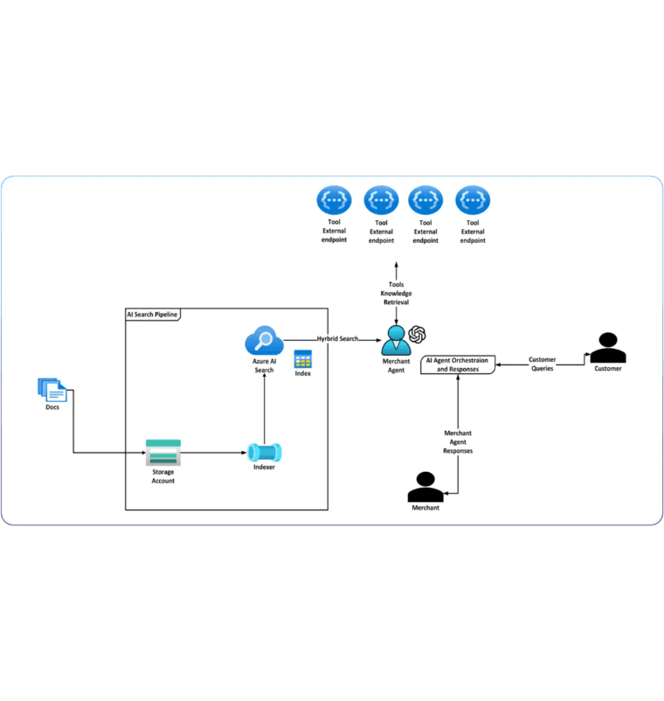
11 / ROADMAP
The next milestone is measurement, not more claims
IMMEDIATE PRIORITIES
Benchmark Creation: Create 3–5 labeled COBOL programs.
Comparative Study: Measure extraction accuracy across methods.
Regression Testing: Confirm demo stability and cost tracking.
RESEARCH EXTENSIONS
Language Coverage: Add copybooks, file I/O, complex PERFORMs.
Agent Collaboration: Add disagreement detection and reviews.
Standards Validation: Produce KDM relationships and validate outputs.
Q2 Project Status Update
11
Notes:
Building the architecture was the first step, but now we need empirical validation. We are moving from qualitative design to a rigorous comparative study using labeled COBOL benchmarks. And this involves tracking accuracy, cost, and validity across different extraction methods. So our roadmap for the next phase prioritizes measurement over new claims, setting the stage for our final conclusions.

Slide 12

12 / CONCLUSION
The Q2 foundation is ready for a measurable study
Multi-agent GenAI can assist legacy-system understanding, but its value must be demonstrated through structured output, validation, and measurable comparison.
MODULARITY
REPRODUCIBILITY
EVALUATION
Specialized agents separate syntax, structure, data flow, and semantic interpretation for better explainability.
Deterministic fallbacks and parser-based core logic ensure reliable results and demo stability.
The decisive next step is rigorous testing against labeled COBOL examples and meaningful baselines.
Ready for Q3: From Prototype to Proven Performance.
Q2 Project Status Update
12
Notes:
Our architectural foundation gives us both modularity and reproducibility through specialized agents and deterministic fallbacks. But the true value of this multi-agent approach must be proven through systematic evaluation. We are ready to move from a working prototype into a measurable study, and I welcome any questions you have on the design.

