Slide 1

TEAM CRIMESPI
And the crimespi app

Slide 2
THE PROBLEM
In our original meeting, we discussed that it would be great to have an app that showed crimes in our local area. It needed to:
We would want to see crimes in the area
That a graphic icon system would be child friendly
And how it could benefit crime prevention through areas with high crime being avoided.

Slide 3
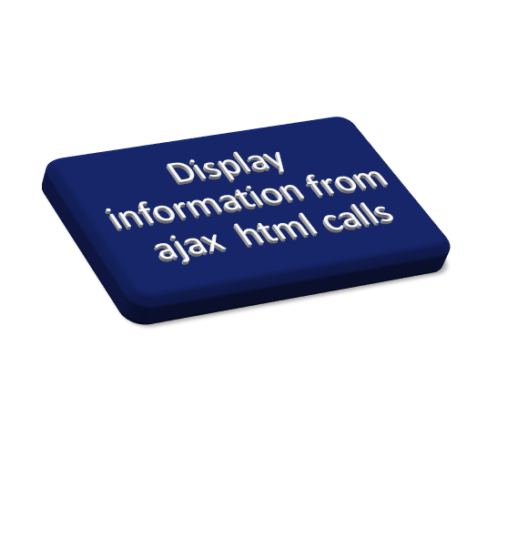
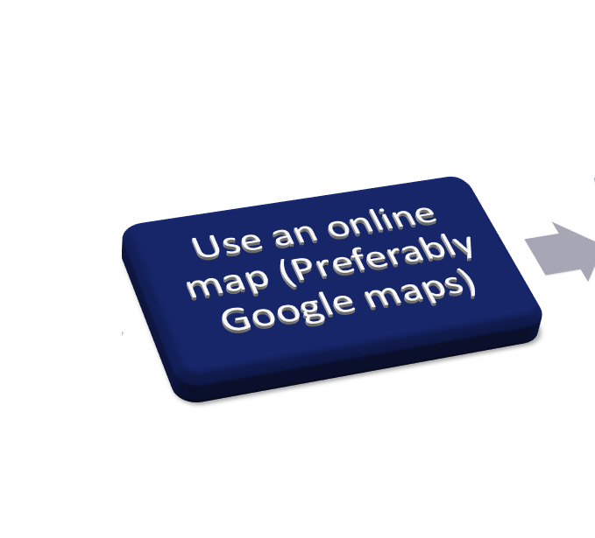


CREATING THE SOLUTION

Slide 4
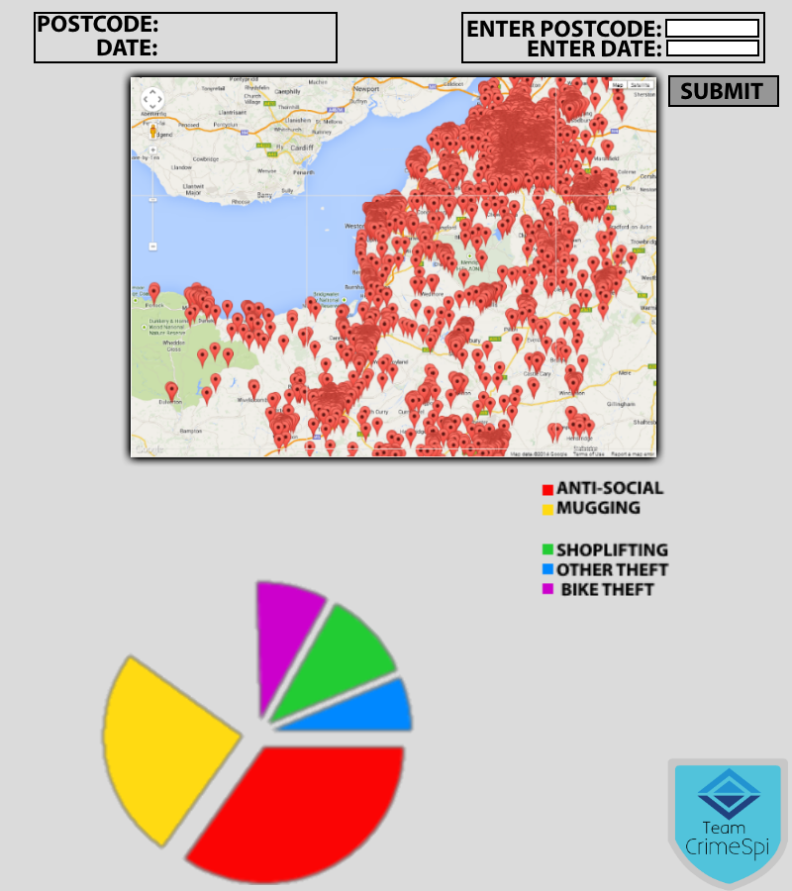
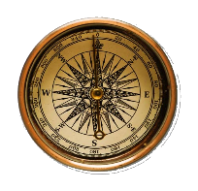


BEGINNING DEVELOPMENT
PREVIEW
ASSIGNING RESEARCH/DESIGN
OLIVER – GEOLOCATION
WILLIAM – MAP ICONS
MAX – MAP & MULTIPLE PINS
DOES NOT REPRESENT FULL PRODUCT AND IS FOR DEMONSTRATION PURPOSES ONLY

Slide 5
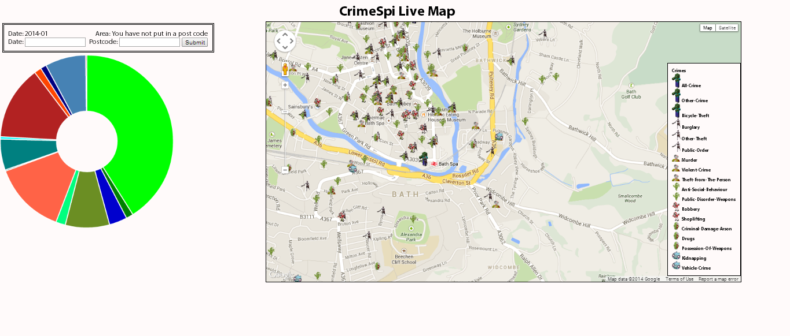
What we thought
What it was

Slide 6
PROBLEMS
And their solutions
PROBLEM|SOLUTION
PIN TOO SMALL
| USE PLACE MARKERS
SHARING CODE
| INCORPORATE GITHUB
POSTCODE INACCURATE|
CREATE A RADIUS AREA
ZOOM SHOWS EMPTY MAP|
LIMIT MAX ZOOM

Slide 7
MAP
PINS
ICONS
Basic site
Zombies
GUI
DATE INPUT
GPS
POSTCODE

Slide 8
CONCLUSION
Use of live maps is vital
Incorporation of Postcode And Date system is useful
Graphs/Charts are popular with the professional user base
Incorporation of icons could be popular with the young user base.
WHAT COULD BE ADDED:
LOCK MAX ZOOM
LATITUDE/LONGITUDE INPUT
SPLASH SCREEN
MOBILE APPLICATIONS
PLEASE WAIT FOR THE LIVE DEMO

