Slide 1
CIS 285 Term Project
Paul Lazaros

Slide 2
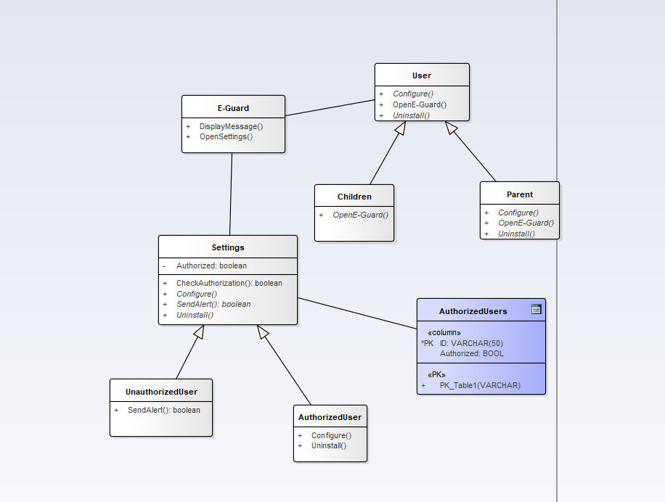
Configure Class Diagram

Slide 3
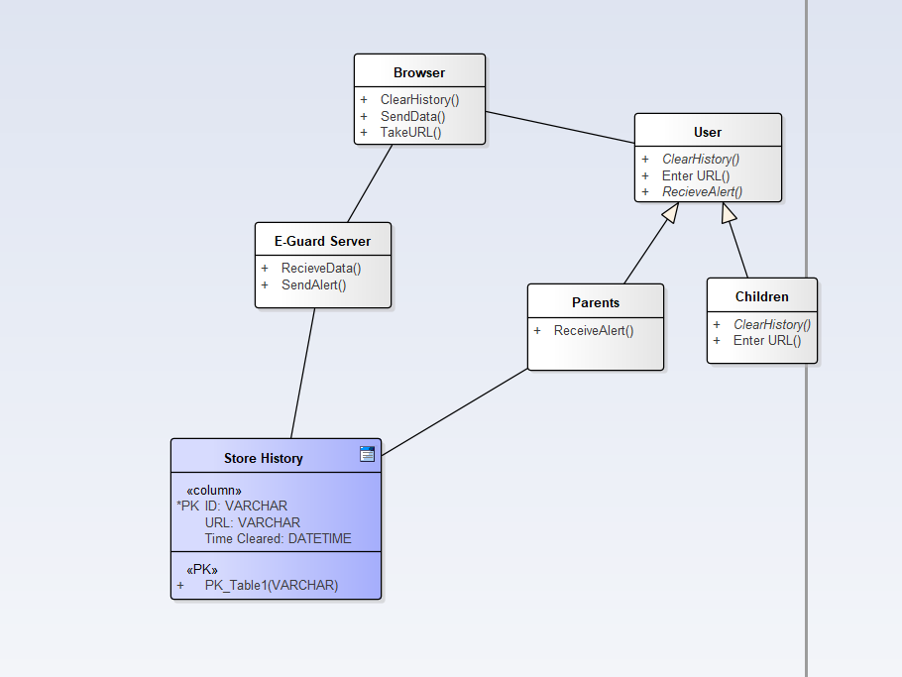
History Class Diagram

Slide 4
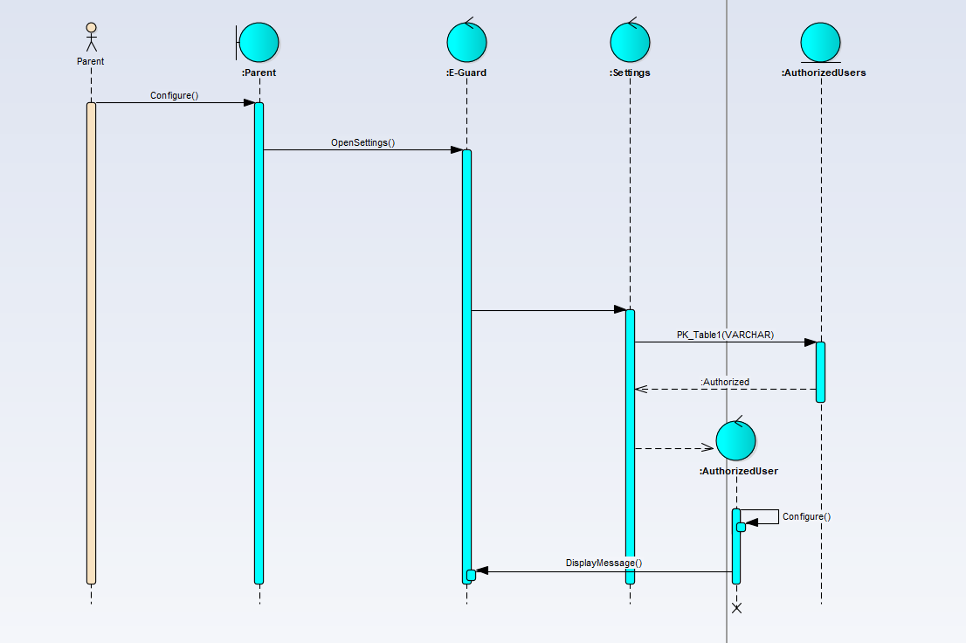
Configure Sequence Diagram

Slide 5
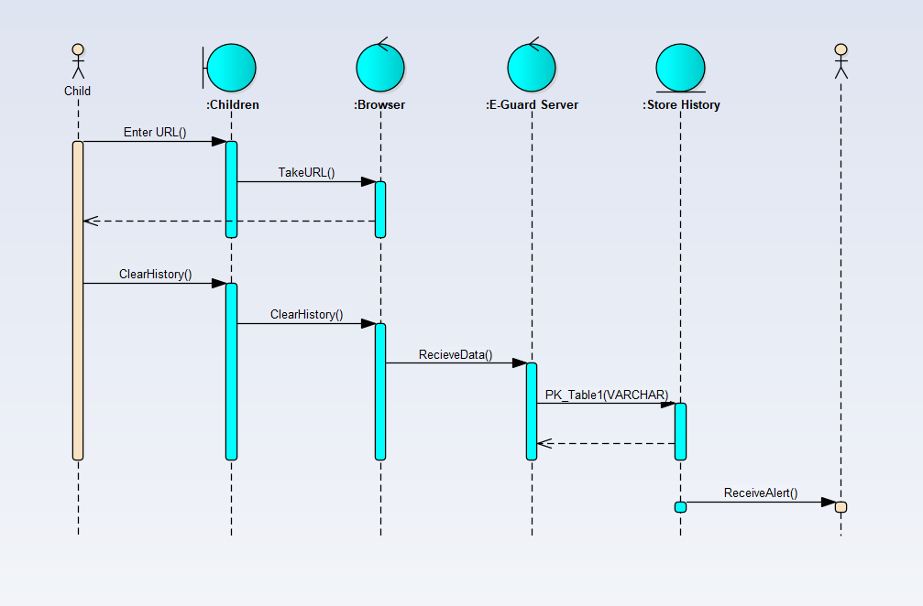
History Sequence Diagram

Slide 6
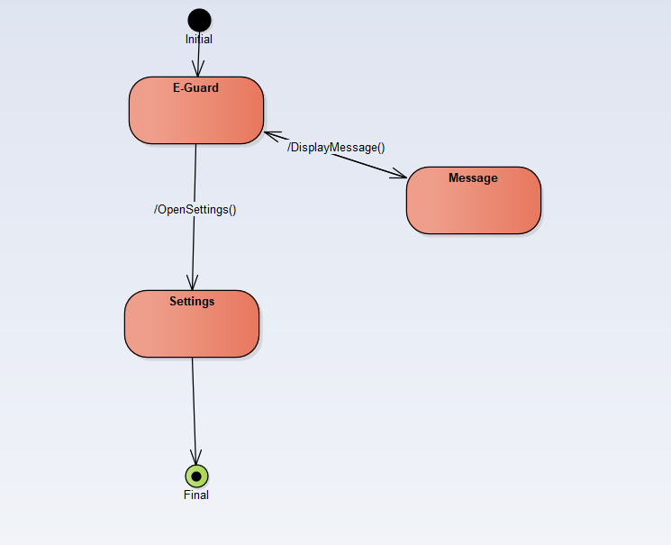
E-Guard State Diagram

Slide 7
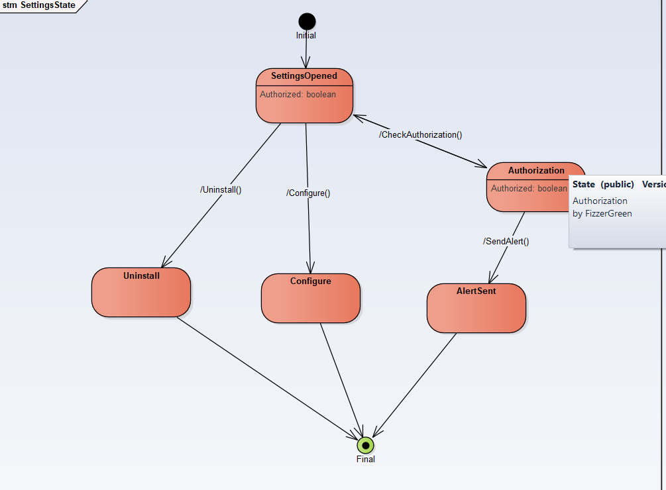
Settings State Diagram

Slide 8
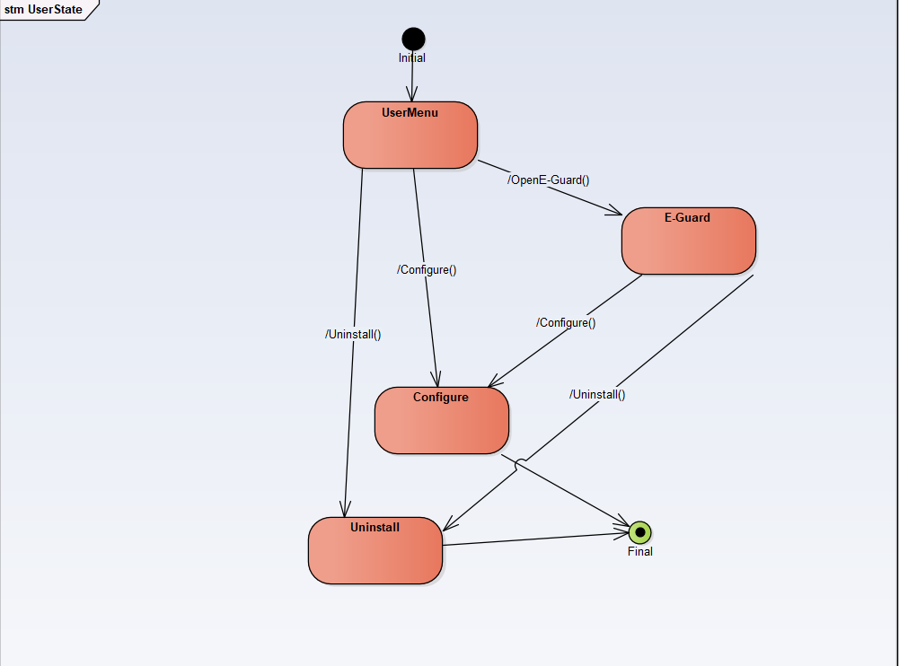
User State Diagram

