Slide 1




NHL Salary Cap Tracker
By: Paul, Marco, Yosep, Jonathan, Nafiz, Sanved and Diego

Slide 2
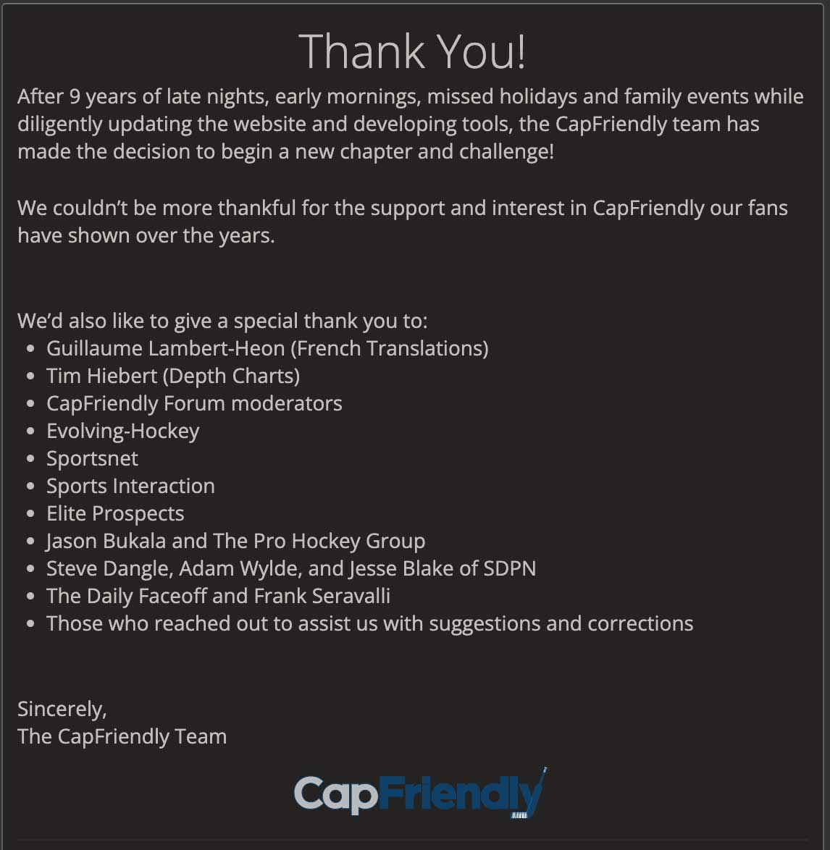
Motivation
CapFriendly.com purchased by Washington Capitals
Public access shut down
Info remains available, but CapFriendly functionality unmatched
Goal: design database system for storing and managing NHL salary cap data
Contribute to hockey community
Provide valuable information to be used by fans, enthusiasts, and professionals

Slide 3
Timeline
Initial Planning
Design scope and goals
Fit ideas to course requirements
Conceptual Design
Create basic ER model with teams and players
Added transactions and contracts to represent relationships
Added assets table to serve as weak entity and identify draft picks
Adjusted players to be subclass of a new persons table; added coaches
Adjusted attributes to meet project requirements

Slide 4
Timeline
Logical Design
Translated EER model into relational schema
Physical Design/Implementation
Implemented scripts to create tables based on the relational schema
Adjusted key constraints
Data Population/Testing
Inserted data using information from NHL, CapSpace.com, and PuckPedia
Tested integrity constraints and query functionality

Slide 5
Timeline
Normalization
Broke down relations into candidate keys, primary keys, prime attributes, and non-prime attributes
Ensured dependencies met 3NF requirements for every table
View Creation
Decided on useful views for finding NHL cap information
i.e., players paid above $x, players from a specific position paid above $x, transactions that have occurred within x months

Slide 6
Timeline
Front-End User Interface
Decided on form for front-end before creating the application
Documentation and Reporting
Summarized information and cited references

Slide 7
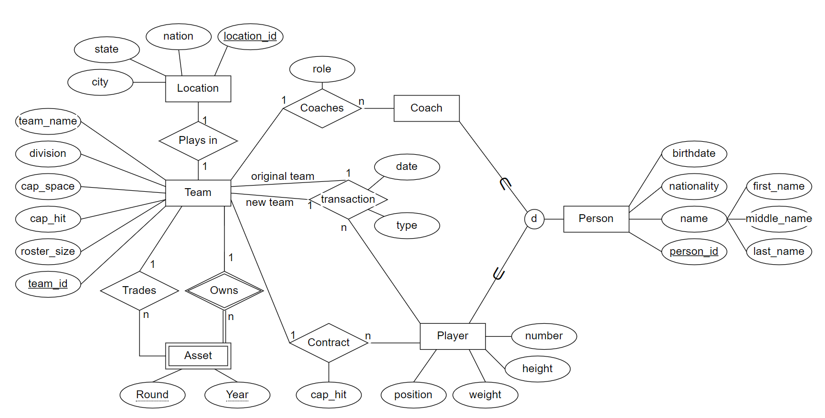
EER Model

Slide 8
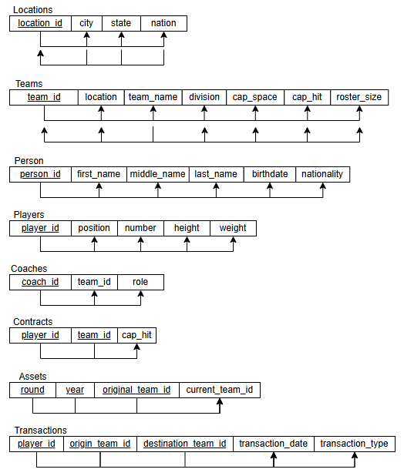
Normalization

Slide 9
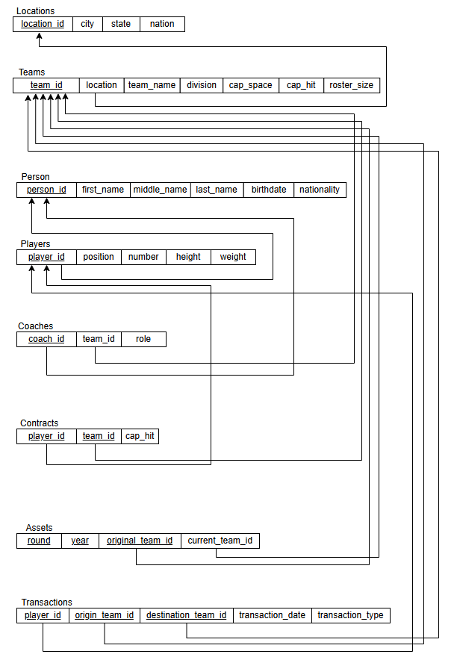
Relational Model

Slide 10
User Interface

Slide 11
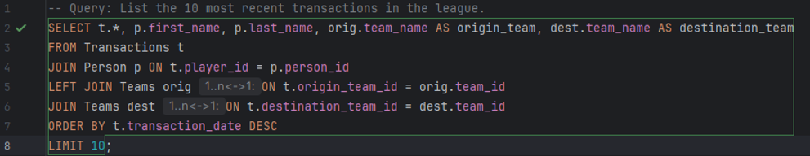
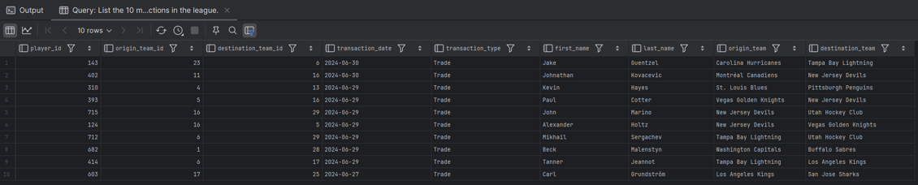
Queries

Slide 12
Queries - UI

Slide 13
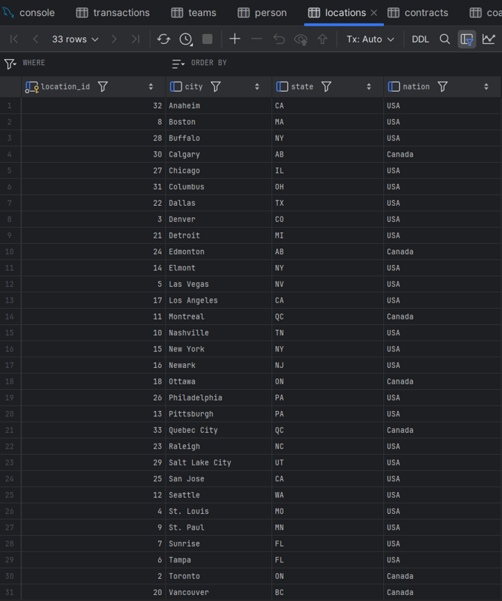
Insertions

Slide 14
Insertions - UI

Slide 15
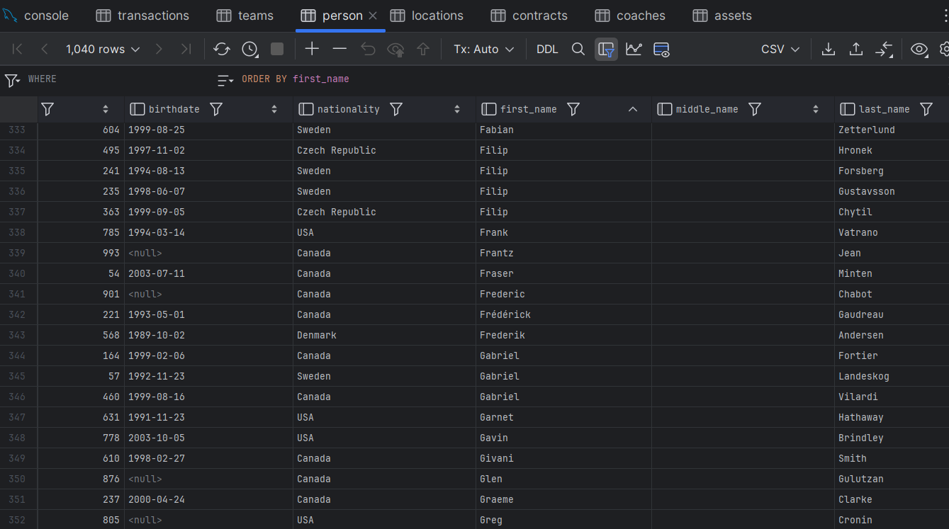

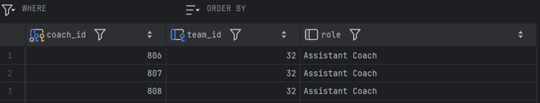
Deletions

Slide 16
Deletions - UI

Slide 17
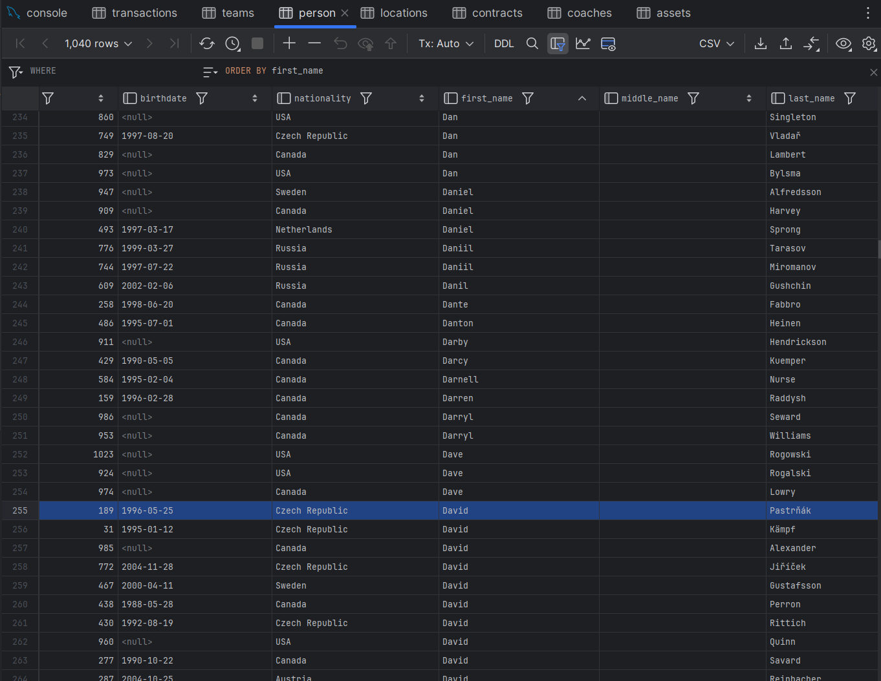

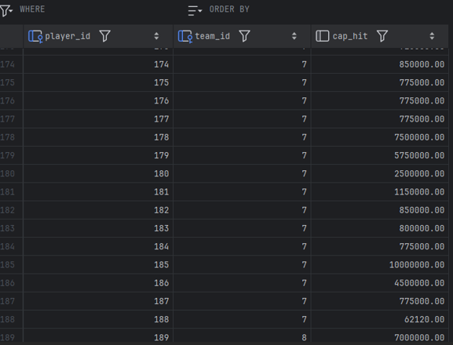
Updates

Slide 18
Updates - UI

Slide 19
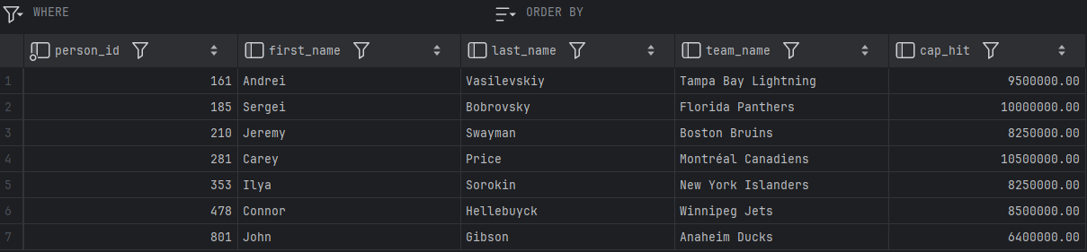
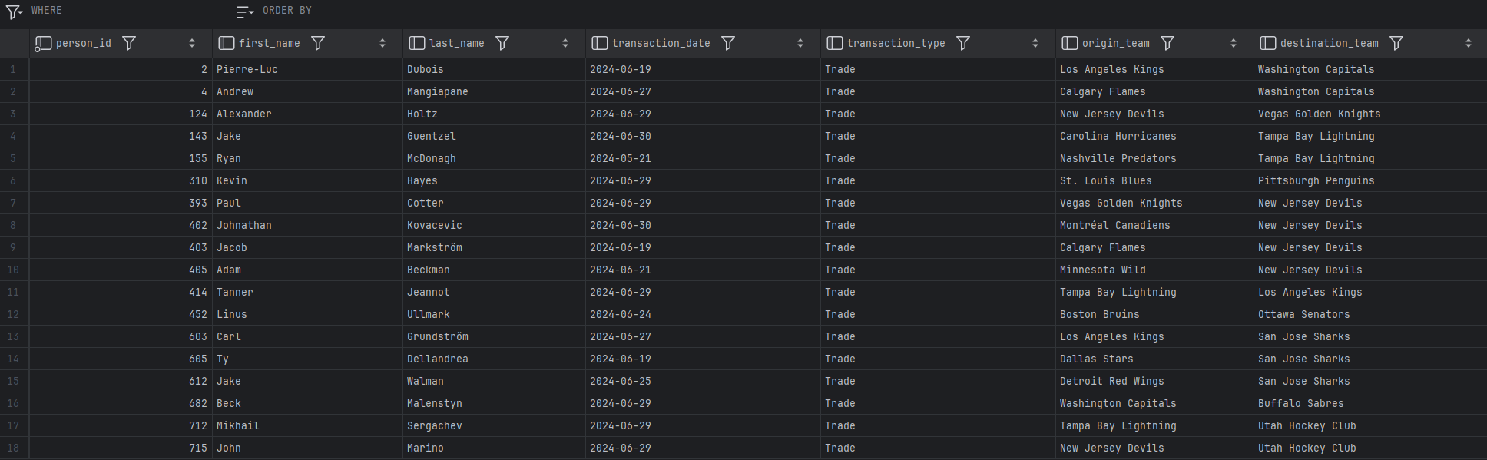
Views

Slide 20
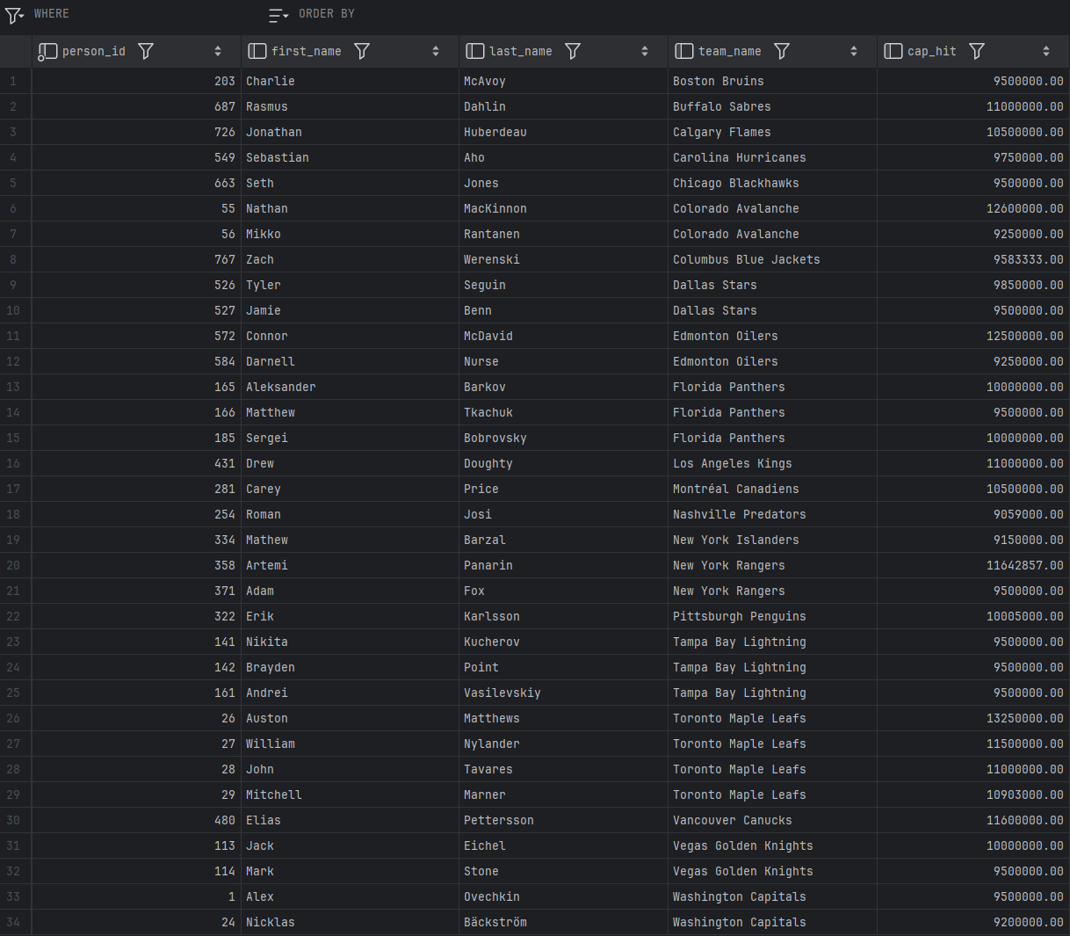
Views

Slide 21
Conclusion/Future Work
Addressed the need for accessible, organized information on NHL contracts
Fills the void left by CapFriendly.com
Exists as a tool for casual fans, armchair analysts, and even professionals
Provides access to player contract info, salary caps, and relevant statistics
Potential Improvements:
Real-time updates using NHL API
Integrating advanced analytics to broaden scope
Enhancing the user interface

Slide 22
References
[1] H. Brown, “Washington Capitals GM MacLellan Confirms Acquisition Of CapFriendly,” NoVa Caps, Jun. 12, 2024. https://novacapsfans.com/2024/06/12/washington-capitals-gm-maclellan-confirms-acquisition-of-capfriendly/ (accessed Oct. 08, 2024).
[2] “PuckPedia - NHL Salary Cap, Player Contracts and Salary Cap Analysis | Puckpedia,” Puckpedia.com, Sep. 27, 2024. https://puckpedia.com (accessed Oct. 08, 2024).
[3] “Home - CapSpace,” Cap-space.com, 2024. https://cap-space.com (accessed Oct. 08, 2024).
[4] “2023-24 NHL Trade Tracker | NHL.com,” www.nhl.com, Jan. 06, 2024. https://www.nhl.com/news/2023-24-nhl-trades-344953916
[5] “NHL Coaches | National Hockey League Coaches’ Association.” https://www.nhlcoaches.com/nhl-coaches/
‌[6] “Hockey Draft Pick Transactions,” Prosportstransactions.com, 2024. https://www.prosportstransactions.com/hockey/DraftTrades/Years/index.htm (accessed Oct. 19, 2024).

Slide 24
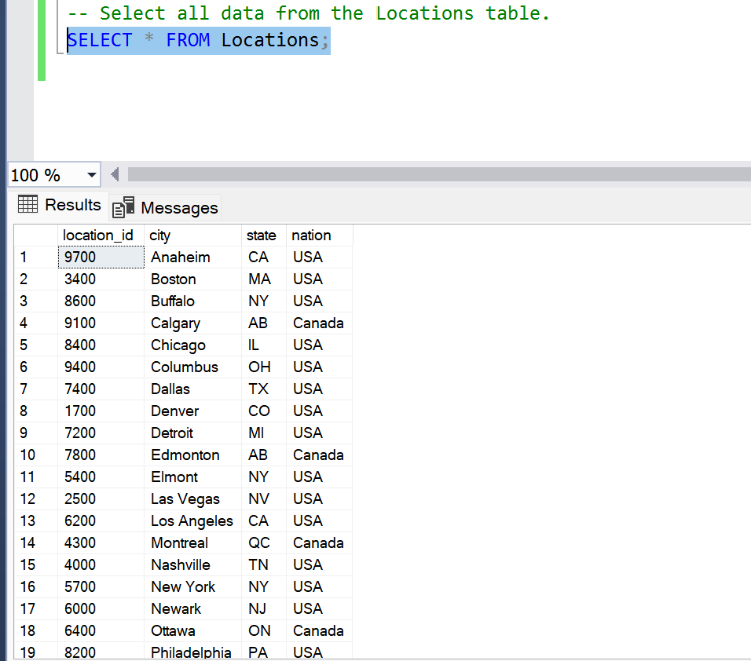
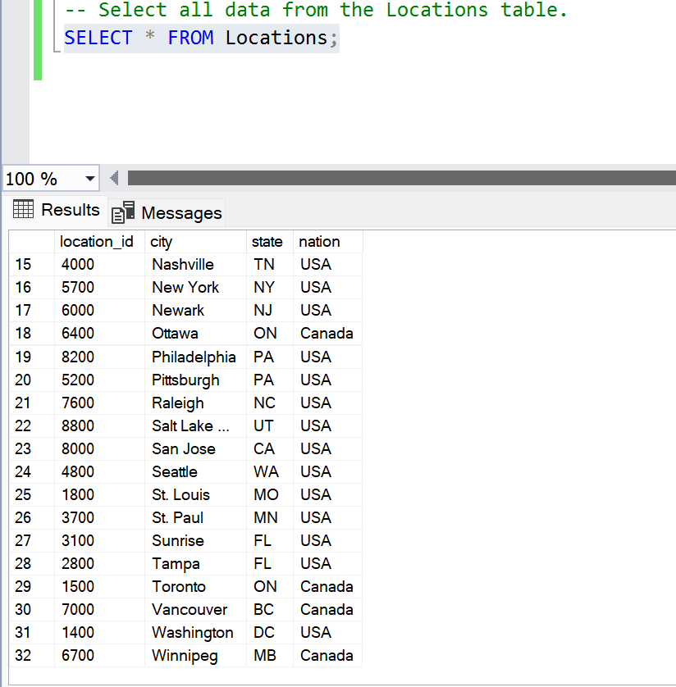
Locations Table displayed

Slide 25
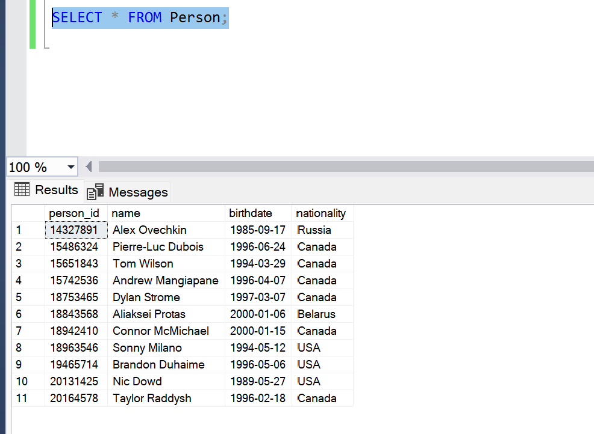
Persons Table displayed

