Slide 1




NHL Salary Cap Tracker
By: Paul, Marco, Yosep, Jonathan, Nafiz, Sanved, and Diego

Slide 2
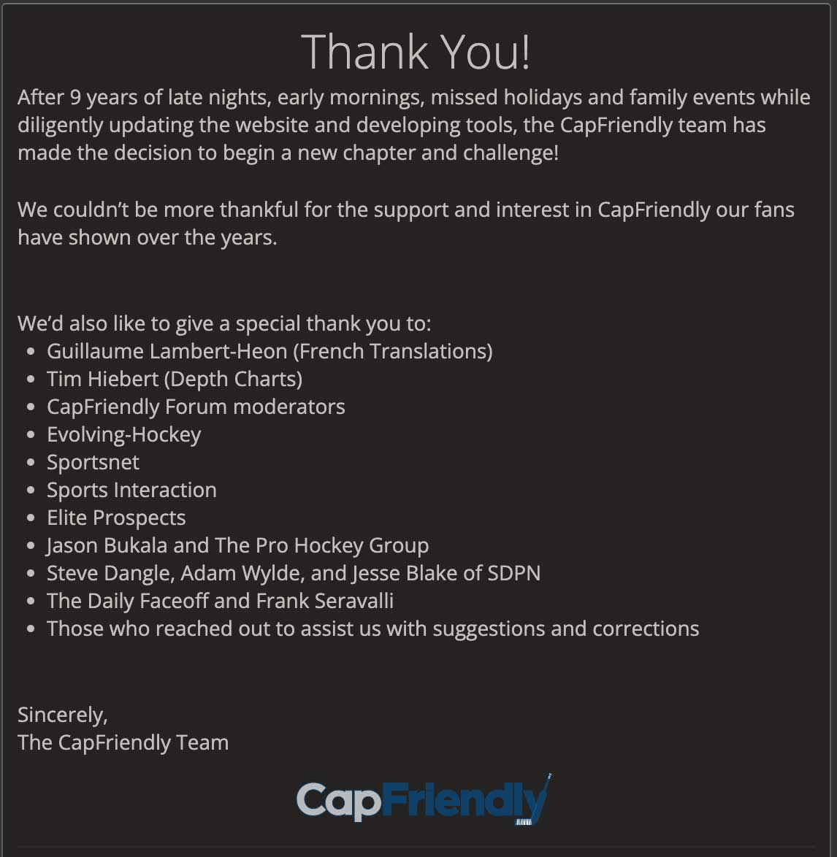
Motivation
CapFriendly.com purchased by Washington Capitals
Public access shut down
Info remains available, but CapFriendly functionality unmatched
Goal: design database system for storing and managing NHL salary cap data
Contribute to hockey community
Provide valuable information to be used by fans, enthusiasts, and professionals

Slide 3
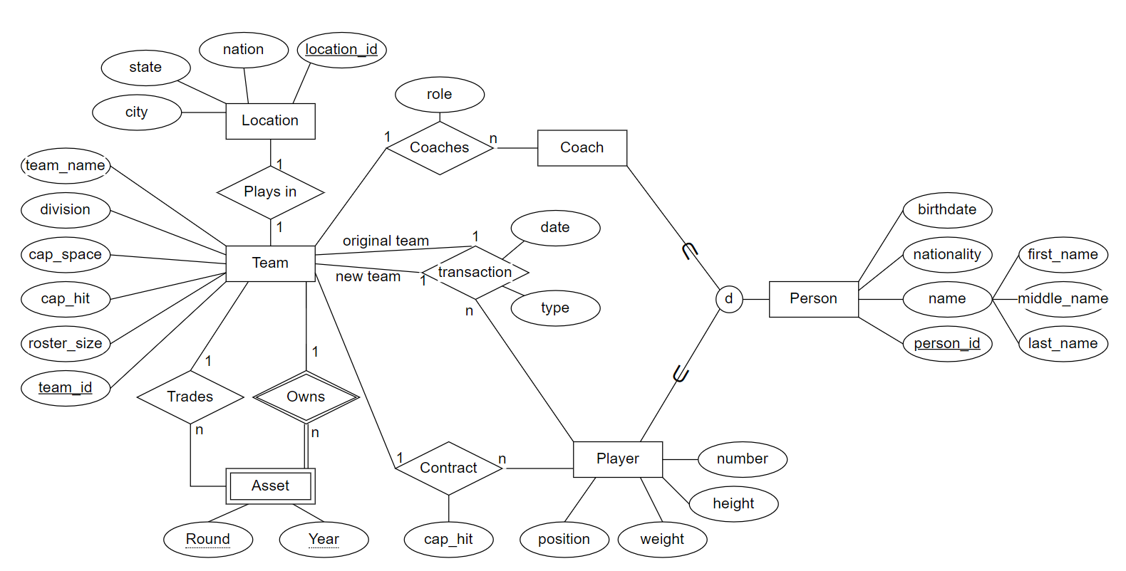
EER Model

Slide 4
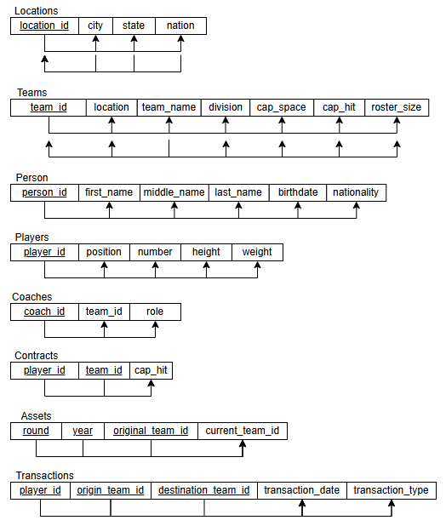
Normalization

Slide 5
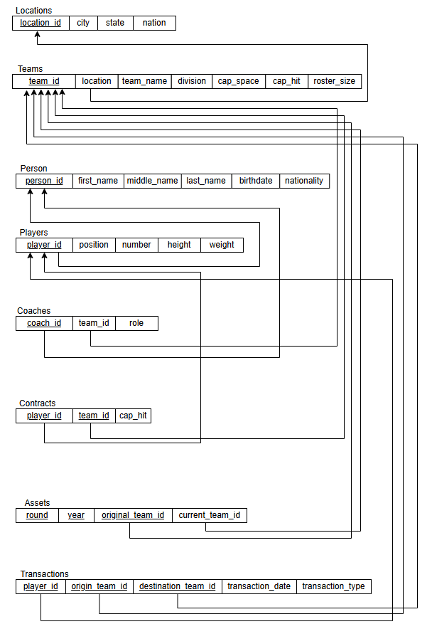
Relational Model

Slide 6
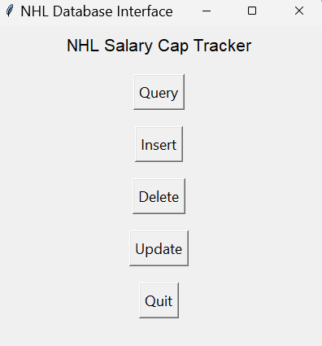
User Interface

Slide 7
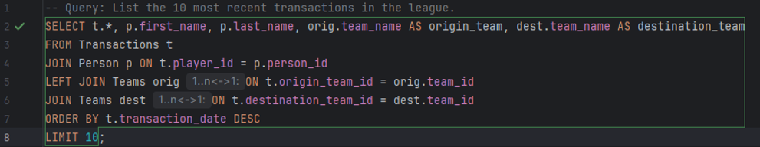
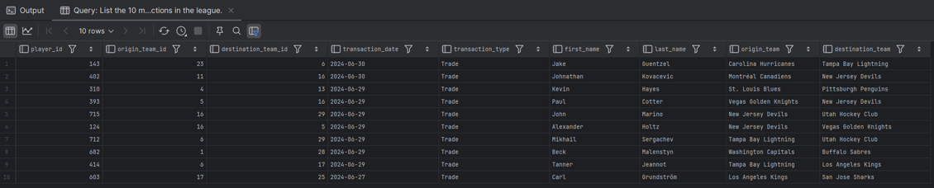
Queries

Slide 8
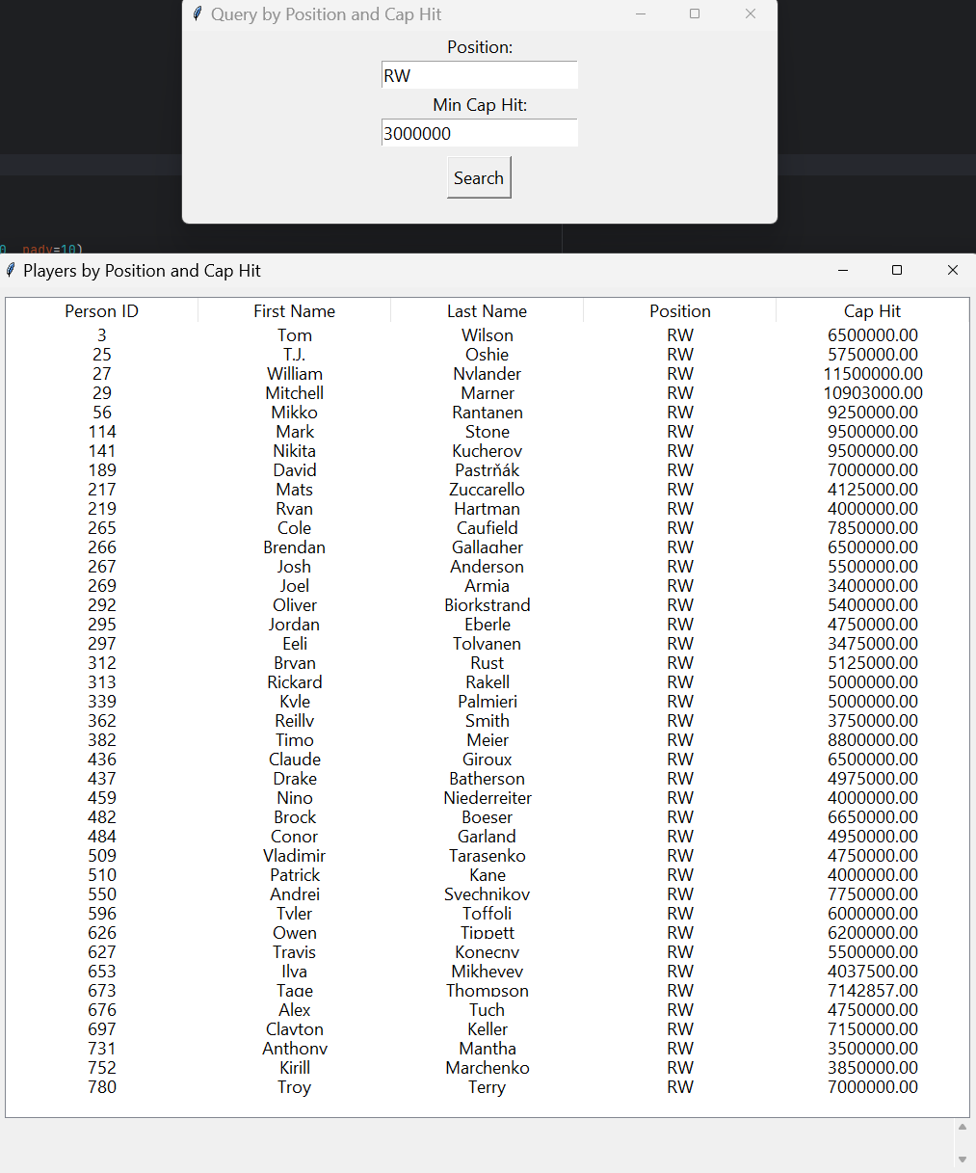
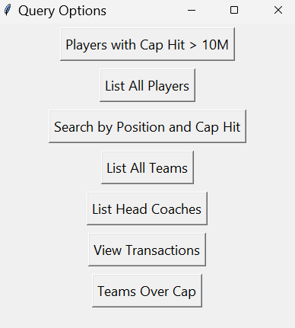
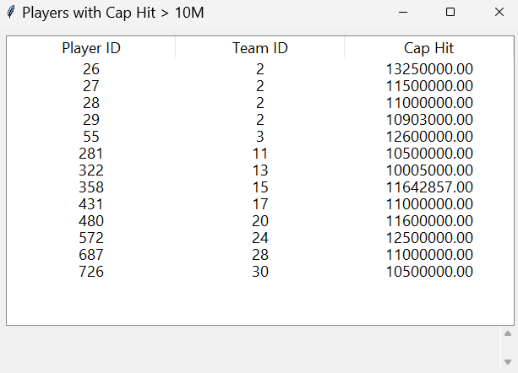
Queries - UI

Slide 9
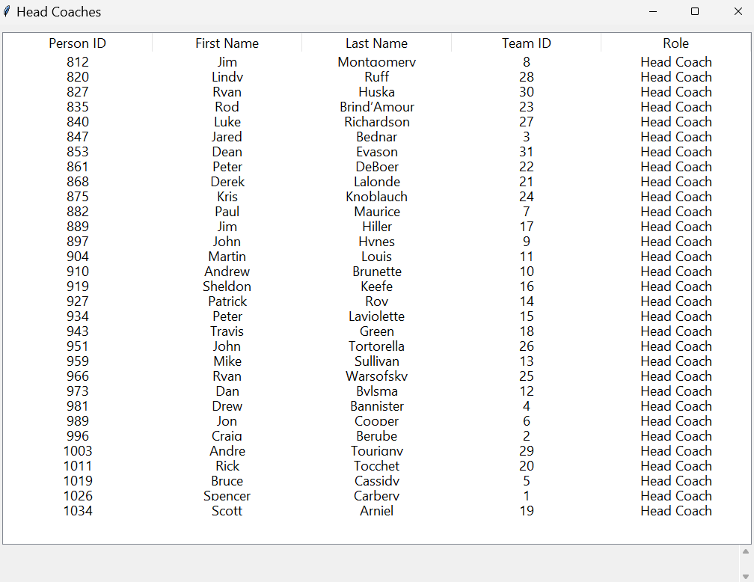
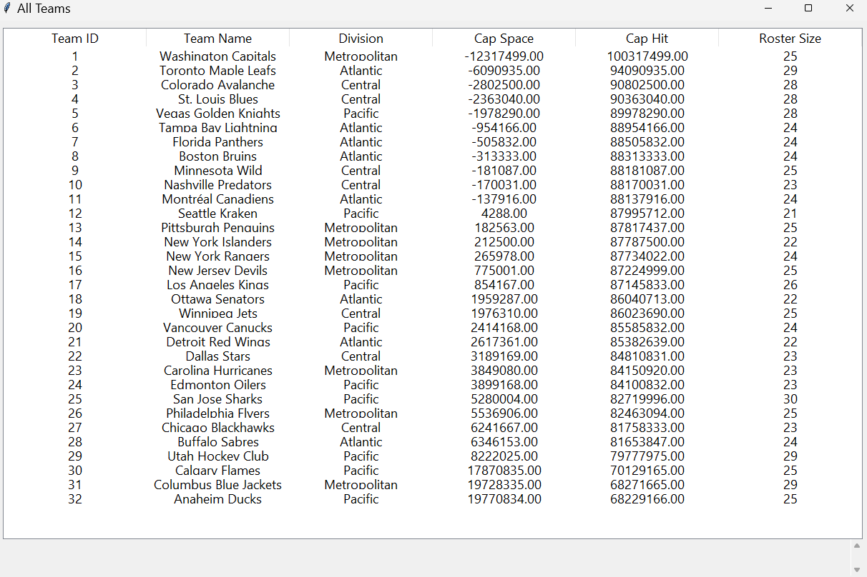
Coach and Team Queries

Slide 10
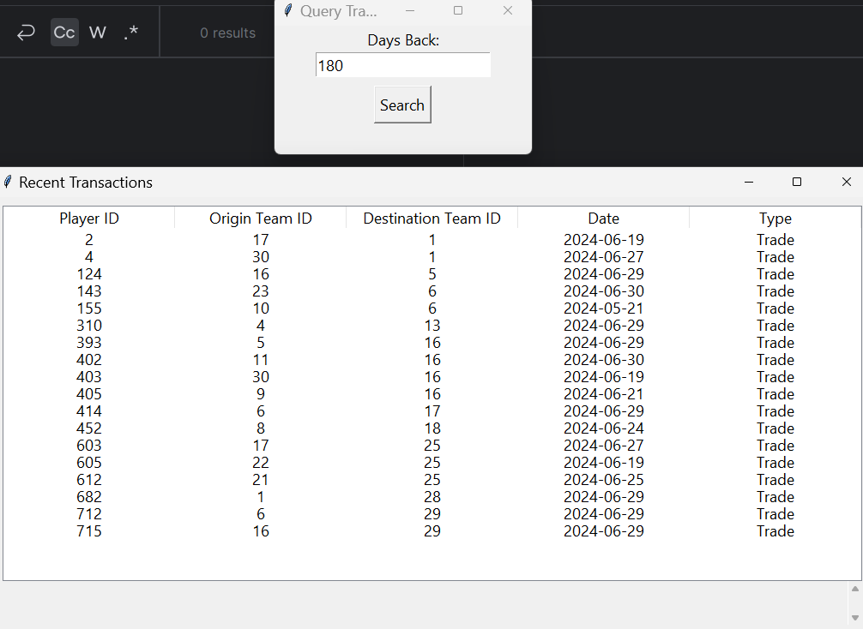
Transactions Query

Slide 11
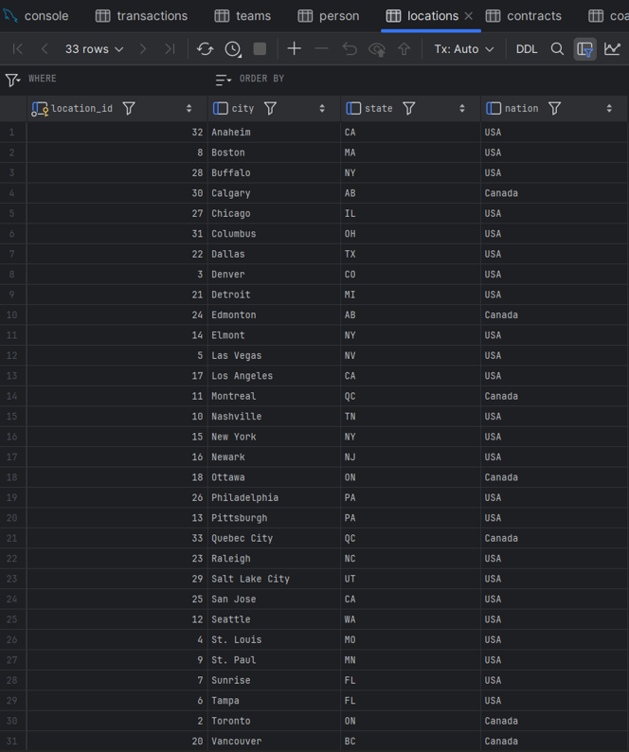
Insertions

Slide 12
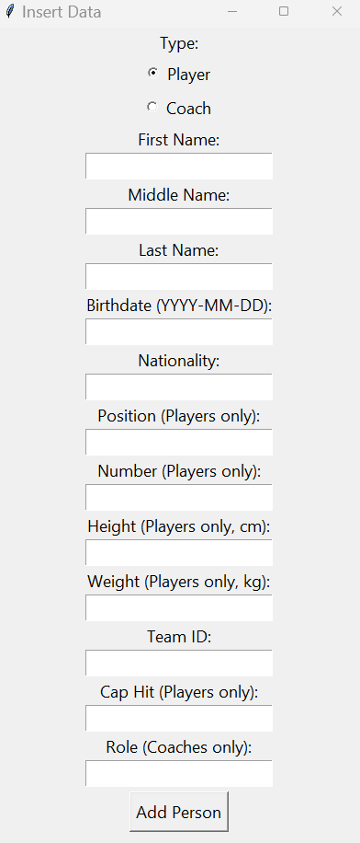
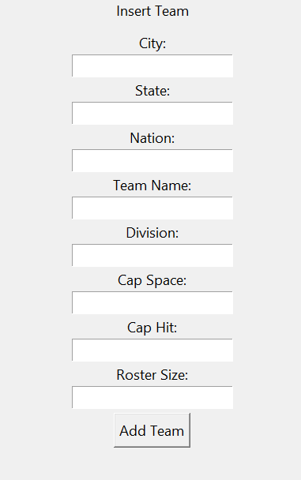
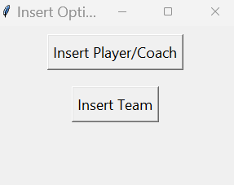
Insertions - UI

Slide 13
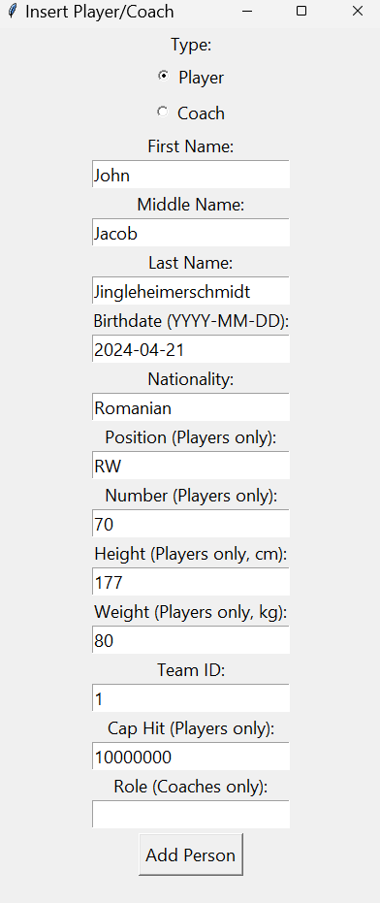
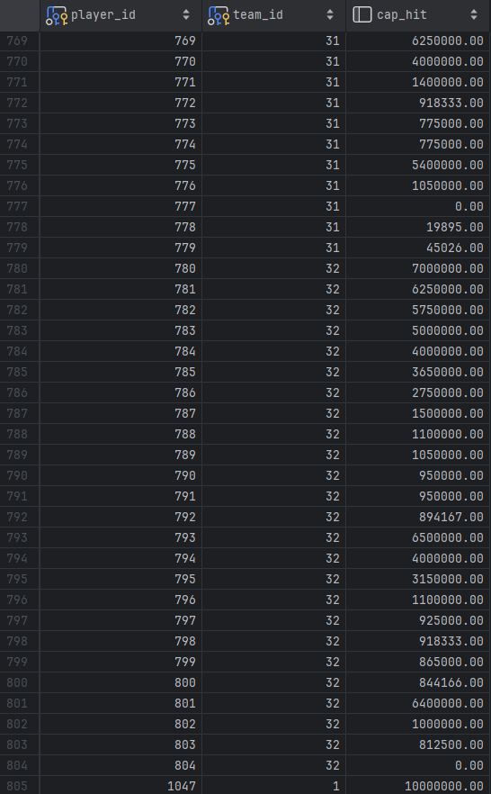
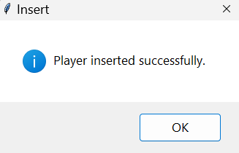
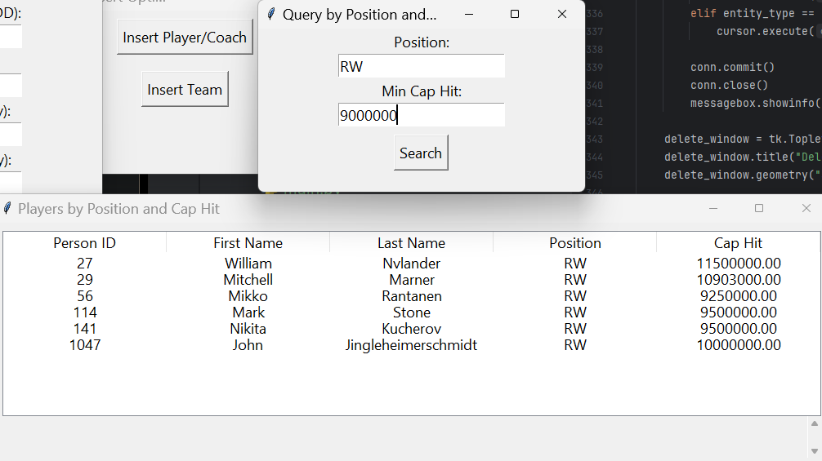
Player Insertion

Slide 14
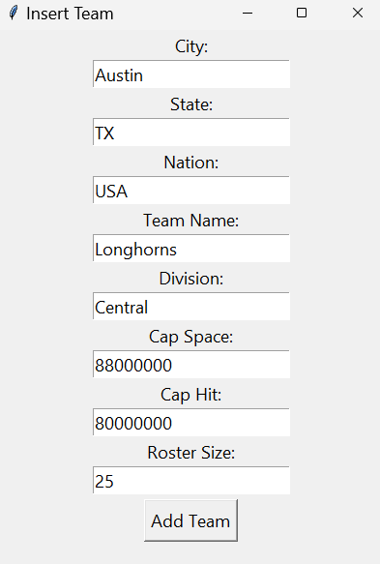
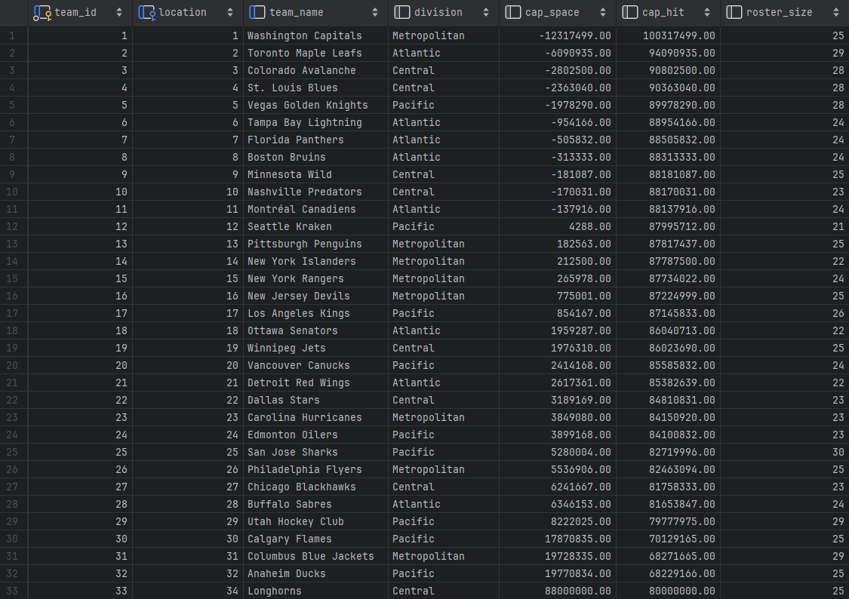
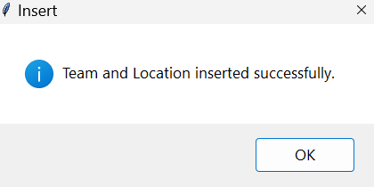
Team Insertion

Slide 15
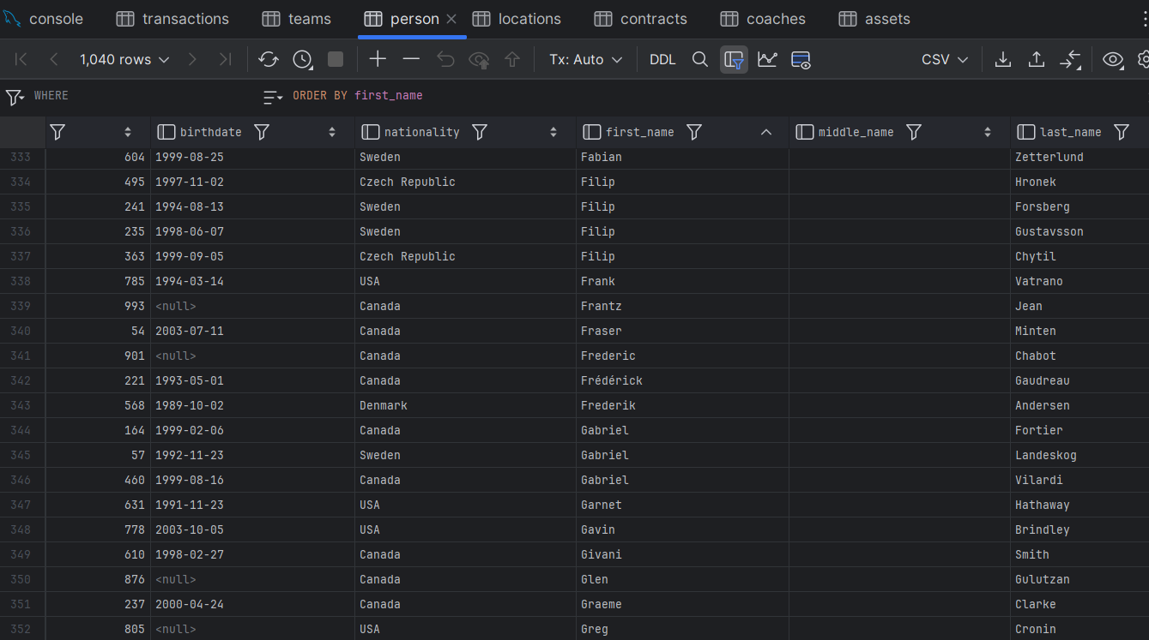

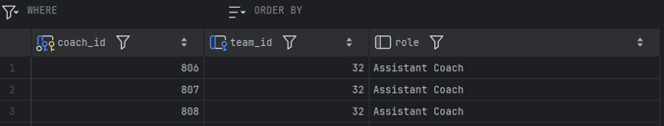
Deletions

Slide 16
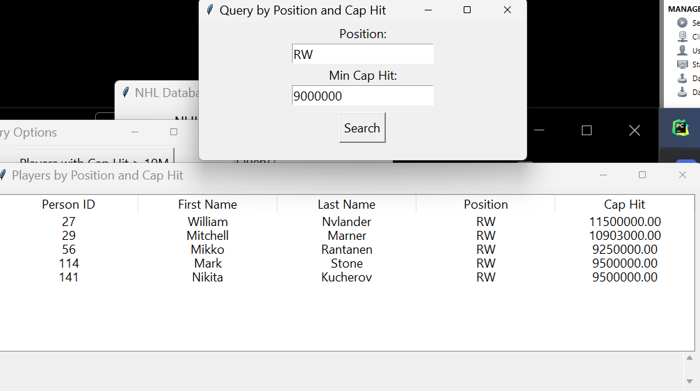
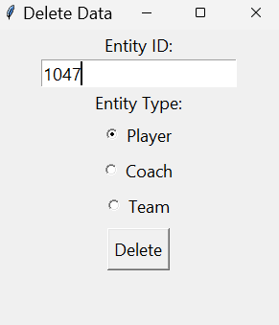
Delete Player

Slide 17
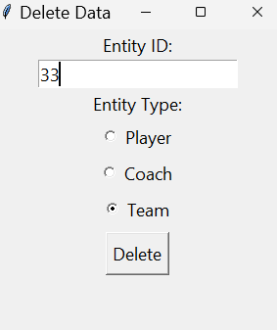
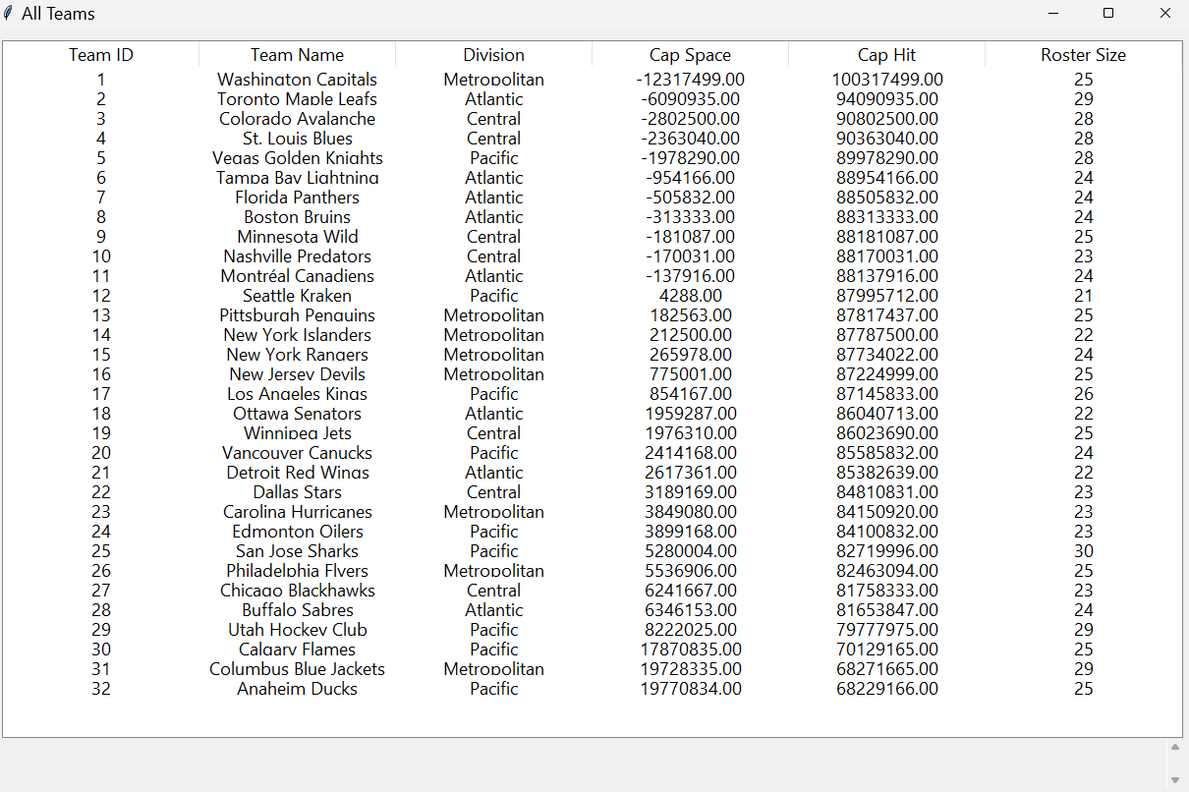
Delete Team

Slide 18
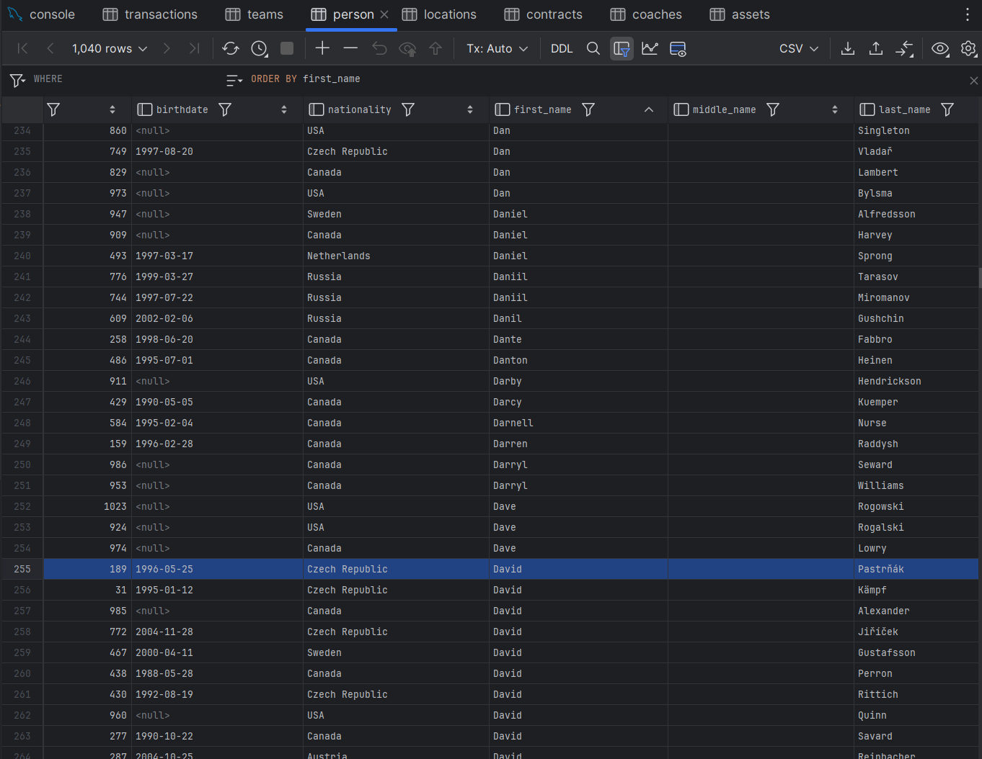

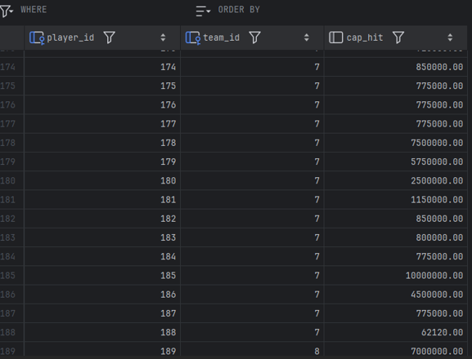
Updates

Slide 19
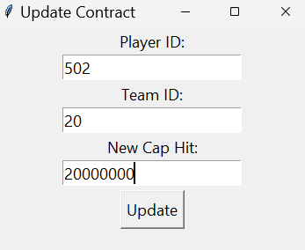
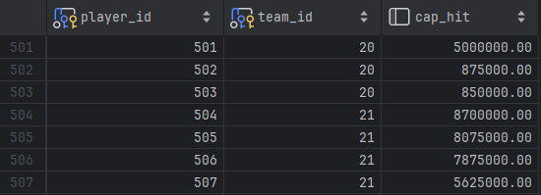
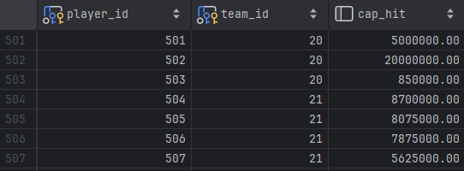
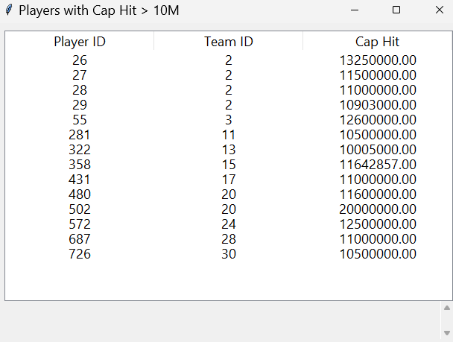
Updates - UI

Slide 20
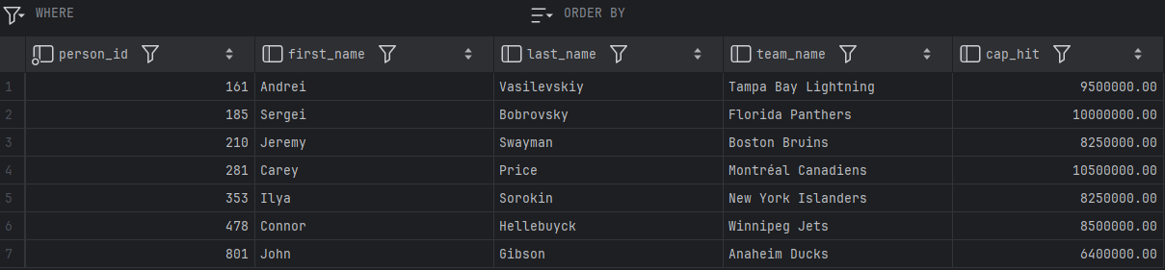
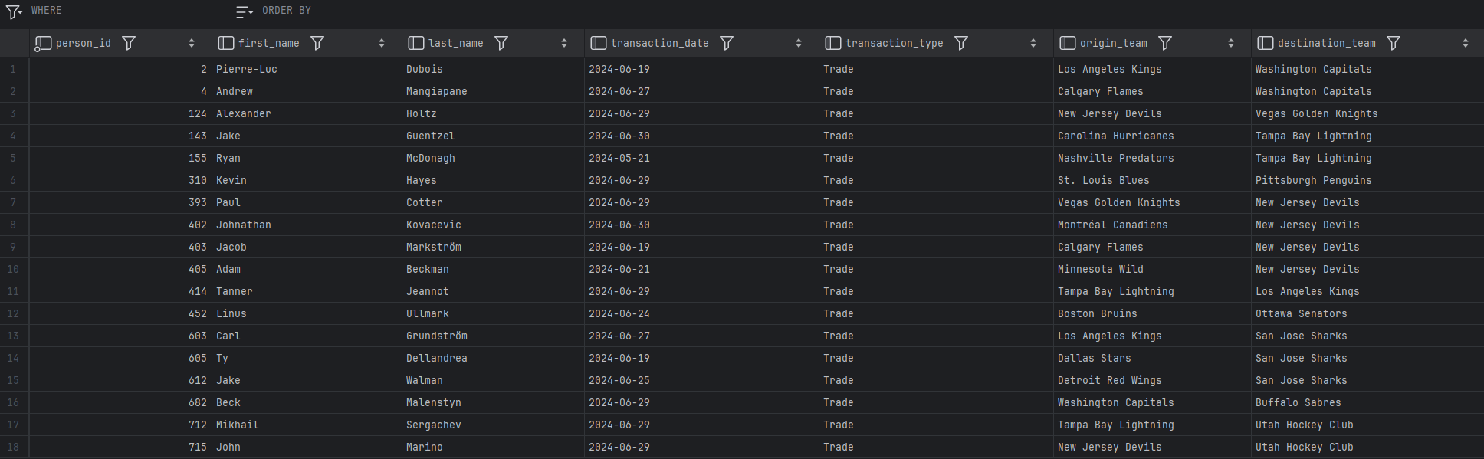
Views

Slide 21
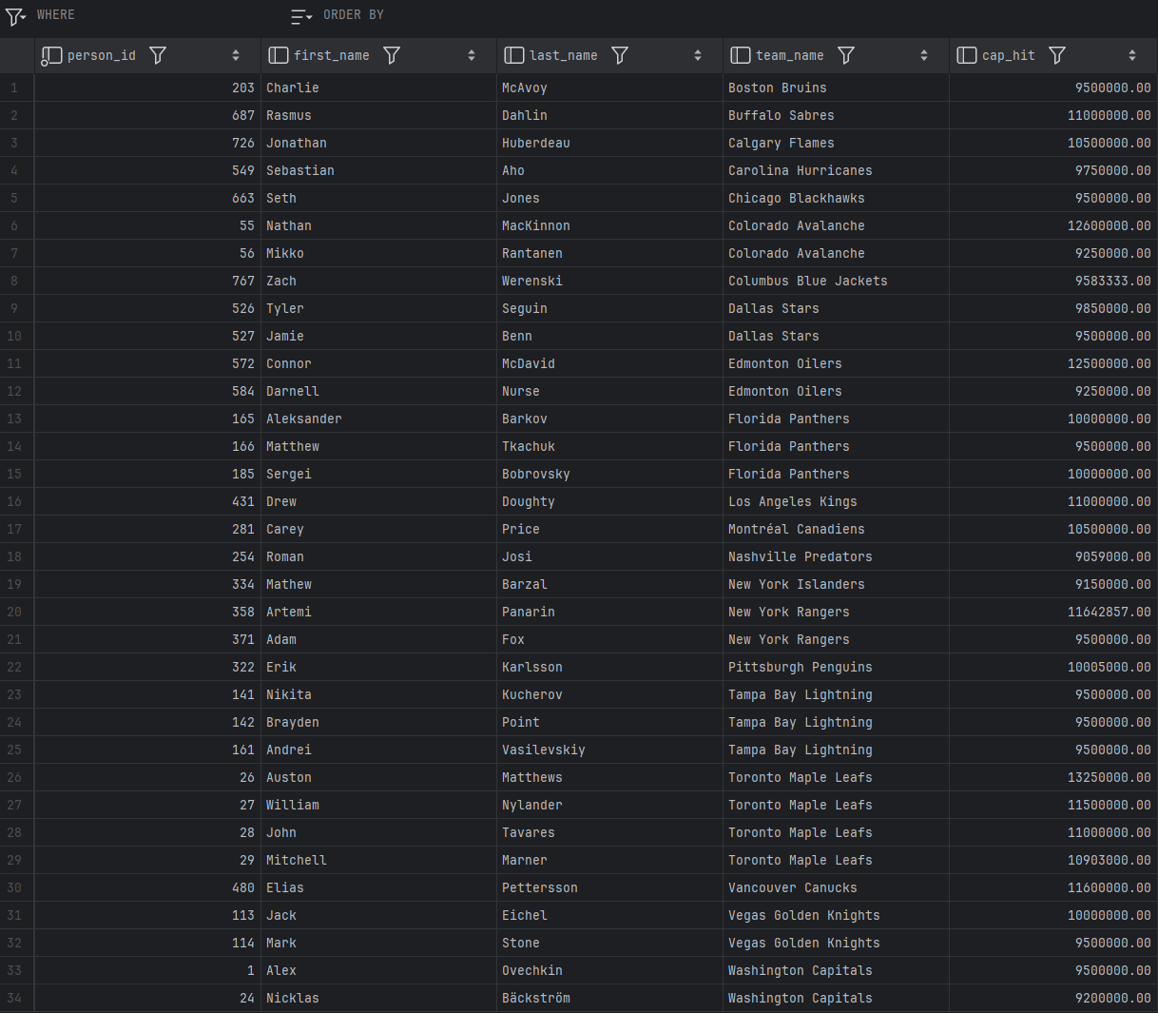
Views

Slide 22
Conclusion/Future Work
Addressed the need for accessible, organized information on NHL contracts
Fills the void left by CapFriendly.com
Exists as a tool for casual fans, armchair analysts, and even professionals
Provides access to player contract info, salary caps, and relevant statistics
Potential Improvements:
Real-time updates using NHL API
Integrating advanced analytics to broaden scope
Enhancing the user interface

Slide 23
References
[1] H. Brown, “Washington Capitals GM MacLellan Confirms Acquisition Of CapFriendly,” NoVa Caps, Jun. 12, 2024. https://novacapsfans.com/2024/06/12/washington-capitals-gm-maclellan-confirms-acquisition-of-capfriendly/ (accessed Oct. 08, 2024).
[2] “PuckPedia - NHL Salary Cap, Player Contracts and Salary Cap Analysis | Puckpedia,” Puckpedia.com, Sep. 27, 2024. https://puckpedia.com (accessed Oct. 08, 2024).
[3] “Home - CapSpace,” Cap-space.com, 2024. https://cap-space.com (accessed Oct. 08, 2024).
[4] “2023-24 NHL Trade Tracker | NHL.com,” www.nhl.com, Jan. 06, 2024. https://www.nhl.com/news/2023-24-nhl-trades-344953916
[5] “NHL Coaches | National Hockey League Coaches’ Association.” https://www.nhlcoaches.com/nhl-coaches/
‌[6] “Hockey Draft Pick Transactions,” Prosportstransactions.com, 2024. https://www.prosportstransactions.com/hockey/DraftTrades/Years/index.htm (accessed Oct. 19, 2024).

