Slide 1




NHL Salary Cap Tracker
By: Paul, Marco, Yosep, Jonathan, Nafiz, Sanved, and Diego

Slide 2
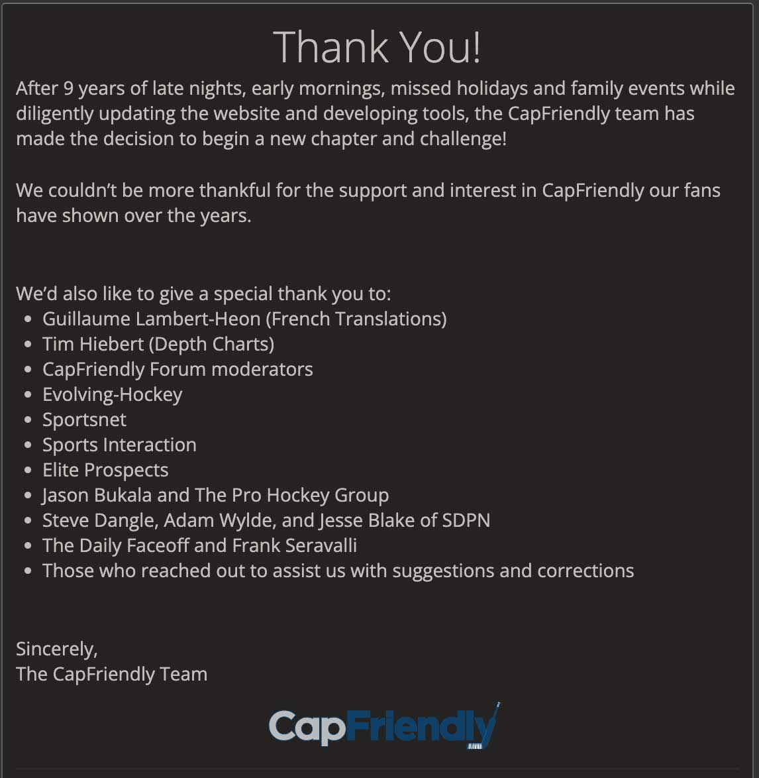
Motivation
CapFriendly.com purchased by Washington Capitals
Public access shut down
Info remains available, but CapFriendly functionality unmatched
Goal: design database system for storing and managing NHL salary cap data
Contribute to hockey community
Provide valuable information to be used by fans, enthusiasts, and professionals

Slide 3
Timeline
Initial Planning
Design scope and goals
Fit ideas to course requirements
Conceptual Design
Create basic ER model with teams and players
Added transactions and contracts to represent relationships
Added assets table to serve as weak entity and identify draft picks
Adjusted players to be subclass of a new persons table; added coaches
Adjusted attributes to meet project requirements

Slide 4
Timeline
Logical Design
Translated EER model into relational schema
Physical Design/Implementation
Implemented scripts to create tables based on the relational schema
Adjusted key constraints
Data Population/Testing
Inserted data using information from NHL, CapSpace.com, and PuckPedia
Tested integrity constraints and query functionality

Slide 5
Timeline
Normalization
Broke down relations into candidate keys, primary keys, prime attributes, and non-prime attributes
Ensured dependencies met 3NF requirements for every table
View Creation
Decided on useful views for finding NHL cap information
i.e., players paid above $x, players from a specific position paid above $x, transactions that have occurred within x months

Slide 6
Timeline
Front-End User Interface
Decided on form for front-end before creating the application
Documentation and Reporting
Summarized information and cited references

Slide 7
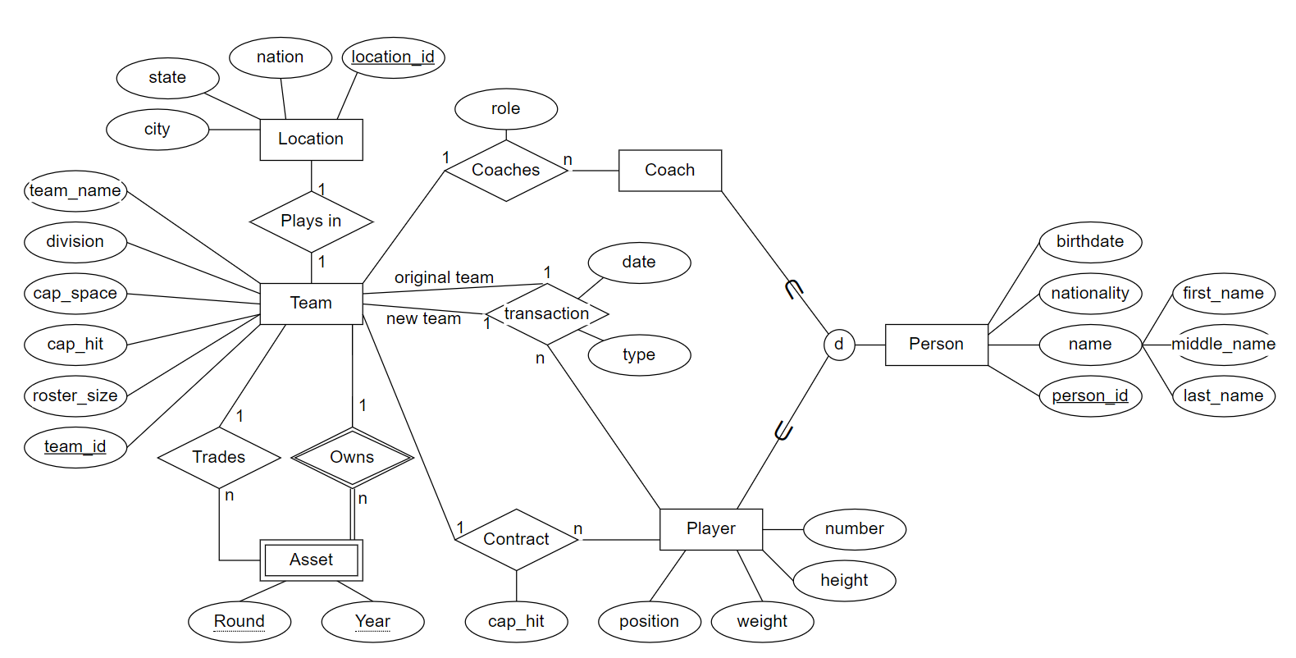
EER Model

Slide 8
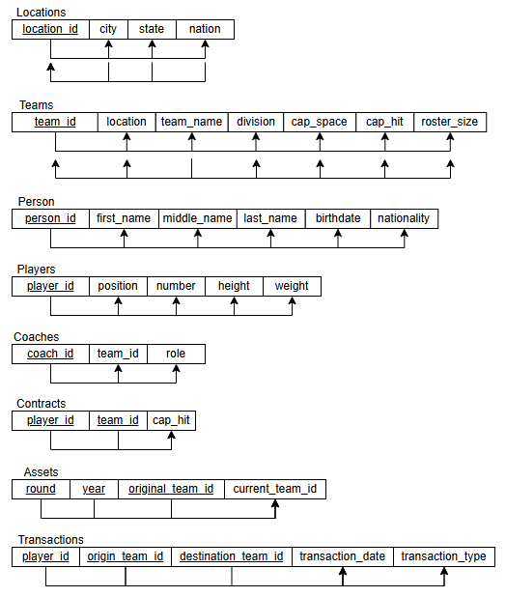
Normalization

Slide 9
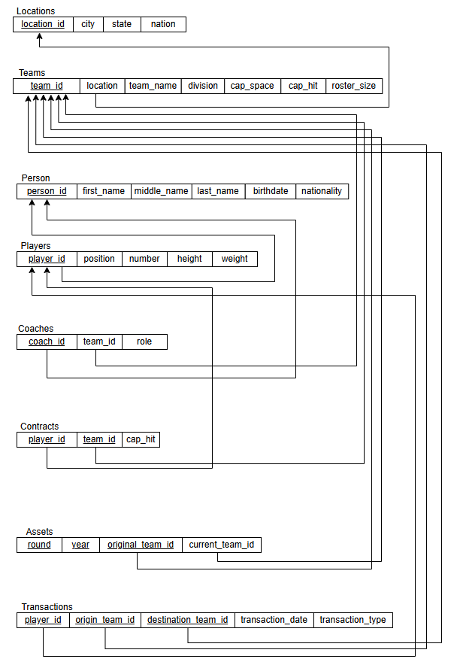
Relational Model

Slide 10
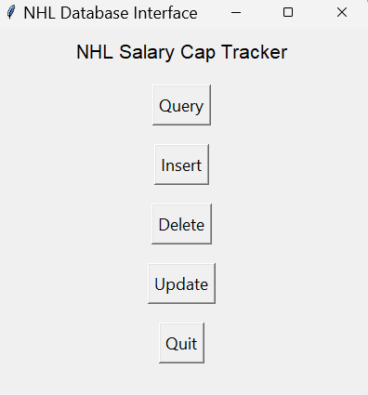
User Interface

Slide 11
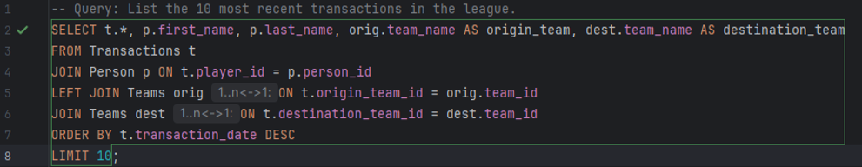
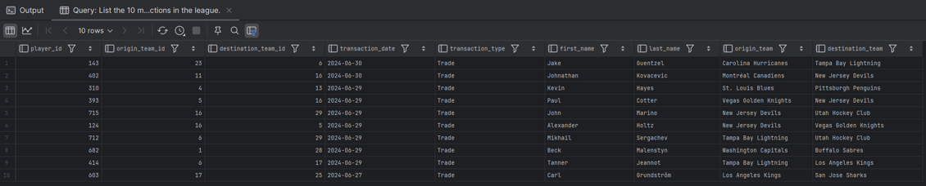
Queries

Slide 12
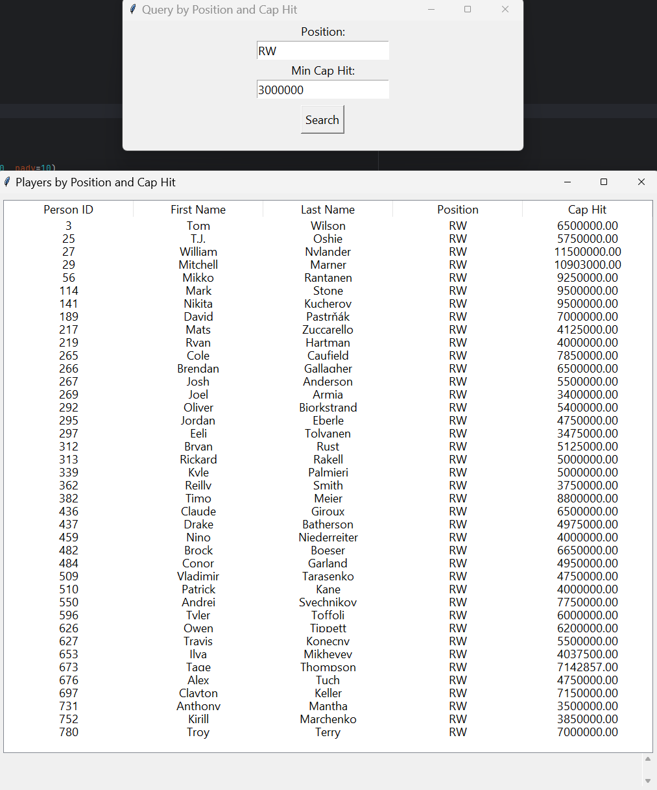
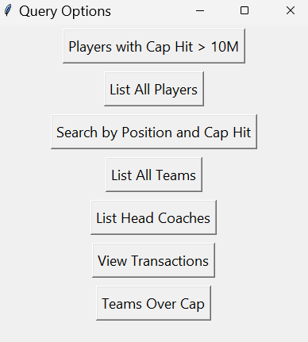
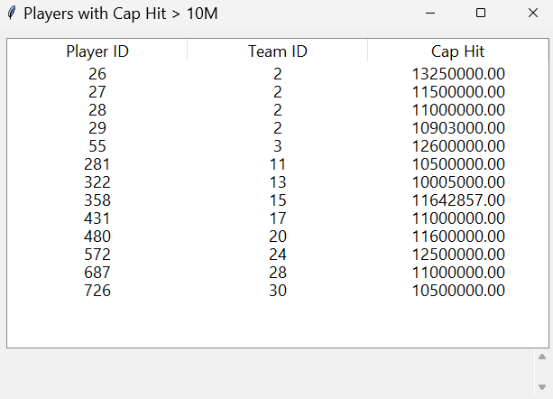
Queries - UI

Slide 13
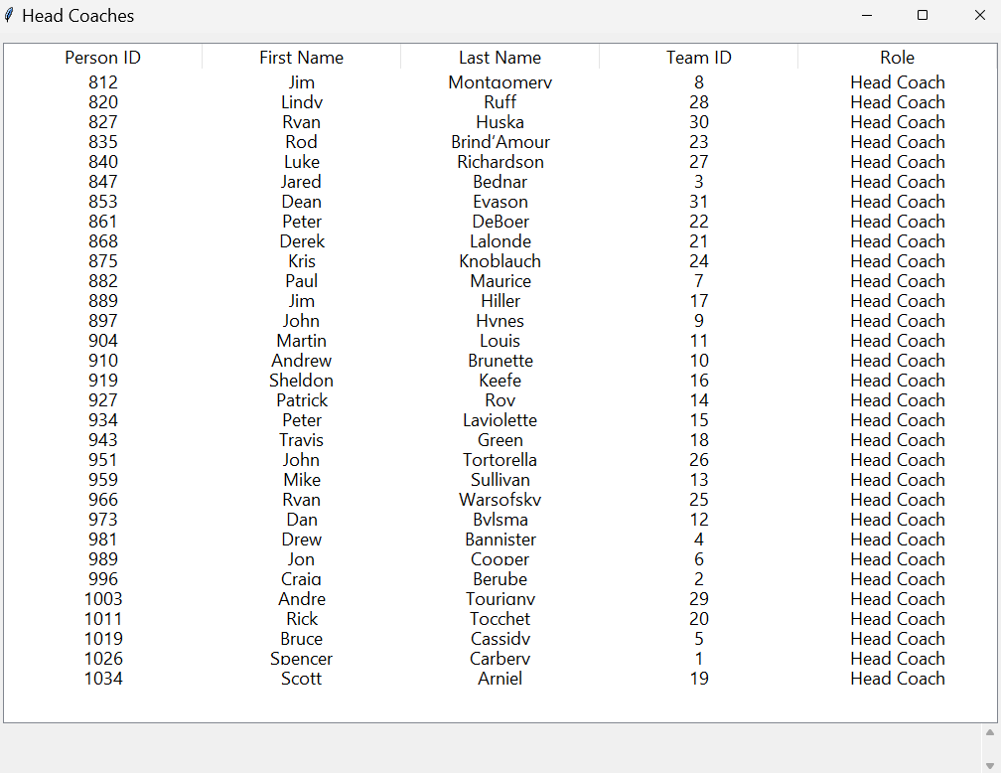
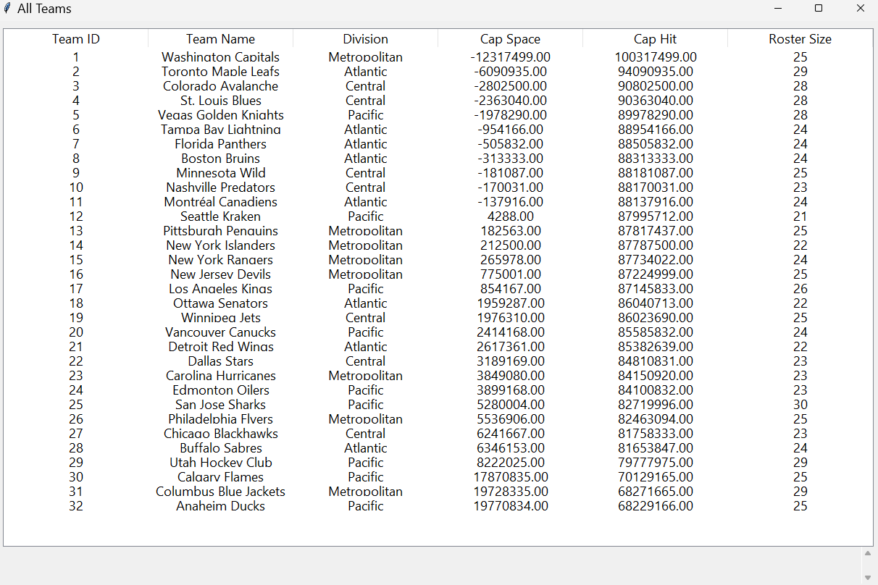
Coach and Team Queries

Slide 14
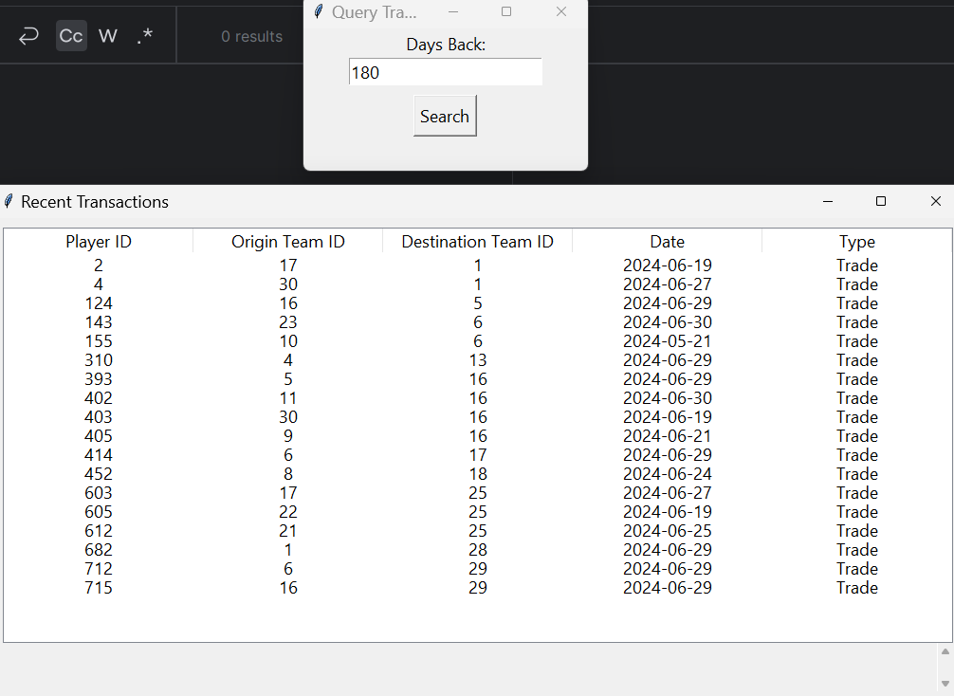
Transactions Query

Slide 15
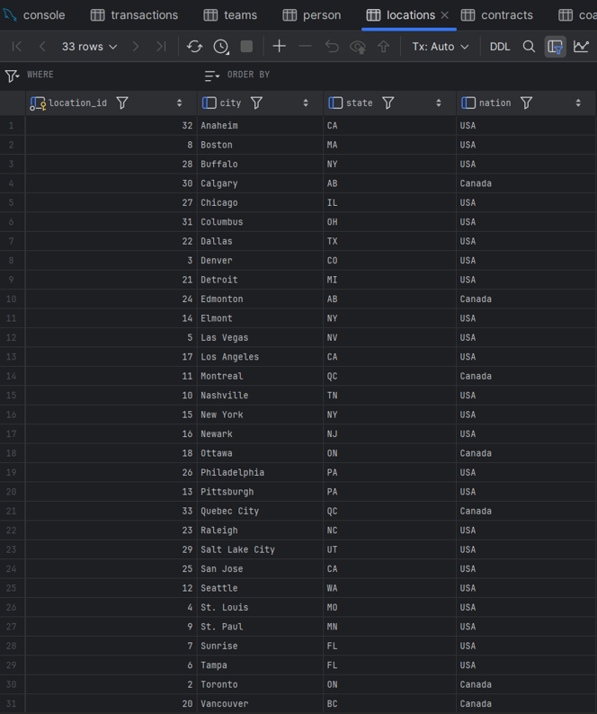
Insertions

Slide 16
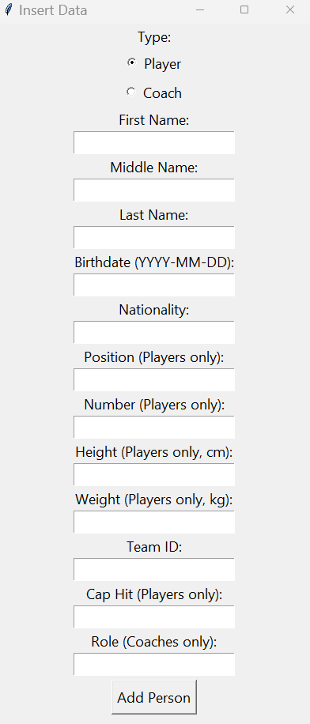
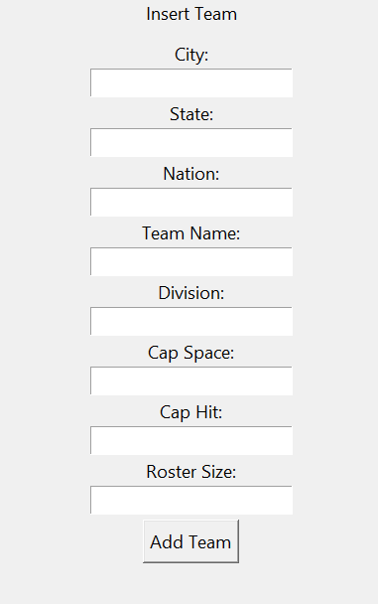
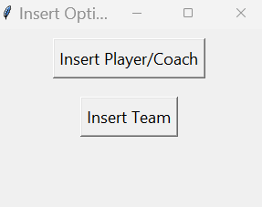
Insertions - UI

Slide 17
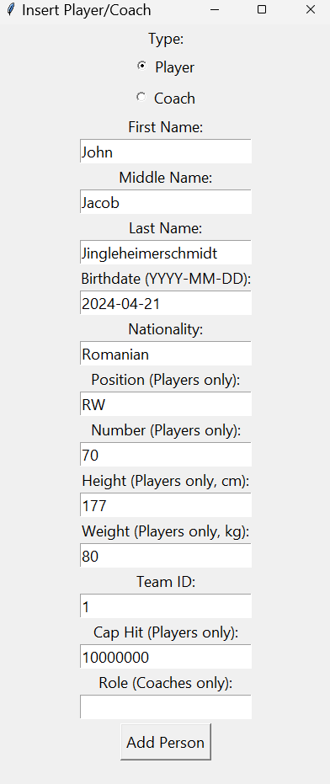
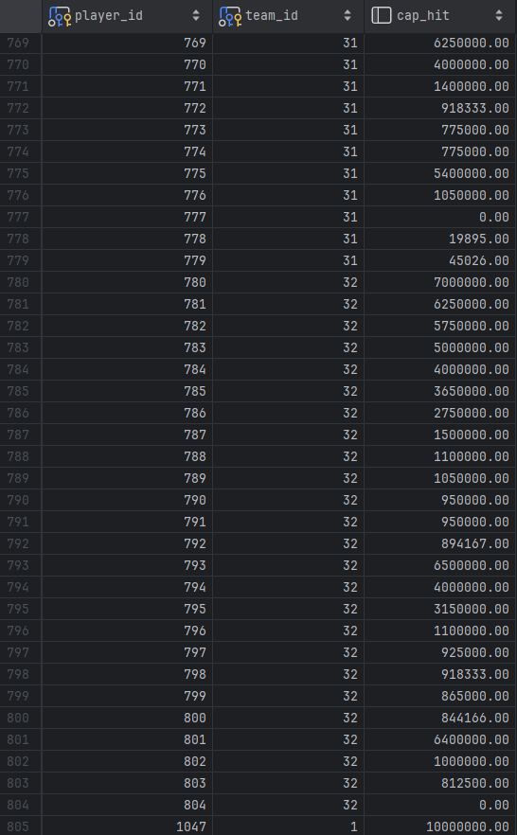
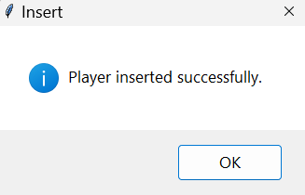
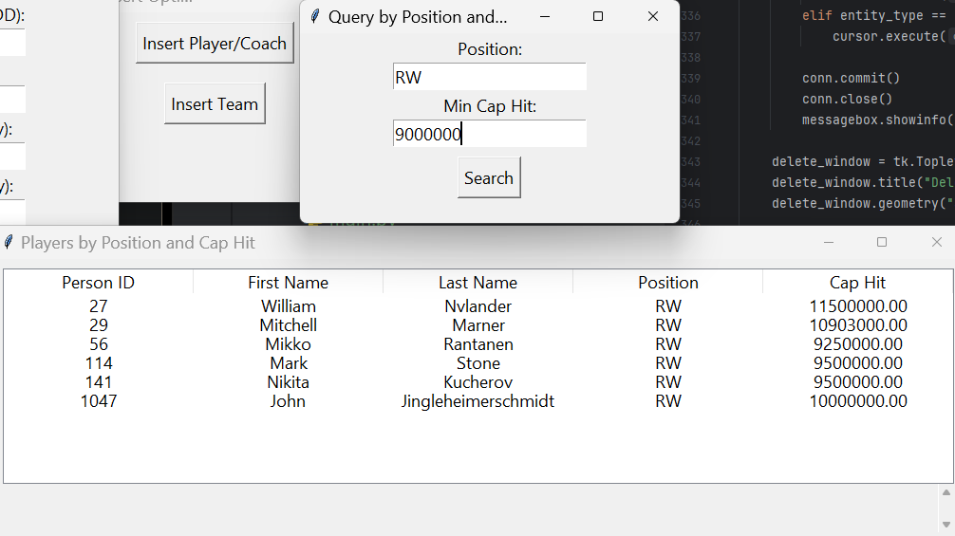
Player Insertion

Slide 18
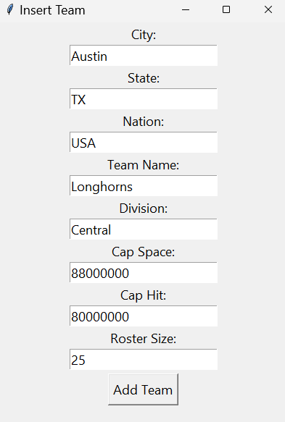
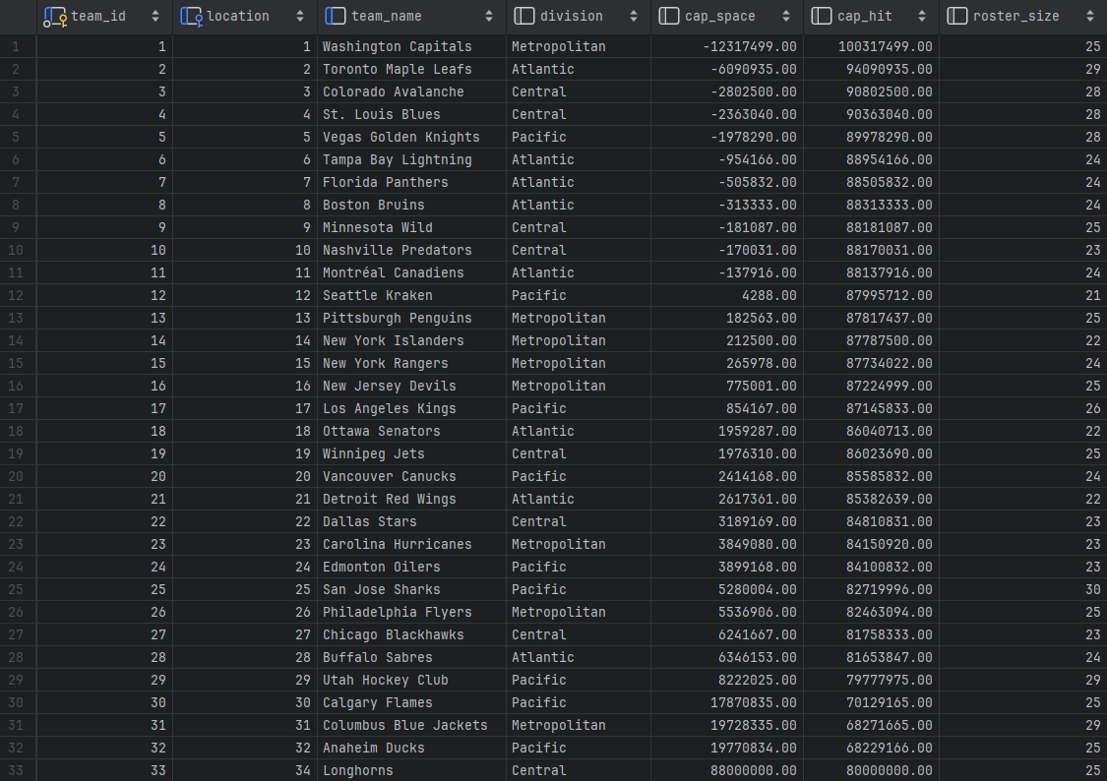
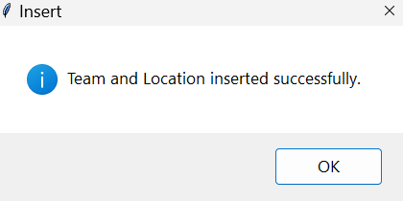
Team Insertion

Slide 19
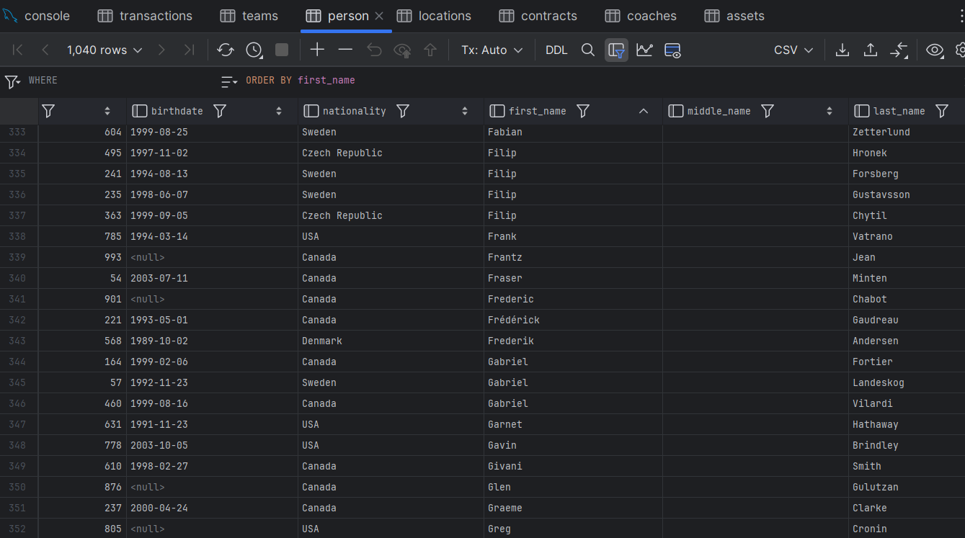

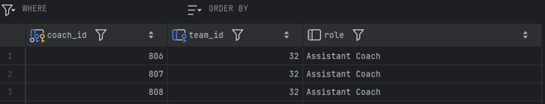
Deletions

Slide 20
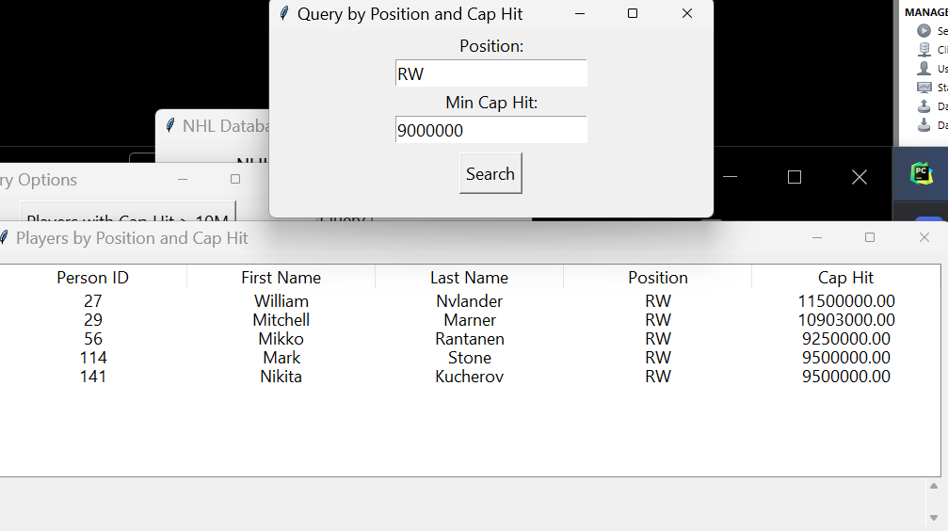
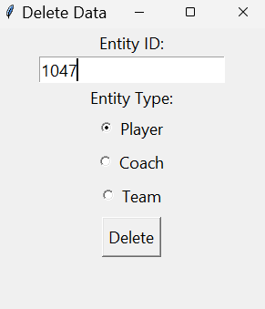
Delete Player

Slide 21
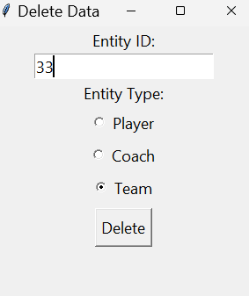
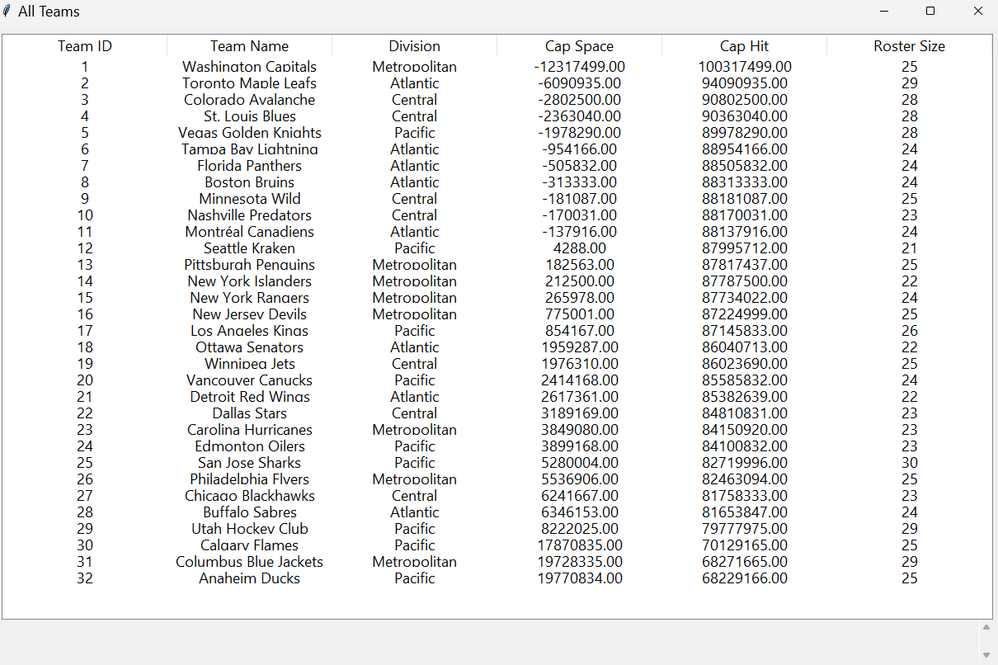
Delete Team

Slide 22
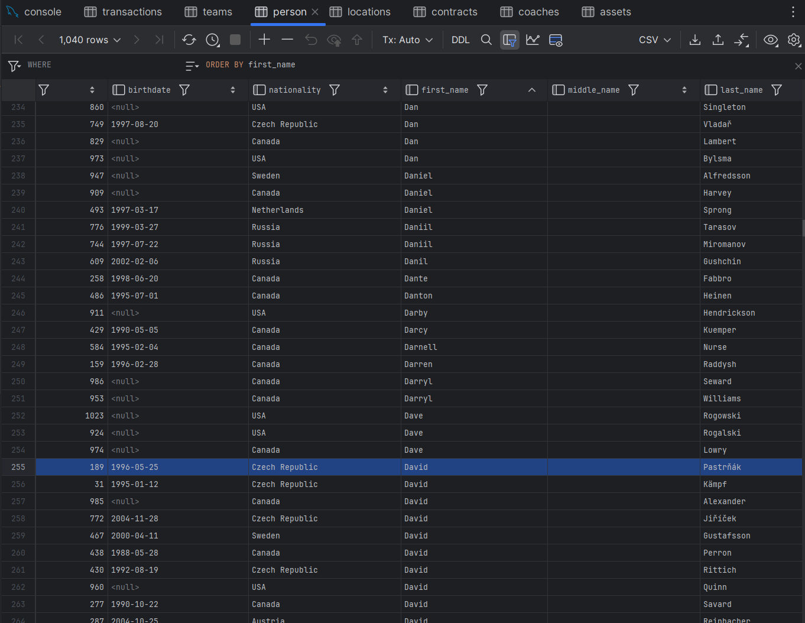

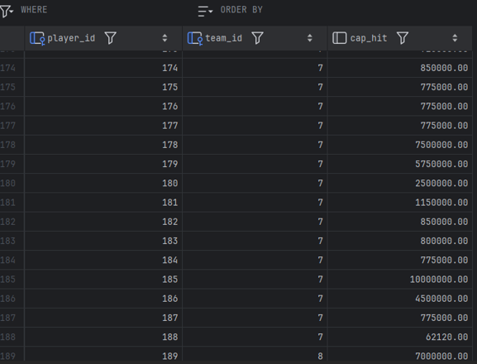
Updates

Slide 23
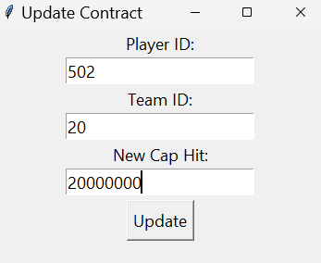
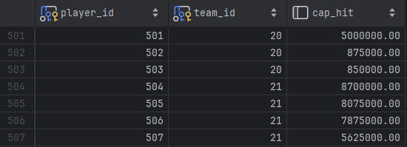
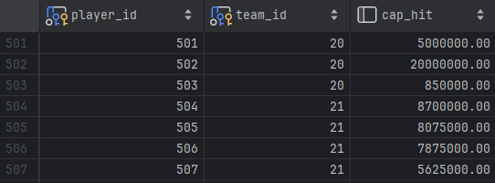
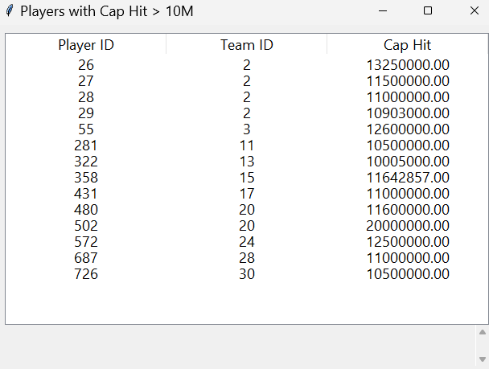
Updates - UI

Slide 24
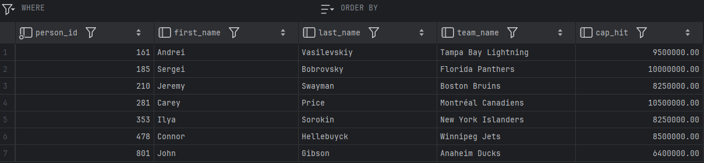
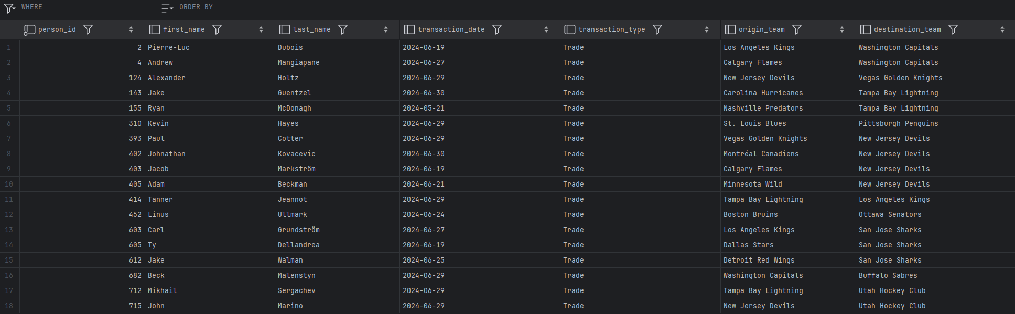
Views

Slide 25
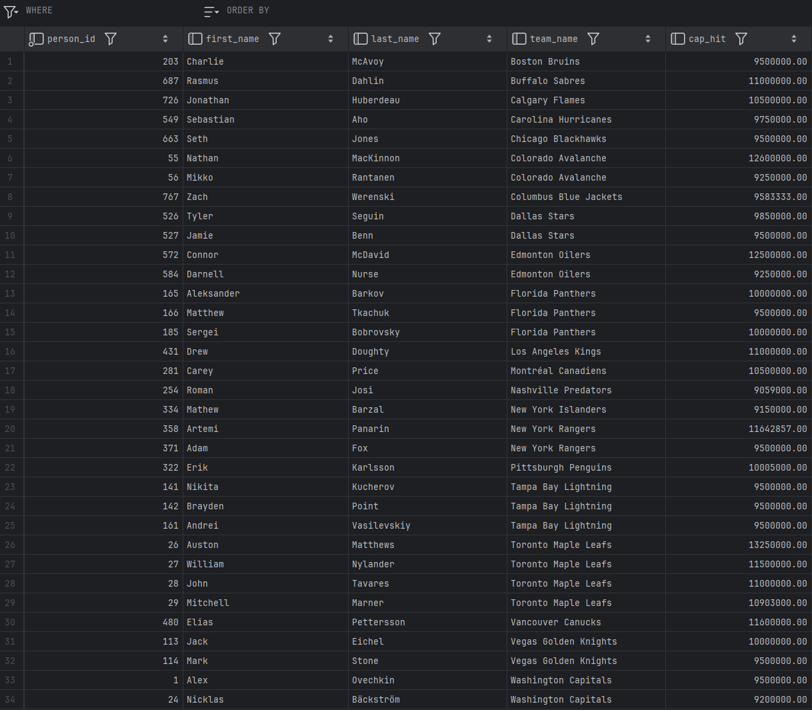
Views

Slide 26
Conclusion/Future Work
Addressed the need for accessible, organized information on NHL contracts
Fills the void left by CapFriendly.com
Exists as a tool for casual fans, armchair analysts, and even professionals
Provides access to player contract info, salary caps, and relevant statistics
Potential Improvements:
Real-time updates using NHL API
Integrating advanced analytics to broaden scope
Enhancing the user interface

Slide 27
References
[1] H. Brown, “Washington Capitals GM MacLellan Confirms Acquisition Of CapFriendly,” NoVa Caps, Jun. 12, 2024. https://novacapsfans.com/2024/06/12/washington-capitals-gm-maclellan-confirms-acquisition-of-capfriendly/ (accessed Oct. 08, 2024).
[2] “PuckPedia - NHL Salary Cap, Player Contracts and Salary Cap Analysis | Puckpedia,” Puckpedia.com, Sep. 27, 2024. https://puckpedia.com (accessed Oct. 08, 2024).
[3] “Home - CapSpace,” Cap-space.com, 2024. https://cap-space.com (accessed Oct. 08, 2024).
[4] “2023-24 NHL Trade Tracker | NHL.com,” www.nhl.com, Jan. 06, 2024. https://www.nhl.com/news/2023-24-nhl-trades-344953916
[5] “NHL Coaches | National Hockey League Coaches’ Association.” https://www.nhlcoaches.com/nhl-coaches/
‌[6] “Hockey Draft Pick Transactions,” Prosportstransactions.com, 2024. https://www.prosportstransactions.com/hockey/DraftTrades/Years/index.htm (accessed Oct. 19, 2024).

Slide 29
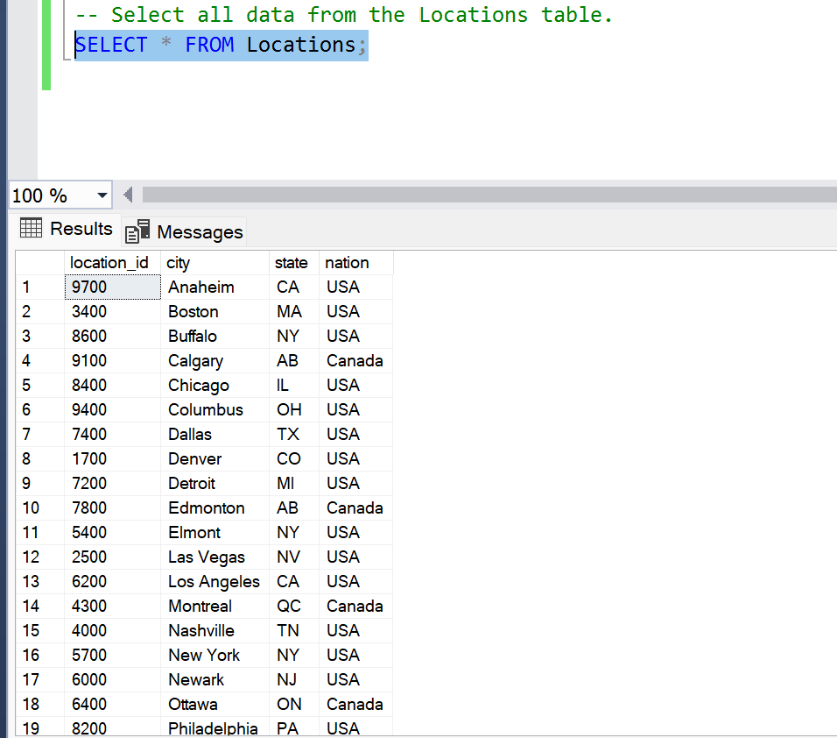
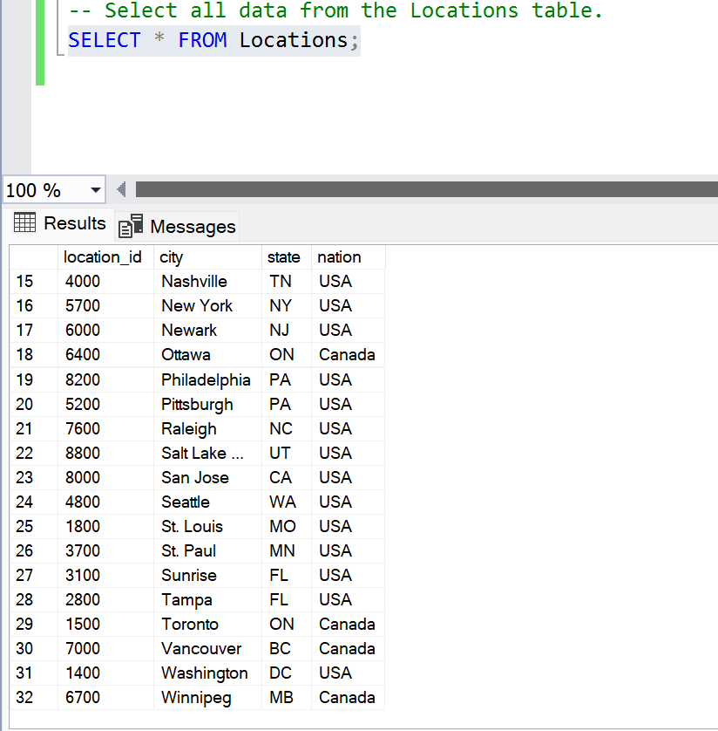
Locations Table displayed

Slide 30
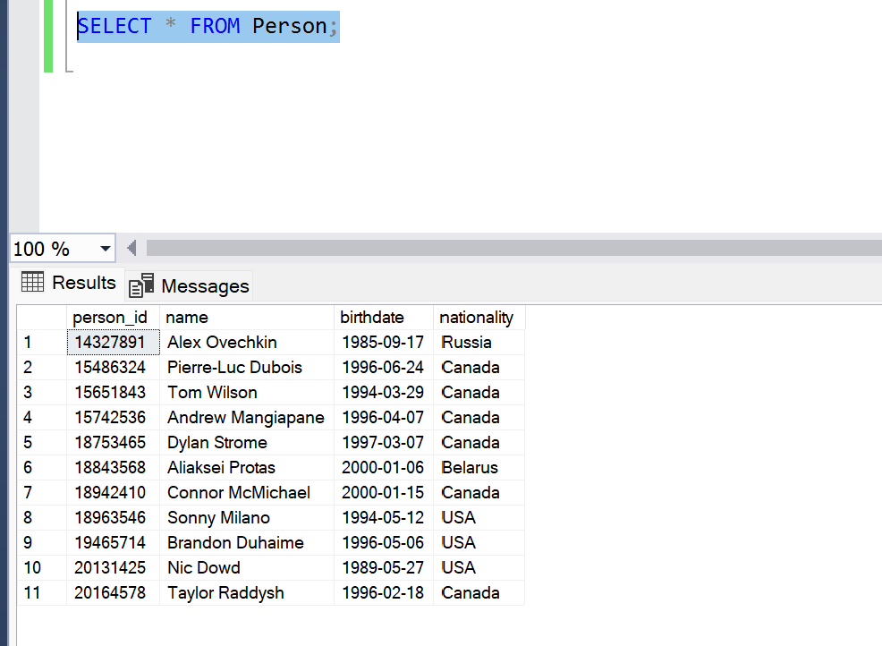
Persons Table displayed

