Slide 1
AP Seminar
Thursday, August 3, 2023

Slide 2
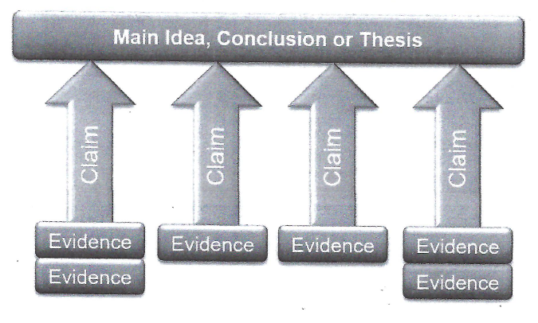
Arguments
Caveat: sometimes AP (and some teachers) use the word “Argument” to mean the thesis, and other times, to mean the entire argument.

Slide 3
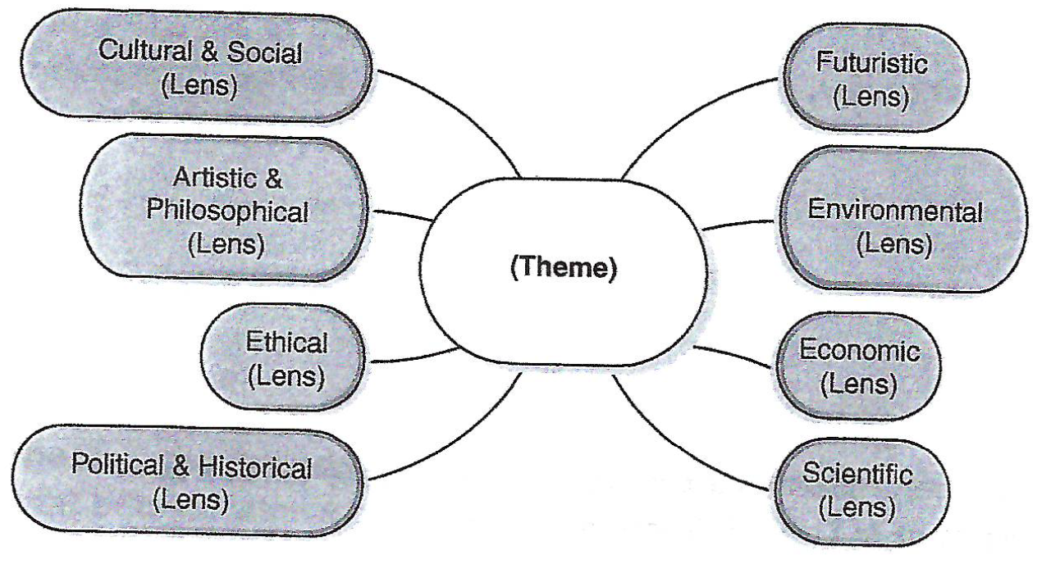
Lenses
“Lenses” are viewpoints from which we can explore a theme.

Slide 4
Lenses for Democracy
In your group, discuss how the theme of “Democracy” may be viewed through the following lenses. Write one of two questions which relate “Democracy” to the lens.
Cultural and Philosophical
Artistic & Social
Ethical
Political & Historical
Futuristic
Environmental
Economic
Scientific

Slide 5
Click on link and type your ideas
Link:
https://docs.google.com/document/d/13gdha2GHSRpm12cPlHUMd8wusa3cLOdCh_YB1djmDEE/edit?usp=sharing

Slide 6
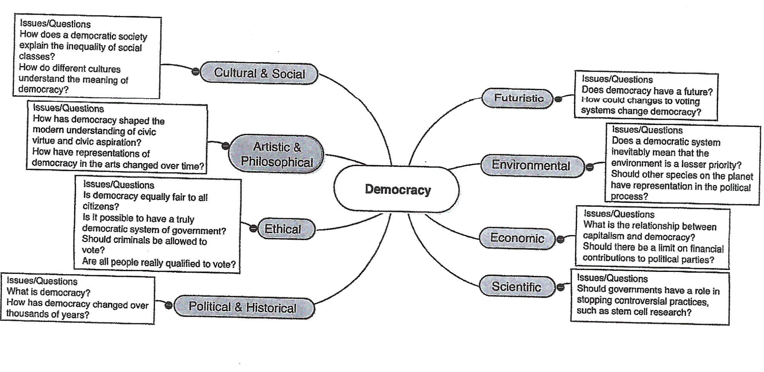
Lenses for Democracy

