Slide 1
Understanding Complexities of Argument

Slide 2
Black and White
52
Notes:
In Seminar, understanding and engaging with multiple perspectives features heavily in the PTs is one of the key First. we tend to see the world in black and white. I like to show my students a Ted Talk called the Danger of a Single Story by Chimamanda Adichie, in which she discusses how Americans see Africa from a single perspective, and therefore, do not really understand it. They associate her with this single view of Africa, and therefore do not understand her at all either.
Author Tim O’Brien discusses this as well. He talks about the danger of absolutism - in seeing one view of the world and failing to understand the others. This type of black and white thinking is prevalent in social media, as the algorithms tend to show people what they want to see - in other words, people who already think like them. And although memes can be hilarious, they also often convey ideas from a single perspective. So we see us v. them; right v. wrong. In other words – we see the world in black and white.

Slide 3
Uncovering Multiple Perspectives - Looking through different lenses
POLITICS
ECONOMICS
SOCIETY/CULTURE
ART
HISTORY
SCIENCE
ENVIRONMENT
RACE
GENDER
AGE
SOCIO-ECONOMIC STATUS
GOVERNMENT
CORPORATIONS
SMALL BUSINESSES
AP Seminar Glossary Lens: Filter through which an issue or topic is considered
PROFESSION or JOB
TAXPAYERS
ETHICS …any many more!
Notes:
So, how do we keep from seeing complex issues in black and white - in our way is right and others are wrong?
One of the ways to delve deeper into the complexities of an issue is to consider the issue from multiple perspectives. We can begin thinking about multiple perspectives by exploring them through these various lenses/fields/worlds. The list on this slide is not comprehensive. However, it is a place to start that represents a good variety. Let’s look at how exploring issues through various lenses can help us see them in a more complex way.

Slide 4
COLONIZING MARS: Should We or Shouldn’t We?
Activity: What do you think? Should we?
Take a few minutes to consider the question above, discuss it with your neighbor, and write your answer on a blank space piece of paper.
Leave room for more.
Notes:
To practice, I wanted to use an issue that isn’t loaded with emotion - colonizing Mars. What is your current position on this issue? Do you think the US should colonize Mars? Take one minute to decide where you currently stand on the issue.

Slide 5
COLONIZING MARS: Should We or Shouldn’t We?
Activity: Jot down the lenses you think would be important ones to consider in the decision. Write down a sentence reflecting how the lens relates to the question.
SOCIETY/
CULTURE
ETHICS
SMALL BUSINESSES
AGE
ECONOMICS
POLITICS
HISTORY
JOB/PROFESSION
GENDER
SCIENCE
ART
TAXPAYERS
SOCIO-ECONOMIC
STATUS
RACE
CORPORATIONS
GOVERNMENT
ENVIRONMENT
Notes:
We might have our own opinion of this, but before we determine whether this is something the US should do, we need to fully understand it. So, what perspectives do we most need to know or understand in order to best understand this situation? What lenses can we look through to help us uncover those perspectives?
Jot down the lenses you think would be important ones to consider in the decision. I’ll start to give you an idea. Science is an important one because we need to know about the technology to get us there and to create an atmosphere, etc., so we definitely need to look into the scientific perspectives of this issue.
Now you take a couple of minutes to write down the other lenses you think might be important.
Note the “lenses” you choose may

Slide 6
COLONIZING MARS: Should We or Shouldn’t We?
Let’s look at how College Board answered this previous prompt.
ETHICS
SOCIETY/
CULTURE
SMALL BUSINESSES
AGE
ECONOMICS
HISTORY
POLITICS
JOB/PROFESSION
GENDER
SCIENCE
ART
TAXPAYERS
SOCIO-ECONOMIC
STATUS
RACE
CORPORATIONS
ENVIRONMENT
GOVERNMENT
Notes:
We might have our own opinion of this, but before we determine whether this is something the US should do, we need to fully understand it. So, what perspectives do we most need to know or understand in order to best understand this situation? What lenses can we look through to help us uncover those perspectives?
Jot down the lenses you think would be important ones to consider in the decision. I’ll start to give you an idea. Science is an important one because we need to know about the technology to get us there and to create an atmosphere, etc., so we definitely need to look into the scientific perspectives of this issue.
Now you take a couple of minutes to write down the other lenses you think might be important.
Note the “lenses” you choose may

Slide 7
Multiple Perspectives Within Lenses (Disciplinary)
Science
We have the technological capability to create an atmosphere, get colonists there, and to sustain life
We can’t get colonists home from Mars
The lifespan of colonists will not be as long as on Earth
History
The Space Race inspired Americans and STEM learning
Economics
The technology to build an atmosphere and sustain life will be very expensive
What will be the economic system on Mars
Environmental
We need to colonize Mars in case Earth can no longer sustain life
We should invest in resources to save Earth instead of to colonize Mars
Notes:
Now let’s look in more depth at each of these. Notice that there are sometimes multiple perspectives, and sometimes disagreement or tensions within the lenses. I didn’t take the time to write every possibility under each of these, just a representation for each to give you an idea. Read through - illustrates the complexity. - continues on next slide

Slide 8
Multiple Perspectives within Lenses (Disciplinary)
Politics
Differing political affiliations stances on colonizing
What the government would be and who would run it
Worth the expense because of the recognition for making it happen
Not worth the expense because it will upset voters who prefer for the money to go to debt relief or education
Ethics
It could save human life if something happens to Earth
Colonists will not be able to return
The lifespan of colonists will not be as long as on Earth

Slide 9
COLONIZING MARS: Should We or Shouldn’t We?
ETHICS
SOCIETY/
CULTURE
SMALL BUSINESSES
AGE
ECONOMICS
HISTORY
POLITICS
JOB/PROFESSION
SCIENCE
GENDER
ART
TAXPAYERS
SOCIO-ECONOMIC
STATUS
RACE
CORPORATIONS
GOVERNMENT
ENVIRONMENT
Notes:
You could also choose to look at it a different way – rather than disciplinary lenses – potential stakeholders.

Slide 10
Multiple Perspectives Within Lenses (Stakeholder)
Profession (Scientists)
Focusing our best efforts towards colonizing Mars is the only way to save humanity in the face of a deteriorating environment on Earth.
Focusing our best efforts towards saving Earth is our best chance of saving humanity.
Corporations
Retrofitting our business to play a role in colonizing Mars will put us on the cutting edge and our investors will gladly support the risk.
Maintaining our current business plan is the safest way to ensure our company remains profitable and investors happy.
Notes:
Now let’s look in more depth at each of these. Notice that there are sometimes multiple perspectives, and sometimes disagreement or tensions within the lenses. I didn’t take the time to write every possibility under each of these, just a representation for each to give you an idea. Read through - illustrates the complexity. - continues on next slide

Slide 11
Multiple Perspectives within Lenses (Stakeholder)
US Government
Early colonization and monopolization of Mars will allow us to claim more of the planet and expand our borders to include Mars's resources.
Working with other countries will allow us to share the costs of colonizing Mars and the technology needed to make colonization successful.
Taxpayers
Putting tax dollars towards the risky attempt to colonize Mars will explode the national debt with no guarantee of a return on that investment. What have we gotten from going to the moon?
Putting tax dollars toward the colonization of Mars will fuel the American economy by providing high paying jobs in technology, science, and manufacturing.

Slide 12
SHADES OF GRAY
Notes:
By exploring the various perspectives within these fields or lenses, we begin to see this is not a simple pro/con or black/white issue. There are many complexities – or shades of gray. There are political, environmental, and economic implications that make it reasonable to take either stance and there are stakeholders that may have competing, complementary or alternate views. That’s where we fall into those shades of gray. And acknowledging those shades of gray in both IRR and IWA that we understand the complexities of the argument which lends sophistication to our essays.

Slide 13
So, what’s your decision? Are we colonizing Mars?
Write down your position on whether or not to colonize Mars.
Write down at least three reasons why you made the decision you made.
Notes:
Now that we have evaluated the multiple perspectives on the issue and thought it through, decide what your stance is. Write down your position on whether to colonize Mars or not and at least three reasons why you made that decision. Let’s take about *3.5 minutes to do this.

Slide 14
The Other Side
It’s likely some of your reasons had opposition. Next to your reasons, write where there are opposing viewpoints. Sometimes the opposition will be from the same lens, but sometimes it will come from a different lens.
For example:
Reason: We can create an atmosphere on Mars to sustain humans.
Opposition: Significant resources from Earth would be required and likely deplete Earth’s stores.
Notes:
Now let’s think about the other side. It’s likely some of your reasons had opposing perspectives. Next to your reasons, write down the opposing points. *3 minutes

Slide 15
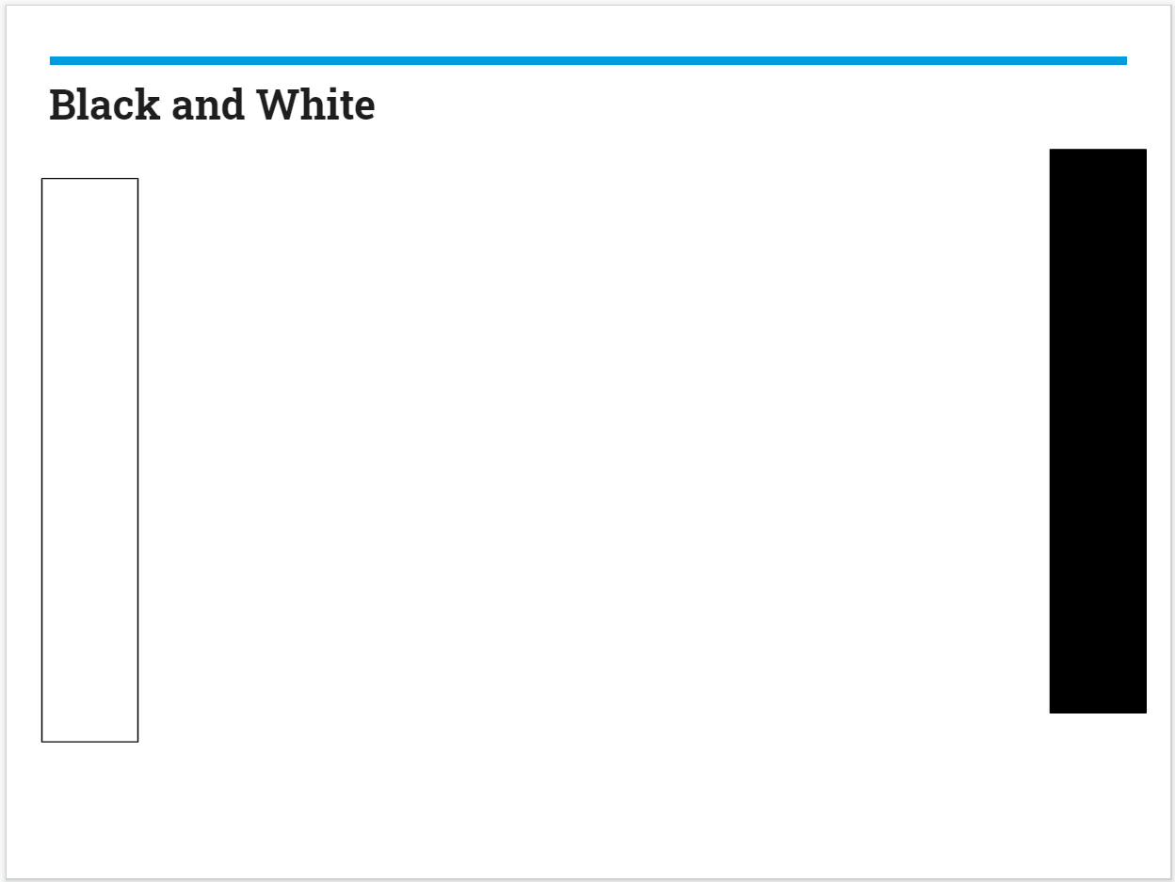
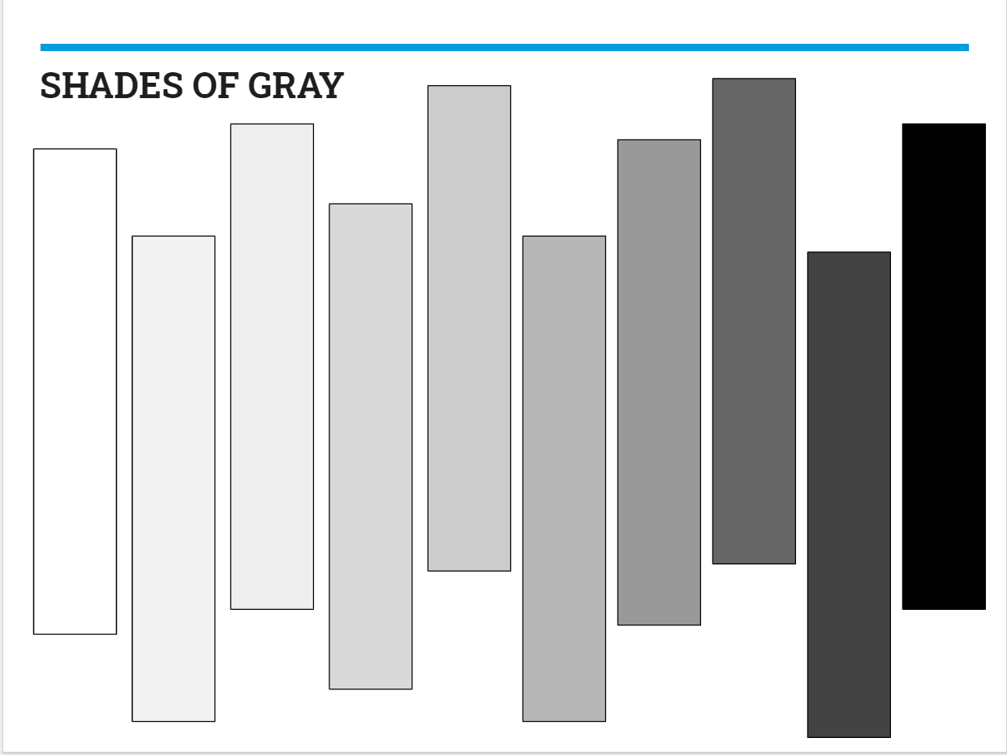
Complexity of Thought/Sophistication
Argument:
We should colonize Mars.
We should not colonize Mars.
Complex Argument:
Although we have the technology to
colonize Mars, the money would be
better spent investing on improving
environmental issues on Earth.
Notes:
Once you move away from the black and white and into the more complex gray areas of argumentation, you end up with a more sophisticated, nuanced argument. Instead of we should or should not colonize Mars, it might look something like: Although we have the technology to colonize Mars, the money would be better spent investing in improving environmental issues on Earth.
Of course, there are a number of potential arguments here, and this is just one of numerous possibilities, but you can clearly see the difference. Notice how the more complex argument acknowledges the opposition and includes some of the most important fields/lenses of the issue.

