Slide 1
AP Seminar
Monday, August 5, 2024

Slide 2
Definitions
Argument: A claim or thesis that conveys a perspective developed through a line of reasoning and supported by evidence.
Thesis: A claim or position on an issue or topic put forward and supported by evidence.
Issue: Important problem for debate or discussion.
Claim: A statement made about an issue that asserts a perspective.
Perspective: A point of view conveyed through an argument.
Evidence: Information used to as proof to support a claim or thesis.
Lens: A filter through which an issue or topic is considered or examined.

Slide 3
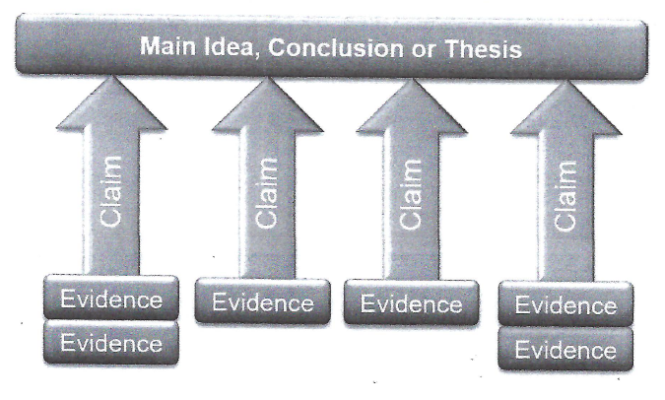
Arguments Argument: a claim or thesis that conveys a perspective developed through a line of reasoning and supported by evidence.
Caveat: sometimes AP (and some teachers) use the word “Argument” to mean the thesis, and other times, to mean the entire argument.

Slide 4
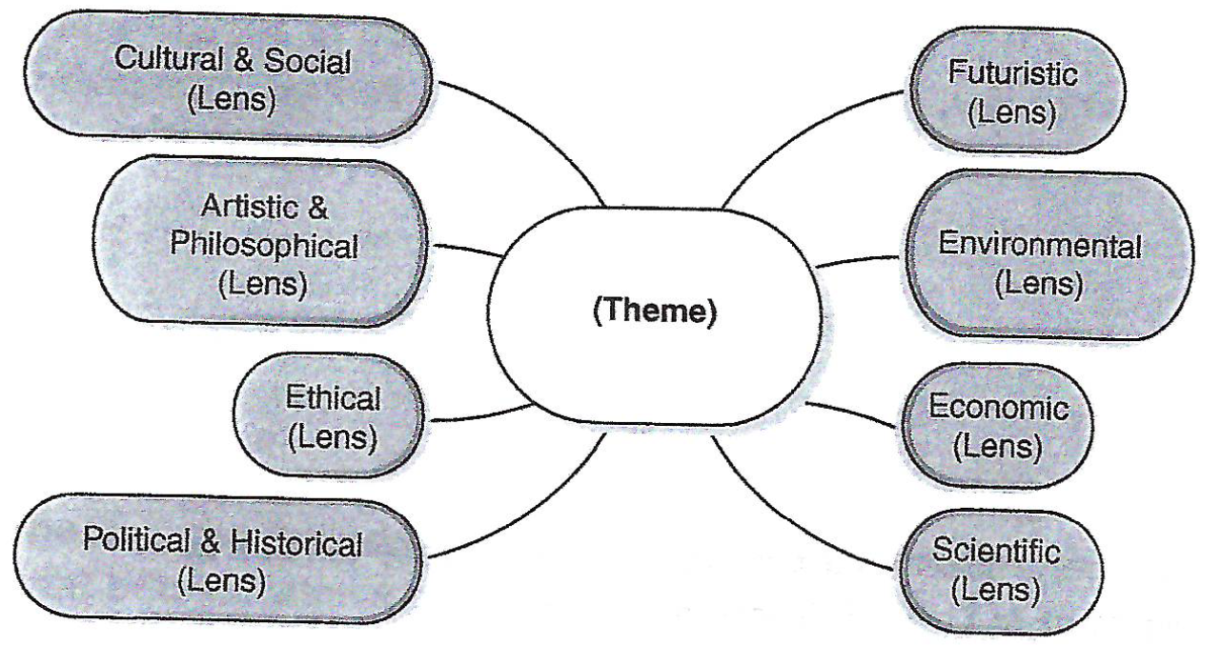
Lenses Lens: A filter through which an issue or topic is considered or examined.
“Lenses” are viewpoints from which we can explore a theme.

Slide 5
Lenses for Democracy
In your group, discuss how the theme of “Democracy” may be viewed through the following lenses. Write one of two questions which relate “Democracy” to the lens.
Cultural and Philosophical
Artistic & Social
Ethical
Political & Historical
Futuristic
Environmental
Economic
Scientific

Slide 6
Click on link and type your ideas
Link:
https://docs.google.com/document/d/13gdha2GHSRpm12cPlHUMd8wusa3cLOdCh_YB1djmDEE/edit?usp=sharing

Slide 7
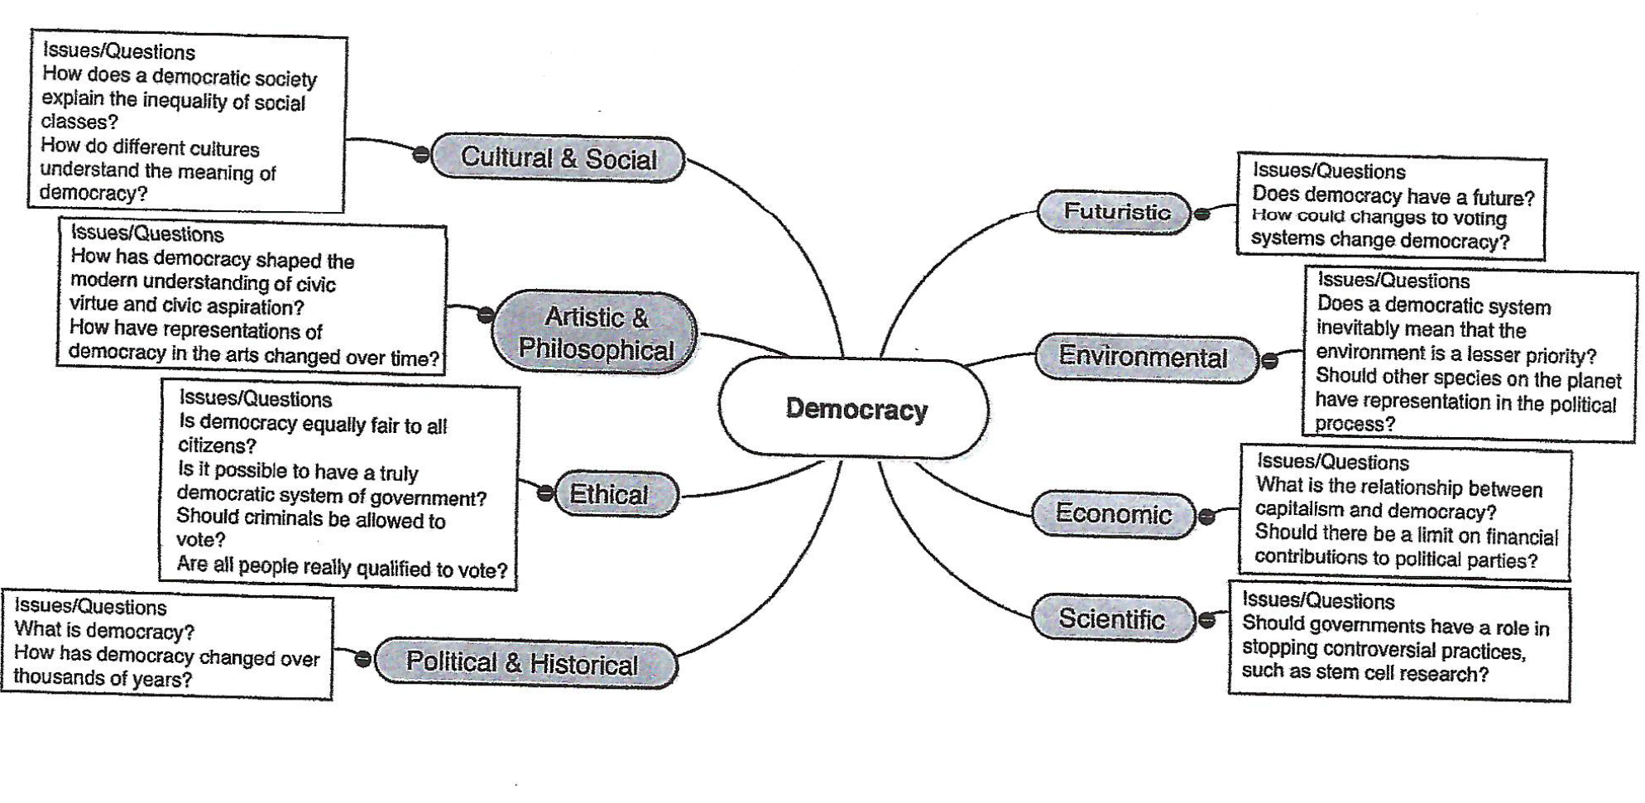
Lenses for Democracy

