Slide 1
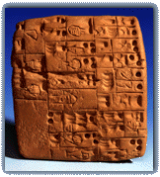
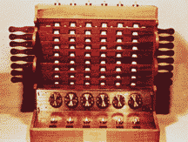
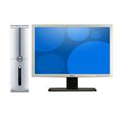
The History of Computing
Limestone to Silicon

Slide 2
Definitions
Compute: to calculate.
Calculate: to reckon; to reason.
Reckon: to count.
Reason: to think logically.
The word calculate is derived from calculus, meaning a stone used in counting, which is in turn derived from calx, meaning limestone.

Slide 3
Primitive Counting Terminology
Digit: one (one finger).
Hand: five (five fingers).
Man: ten (ten fingers).
Man: twenty (ten fingers, ten toes).
Mattress: forty.

Slide 4
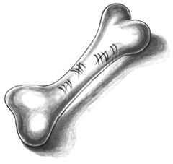
Prehistoric Computing
50,000 years old: archeological evidence of counting by man.
20,000 years old: bone with notches in groups of five.
10,000 years old: notched bone indicating the prime numbers 11, 13, 17, and 19.

Slide 5
Sticks and Stones
Ancients Mayans used sticks and stones to count. A stone was worth one and a stick was worth five.
A number consisted of a group of stick and stones; adding the values of the sticks and stones produced the number. Adding two numbers amounted to combining the two groups.
To represent large numbers, Mayans developed a positional base twenty system wherein a shell represented zero.

Slide 6
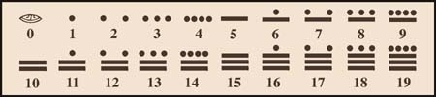

Mayan Numerals
The Mayans later developed writing, and their symbols for numerals reflected these origins.

Slide 7
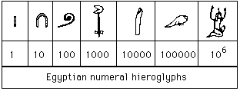


Egyptian Numerals
The Egyptians used hieroglyphic numerals in an additive, nonpositional system. These pictures were carved in stone.

Slide 8
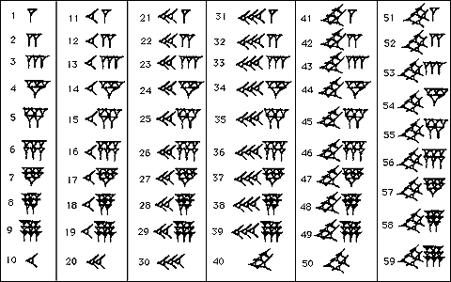

Babylonian Numerals
The Babylonians produced cuneiform writing, which consisted of wedges pressed into clay tablets. They developed a base sixty positional numeral system.

Slide 9
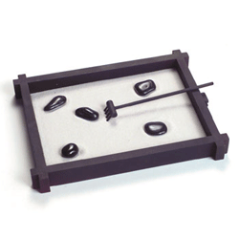
Sand Trays (2400 B.C.)
The ancient Babylonians used sand trays to do mathematical scratch work.
Combining the sand tray with stones led to a computational tool, using stones to represent one, ten, sixty, etc., depending on their position.

Slide 10
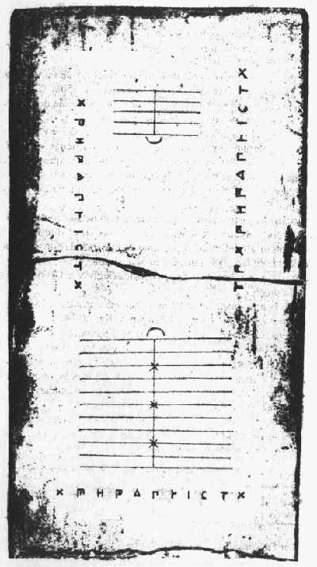
Counting Boards (300 B.C.)
Boards with fixed positions were designed to hold the stones used in computation.
The Salamis tablet is a counting board used by the Babylonians circa 300 B.C. It is a slab of white marble measuring 149cm in length, 75cm in width and 4.5cm thick.

Slide 11
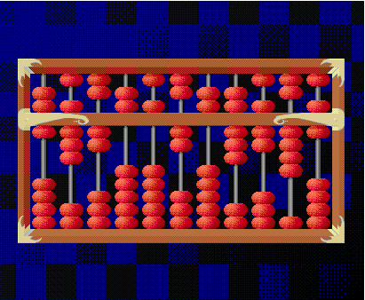
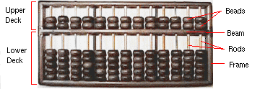
The Abacus (100 A.D.)
Eventually, the stones were place on rods to fix their position. This led to the abacus, from the Greek word abax, meaning sand tray.

Slide 12
Origins of Algebra (800 A.D.)
Ancient Greeks, masters of geometry, had no algebra and a difficult numeral system.
Ancient Hindus invented our current numeral system, using positional base ten and zero.
Hindus and Arabs explored algebraic notation.
“Algebra” comes from the Arabic الجبر (al-jabr) “reunion”, “resetting of broken parts”, used in the title of al-Khwarizmi’s influential work علم الجبر والمقابلة (ilm al-jabr wa’l-muqābala), “the science of restoration and equating like with like”.

Slide 13
Middle Ages (300-1200 A.D.)
Technology, knowledge, and nearly all intellectual endeavors came to a virtual standstill in Europe during the period of dominance by the Holy Roman Empire.
Communication with the east sparked the European Renaissance, and with it, ideas for computational technology.

Slide 14
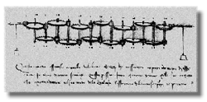

Da Vinci’s Mechanical Calculator (1500 A.D.)
Leonardo Da Vinci, Italian painter, musician, sculptor, architect, and engineer, created drawings of a mechanical calculator, working models of which have since been constructed.

Slide 15
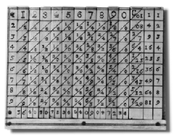
Napier’s Bones (1600 A.D.)
John Napier, Scottish mathematician, inventor of logarithms, invented a tool called Napier's Bones, which were multiplication tables inscribed on strips of wood or bone.

Slide 16
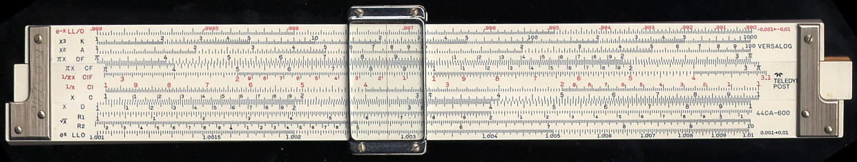
Oughtred’s Slide Rule (1620 A.D.)
William Oughtred, English mathematician and clergyman, early explorer of Calculus, invented the slide rule using Napier's logarithms.
Exceptionally effective tool that remained in common use for over three hundred years.

Slide 17
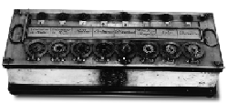
Pascal’s Arithmetic Machine (1640 A.D.)
Blaise Pascal, French mathematician, physicist, and theologian, is credited with the invention of the first operational calculating machine. He developed an operating model of the Arithmetic Machine to help his father add sums of money.

Slide 18
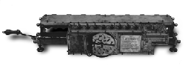
Leibnitz’ Step Reckoner (1670 A.D.)
Gottfried von Leibnitz: French mathematician, philosopher, and lawyer, cocreator of Calculus, developed the Step Reckoner, a device which, as well as performing additions and subtractions, could multiply, divide, and evaluate square roots by series of stepped additions.

Slide 19
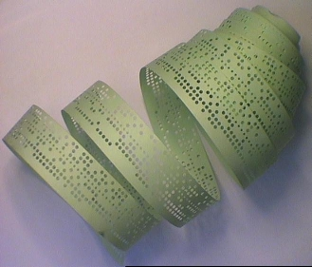
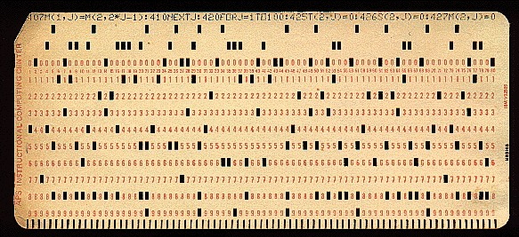
Jacquard’s Punched Cards (1800 A.D.)
Joseph-Marie Jacquard, French silk weaver, invented a way of automatically controlling the warp and weft threads on a silk loom by recording patterns of holes in a string of cards.
Punch Card
Paper Tape

Slide 20
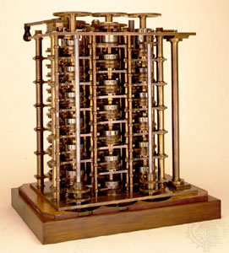
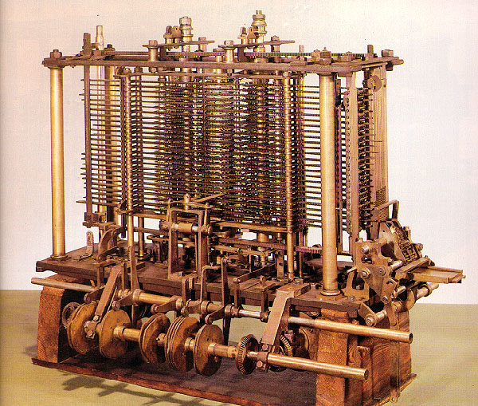
Babbage’s Engines (1830 A.D.)
Charles Babbage, English mathematician and inventor, designed the Difference Engine to automatically compute mathematical tables.
Later, he designed the Analytical Engine, intended to use punched cards, sequencing, branching, and looping to control an automatic calculator.

Slide 21
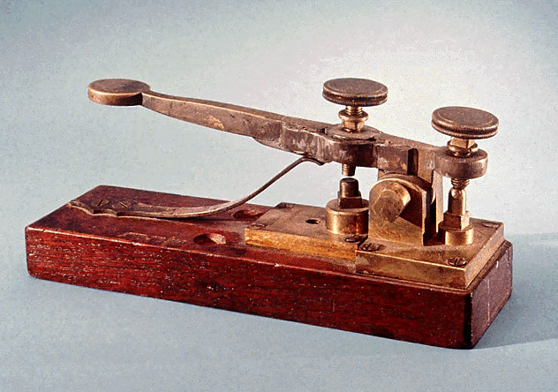
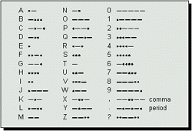
Wheatstone and Morse’s Telegraphs (1840 A.D.)
Sir Charles Wheatstone invented the first British telegraph.
Samuel Morse invented the first American telegraph, using dots and dashes. This became the standard known as Morse code.

Slide 22

Wheatstone’s Tape (1860 A.D.)
Wheatstone introduced paper tapes as a medium for the preparation, storage, and transmission of data in the form of Morse Code.
The paper tape used two rows of holes to represent Morse's dots and dashes. Outgoing messages could be prepared off-line on paper tape and transmitted later.

Slide 23
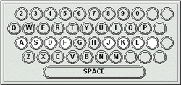
Sholes’ Keyboard (1874 A.D.)
Christopher Latham Sholes invented the QWERTY keyboard.
Designed so that digraphs used alternating hands, to increase speed.

Slide 24
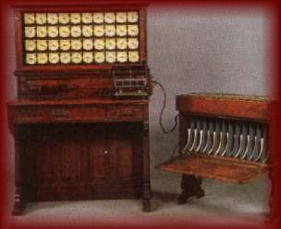
Hollerith’s Tabulating Machine (1890 A.D.)
American inventor Herman Hollerith used punched cards to represent the data gathered for the 1890 American census, and to read and collate this data using an automatic machine. His company became IBM in 1924.

Slide 25
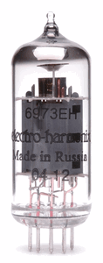
De Forest’s Vacuum Tubes (1906 A.D.)
In 1879, Thomas Edison demonstrates the incandescent light bulb.
In 1883, John Ambrose Fleming uses this to convert electromagnetic radiation into electricity, the precursor of the radio. He produced 2-element vacuum tubes (diodes).
In 1906, Lee de Forest produced 3-element vacuum tubes (triodes), which could be used as both an amplifier and a switch.

Slide 26
Turing’s Machine (1937 A.D.)
Alan Turing, English logician and mathematician, invented the abstract Turing Machine, a theoretical construct which helped prove the non-computability of certain arithmetic results.
The abstraction involves the movement of a sequence of cells called a “tape”.

Slide 27
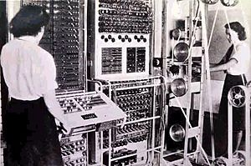
Flower’s COLOSSUS (1941 A.D.)
Sir Tommy Flowers, British engineer, together with Turing, designed and constructed COLOSSUS from 1941 to 1943 during WW II to break German encryption. COLOSSUS has been credited as the 1st programmable computer.

Slide 28
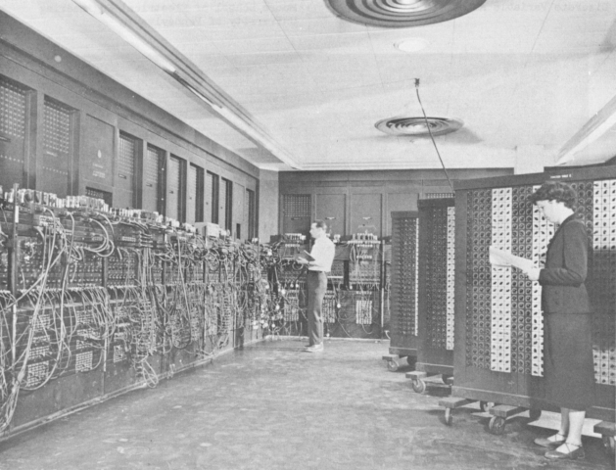
Princeton’s ENIAC (1943 A.D.)
Princeton University constructed ENIAC, the 1st truly general purpose programmable computer, between 1943 and 1946.
Miles of wiring
70,000 resistors, 10,000 capacitors
18,000 vacuum tubes
No monitor
3,000 blinking lights
Cost $486,000
100,000 additions per second
Weighed 30 tons
Filled a 30x50 foot room
Could be replaced today by one fingernail-size silicon chip

Slide 29
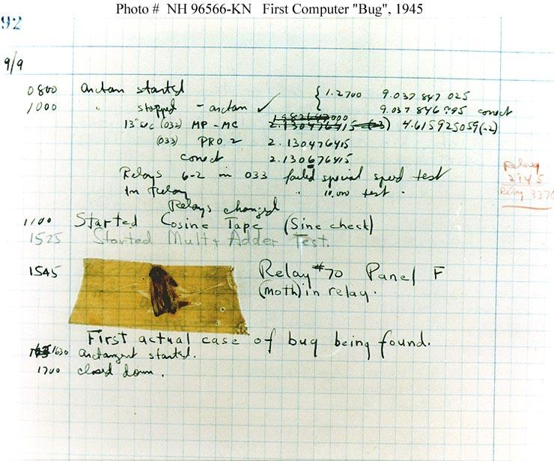
The First “Bug” (1945 A.D.)
On September 9th, 1945, a moth flew into the wiring of the Harvard Mark II Relay Calculator, which was in service at the Naval Weapons Center in Dahlgren, Virginia, causing it to malfunction.
The operator “debugged” the machine by removing the insect.

Slide 30
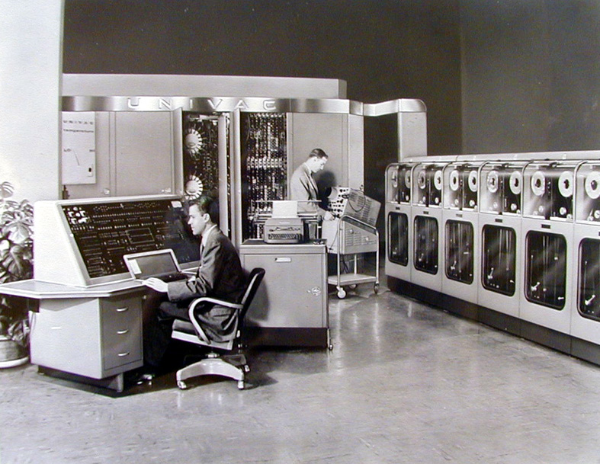
Eckert-Mauchly’s UNIVAC (1951 A.D.)
John William Mauchly and J. Presper Eckert Jr. produce the UNIVAC (Universal Automatic Computer), the 1st commercially available computer.
Handled letters as well as numbers.
Separated input/output from computation.
The Eckert-Mauchly Computer Company was eventually purchased by Sperry-Rand.

Slide 31
Transistors
Transistors, which replaced vacuum tubes, were developed between 1947 and 1959.
The advent of transistors revolutionized electronics and computing; this is a story unto itself, to be explored in the next installment.

Slide 32
References
http://www.maxmon.com/history.htm
http://www.pbs.org/transistor/index.html

