Slide 1
Circuits
Logic in Hardware

Slide 2
What is a Circuit?
A circuit is a collection of connected electrical components, such as wires, voltage sources, resistors, transistors, and so forth.
Electricity flows through the circuit like water through an irrigation system.
Voltage: Force behind the flow.
Current: Rate of flow.
Electrical components control the voltage and current on each wire.

Slide 3
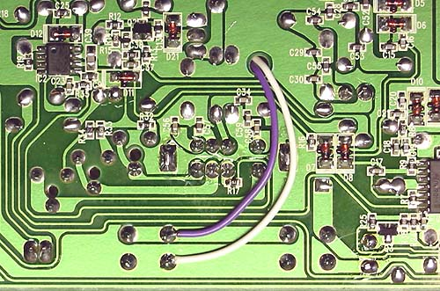
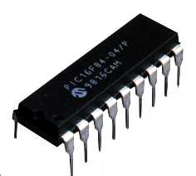
Physical Circuits
The circuit may be placed on a piece of plastic, called a circuit board.
The circuit may be compressed into a single microchip.
In either case, the ideas behind the design are similar.

Slide 4
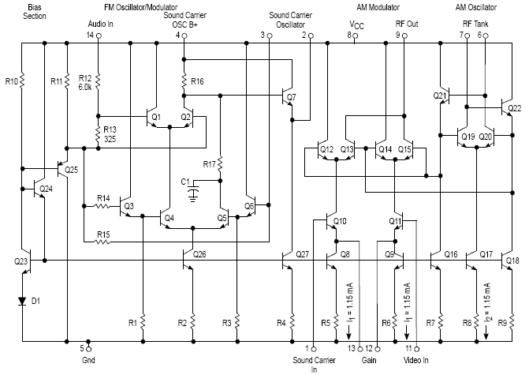

Circuit Diagrams
Circuit diagrams describe the circuit.
Each component has a standardized symbol to be used in the diagrams.

Slide 5

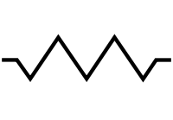

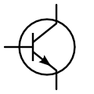
Circuit Components
Voltage source: acts like a pump.
Resistor: reduces voltage.
Ground: eliminates voltage.
Transistor: acts like a gate.

Slide 6
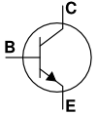
Transistors
Transistors have three connections: base, collector, and emitter.
A small current applied to the base allows the large current to flow through the transistor from the collector to the emitter.

Slide 7
Logical Gates
In digital circuits, the presence or absence of voltage translates to binary digits (bits).
0V = binary 0 = logical FALSE
+5V = binary 1 = logical TRUE
A gate is a circuit which detects input voltage to control output voltage. Gates are used as subcircuits of digital circuits to perform standard logical operations.
Each logical operator has a corresponding gate represented by its own symbol.

Slide 8

NOT Gate
NOT Symbol
NOT Table
A | Q
0 | 1
1 | 0

Slide 9

AND Gate
AND Symbol
AND Table
A | B | Q
0 | 0 | 0
0 | 1 | 0
1 | 0 | 0
1 | 1 | 1

Slide 10
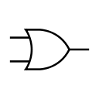
OR Gate
OR Symbol
OR Table
A | B | Q
0 | 0 | 0
0 | 1 | 1
1 | 0 | 1
1 | 1 | 1

Slide 11

NAND Gate
NAND Symbol
NAND Table
A | B | Q
0 | 0 | 1
0 | 1 | 0
1 | 0 | 0
1 | 1 | 0

Slide 12

NOR Gate
NOR Symbol
NOR Table
A | B | Q
0 | 0 | 0
0 | 1 | 1
1 | 0 | 1
1 | 1 | 1

Slide 13

XOR Gate
XOR Symbol
XOR Table
A | B | Q
0 | 0 | 0
0 | 1 | 1
1 | 0 | 1
1 | 1 | 0

Slide 14

XNOR Gate
XNOR Symbol
XNOR Table
A | B | Q
0 | 0 | 1
0 | 1 | 0
1 | 0 | 0
1 | 1 | 1
electrical XNOR corresponds to logical IFF

Slide 15
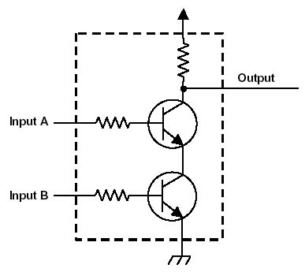
NAND Circuit
A NAND circuit sinks voltage on one output exactly when there is voltage on either of two inputs.
The resistors on the inputs limit the base-emitter current to just enough to turn the transistors on. If both transistors are on (both inputs +5V, or 1) the output will be connected to ground (be at 0V, or 0). If either transistor is off, the output is connected through the resistor to +5V.

Slide 16
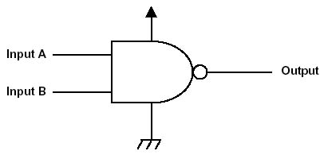
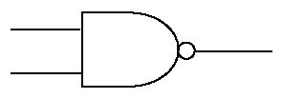
NAND Symbol
The NAND schematic symbol represents the NAND circuit diagram.
Since all digital circuits circuits have the same +5V and 0V power supply connections, we can eliminate them from the symbol.

Slide 17


Gate Construction: NOT
NOT A = A NAND A

Slide 18
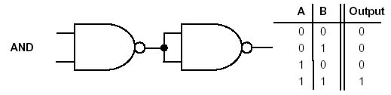
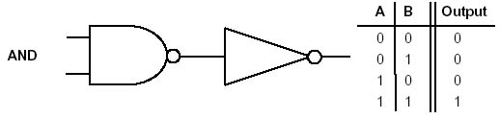
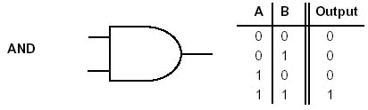
Gate Construction: AND
A AND B = NOT(A NAND B)

Slide 19
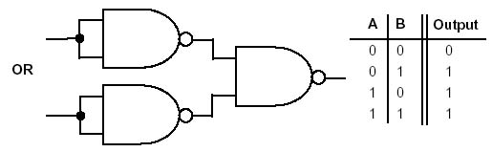
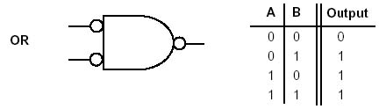
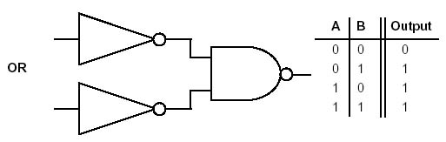
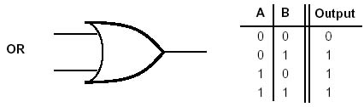
Gate Construction: OR
A OR B = (NOT A) NAND (NOT B)

Slide 20
Operator Construction: XOR
C = A NAND B = NOT(A AND B) = NOT(A) OR NOT(B)
Note: A AND C = A AND NOT(B)
Note: B AND C = B AND NOT(A)
D = A NAND C = NOT(A AND NOT(B))
E = B NAND C = NOT(B AND NOT(A))
D NAND E = NOT(D AND E)
D NAND E = NOT(D) OR NOT(E)
D NAND E = (A AND NOT(B)) OR (B AND NOT(A))
D NAND E = A XOR B

Slide 21
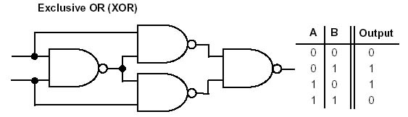
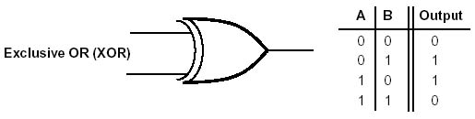
Gate Construction: XOR
C = A NAND B
D = A NAND C
E = B NAND C
A XOR B = D NAND E
A
D
C
B
E

Slide 22
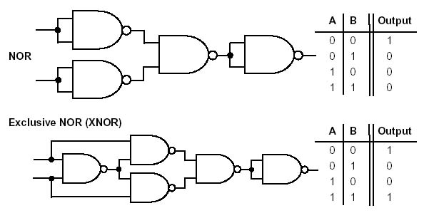
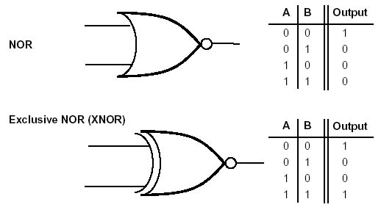
Gate Construction: NOR, XNOR
A NOR B = NOT(A OR B)
A XNOR B = NOT(A XOR B)

Slide 23
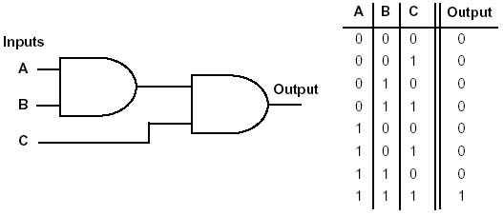
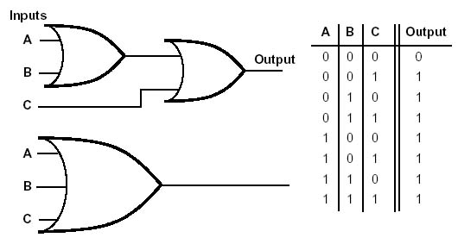
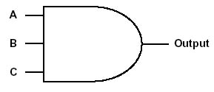
Three Input Gates
Commutative and associative operators admit clearly defined three input gate symbols.

Slide 24
Adder Concept
Recall binary addition; we add two bits at a time, plus a possible carry bit.
1
1
0
0
0111
+ 0110
------
1
1
0
1
An adder is a circuit which takes three input bits (two summands and carry in) and produces two output bits (the sum and the carry out).

Slide 25
Adder Table
A,B: summands
I: carry in
Q: sum mod 2
O: carry out
A | B | I | O | Q
0 | 0 | 0 | 0 | 0
0 | 0 | 1 | 0 | 1
0 | 1 | 0 | 0 | 1
0 | 1 | 1 | 1 | 0
1 | 0 | 0 | 0 | 1
1 | 0 | 1 | 1 | 0
1 | 1 | 0 | 1 | 0
1 | 1 | 1 | 1 | 1
We wish to analyze the sequence of logical operations required to compute O and Q, so that we can construct a circuit to output them.

Slide 26
Sum Bit
Addition modulo two for a pair of bits is given by
0+0=0 1+0=1 0+1=1 1+1=0
This is XOR; but summing requires 3 bits.
Sum bit Q is on if just one of the three inputs A, B, I is on, or if all three are on.
Q = (just A) OR (just B) OR (just I) OR (all 3 on)

Slide 27
Carry Bit
Carry bit O is on if at least two of the three inputs A, B, I are on,
O = (A AND B) OR (A AND I) OR (B AND I)

Slide 28
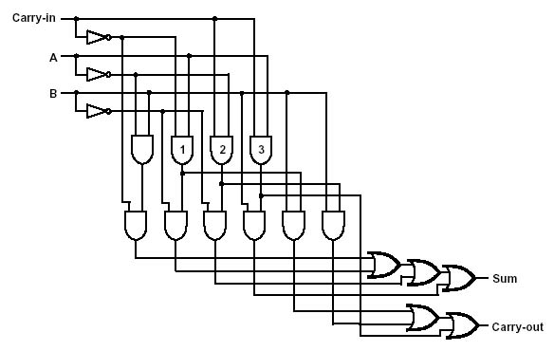
Adder Circuit
The complete adder circuit is as follows.
A = Input 1
B = Input 2
I = Carry In
Q = Sum
O = Carry Out
A & B
B & I
A & I
just B
just A
just I
all on

Slide 29
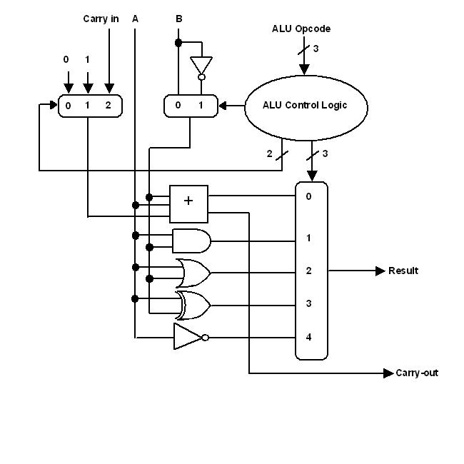
Arithmetic Logic Unit (ALU) Circuit
Input: A,B and I
Output: A+B,O
Output: A AND B
Output: A OR B
Output: A XOR B
Output: NOT A
Adder and ALU Circuits courtesy of Donn Stewart

Slide 30
References
http://cpuville.4t.com/index.htm
http://en.wikipedia.org

