Slide 1
War Is Peace
Emmanuel Goldstein

Slide 2
Participants!
Abuwandi, Ayah
Ahmad, Esra
Ahmed, Suweyda
Alymansour, Malak
Botiller, Armando
Hlayhel, Salma
Khattab, Leena
Magarinos, Marco
Mohamed, Aisha
Munni, Sumaiya
Salas, Joaquin
Shams, Raihan
Shqeirat, Juman

Slide 3
Paragraph 1
What are the three great super-states, and what are their boundaries?
How does this compare with the world today?

Slide 4
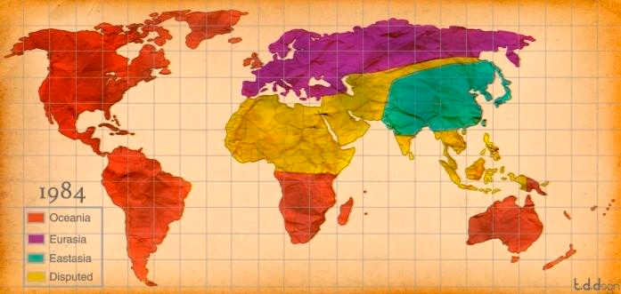
Global map in 1984

Slide 5
Paragraph 2
Who fights in wars?
What does war mean for most people?

Slide 6
Paragraph 3
To what does “… the regrouping that occurs every few years …” refer?
Why can none of the super-states be conquered?
Why is there no longer anything to fight about?
What are the corners of the quadrilateral which contains the war?
Notes:
The corners are Tangier, Brazzaville, Darwin, and Hong Kong.
Tangier it the tip of Africa opposite the Straight of Gibraltar. Brazzaville is in the Congo. Darwin is the northernmost point of Australia. Hong Kong is on the south coast of China.

Slide 7
Paragraph 4
What valuables do the disputed territories contain?
What are some of the regions that are disputed?
Do these valuables add anything to the wealth of the world?

Slide 8
Paragraph 7
Why is it insufficient to restrict the output of goods?

Slide 9
Paragraph 8
According to Goldstein, what is the essential act of war?
Does this hold true in today’s world?

Slide 10
Paragraph 10
What does Goldstein say is the Party’s attitude toward science?
Why does the party have this attitude?
Does this have a parallel to the modern world?

Slide 11
Paragraph 11
How accurate is Orwell’s description of the evolution of weapons?

Slide 12
Paragraph 12
Why would it be inadvisable for Oceania to conquer the territory which had been France and Germany?

Slide 13
Paragraph 14 and 15
According to Goldstein, how has the nature of war evolved?

Slide 14
Paragraph 16
What is the ultimate purpose of the war?
What is the meaning of the slogan “War is Peace”?

