Slide 1
Bell Work
In your notebook, write a paragraph about whether you think babies are born good or not and why.

Slide 2


Slide 3
Agenda
Psychology’s Roots
  Early psychologists
  Different approaches
Contemporary Psychology
3 Main Levels of Analysis
  Biopsychosocial Approach
Psychology’s Subfields

Slide 4
Terms & Concepts (p. 13)
Structuralism
Functionalism
Behaviorism
Humanistic Psychology
Cognitive Neuroscience
Psychology
Nature-Nurture Issue
Natural Selection
Levels of Analysis
Biopsychosocial Approach
Basic Research
Applied Research
Counseling Psychology
Clinical Psychology
Psychiatry
SQ3R

Slide 5
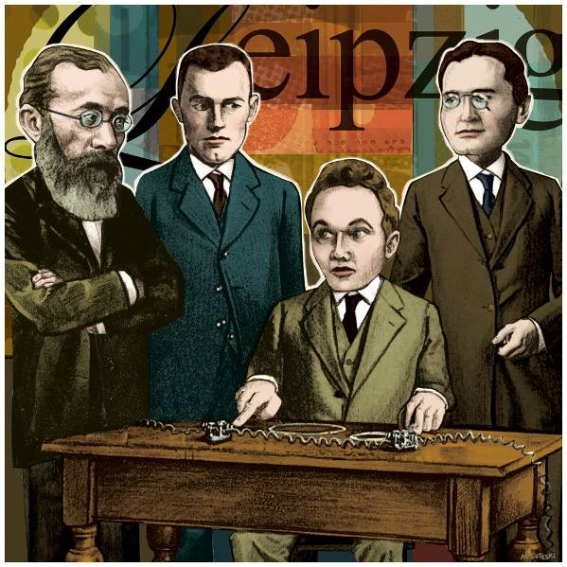
Roots of Psychology
Wundt (1832-1920)
Wilhelm Wundt (1879)
  Studied the “atoms of the mind” by conducting experiments at Leipzig, Germany
    Lag time in hearing a ball hit a platform and being aware of hearing it
  Established the first laboratory for psychological research
  Differentiated psychology from other fields (philosophy & physiology)
  Focused on consciousness/awareness and subjective experiences

Slide 6
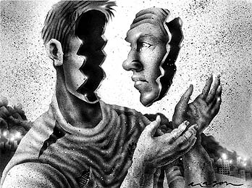
Roots of Psychology – The Two Early Schools
Structuralism: school of psychology that used introspection to explore the structural elements of the human mind.
  Introduced by Edward B. Titchener (Wundt’s student)
    Studied self-reports of an event including sensations and feelings
    Cons:
      Varies from person to person
      Some better understand
      themselves and communicate
      Can’t be used to study animals
    Proved to be unreliable

Slide 7
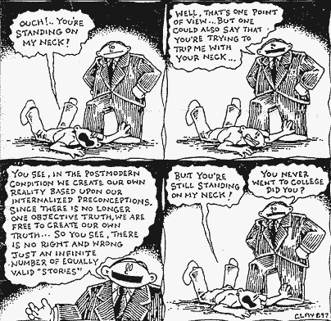

Slide 8

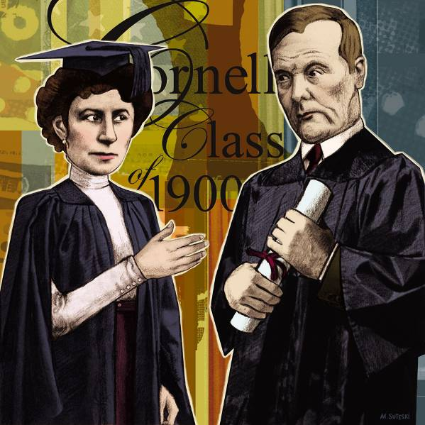
Roots of Psychology – The Two Early Schools
Functionalism: focused on how our mental & behavioral processes function enabling us to adapt, survive, & flourish.
  William James
    Studied emotions, memory, willpower, habits, & consciousness
    Wrote the textbook Principles of Psychology
  G. Stanley Hall
    1st American to earn a psych Ph.D. (under James)
    1st APA president
  Mary Whiton Calkins
    Admitted into James’ Harvard graduate seminar but denied her PhD
    Became APA’s 1st female president
  Margaret Floy Washburn
    1st woman to receive a Psych. PhD
    APA’s 2nd female president

Slide 9
What does this mean?
“If you smile at me, I will understand, for that is something everybody everywhere does in the same language.”
Crosby, Stills, and Nash – Wooden Ships
11/8-11/12
6 Chem Week 14

Slide 10
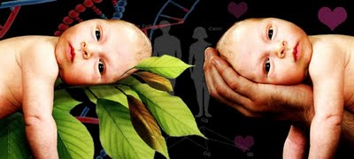
Nature vs. Nurture
Nature vs. Nurture is one of the biggest historical controversies and continues to be in Psychology today
Philosophical Roots
  Nature
    Plato (428-348 _{B.C.}) – character/intelligence are inherited
    Rene Descartes (1596-1650) – some ideas are inborn
    Versus
  Nurture
    Aristotle (384-322 _{B.C.}) - Minds are built through experience
    John Locke (1632-1704) - Tabula Rasa (blank slate)

Slide 11
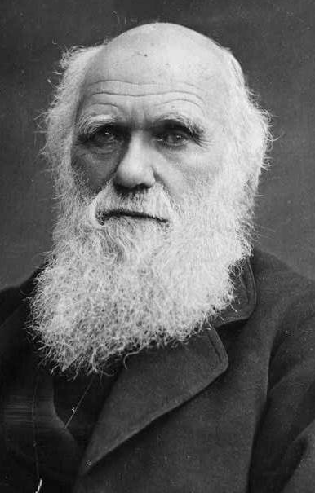
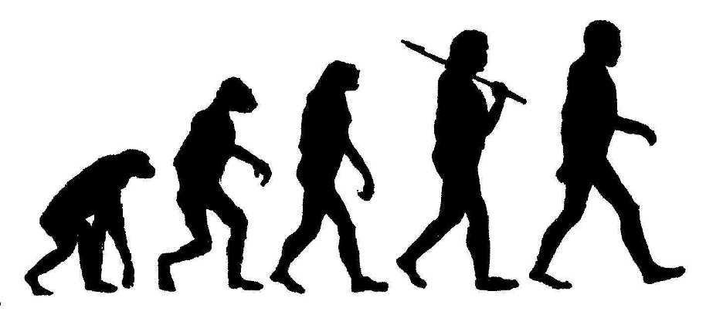
Nature vs. Nurture
Naturalist Charles Darwin (1809-1882)
  Believed that nature selects which traits help organisms to survive and reproduce
    Traits can be physical or behavioral
  What are some examples of traits of humans or other animals that have selected or rejected by nature?

Slide 12
Nature vs. Nurture
Questions to ponder:
  How are humans alike and diverse across different environments?
  How are differences in intelligence and personality influenced by heredity and by our environments?
  Are babies born good?

Slide 13
Bell Work
In your notes, hypothesize about the possible causes of teenage drinking.

Slide 14
HW Assignment
FRQ: Are differences in gender biologically predisposed or socially constructed?
  Provide at least five examples of gender differences and whether you think they are biologically predisposed or socially constructed or both and why.
    You can have different views for each difference

