Slide 1


Slide 2
Psychology Perspectives

Slide 3
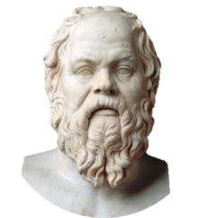
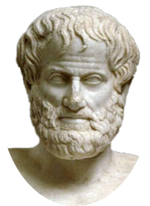
Prehistoric Psychology
Used observation; knowledge grows from experience
Socrates & Plato
387 B.C.E.
335 B.C.E.
Used logic;
Mind and body are separate; knowledge is innate
Aristotle
Notes:
Plato= mind continues after body dies

Slide 4
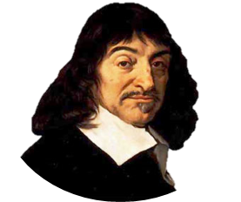
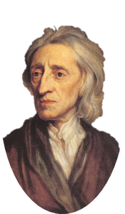
Prehistoric Psychology
Rene Descartes
Insisted mind is blank slate, or tablua rasa
1637
1690
Performed animal autopsies and found “animal spirits”
John Locke
Notes:
Animals are incapable of pain, have no souls or consciousness

Slide 5
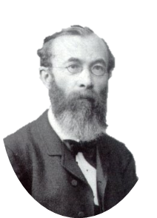
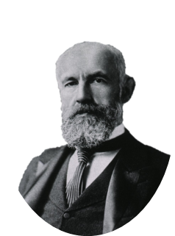
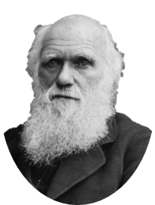
Origins of Psychology
Published Origin of Species and coined term ‘survival of the fittest’
William Wundt
Wundt’s American student establishes first U.S. psych lab at John Hopkins University
1859
1879
1883
Opened first psychological lab in Leipzig, Germany; considered father of psychology
Charles Darwin
G. Stanley Hall
Notes:
Differentiated psychology from other fields, like philosophy or physiology; Focused on awareness and subjective experiences

Slide 6
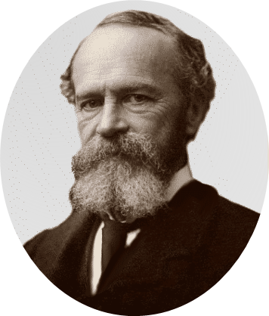
Early Perspectives: Functionalism
Explores how mental and behavioral processes function – how they enable an organism to adapt, survive and flourish
Studied emotion, memory, willpower, habits and consciousness
William James
1890
Notes:
Harvard
Best to consider parts for their functions; the nose smells, the eyes see; likewise consciousness and the mind serve a function; enables use to consider the past, adjust to the present, plan the future.

Slide 7
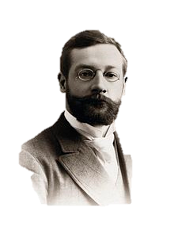
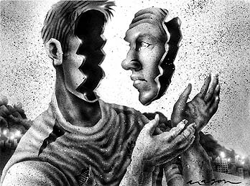
Early Perspectives: Structuralism
1892
Uses introspection to explore structural elements of the human mind
Study self-reports of an event including sensations and feelings
Edward Titchener
Notes:
Cornell
Pros and cons?

Slide 8
Psychology in America
G. Stanley Hall
Mary Whiton Calkins
Mary Whiton Calkins first female APA president
APA founded by G. Stanley Hall and is first president
First woman to receive a psych PhD (Cornell)
1878
1892
1891
1894
1905
1921
Receives PhD from Harvard based on psych research
First woman admitted to James’ seminar but denied PhD
Margaret Floy Washburn
Margaret Floy Washburn 2nd female APA president
American Psychological Association

Slide 9



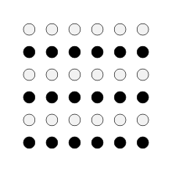
Gestalt Psychology
Gestalt Psychology defined Psychology as the study of the immediate experience of the whole organism.
  The whole is different from the sum of its parts
    Revolt against Structuralism which focused on the parts
  Gestaltists focused on perception and how it is organized
    Humans are wired to see patterns
    http://ted.us1.list-manage1.com/track/click?u=07487d1456302a286cf9c4ccc&id=fac55a3fd0&e=2228b3a6e8

Slide 10
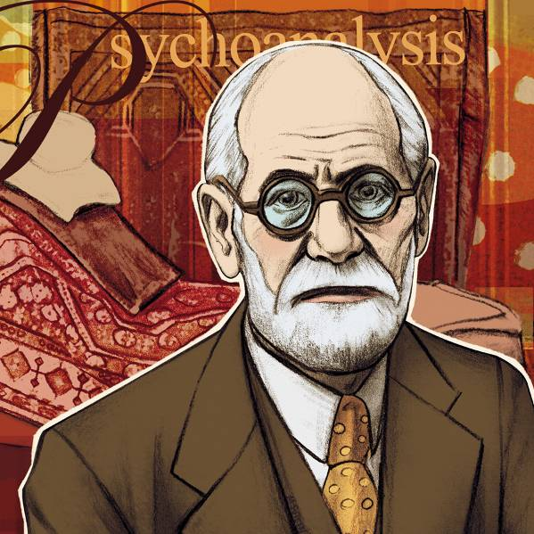
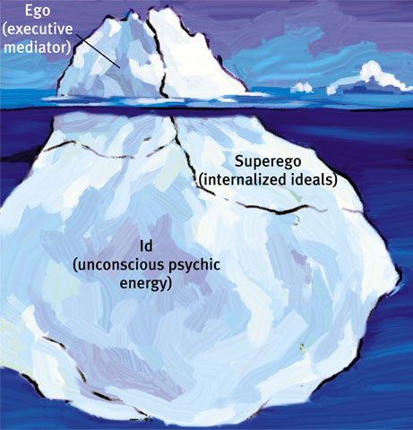
Psychoanalysis / Psychodynamics
Freud (1856-1939)
Psychoanalysis, led by Austrian physician Sigmund Freud, focused on the causes, development, and treatment of abnormal behavior.
  Believed unconscious mental forces direct behavior
  Psychological issues result from unconscious, unresolved conflicts
  Helping patients become aware of these unconscious forces should help patients to lead happier lives

Slide 11
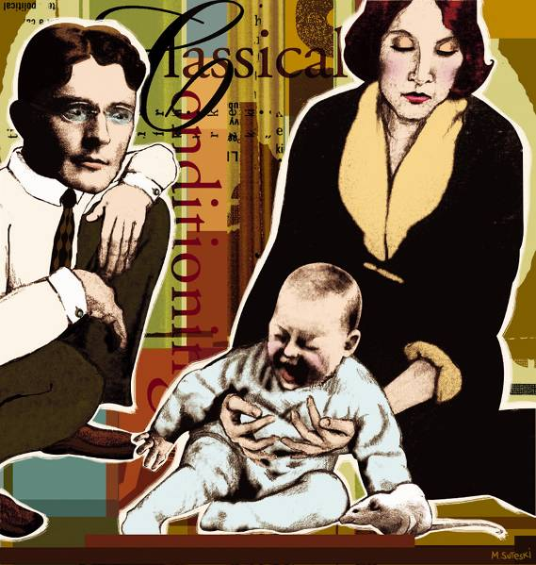
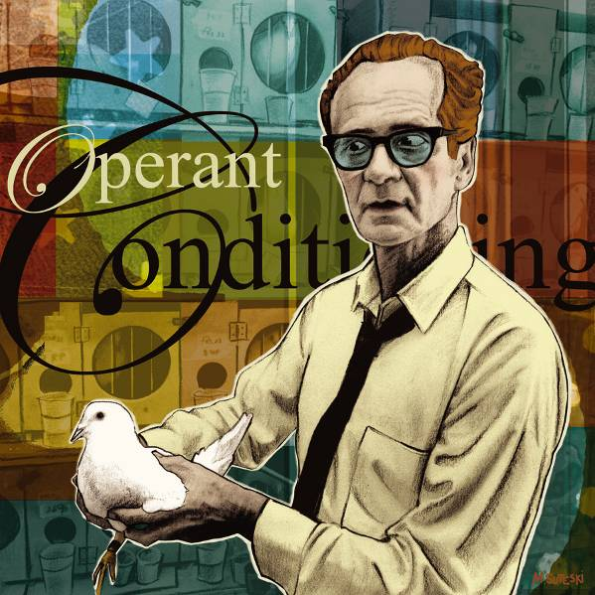
Psychology’s Transformation (1920’s – 1960’s)
Psychology went from the “scientific study of mental life” to the “scientific study of observable behavior”.
Behaviorism: view that psychology should be an objective science that studies behavior without reference to mental processes.
John B. Watson (1878-1958)
B.F. Skinner (1904-1990)

Slide 12
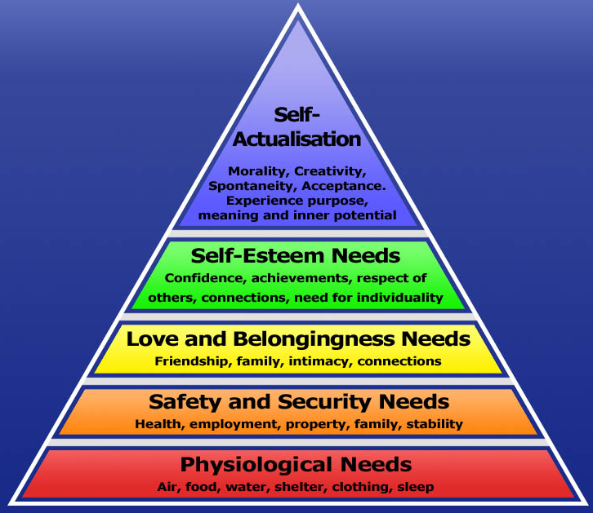
Humanistic Psychology
Humanistic Psychology: emphasized the growth potential of healthy people and the individual’s potential for personal growth.
  Focused on how current environmental factors influence people’s potential and importance of having their needs for love and acceptance satisfied
  Carl Rogers
  Abraham Maslow
    Hierarchy of Needs

Slide 13
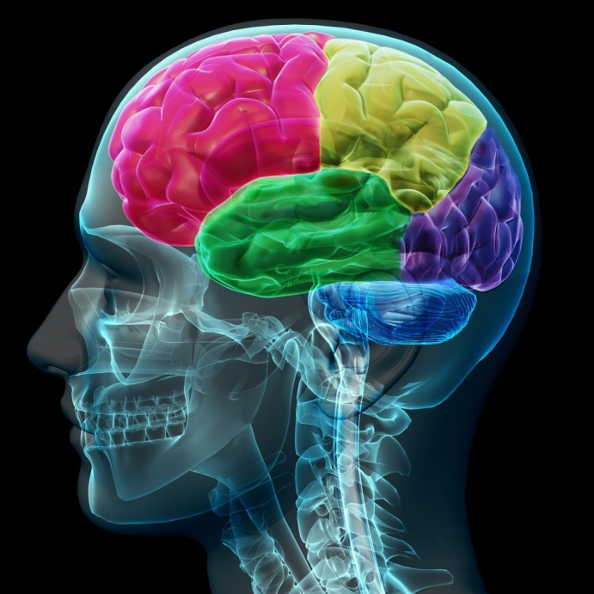
Cognitive Neuroscience
Cognitive Neuroscience: interdisciplinary study of the brain activity linked with cognition (including perception, thinking, memory, and language).
  Emerged in the 1960’s and goes back to Psychology’s initial interests in mental processes.

Slide 14
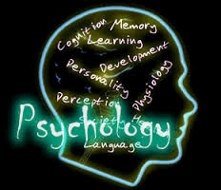
Contemporary Psychology
Psychology: science of behavior & mental processes.

Slide 15
Psychology’s Current Perspectives
Perspective | Focus | Sample Questions
Neuroscience | How the body and brain enables emotions? | How are messages transmitted in the body? How is blood chemistry linked with moods and motives?
Evolutionary | How the natural selection of traits the promotes the perpetuation of one’s genes? | How does evolution influence behavior tendencies?
Behavior genetics | How much our genes and our environments influence our individual differences? | To what extent are psychological traits such as intelligence, personality, sexual orientation, and vulnerability to depression attributable to our genes? To our environment?

Slide 16
Psychology’s Current Perspectives
Perspective | Focus | Sample Questions
Psychodynamic | How behavior springs from unconscious drives and conflicts? | How can someone’s personality traits and disorders be explained in terms of sexual and aggressive drives or as disguised effects of unfulfilled wishes and childhood traumas?
Behavioral | How we learn observable responses? | How do we learn to fear particular objects or situations? What is the most effective way to alter our behavior, say to lose weight or quit smoking?

Slide 17
Psychology’s Current Perspectives
Perspective | Focus | Sample Questions
Cognitive | How we encode, process, store and retrieve information? | How do we use information in remembering? Reasoning? Problem solving?
Social-cultural | How behavior and thinking vary across situations and cultures? | How are we — as Africans, Asians, Australians or North Americans – alike as members of human family? As products of different environmental contexts, how do we differ?

Slide 18
3 Main Levels of Analysis
Levels of analysis offer differing, complementary views for analyzing any given phenomenon.
  The Biospychosocial Approach is Psychology’s integrated approach that incorporates biological, psychological, and social-cultural levels of analysis.
    Provides a more complete picture of behavior and mental processes.

Slide 19
Bell Work
Have Vocab 1-8 out for me to check.
Write in CJ.
In your notes, write a list of careers you think are related to Psychology (or having a Psych degree would help).

Slide 20
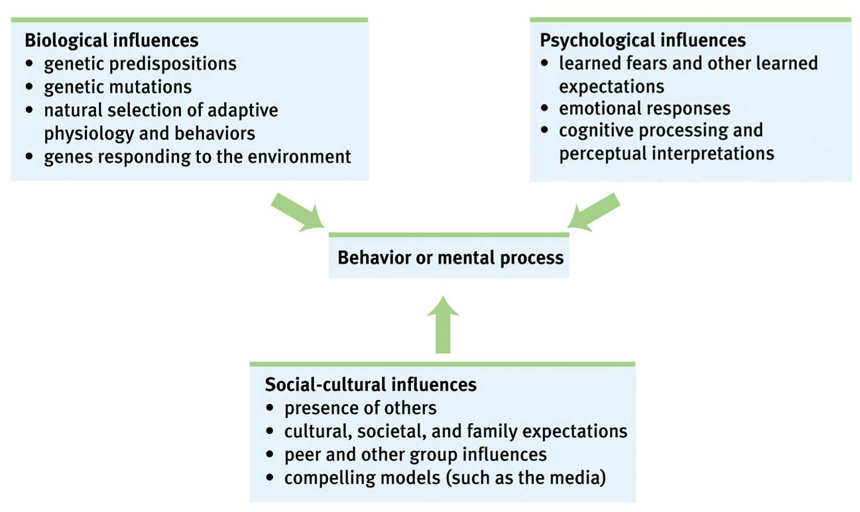
Psychology’s Three Main Levels of Analysis
Notes:
Preview Question 4: What are psychology’s levels of analysis and related perspectives?

Slide 21
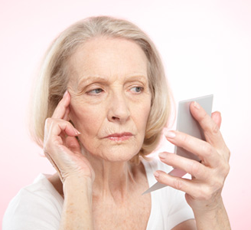
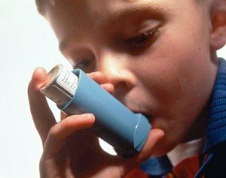

How would each of the levels of analysis look at the following:
Aging
Asthma
Hoarding
Eating Disorders

Slide 22
Psychology’s Subfields

Slide 23
Psychology’s Subfields
Basic Research: pure science that aims to increase the scientific knowledge base.

Slide 24
Psychology’s Subfields: Basic Research
Psychologist | What she does
Biological | Explore the links between brain and mind.
Developmental | Study changing abilities from womb to tomb.
Cognitive | Study how we perceive, think, and solve problems.
Personality | Investigate our persistent traits.
Social | Explore how we view and affect one another.
Notes:
Preview Question 5: What are psychology’s main subfields?

Slide 25
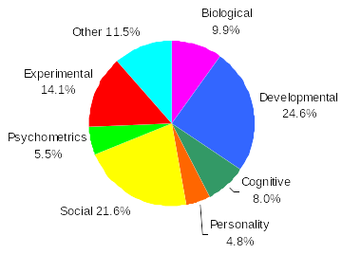
Psychology’s Subfields: Basic Research
Data: APA 1997

Slide 26
Psychology’s Subfields
Applied Research: scientific study that aims to solve practical problems.

Slide 27
Psychology’s Subfields: Applied Research
Psychologist | What she does
Clinical | Studies, assesses, and treats people with psychological disorders
Counseling | Helps people cope with academic, vocational, and marital challenges.
Educational | Studies and helps individuals in school and educational settings
Industrial/ Organizational | Studies and advises on behavior in the workplace.

Slide 28
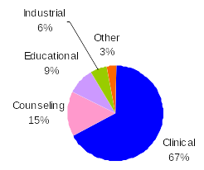
Psychology’s Subfields: Applied
Data: APA 1997

Slide 29
Clinical Psychology vs. Psychiatry
A clinical psychologist (PhD) studies, assesses, and treats troubled people with psychotherapy.
Psychiatrists on the other hand are medical professionals (MD) who use treatments like drugs and psychotherapy to treat psychologically diseased patients.

Slide 30
SQ3R
Study/reading method that stands for:
  Survey
    Scan headings and notice the organization of the information
  Question
    For each section, ask a question you should be able to answer after reading
  Read
    While actively looking to answer the questions you asked
  Rehearse
    Repeat the main ideas and information in your own words
  Review
    Go over the info at least one more time

Slide 31
Bell Work
Have Ch. 0 Vocab Part 2 out for me to check.
Write in CJ.
Grab a WB from the back of the room, and write your answer to the following:
Which philosopher agreed with Aristotle’s assertion that the mind is built through experience?
A. Plato
B. Sigmund Freud
C. John Locke
D. René Descartes
Notes:
C

Slide 32
Review

Slide 33
Which philosopher agreed with Aristotle’s assertion that the mind is built through experience?
A. Plato
B. Sigmund Freud
C. John Locke
D. René Descartes
Notes:
Answer: C

Slide 34
Who was denied the Ph.D. degree from Harvard?
A. Mary Whiton Calkins
B. William James
C. Margaret Floy Washburn
D. Edward Bradford Titchener
Notes:
Answer: A

Slide 35
Psychology is currently defined as:
A. the study of individual experience.
B. the scientific study of behavior and mental processes.
C. the study of mental life.
D. the scientific study of observable behavior.
Notes:
Answer: B

Slide 36
Which of the following is NOT one of psychology’s three main levels of analysis?
A. developmental
B. social-cultural
C. biological
D. psychological
Notes:
Answer: A

Slide 37
Dr. Garcia asks participants in her study to describe their experience as they smell an orange. Dr. Garcia’s method most closely resembles that of the early:
A. Structuralists
B. Behaviorists
C. Freudians
D. Functionalists
Notes:
Answer: A

Slide 38
John B. Watson is most likely to say:
A. “A person needs unconditional love and acceptance in order to reach her true potential.”
B. “A person’s behavior reflects unconscious conflicts and emotions that result from early childhood experiences.”
C. “Emotional responses reflect biological processes such as hormones and brain chemistry.
D. “Science must be rooted in observation of behavior, rather than introspective processes.”
Notes:
Answer: D

Slide 39
Dr. Frye conducts research investigations on memory, with the intent of contributing to what is known about human memory processes. Dr. Frye conducts:
A. professional service
B. applied research
C. basic research
D. psychiatry
Notes:
Answer: C

