Slide 1
Two applications
(this is NOT an intro to provenance)
Dan Suciu
University of Washington

Slide 2
Two Applications
Provenance summaries for query answering using probabilistic views
  With Chris Re
  Status: ongoing
Provenance for privacy in RFID applications
  With Vibhor Rastogi
  Status: preliminary

Slide 3
Query Answering Using Views
Application 1: Provenance summaries
V(x) = R(x,y),S(x,y,z),T(x,z)
Materialize:
x
a
c
b
f
V=
Query:
q = R(x,y),S(x,y,z),T(x,z),U(x,v),K(v,w)
Rewrite to:
q = V(x), U(x,v),K(v,w)
More efficient !

Slide 4
Using Probabilistic Views
Application 1: Provenance summaries
R^{p}:
S^{p}:
T^{p}:
V^{p}:
x | y | P
a | m | 0.3
a | n | 0.2
b | m | 0.4
b | p | 0.1
x | y | z | P
a | m | s | 0.1
a | n | s | 0.5
b | m | t | 0.4
b | p | t | 0.9
x | z | P
a | s | 0.3
b | s | 0.2
b | t | 0.4
x | P
a | 0.1
b | 0.5
Marginal
probabilities
V(x) = R^{p}(x,y),S^{p}(x,y,z),T^{p}(x,z)
Marginal Prob
in V^{p} insufficient
q = V(x), U(x,v),K(v,w)

Slide 5
Enter Provenance
Application 1: Provenance summaries
R^{p}:
S^{p}:
T^{p}:
V^{p}:
x | y | E
a | m | E1
a | n | E2
b | m | E3
b | p | E4
x | y | z | E
a | m | s | F1
a | n | s | F2
b | m | t | F3
b | p | t | F4
x | z | E
a | s | G1
b | s | G2
b | t | G3
x | E
a | E1∧F1∧G1∨E2∧F2∧G1
b | E3∧F3∧G3∨E4∧F4∧G3
Provenance
[Trio: “lineage”]
V(x) = R^{p}(x,y),S^{p}(x,y,z),T^{p}(x,z)
Can compute now
but inefficient
q = V(x), U(x,v),K(v,w)

Slide 6
“Provenance Summary”
Application 1: Provenance summaries
V^{p}:
x | E
a | E1∧F1∧G1∨E2∧F2∧G1
b | E3∧F3∧G3∨E4∧F4∧G3
x | E
a | H1
b | H2
➔
Now we know we can
use the marginals
A very concise
summary of
the provenance
Status: deciding if a view V has independent tuples
is Π^{p}₂ complete
Open: find a minimal provenance summary

Slide 7
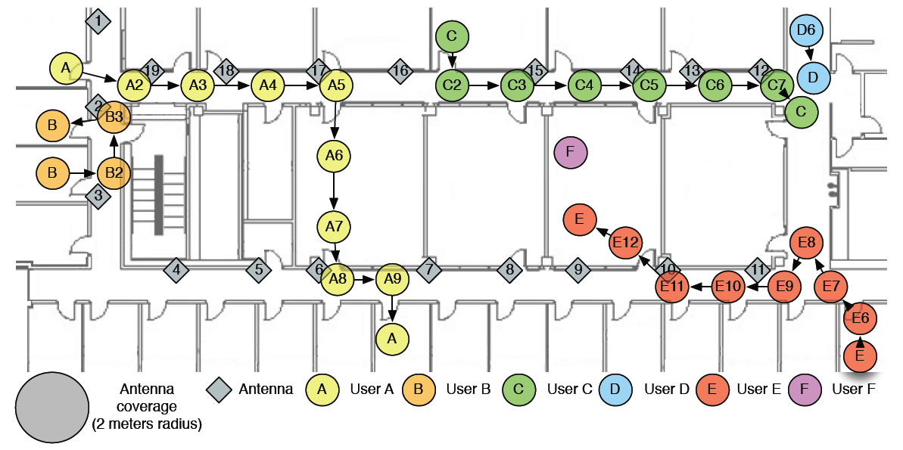
RFID Ecosystem at UW
Application 2: RFID Security
[Welbourne’2007]
Notes:
Welbourne, E., Balazinska, M., Borriello, G., Brunette, W. Challenges for Pervasive RFID-based Infrastructures. PERTEC 2007, Mar. 19, 2007

Slide 8
RFID Data
Application 2: RFID Security
Base table
SIGHTINGS(tagID, antennaID, time)
EnteredRoom(personTagID, room, time)
CarriesObject(personTagID, objectTagID, time)
Meeting(personTagID1, personTagID2, time)
…….…
Derived tables (views)

Slide 9
Privacy w.Authorization Views
Application 2: RFID Security
Alice’s query
q(x) = EnteredRoom(x,”Rm552”,t), Yesterday(t)
v1(x,l,t) = LocatedAt(x,l,t), LocatedAt(“Alice”,l,t)
v2(x,r) = EnteredRoom(x,r,t),EnteredRoom(“Alice”,r,t’),|t-t’|<10
v3(x,r,t) = Friend(x,”Alice”), EnteredRoom(x,r,t)
. . . . .
Authorization
view
System answers the query if it can
be rewritten in terms of views; else deny
[Rizvi’2004]

Slide 10
Privacy and Provenance
Application 2: RFID Security
Issue 1: the data itself is a materialized view. How can we make access control decisions based on how the data was derived ?
Issue 2: the authorization views are probabilistic. How can we grant access with probability, say, 75% ?

Slide 11
Questions ?

