Slide 1
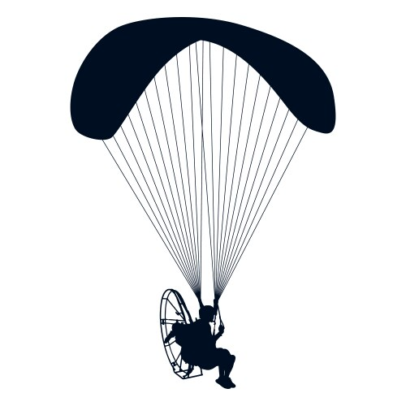

SkyScore 1.0

