Slide 1

Tutorial Project
By PIERRE Tom / MANOHARAN Anushan / PARISOT Theo / GIANNICO Raffaele

Slide 2
Summary
Introduction
Work done
To do
Conclusion

Slide 3
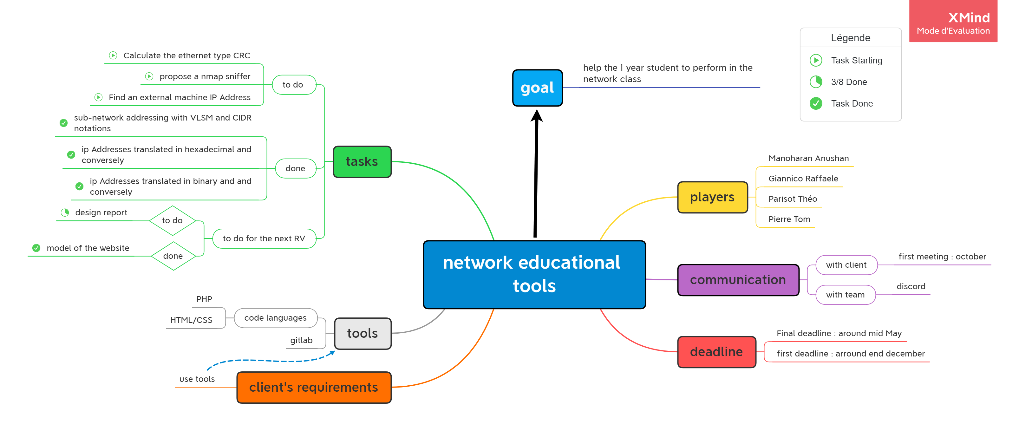
Introduction
Work done main page hex to dec bin to dec sub network
To do
Conclusion
Introduction​
Work done​
Main page
Bin to dec
Hex to dec
Sub network
To do ​
Conclusion ​
Introduction

Slide 4
Introduction​
Work done​
Main page
Bin to dec
Hex to dec
Sub network
To do ​
Conclusion ​
Introduction

Slide 5
Introduction​
Work done​
Main page
Bin to dec
Hex to dec
Sub network
To do ​
Conclusion ​
Introduction

Slide 6
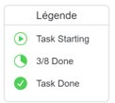
Introduction​
Work done​
Main page
Bin to dec
Hex to dec
Sub network
To do ​
Conclusion ​
Introduction

Slide 7
Introduction​
Work done​
Main page
Bin to dec
Hex to dec
Sub network
To do ​
Conclusion ​
Work Done

