Slide 1
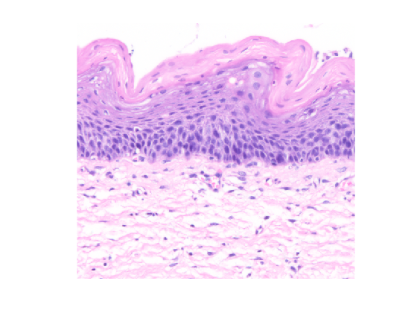
Superficial cells
X = 266; Y = 52
Basal cells
X = 337; Y = 266
Stroma
X = 416; Y = 319

