Slide 1
IPFS Dapp for image uploading
Lemonopoulos Petros

Slide 2
Useful tools
Ethereum
IPFS
Ganache
Truffle
Metamask
Visual Studio Code
Solidity
ReactJS

Slide 3

Image uploading

Slide 4

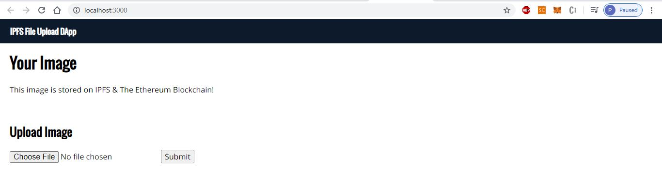
Home Screen

Slide 5
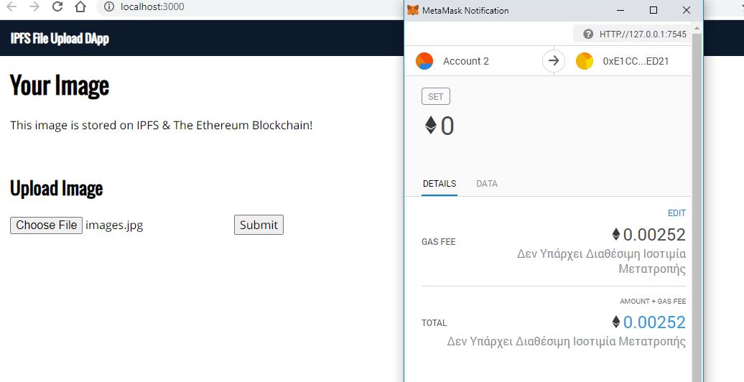

Slide 6
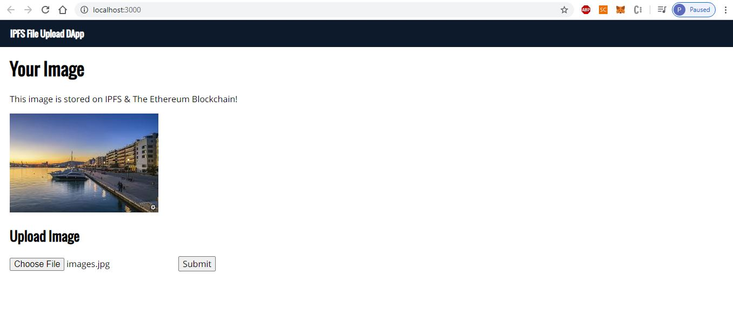
This image is stored on IPFS

Slide 7
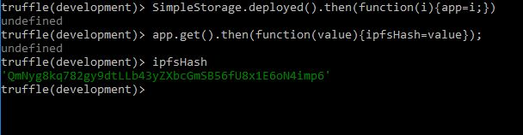
Truffle console
Consequently, we see that we have stored the ipfs hash in the smart contract

Slide 8
For the implementation of this project I used as references articles and tutorials about ipfs uploading dapps from:
Medium
Youtube
Github
Ethereum Stack Exchange

