Slide 1
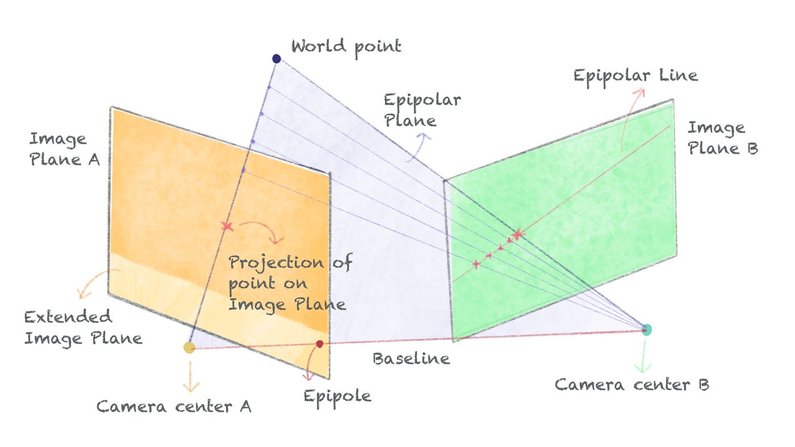
Lecture 09: Stereo and Multi-view Stereo
Picture from Niraj Krishna: https://towardsdatascience.com/a-comprehensive-tutorial-on-stereo-geometry-and-stereo-rectification-with-python-7f368b09924a
Slides inspired/borrowed from Derek Hoeim

Slide 2
This class: Stereo Geometry
Epipolar geometry
Relates cameras from two positions
Stereo depth estimation
Recover depth from two images

Slide 3
Depth from Stereo
Goal: recover depth by finding image coordinate x’ that corresponds to x
X
X
x
z
x
x’
x'
f
f
C
Baseline B
C’

Slide 4
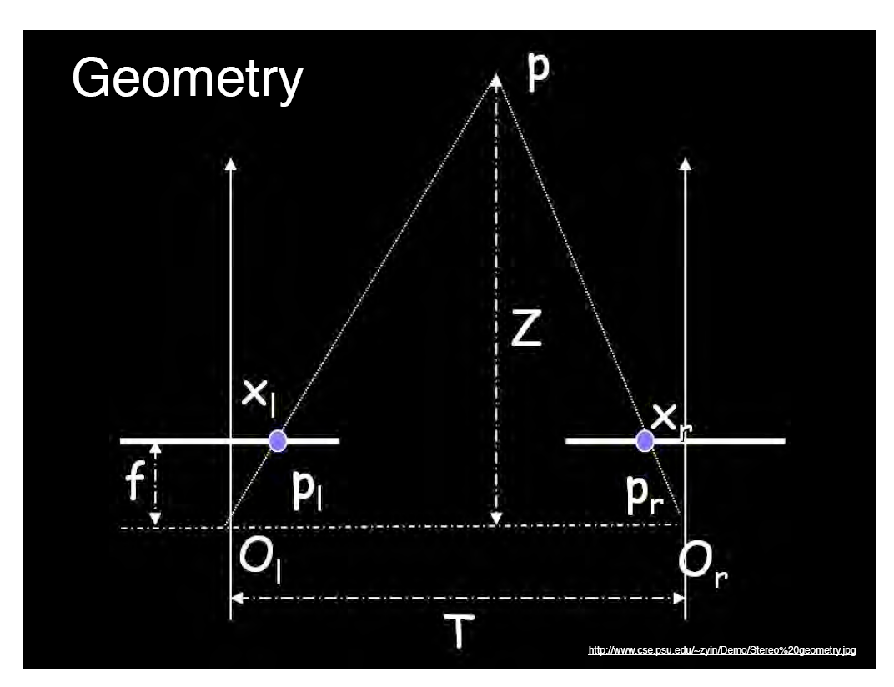
Geometry for a simple stereo system
Assume parallel optical axes, known camera parameters (i.e., calibrated cameras). What is expression for Z?
Similar triangles (p_{l}, P, p_{r}) and (O_{l}, P, O_{r}):
B
B
B
B
disparity
Notes:
4

Slide 5
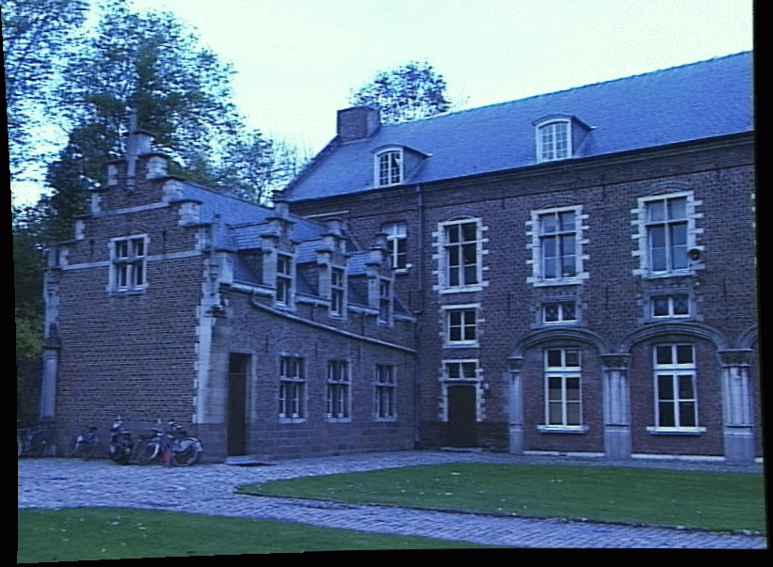
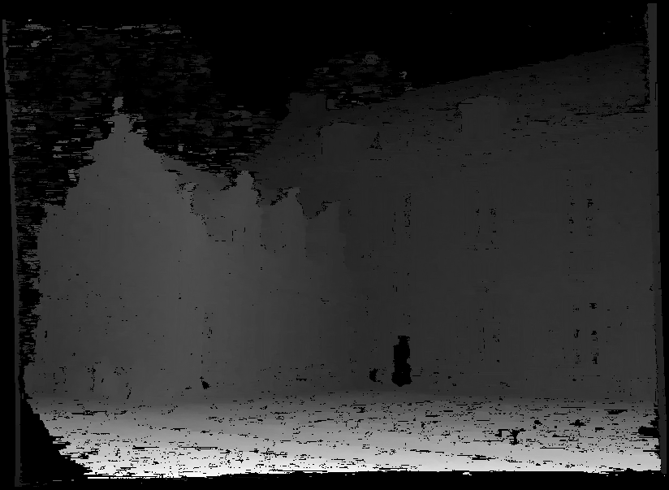
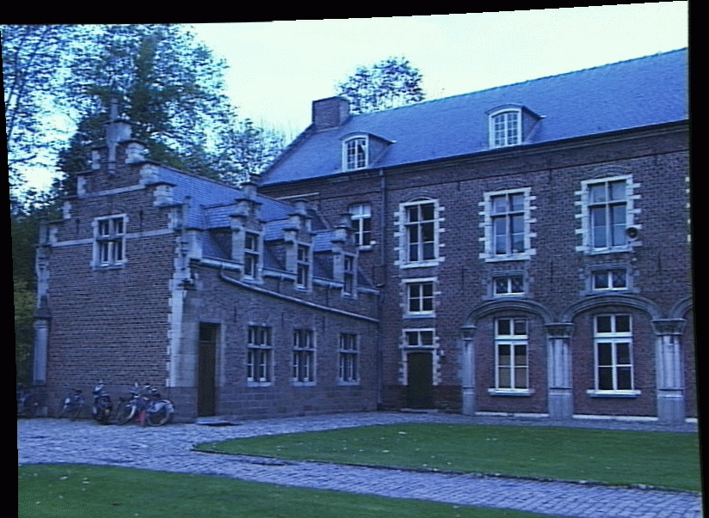
Depth from disparity
image I(x,y)
Disparity map D(x,y)
image I´(x´,y´)
(x´,y´)=(x+D(x,y), y)
So if we could find the corresponding points in two images, we could estimate relative depth…

Slide 6
Depth from Stereo
Goal: recover depth by finding image coordinate x’ that corresponds to x
Sub-Problems
Calibration: How do we recover the relation of the cameras (if not already known)?
Correspondence: How do we search for the matching point x’?
X
x
x'

Slide 7
Correspondence Problem
x
?
We have two images taken from cameras with different intrinsic and extrinsic parameters
How do we match a point in the first image to a point in the second? How can we constrain our search?

Slide 8
Key idea: Epipolar constraint

Slide 9
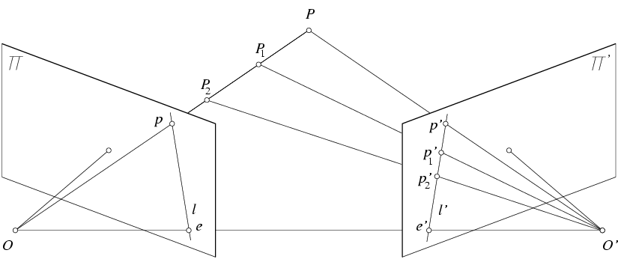
Key idea: Epipolar constraint
X
X
X
x
x’
x’
x’
Potential matches for x have to lie on the corresponding line l’.
Potential matches for x’ have to lie on the corresponding line l.

Slide 10
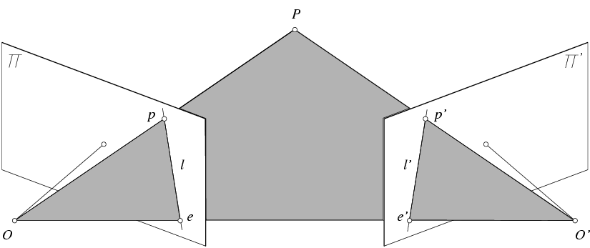
Epipolar geometry: notation
X
x
x’
Baseline – line connecting the two camera centers
Epipoles
= intersections of baseline with image planes
= projections of the other camera center
Epipolar Plane – plane containing baseline (1D family)

Slide 11
Epipolar geometry: notation
X
x
x’
Baseline – line connecting the two camera centers
Epipoles
= intersections of baseline with image planes
= projections of the other camera center
Epipolar Plane – plane containing baseline (1D family)
Epipolar Lines - intersections of epipolar plane with image planes (always come in corresponding pairs)

Slide 12
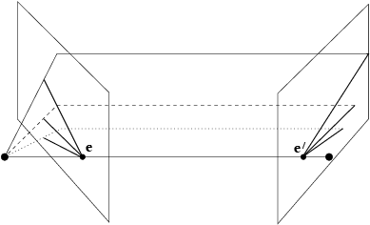
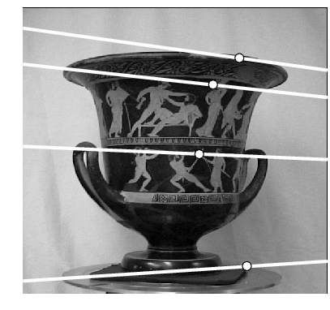
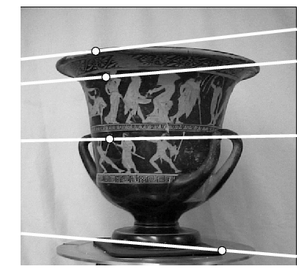
Example: Converging cameras

Slide 13
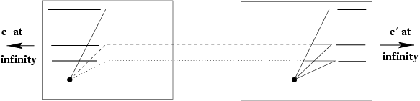
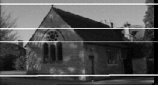
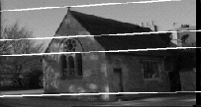
Example: Motion parallel to image plane

Slide 14
Example: Forward motion
What would the epipolar lines look like if the camera moves directly forward?

Slide 15
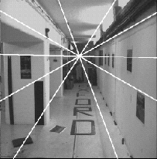
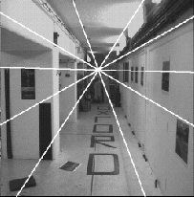
Example: Forward motion
e’
e
Epipole has same coordinates in both images.
Points move along lines radiating from e: “Focus of expansion”

Slide 16
Epipolar constraint: Calibrated case
X
x
x’
Given the intrinsic parameters of the cameras:
Convert to normalized coordinates by pre-multiplying all points with the inverse of the calibration matrix; set first camera’s coordinate system to world coordinates
3D scene point
Homogeneous 2d point (3D ray towards X)
2D pixel coordinate (homogeneous)
3D scene point in 2nd camera’s 3D coordinates

Slide 17
Epipolar constraint: Calibrated case
X
x
x’
Given the intrinsic parameters of the cameras:
Convert to normalized coordinates by pre-multiplying all points with the inverse of the calibration matrix; set first camera’s coordinate system to world coordinates
Define some R and t that relate X to X’ as below

Slide 18
Epipolar constraint: Calibrated case
X
x
x’
Notes:
X’ is X in the second camera’s coordinate system
We can identify the non-homogeneous 3D vectors X and X’ with the homogeneous coordinate vectors x and x’ of the projections of the two points into the two respective images

Slide 19
Essential matrix
X
x
x’
Essential Matrix
(Longuet-Higgins, 1981)
Notes:
[t]_{x} is the skew symmetric matrix of t

Slide 20
Properties of the Essential matrix
X
x
x’
Drop ^ below to simplify notation
E x’ is the epipolar line associated with x’ (l = E x’)
E^{T}x is the epipolar line associated with x (l’ = E^{T}x)
E e’ = 0 and E^{T}e = 0
E is singular (rank two)
E has five degrees of freedom
(3 for R, 2 for t because it’s up to a scale)

Slide 21
Epipolar constraint: Uncalibrated case
X
x
x’
If we don’t know K and K’, then we can write the epipolar constraint in terms of unknown normalized coordinates:

Slide 22
The Fundamental Matrix
Without knowing K and K’, we can define a similar relation using unknown normalized coordinates
Fundamental Matrix
(Faugeras and Luong, 1992)

Slide 23

Properties of the Fundamental matrix
X
x
x’
F x’ is the epipolar line associated with x’ (l = F x’)
F^{T}x is the epipolar line associated with x (l’ = F^{T}x)
F e’ = 0 and F^{T}e = 0
F is singular (rank two): det(F)=0
F has seven degrees of freedom: 9 entries but defined up to scale, det(F)=0

Slide 24
Estimating the Fundamental Matrix
8-point algorithm
Least squares solution using SVD on equations from 8 pairs of correspondences
Enforce det(F)=0 constraint using SVD on F
7-point algorithm
Use least squares to solve for null space (two vectors) using SVD and 7 pairs of correspondences
Solve for linear combination of null space vectors that satisfies det(F)=0
Minimize reprojection error
Non-linear least squares
Note: estimation of F (or E) is degenerate for a planar scene.

Slide 25
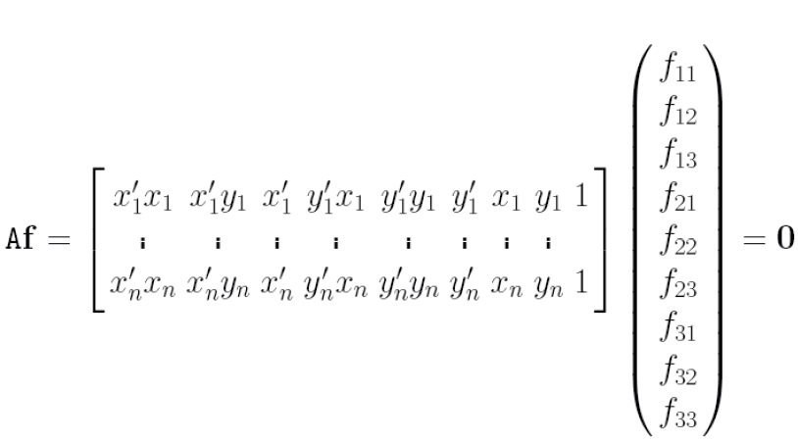
8-point algorithm
Solve a system of homogeneous linear equations
Write down the system of equations

Slide 26
8-point algorithm
Solve a system of homogeneous linear equations
Write down the system of equations
Solve f from Af=0 using SVD
Matlab:
[U, S, V] = svd(A);
f = V(:, end);
F = reshape(f, [3 3])’;

Slide 27
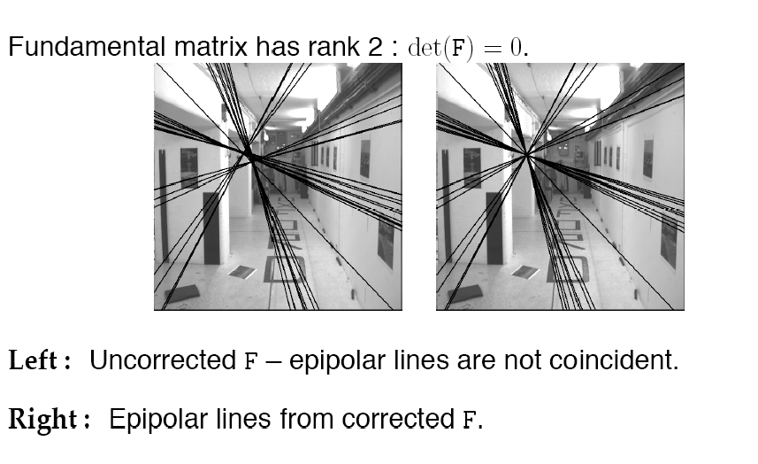
Need to enforce singularity constraint

Slide 28
8-point algorithm
Solve a system of homogeneous linear equations
Write down the system of equations
Solve f from Af=0 using SVD
Resolve det(F) = 0 constraint using SVD
Matlab:
[U, S, V] = svd(A);
f = V(:, end);
F = reshape(f, [3 3])’;
Matlab:
[U, S, V] = svd(F);
S(3,3) = 0;
F = U*S*V’;

Slide 29
8-point algorithm
Solve a system of homogeneous linear equations
Write down the system of equations
Solve f from Af=0 using SVD
Resolve det(F) = 0 constraint by SVD
Notes:
Use RANSAC to deal with outliers (sample 8 points)
How to test for outliers?
Solve in normalized coordinates
mean=0
standard deviation ~= (1,1,1)
just like with estimating the homography for stitching
Notes:
Test for outliers by computing distance from epipolar line to corresponding point (NOT by taking square of x^{T}Fx’)

Slide 30
Comparison of homography estimation and the 8-point algorithm
Assume we have matched points x x’ with outliers
Homography (No Translation)
Fundamental Matrix (Translation)

Slide 31
Comparison of homography estimation and the 8-point algorithm
Assume we have matched points x x’ with outliers
Homography (No Translation)
Fundamental Matrix (Translation)
Correspondence Relation
Normalize image coordinates
RANSAC with 4 points
Solution via SVD
De-normalize:

Slide 32
Comparison of homography estimation and the 8-point algorithm
Assume we have matched points x x’ with outliers
Homography (No Translation)
Fundamental Matrix (Translation)
Correspondence Relation
Normalize image coordinates
RANSAC with 4 points
Solution via SVD
De-normalize:
Correspondence Relation
Normalize image coordinates
RANSAC with 8 points
Initial solution via SVD
Enforce by SVD
De-normalize:

Slide 33
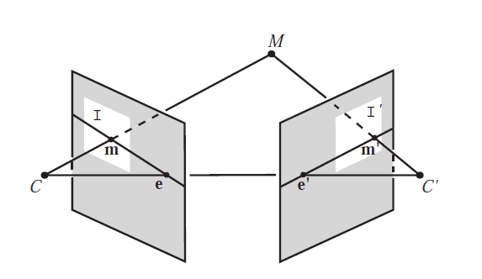
“Gold standard” algorithm
Use 8-point algorithm to get initial value of F
Use F to solve for P and P’ (discussed later)
Jointly solve for 3d points X and F that minimize the squared re-projection error
X
x
x'

Slide 34
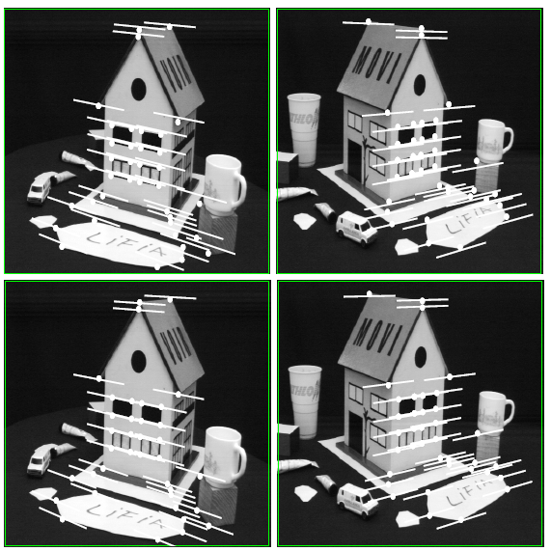
Comparison of estimation algorithms
 | 8-point | Normalized 8-point | Nonlinear least squares
Av. Dist. 1 | 2.33 pixels | 0.92 pixel | 0.86 pixel
Av. Dist. 2 | 2.18 pixels | 0.85 pixel | 0.80 pixel

Slide 35
We can get projection matrices P and P’ up to a projective ambiguity
K’*rotation
K’*translation
Code:
function P = vgg_P_from_F(F)
[U,S,V] = svd(F);
e = U(:,3);
P = [-vgg_contreps(e)*F e];
See HZ p. 255-256
If we know the intrinsic matrices (K and K’), we can resolve the ambiguity

Slide 36
From epipolar geometry to camera calibration
Estimating the fundamental matrix is known as “weak calibration”
We cIf we know the calibration matrices of the two cameras, we can estimate the essential matrix: E = K^{T}FK’
The essential matrix gives us the relative rotation and translation between the cameras, or their extrinsic parameters

Slide 37
Let’s recap…
Fundamental matrix song

Slide 38
Moving on to stereo…
Fuse a calibrated binocular stereo pair to produce a depth image
image 1
image 2
Dense depth map
Many of these slides adapted from Steve Seitz and Lana Lazebnik

Slide 39
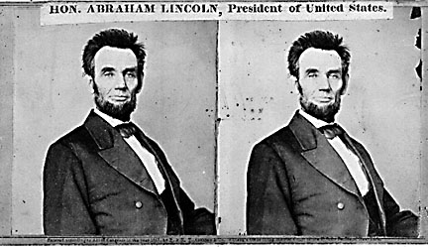
Basic stereo matching algorithm
For each pixel in the first image
Find corresponding epipolar line in the right image
Search along epipolar line and pick the best match
Triangulate the matches to get depth information
Simplest case: epipolar lines are scanlines
When does this happen?

Slide 40
Simplest Case: Parallel images
Image planes of cameras are parallel to each other and to the baseline
Camera centers are at same height
Focal lengths are the same

Slide 41
Simplest Case: Parallel images
Image planes of cameras are parallel to each other and to the baseline
Camera centers are at same height
Focal lengths are the same
Then, epipolar lines fall along the horizontal scan lines of the images

Slide 42
Simplest Case: Parallel images
Epipolar constraint:
R = I t = (T, 0, 0)
x
x’
t
The y-coordinates of corresponding points are the same

Slide 43
Depth from disparity
X
z
x
x’
f
f
O
Baseline B
O’
Disparity is inversely proportional to depth.

Slide 44
Stereo image rectification

Slide 45
Stereo image rectification
Reproject image planes onto a common plane parallel to the line between camera centers
Pixel motion is horizontal after this transformation
Two homographies (3x3 transform), one for each input image reprojection
C. Loop and Z. Zhang. Computing Rectifying Homographies for Stereo Vision. IEEE Conf. Computer Vision and Pattern Recognition, 1999.

Slide 46
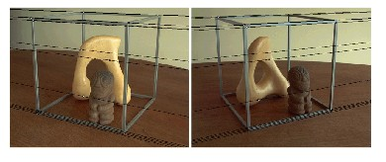
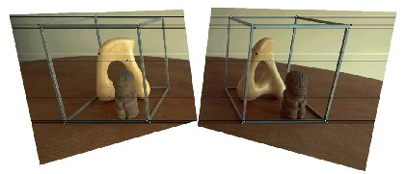
Rectification example

Slide 47
Basic stereo matching algorithm
If necessary, rectify the two stereo images to transform epipolar lines into scanlines
For each pixel x in the first image
Find corresponding epipolar scanline in the right image
Search the scanline and pick the best match x’
Compute disparity x-x’ and set depth(x) = fB/(x-x’)

Slide 48
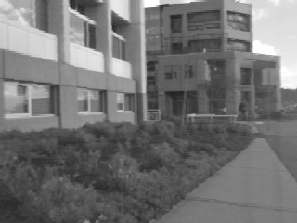
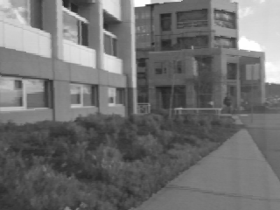
Correspondence search
Left
Right
scanline
Matching cost
disparity
Slide a window along the right scanline and compare contents of that window with the reference window in the left image
Matching cost: SSD or normalized correlation

Slide 49
Correspondence search
Left
Right
scanline
SSD

Slide 50
Correspondence search
Left
Right
scanline
Norm. corr

Slide 51
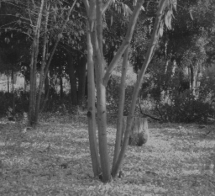
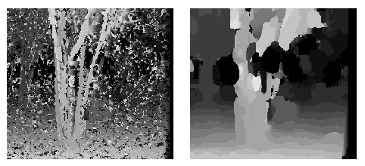
Effect of window size
W = 3
W = 20
Smaller window
+ More detail
More noise
Larger window
+ Smoother disparity maps
Less detail
Fails near boundaries
Notes:
smaller window: more detail, more noise
bigger window: less noise, more detail

Slide 52

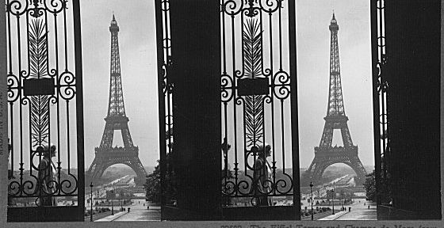
Failures of correspondence search
Textureless surfaces
Occlusions, repetition
Non-Lambertian surfaces, specularities

Slide 53
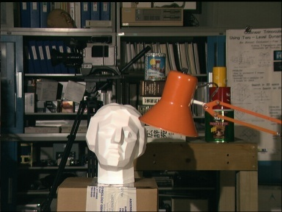
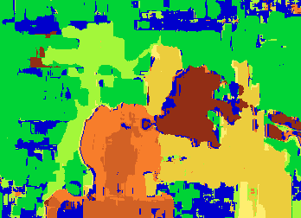

Results with window search
Data
Window-based matching
Ground truth

Slide 54
Summary
Epipolar geometry
Epipoles are intersection of baseline with image planes
Matching point in second image is on a line passing through its epipole
Fundamental matrix maps from a point in one image to a line (its epipolar line) in the other
Can solve for F given corresponding points (e.g., interest points)
Can recover canonical camera matrices from F (with projective ambiguity)
Stereo depth estimation
Estimate disparity by finding corresponding points along scanlines
Depth is inverse to disparity

Slide 55
https://www.youtube.com/watch?v=IgBQCoEfiMs

Slide 56
FINAL PROJECT
“ANYTHING YOU WANT!” *
* if not one of the ideas on the next page, drop me a note with your project idea include: (a) what you want to do, (b) specific examples of the data you are going to work with, (c) what you think is a reasonable measure of your success. This should be in the form of a blog post.

Slide 57

Project Idea 1
(a) Make an autostereogram.

Slide 58

… but not just a normal one…
https://ironicsans.substack.com/p/24-adventures-in-stereograms

Slide 59
Project idea 2
Any current image based Kaggle competition.
Evaluated based on competitive results! Knowledge or things you learned about the problem domain that you integrated in your approach, and your write-up.

Slide 60
Project Idea 3
Re-implement any recent NeurIPS or CVPR paper
(one of my favorites: https://github.com/james-oldfield/PoS-subspaces).

Slide 61
Project Idea 4
Stress test any recent NeurIPS or CVPR paper with new data, and *really* make an argument if it works for a problem domain or note (again, my recent favorite: https://github.com/james-oldfield/PoS-subspaces).

Slide 62
Project Timeline
Proposals (mandatory even if using a project idea), due Monday November 17.
Final project due Dec. 8. I will give ”grade for class” computed based on that project within a few days, with option to resubmit final project by December 17.

