Slide 1
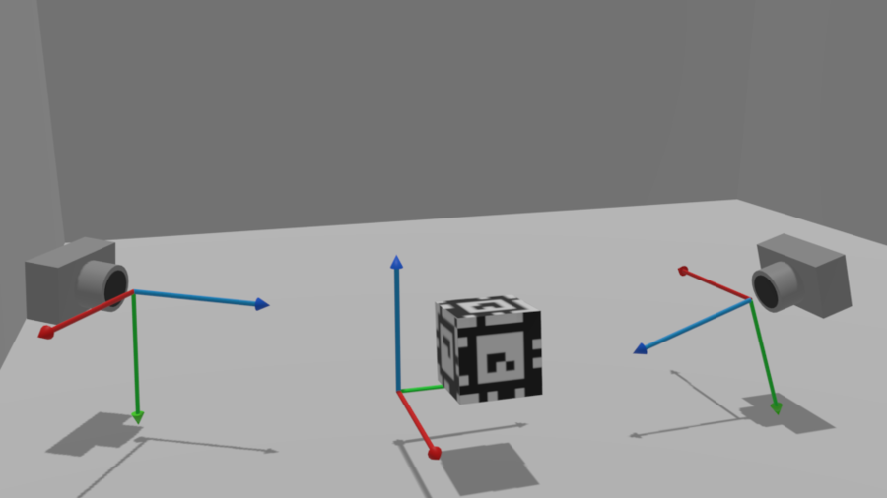
Lecture 08: Calibration and Pose Estimation
Image from: https://developer.ridgerun.com/wiki/index.php?title=Full_Body_Pose_Estimation_for_Sports_Analysis_-_AprilTag_Camera_Calibration
Slides inspired/borrowed from Steve Seitz and Rick Szeliski and Alexei Efros and James Hays and Linda Shapiro

Slide 2
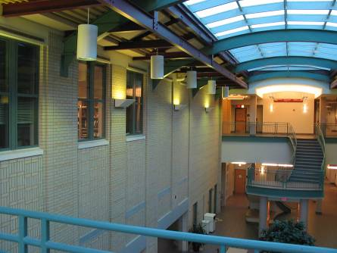
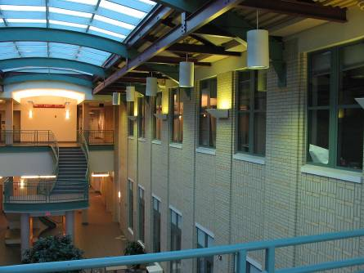
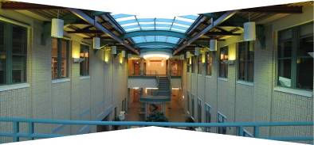
Image Mosaics
p’ = Hp
Can set scale factor i=1. So, there are 8 unkowns.
Set up a system of linear equations:
Ah = b
where vector of unknowns h = [a,b,c,d,e,f,g,h]^{T}
Need at least 8 eqs, but the more the better…
Solve for h. If overconstrained, solve using least-squares:
Can be done in Matlab using “\” command
see “help lmdivide”

Slide 3
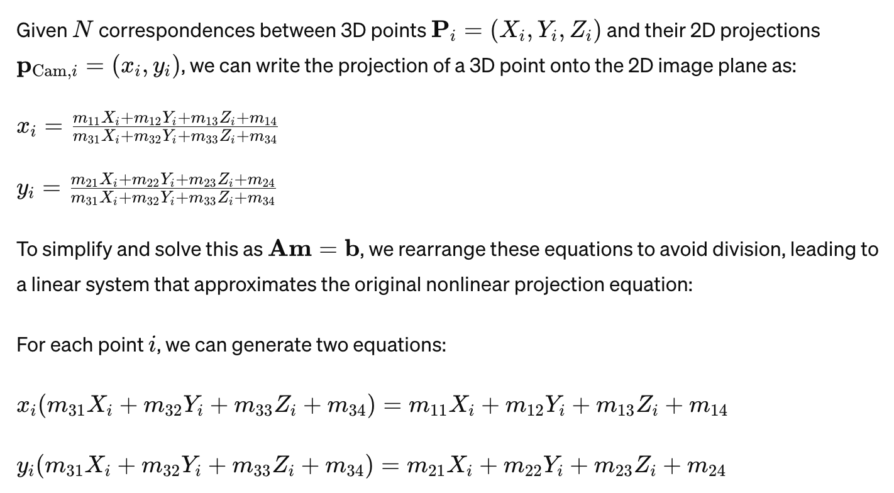
Today: Camera Calibration

Slide 4
Today: Camera Calibration
No longer an image warp, translating 2D images to each other, but instead mapping 3D points to a 2D image. Main problem is to learn in this situation:

Slide 5
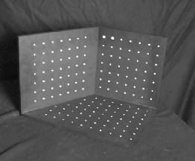
Camera Calibration
A funny object with multiple planes.

Slide 6
Camera calibration
Given n points with known 3D coordinates X_{i} and known image projections p_{i}, estimate the camera parameters
X_{i}
p_{i}
Slide credit: S. Lazebnik

Slide 7
Today: Solve for the “Direct Linear Transformation”

Slide 8

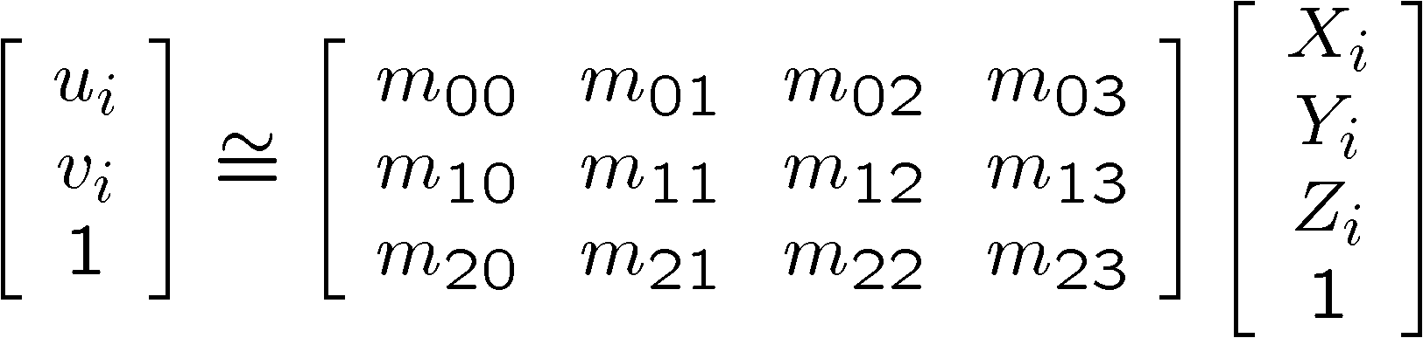
In reality: solve for projection matrix
Place a known object in the scene
identify correspondence between image and scene
compute mapping from scene to image

Slide 9
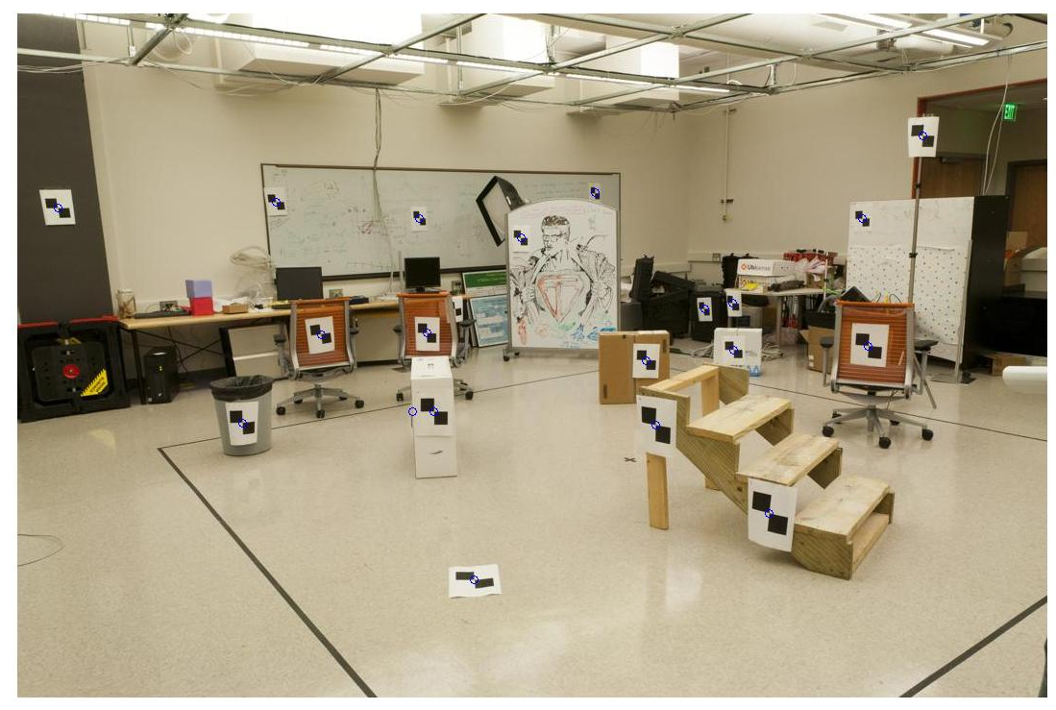
Camera Calibration Targets
Using a tape measure
Known 2d image coords
Known 3d locations
880 214
43 203
270 197
886 347
745 302
943 128
476 590
419 214
317 335
783 521
235 427
665 429
655 362
427 333
412 415
746 351
434 415
525 234
716 308
602 187
312.747 309.140 30.086
305.796 311.649 30.356
307.694 312.358 30.418
310.149 307.186 29.298
311.937 310.105 29.216
311.202 307.572 30.682
307.106 306.876 28.660
309.317 312.490 30.230
307.435 310.151 29.318
308.253 306.300 28.881
306.650 309.301 28.905
308.069 306.831 29.189
309.671 308.834 29.029
308.255 309.955 29.267
307.546 308.613 28.963
311.036 309.206 28.913
307.518 308.175 29.069
309.950 311.262 29.990
312.160 310.772 29.080
311.988 312.709 30.514
Image credit: J. Hays

Slide 10
Camera Calibration Targets
A set of views of a plane (not covered today)
…

Slide 11
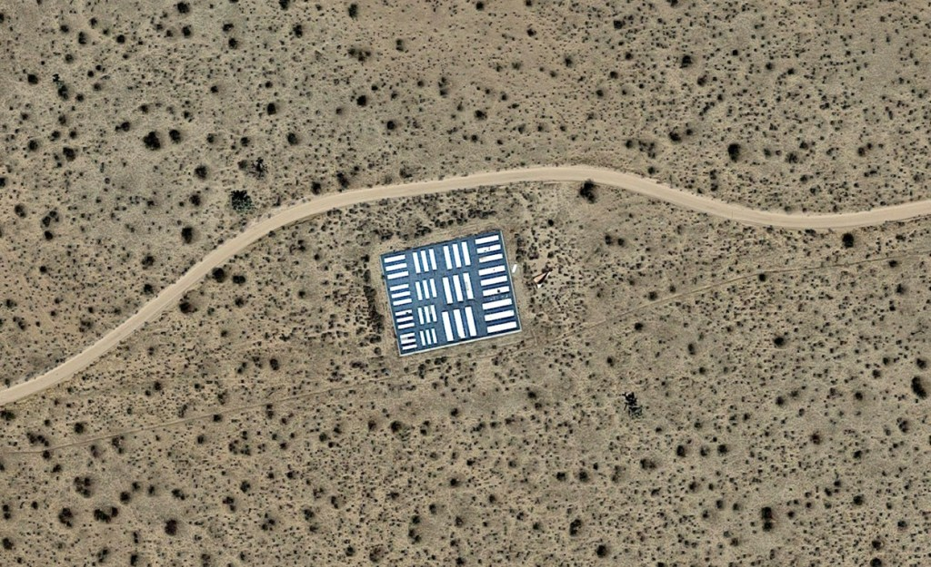
Camera Calibration Targets
A single, huge plane. What’s this for?

Slide 12
Direct linear calibration
Solve for Projection Matrix Π using least-squares (just like last class)
Advantages:
All specifics of the camera summarized in one matrix
Can predict where any world point will map to in the image
Disadvantages:
Doesn’t tell us about particular parameters
Mixes up internal and external parameters
pose specific: move the camera and everything breaks

Slide 13
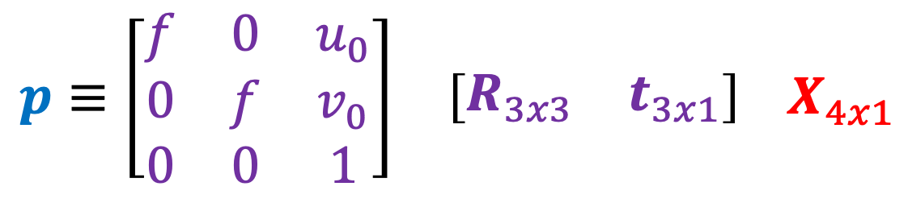
Typical Perspective Model
principal point (image coords of camera origin on retina)
Just moves camera origin
focal length
rotation
translation
$$p≡\begin{matrix}\left[\begin{matrix}f & 0 & u_{0} \\ 0 & f & v_{0} \\ 0 & 0 & 1\end{matrix}\right] & \left[\begin{matrix}R_{3x3} & t_{3x1}\end{matrix}\right]\end{matrix} X_{4x1}$$
3D point
2D Projection of X

Slide 14
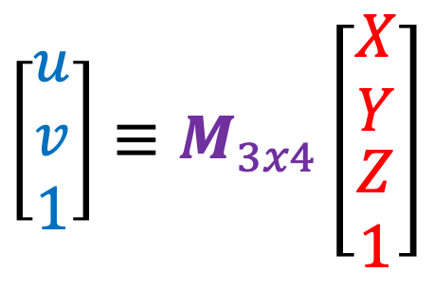
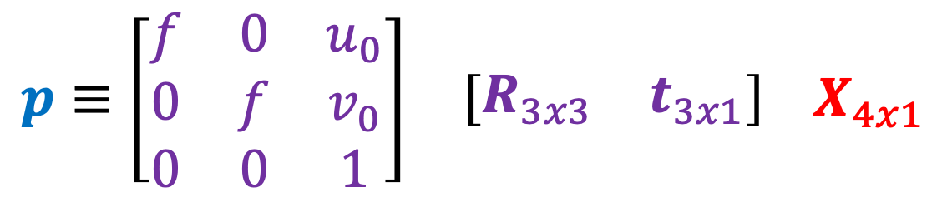
Camera Calibration
$$p≡\begin{matrix}\left[\begin{matrix}f & 0 & u_{0} \\ 0 & f & v_{0} \\ 0 & 0 & 1\end{matrix}\right] & \left[\begin{matrix}R_{3x3} & t_{3x1}\end{matrix}\right]\end{matrix} X_{4x1}$$
$$\left[\begin{matrix}u \\ v \\ 1\end{matrix}\right]≡M_{3x4}\left[\begin{matrix}\begin{matrix}X \\ Y\end{matrix} \\ \begin{matrix}Z \\ 1\end{matrix}\end{matrix}\right]$$
Pairs of [X,Y,Z] and [u,v] → eqns to constrain M
How do I get [X,Y,Z], [u,v]?

Slide 15
Stereo

Slide 17
Amount of horizontal movement is …
…inversely proportional to the distance from the camera

Slide 18
Depth from Stereo
Goal: recover depth by finding image coordinate x’ that corresponds to x
X
X
x
z
x
x’
x'
f
f
C
Baseline B
C’

Slide 19
Depth from disparity
X
z
x
x’
f
f
O
Baseline B
O’
Disparity is inversely proportional to depth.

Slide 20
Depth from Stereo
Goal: recover depth by finding image coordinate x’ that corresponds to x
Sub-Problems
Calibration: How do we recover the relation of the cameras (if not already known)?
Correspondence: How do we search for the matching point x’?
X
x
x'

Slide 21
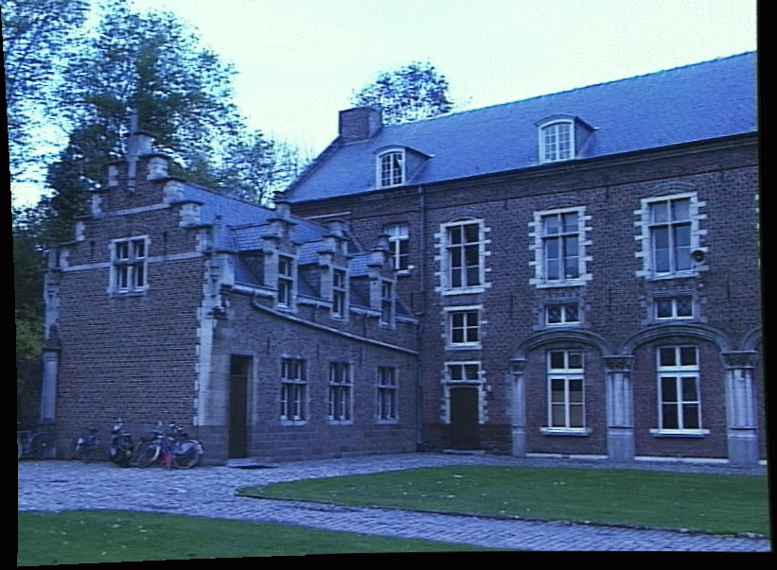
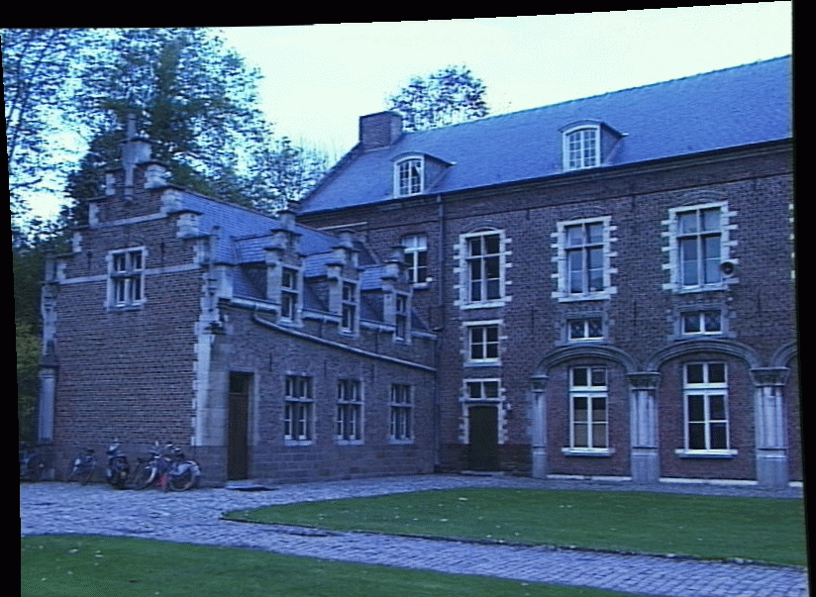
Correspondence Problem
x
?
We have two images taken from cameras with different intrinsic and extrinsic parameters
How do we match a point in the first image to a point in the second? How can we constrain our search?

Slide 22
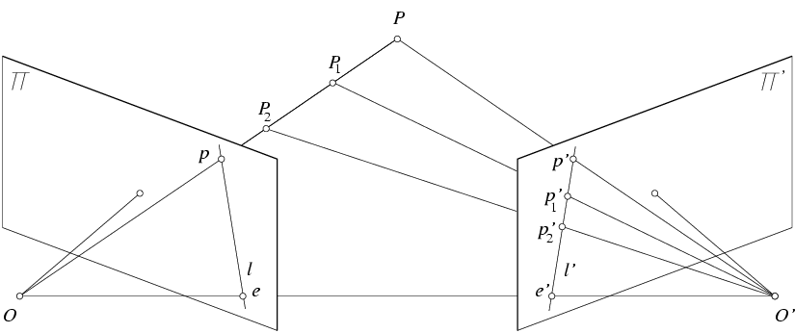
Key idea: Epipolar constraint
X
X
X
x
x’
x’
x’
Potential matches for x have to lie on the corresponding line l’.
Potential matches for x’ have to lie on the corresponding line l.

Slide 23
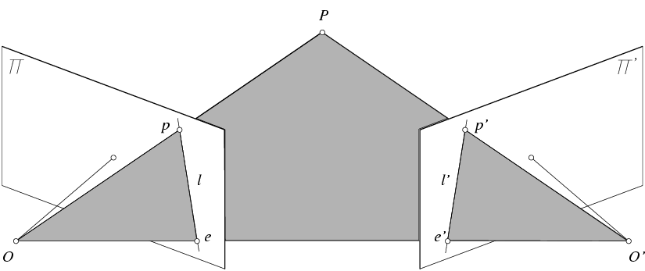
Epipolar geometry: notation
X
x
x’
Baseline – line connecting the two camera centers
Epipoles
= intersections of baseline with image planes
= projections of the other camera center
Epipolar Plane – plane containing baseline (1D family)

Slide 24
Epipolar geometry: notation
X
x
x’
Baseline – line connecting the two camera centers
Epipoles
= intersections of baseline with image planes
= projections of the other camera center
Epipolar Plane – plane containing baseline (1D family)
Epipolar Lines - intersections of epipolar plane with image planes (always come in corresponding pairs)

Slide 25
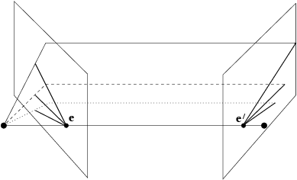
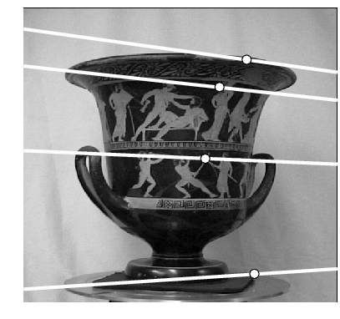
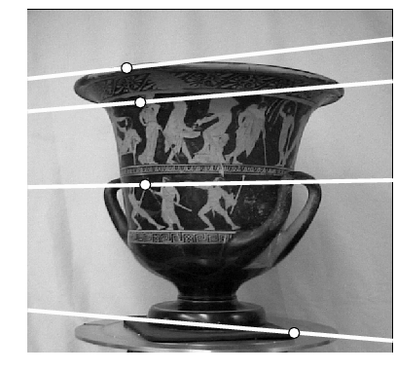
Example: Converging cameras

Slide 26
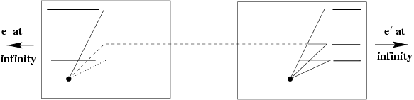
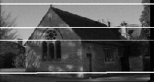
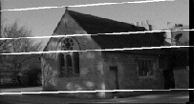
Example: Motion parallel to image plane

Slide 27
Epipolar constraint
X
x
x’
If we observe a point x in one image, where can the corresponding point x’ be in the other image?

Slide 28
Epipolar constraint
X
X
X
x
x’
x’
x’
Potential matches for x have to lie on the corresponding
epipolar line l’.
Potential matches for x’ have to lie on the corresponding
epipolar line l.

Slide 29
Epipolar constraint example

Slide 30
Epipolar constraint: Calibrated case
X
x
x’
Assume that the intrinsic and extrinsic parameters of the cameras are known
We can multiply the projection matrix of each camera (and the image points) by the inverse of the calibration matrix to get normalized image coordinates
We can also set the global coordinate system to the coordinate system of the first camera. Then the projection matrices of the two cameras can be written as [I | 0] and [R | t]

Slide 31
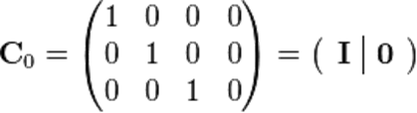

Simplified Matrices for the 2 Cameras
= (R | T)

Slide 32
Epipolar constraint: Calibrated case
X
= (x,1)^{T}
x
x’ = Rx+t
t
R
The vectors Rx, t, and x’ are coplanar
Notes:
X’ is X in the second camera’s coordinate system
We can identify the non-homogeneous 3D vectors X and X’ with the homogeneous coordinate vectors x and x’ of the projections of the two points into the two respective images

Slide 33
Epipolar constraint: Calibrated case
X
x
x’
Essential Matrix E
(Longuet-Higgins, 1981)
The vectors Rx, t, and x’ are coplanar

Slide 34
Epipolar constraint: Calibrated case
X
x
x’
E x is the epipolar line associated with x (l' = E x)
E^{T}x' is the epipolar line associated with x' (l = E^{T}x')
E e = 0 and E^{T}e' = 0
E is singular (rank two)
E has five degrees of freedom

Slide 35
Epipolar constraint: Uncalibrated case
X
x
x’
Fundamental Matrix
(Faugeras and Luong, 1992)

Slide 36
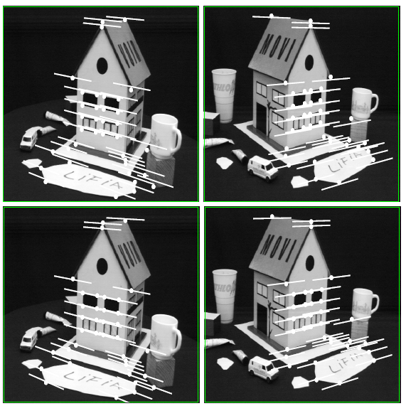
Comparison of estimation algorithms
 | 8-point | Normalized 8-point | Nonlinear least squares
Av. Dist. 1 | 2.33 pixels | 0.92 pixel | 0.86 pixel
Av. Dist. 2 | 2.18 pixels | 0.85 pixel | 0.80 pixel

Slide 37
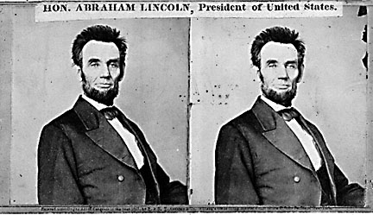
Basic stereo matching algorithm
If necessary, rectify the two stereo images to transform epipolar lines into scanlines
For each pixel x in the first image
Find corresponding epipolar scanline in the right image
Search the scanline and pick the best match x’
Compute disparity x-x’ and set depth(x) = fB/(x-x’)

Slide 38
Basic stereo matching algorithm
For each pixel in the first image
Find corresponding epipolar line in the right image
Search along epipolar line and pick the best match
Triangulate the matches to get depth information
Simplest case: epipolar lines are scanlines
When does this happen?

Slide 39
Stereo image rectification

Slide 40
Stereo image rectification
Reproject image planes onto a common plane parallel to the line between camera centers
Pixel motion is horizontal after this transformation
Two homographies (3x3 transform), one for each input image reprojection
C. Loop and Z. Zhang. Computing Rectifying Homographies for Stereo Vision. IEEE Conf. Computer Vision and Pattern Recognition, 1999.

Slide 41
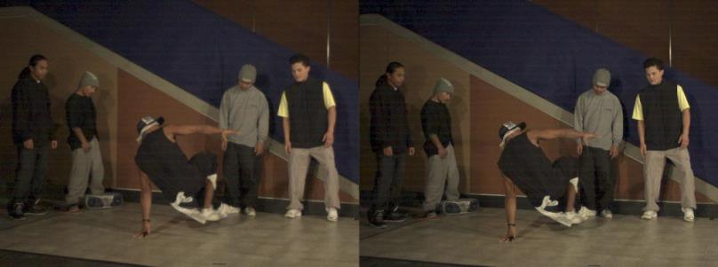
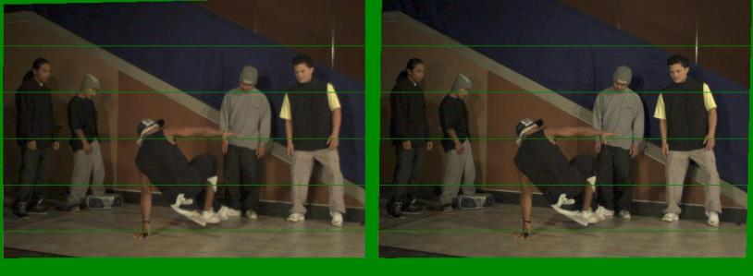
Example
Unrectified
Rectified

Slide 42
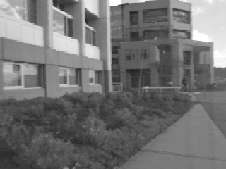
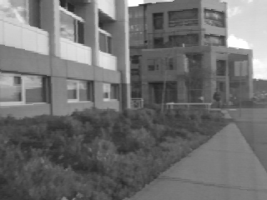
Left
Right
scanline
Matching cost
disparity
Slide a window along the right scanline and compare contents of that window with the reference window in the left image
Matching cost: SSD, SAD, or normalized correlation

Slide 43
Correspondence search
Left
Right
scanline
SSD

Slide 44
Correspondence search
Left
Right
scanline
Norm. corr

Slide 45

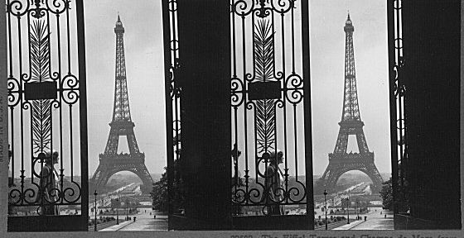
Failures of correspondence search
Textureless surfaces
Occlusions, repetition
Non-Lambertian surfaces, specularities

Slide 46
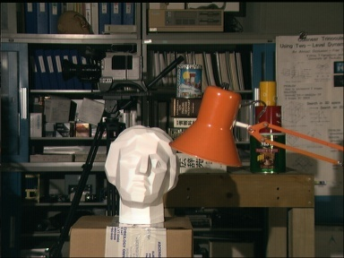
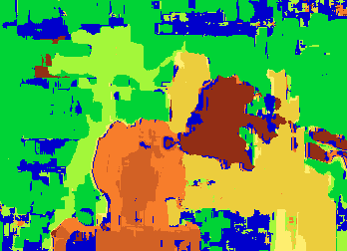

Results with window search
Data
Window-based matching
Ground truth

Slide 47
Priors and constraints
Uniqueness
For any point in one image, there should be at most one matching point in the other image
Ordering
Corresponding points should be in the same order in both views
Smoothness
We expect disparity values to change slowly (for the most part)

Slide 48
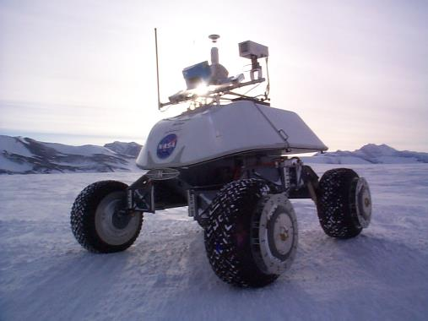
Real-time stereo
Nomad robot searches for meteorites in Antartica
http://www.frc.ri.cmu.edu/projects/meteorobot/index.html
Used for robot navigation (and other tasks)
Several software-based real-time stereo techniques have been developed (most based on simple discrete search)

Slide 49
Stereo reconstruction pipeline
Steps
Calibrate cameras
Rectify images
Compute disparity
Estimate depth
What will cause errors?
Camera calibration errors
Poor image resolution
Occlusions
Violations of brightness constancy (specular reflections)
Large motions
Low-contrast image regions

Slide 50
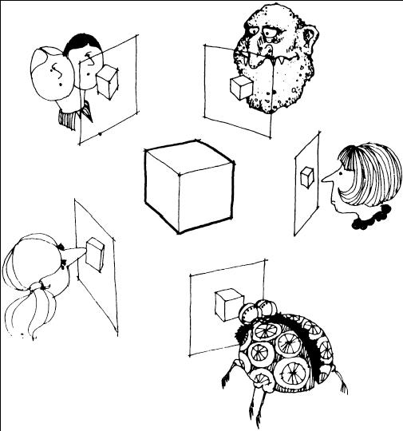
Multi-view stereo ?

Slide 51
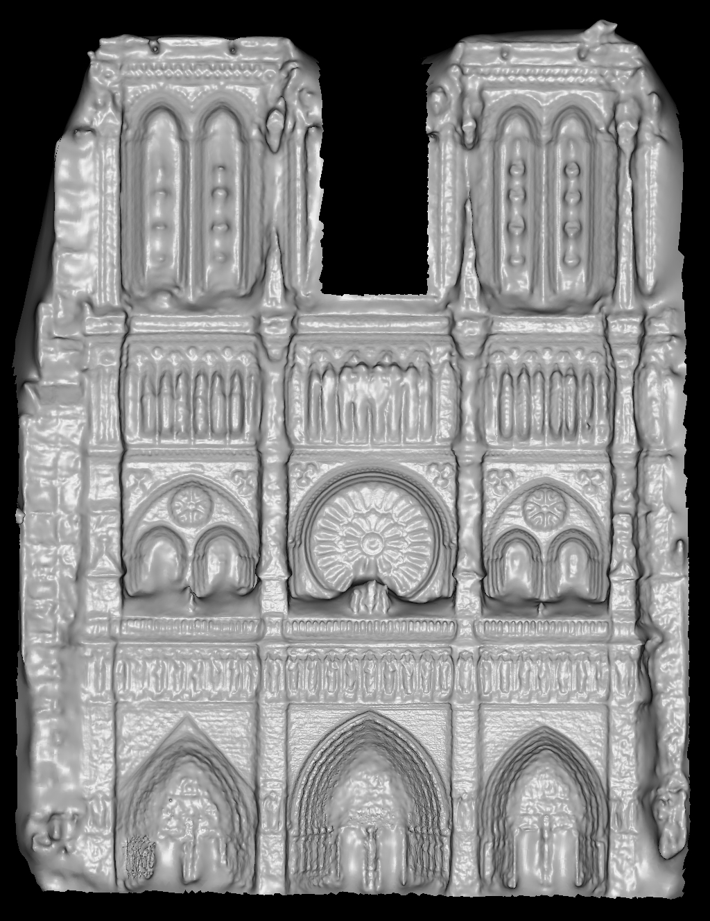
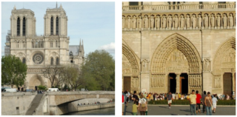
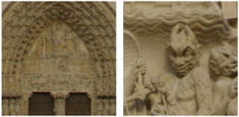
Using more than two images
Multi-View Stereo for Community Photo Collections M. Goesele, N. Snavely, B. Curless, H. Hoppe, S. Seitz Proceedings of ICCV 2007,

Slide 52
1. Matlab 2. Current project.

