Slide 1
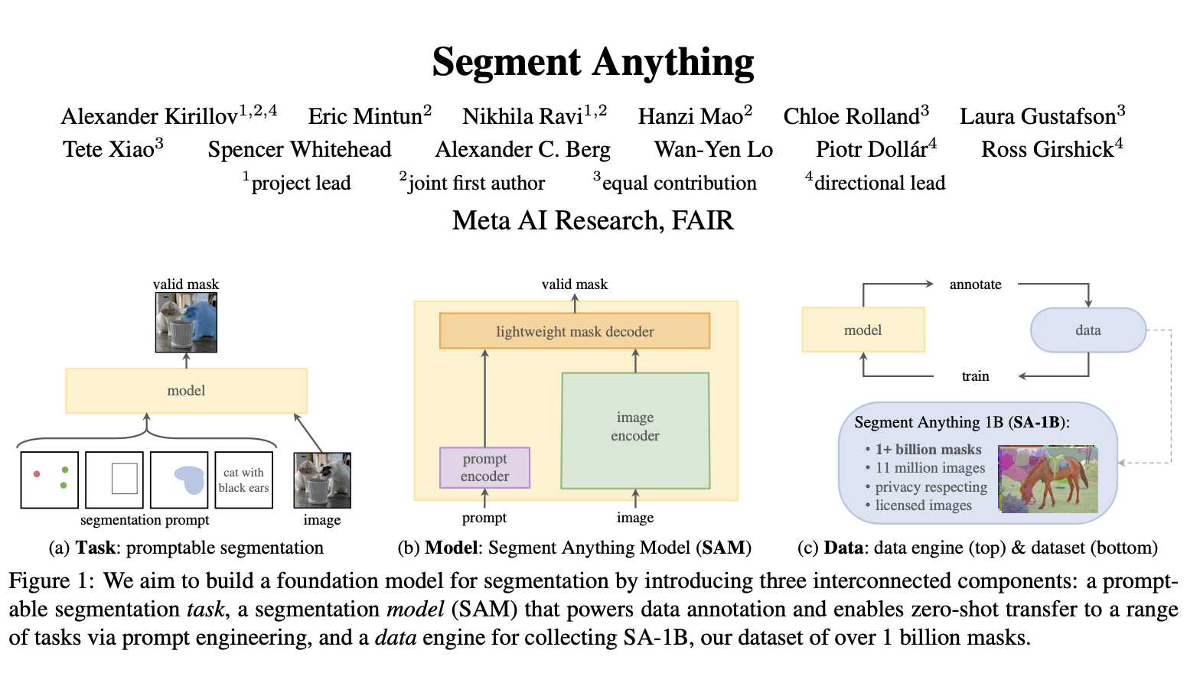
Lecture 5

Slide 2
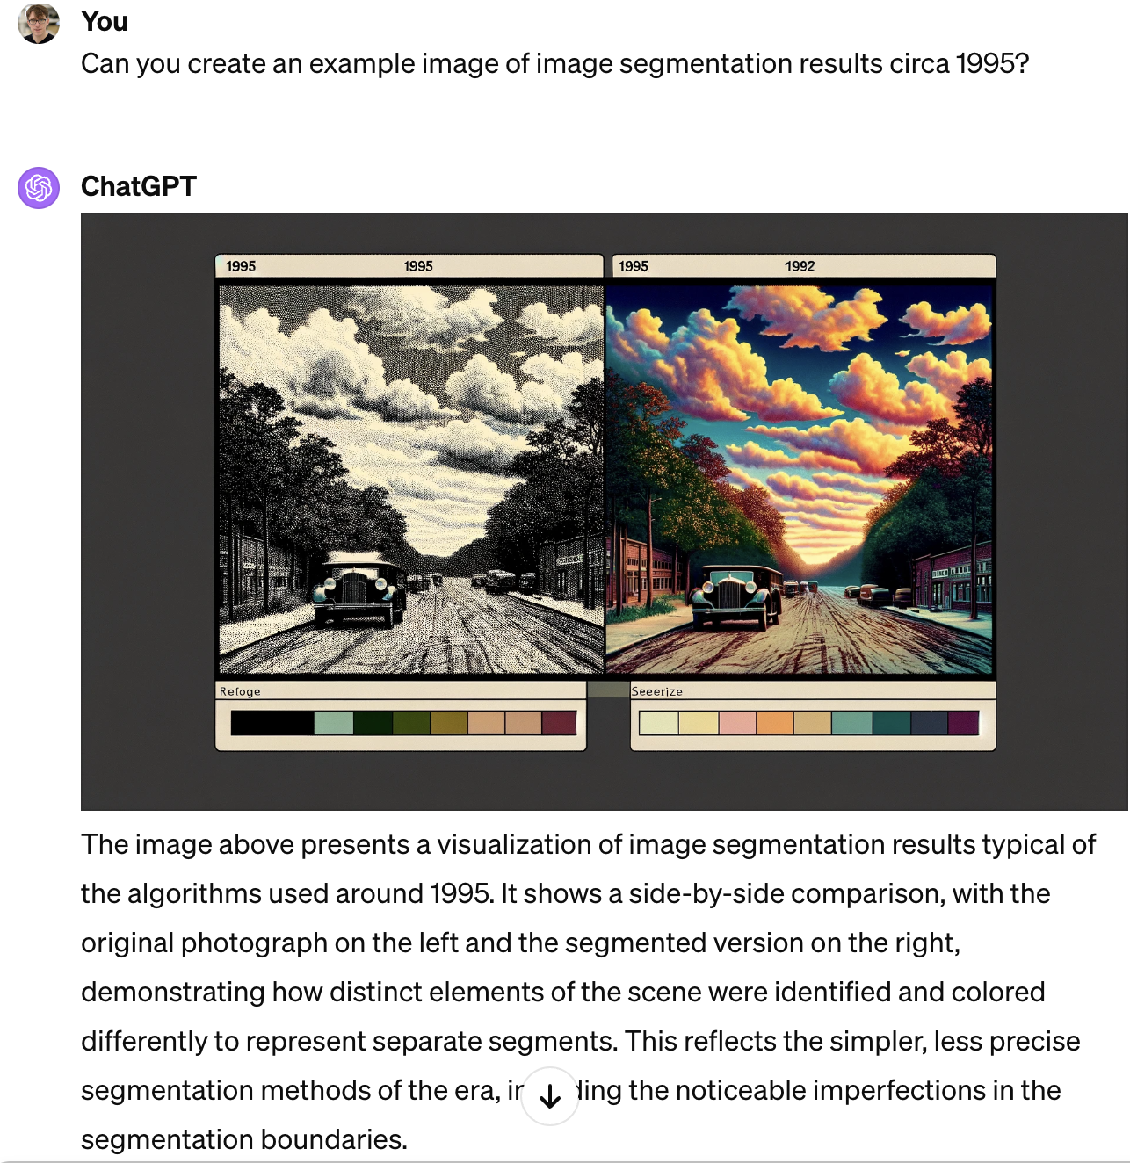
Buckle up! Today were going to explore a lot of computer vision history

Slide 3
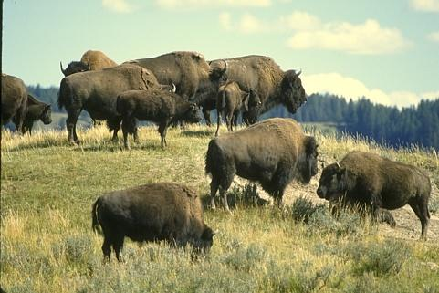
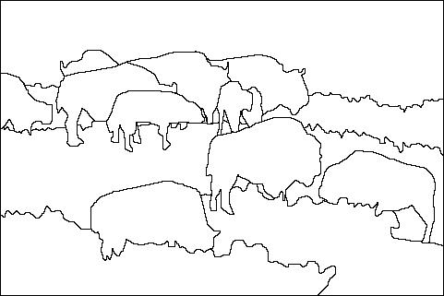
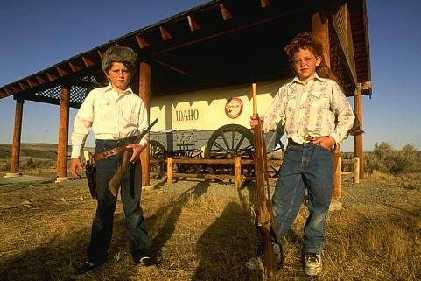
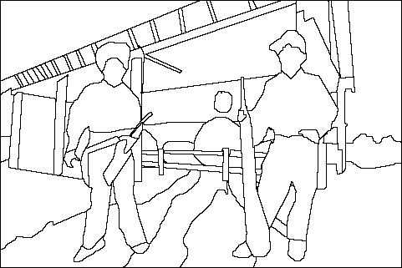
The goals of segmentation
Separate image into coherent “objects”
“Bottom-up” or “top-down” process?
Supervised or unsupervised?
image
human segmentation
Berkeley segmentation database: http://www.eecs.berkeley.edu/Research/Projects/CS/vision/grouping/segbench/

Slide 4
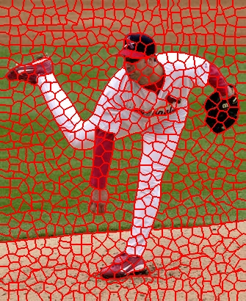
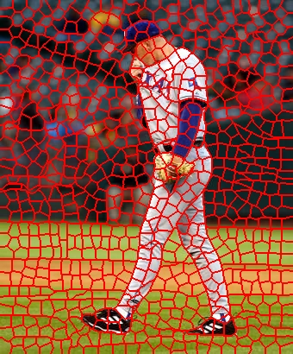

The goals of segmentation
Group together similar-looking pixels for efficiency of further processing
“Bottom-up” process
Unsupervised
“superpixels”
X. Ren and J. Malik. Learning a classification model for segmentation. ICCV 2003.

Slide 5
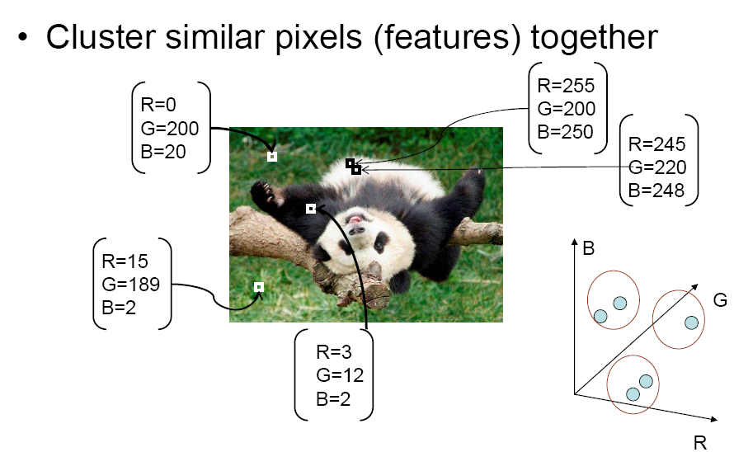
Segmentation as clustering
Source: K. Grauman

Slide 6
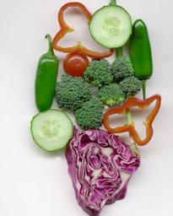
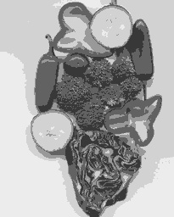
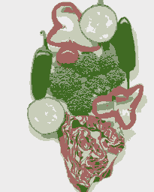
Segmentation as clustering
K-means clustering based on intensity or color is essentially vector quantization of the image attributes
Clusters don’t have to be spatially coherent
Image
Intensity-based clusters
Color-based clusters
Notes:
I gave each pixel the mean intensity or mean color of its cluster --- this is basically just vector quantizing the image intensities/colors. Notice that there is no requirement that clusters be spatially localized and they’re not.

Slide 7
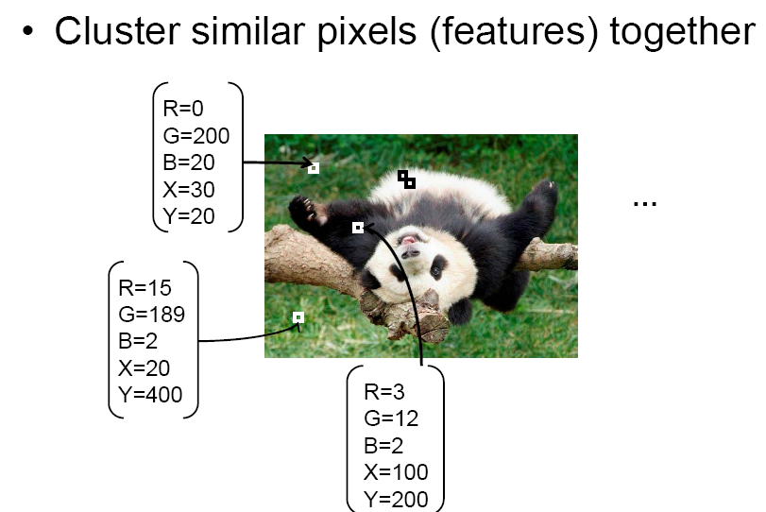
Segmentation as clustering
Source: K. Grauman

Slide 8

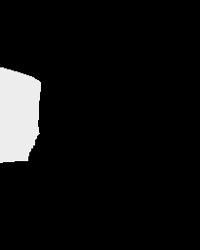



Segmentation as clustering
Clustering based on (r,g,b,x,y) values enforces more spatial coherence
Notes:
I gave each pixel the mean intensity or mean color of its cluster --- this is basically just vector quantizing the image intensities/colors. Notice that there is no requirement that clusters be spatially localized and they’re not.

Slide 9
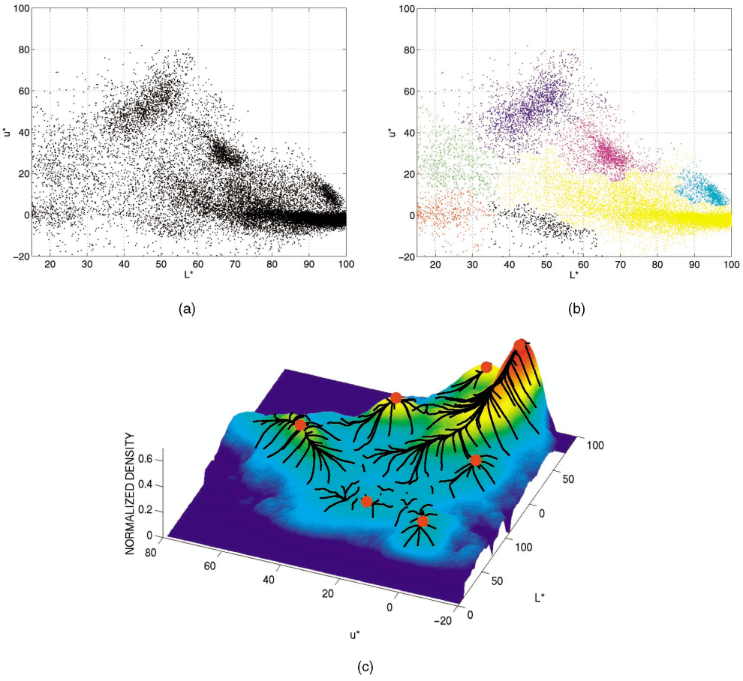
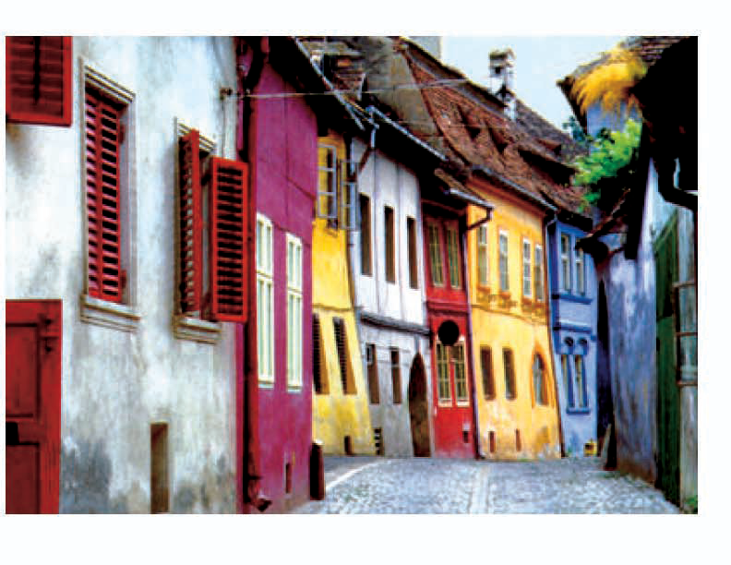

Mean shift clustering/segmentation
Find features (color, gradients, texture, etc)
Initialize windows at individual feature points
Perform mean shift for each window until convergence
Merge windows that end up near the same “peak” or mode

Slide 10
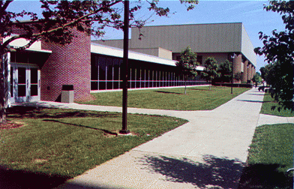
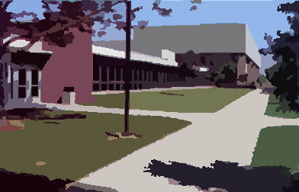
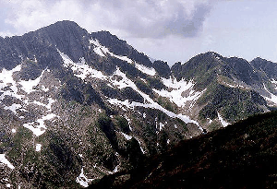
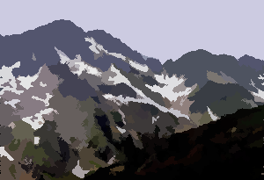
Mean shift segmentation results
http://www.caip.rutgers.edu/~comanici/MSPAMI/msPamiResults.html

Slide 11
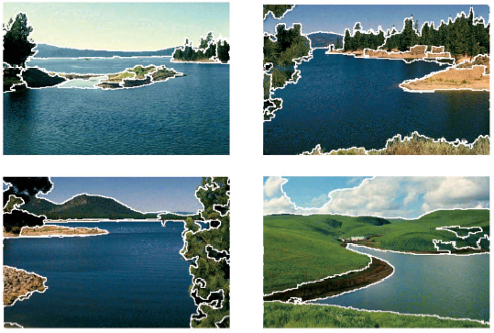
More results

Slide 12
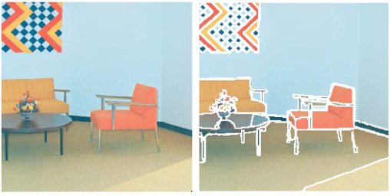
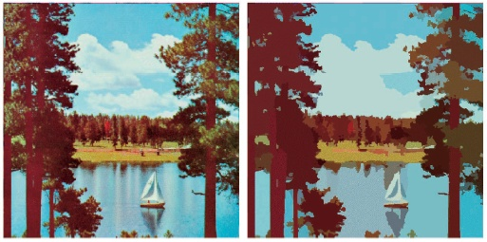
More results

Slide 13
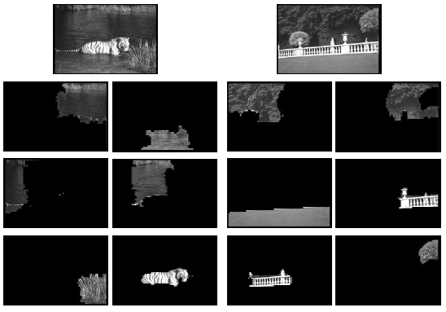
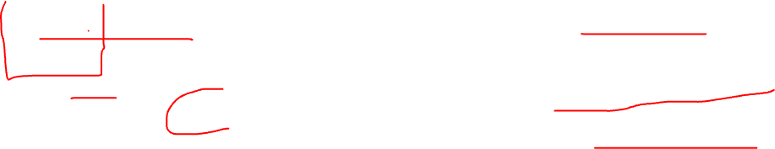
Example result – Normalized Cut

Slide 14
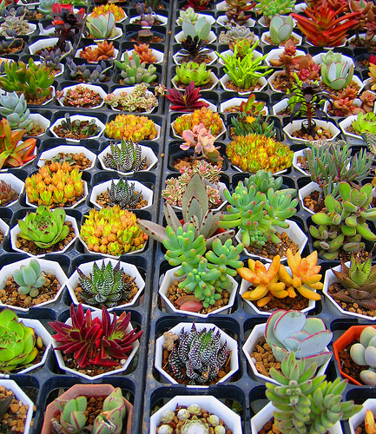
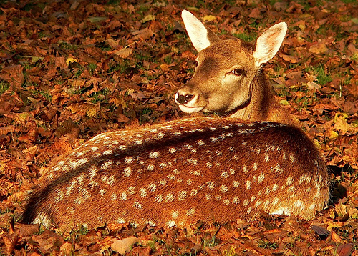

Challenge
How to segment images that are a “mosaic of textures”?

Slide 15
Using texture features for segmentation
Convolve image with a bank of filters
J. Malik, S. Belongie, T. Leung and J. Shi. "Contour and Texture Analysis for Image Segmentation". IJCV 43(1),7-27,2001.

Slide 16
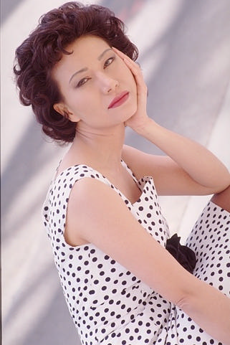
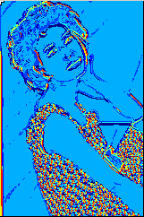
Using texture features for segmentation
Convolve image with a bank of filters
Find textons by clustering vectors of filter bank outputs
Image
Texton map
J. Malik, S. Belongie, T. Leung and J. Shi. "Contour and Texture Analysis for Image Segmentation". IJCV 43(1),7-27,2001.

Slide 17

Using texture features for segmentation
Convolve image with a bank of filters
Find textons by clustering vectors of filter bank outputs
The final texture feature is a texton histogram computed over image windows at some “local scale”
J. Malik, S. Belongie, T. Leung and J. Shi. "Contour and Texture Analysis for Image Segmentation". IJCV 43(1),7-27,2001.

Slide 18
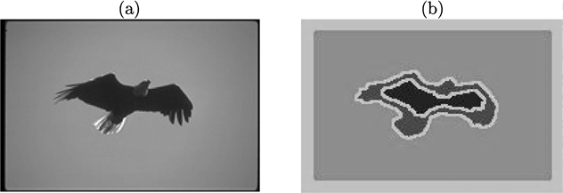
Pitfall of texture features
J. Malik, S. Belongie, T. Leung and J. Shi. "Contour and Texture Analysis for Image Segmentation". IJCV 43(1),7-27,2001.

Slide 19
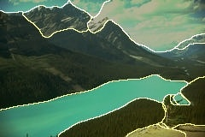
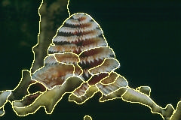
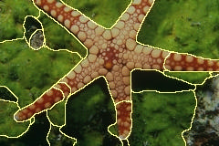
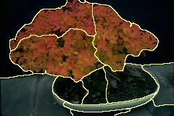
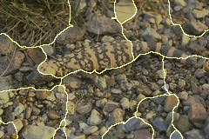
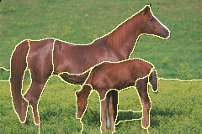
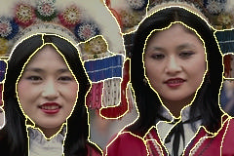
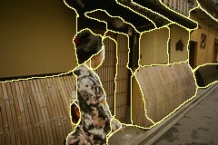
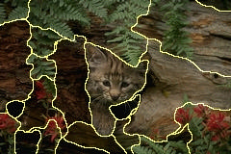
Example results

Slide 20
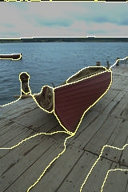
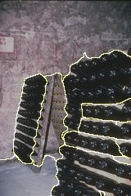
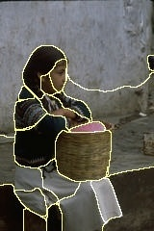
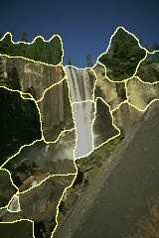
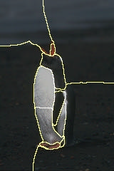
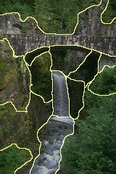
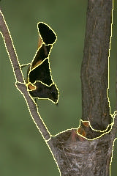
Results: Berkeley Segmentation Engine
http://www.cs.berkeley.edu/~fowlkes/BSE/

Slide 21
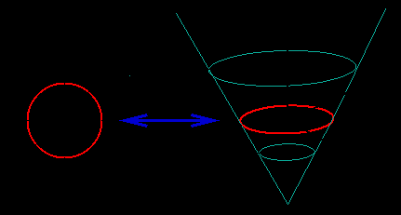


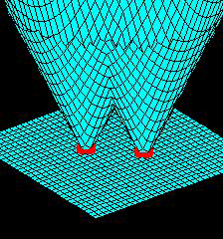
Representations of regions: Active contour and level set
Active contour method
A level-set function

Slide 22
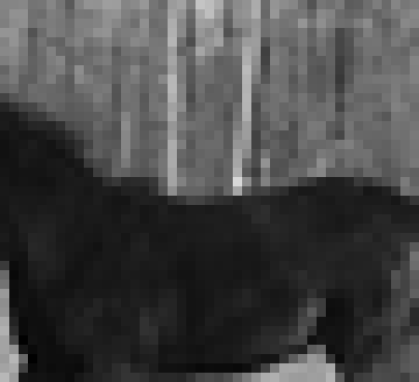
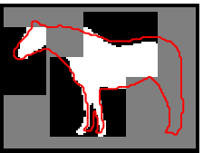




Top-down segmentation
E. Borenstein and S. Ullman, “Class-specific, top-down segmentation,” ECCV 2002
A. Levin and Y. Weiss, “Learning to Combine Bottom-Up and Top-Down Segmentation,” ECCV 2006.

Slide 23

Top-down segmentation
Normalized cuts
Top-down segmentation
E. Borenstein and S. Ullman, “Class-specific, top-down segmentation,” ECCV 2002
A. Levin and Y. Weiss, “Learning to Combine Bottom-Up and Top-Down Segmentation,” ECCV 2006.

Slide 24
OK!
So now, let’s think about this paper: In this work, our goal is to build a foundation model for image segmentation. That is, we seek to develop a promptable model and pre-train it on a broad dataset using a task that enables powerful generalization.

Slide 25

The success of this plan hinges on three components: task, model, and data. To develop them, we address the following questions about image segmentation: 1. What task will enable zero-shot generalization? 2. What is the corresponding model architecture? 3. What data can power this task and model?

Slide 26


Slide 27

Insane dataset

Slide 28


Slide 29
Key ideas!
To make SAM ambiguity-aware, we design it to predict multiple masks for a single prompt allowing SAM to naturally handle ambiguity, such as the shirt vs. person example.
Dataset (§5). Our final dataset, SA-1B, includes more than 1B masks from 11M licensed and privacy-preserving images (see Fig. 2). SA-1B, collected fully automatically using the final stage of our data engine, has 400× more masks than any existing segmentation dataset

Slide 30

Unbelievable dataset

Slide 32
Some background questions
In the article, I saw some models of Transformer and attention. I was wondering if how does it work?
What is the reasoning behind using an ablation as described in the study? What is it designed to test/evaluate?
The paper mentioned the word Mask in many places. What is the Mask meaning in the paper? Is it kind of images?
Can you explain focal loss.
Can you explain working of mask decoder.
What are self-attention and cross-attention?
What is focal loss and dice loss?
I need help understanding pixel-level masks. Can you please explain this in the lecture? Also, Is prompt-based modeling different than contrastive modeling?"

Slide 33
Transformers and Attention Mechanisms: Transformers are a type of deep learning model that rely on attention mechanisms to process data in a way that each output element is dynamically weighted by its relevance to the input elements. This is particularly effective in tasks that require understanding of context and relationships within data, such as natural language processing and, surprisingly (to some!), computer vision. They are an alternative to convolutional neural networks.

Slide 34
What is an ablation study? An ablation study in machine learning is used to analyze the contribution of individual components of a model by systematically removing them (ablating) and observing the effect on performance. This helps in understanding the importance of each component and in validating the design choices of the model.

Slide 35
Masks in Image Segmentation: In the context of image segmentation, a "mask" refers to an image that delineates certain parts of the image, typically used to highlight or isolate objects. Each pixel in a mask corresponds to a pixel in the original image, indicating whether that pixel belongs to a specific object or background.

Slide 36
Focal Loss and Dice Loss: Focal loss is designed to address class imbalance by focusing more on hard-to-classify examples. Dice loss, often used in medical image segmentation, measures the overlap between predicted segmentation and the ground truth, promoting better precision and recall.

Slide 37
Mask Decoder: A mask decoder is a component of a segmentation model that translates the encoded features back into a spatial domain to produce a segmentation mask. It reconstructs the high-resolution details necessary for accurately delineating object boundaries.
(It is very much like the image decoder used to create the Dall-E pictures, but it creates a mask instead of an image).

Slide 38
Demo!
segment-anything.com

Slide 39
Project
In anyway you like, build a system that measures growth or counts of something you care about. How big has a plant gotten? How many people are on a beach? How many bits of corn has a bird eaten? Show input with a time-sequence of images (at last 10) and a plot of the size or count over time.

